Slide 1
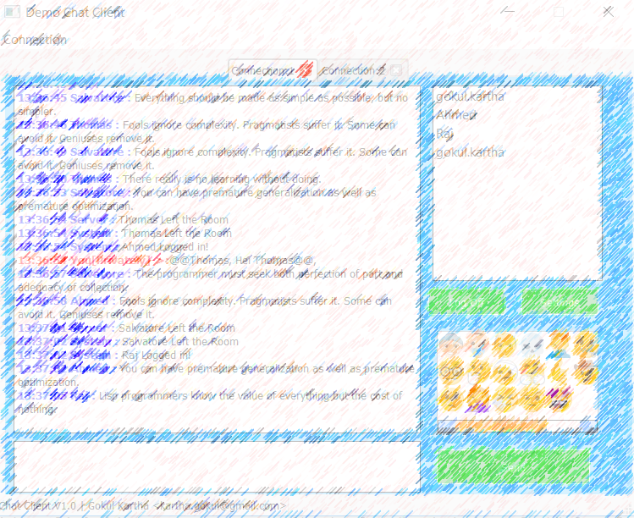
Chitchat Service
Gokul Kartha
<kartha.gokul@gmail.com>

Slide 2
Features
Available
Message Broadcasting.
Planned
Real Time Whiteboard.
File Sharing.
QML Desktop client.
Multiple Chat Rooms.
MQTT Protocol support.
Online Buddy List.
Private Message to any user.
Browser Based Chat Support using WebSocket.
JSON based minimalistic protocol.
Emoticon Smileys.
Automated Functional Testing.
Search Server through Multi Casting.
Login Authentication.
Bridging of multiple servers (MQTT).
Create a Worker Thread for Chat Room on Message arrival.

Slide 3
Implementation Strategy
Performance
Use a Lightweight Protocol to implement the use cases.
Handle multiple requests with less resources.
Scalability
Use a protocol which can be extended for future use cases without changing the design.
Portability
The Qt SDK is already portable to multiple platform.
Do not use any platform specific APIs and features should be enabled/disabled from a Project file level .
The entire system should be scalable from one to Many with out any design change.

Slide 4
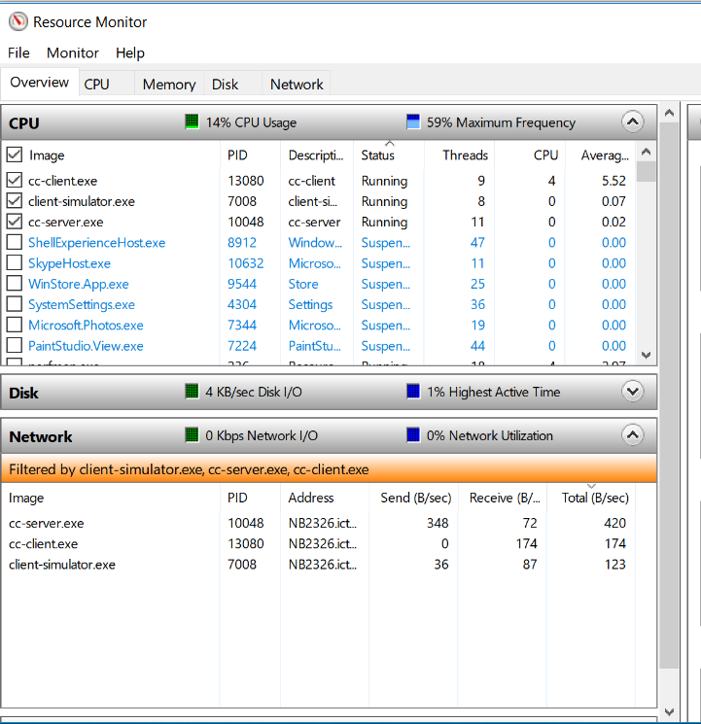
KPI Parameters

Slide 5
Solution & Technology - Components
Chat Service Server
Qt Core Application which uses TCP Server Socket and Web Socket Server (Optional)
Protocol Lib
Desktop Client
Built in Emoticon support using Qt Resourcing System
Web Client
Browser Based Chat Client in Javascript
Client Simulator
It supports multiple network Interfaces
The Protocol used by the Client & Servers is encapsulated in this layer
QTest based Unit tests are also written for demonstration.
Qt5 Widget application
It needs the Server to support Web sockets
A Chatbot to simulate a full fledged Chat room
The Simulator Creates Fake Users and Send “prepared texts” to the Other Online Clients on Intervals.
It can be used as a Functional Testing tool for the Chat Server

Slide 6
Development Tools
Qt Creator 4.5.1
Qt 5.10 SDK
C++
JavaScript /HTML/CSS
Windows & Linux(Ubuntu)

Slide 7
Solution Analysis
Pros
Cons
JSON protocol makes system extensible for any use case.
Written in purely Qt and the solution can be easily ported from Desktop to Embedded systems with less/no changes.
Tightly Coupled with Qt Runtime.
Works on Plain TCP Protocol , Prefer to have a light weight protocol like MQTT

Slide 8
High Availability Chat Service : Design Proposal
The Transport Mechanism should be improvised
Client and Server can communicate via TCP Sockets and Close the socket whenever there is no need .
Clients will use Datagram Protocol to send the Online Heart Beat Status to server.
MQTT would be an ideal Protocol if the chat service needs to support multiple Rooms & Multimedia transportation .
Reduce the Number of Passive Chat session on Server to reduce the threads in Server

Slide 9
Thank you !

