Slide 1
Adapter Design Pattern
An Audio Player Example
Gokul Kartha <kartha.gokul@gmail.com>
https://github.com/karthagokul
http://techysaint.com

Slide 2
The adapter pattern converts the interface of a class into another interface the clients expects. This pattern mainly adapts one object to another one. Adapter lets classes work together that couldn’t otherwise because of incompatible interfaces.
Adapter allows to reuse existing coding without changing it, as the adapter ensures the conversion between the different interfaces.

Slide 3
Example
You are developing a media player say VLC.
The VLC player knows only how to play raw audio data .
There are several popular audio formats in the world and its expanding, Here we will use Mp3 and Ogg file formats.
How can we connect the VLC player with those file formats now and in future with the many new audio formats so that VLC do not have tight coupling with the audio formats?
Yes, We can use Adapter Pattern very well , Lets see the Class diagram

Slide 4
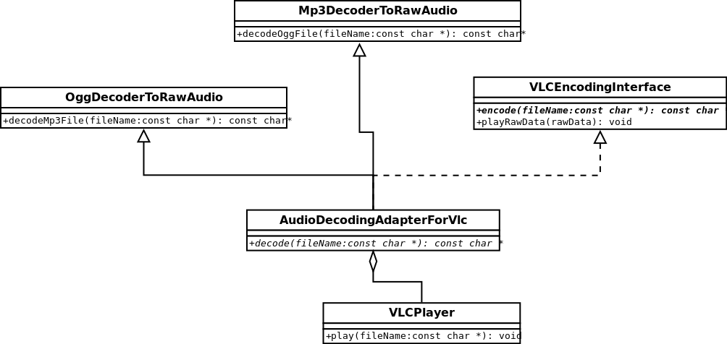
MediaPlayer

