Slide 1
CSCA 5642 Final Project
Convolutional Neural Networks for Photoelectric-Compton Decomposition in Duel-Energy CT Tissue Classification
Karl Schmidt

Slide 2
Table of Contents
1. Introduction
2. Methodology
3. Evaluation & Analysis
4. Conclusion

Slide 3
Introduction

Slide 4
Introduction
Goal: Create a DL-spectral CT model to accurately “recover” three-tissue images.
Models:
  11 convolutional layers (Unet256) and
  15 convolutional layers (UNet512)

Slide 5
Methodology

Slide 6
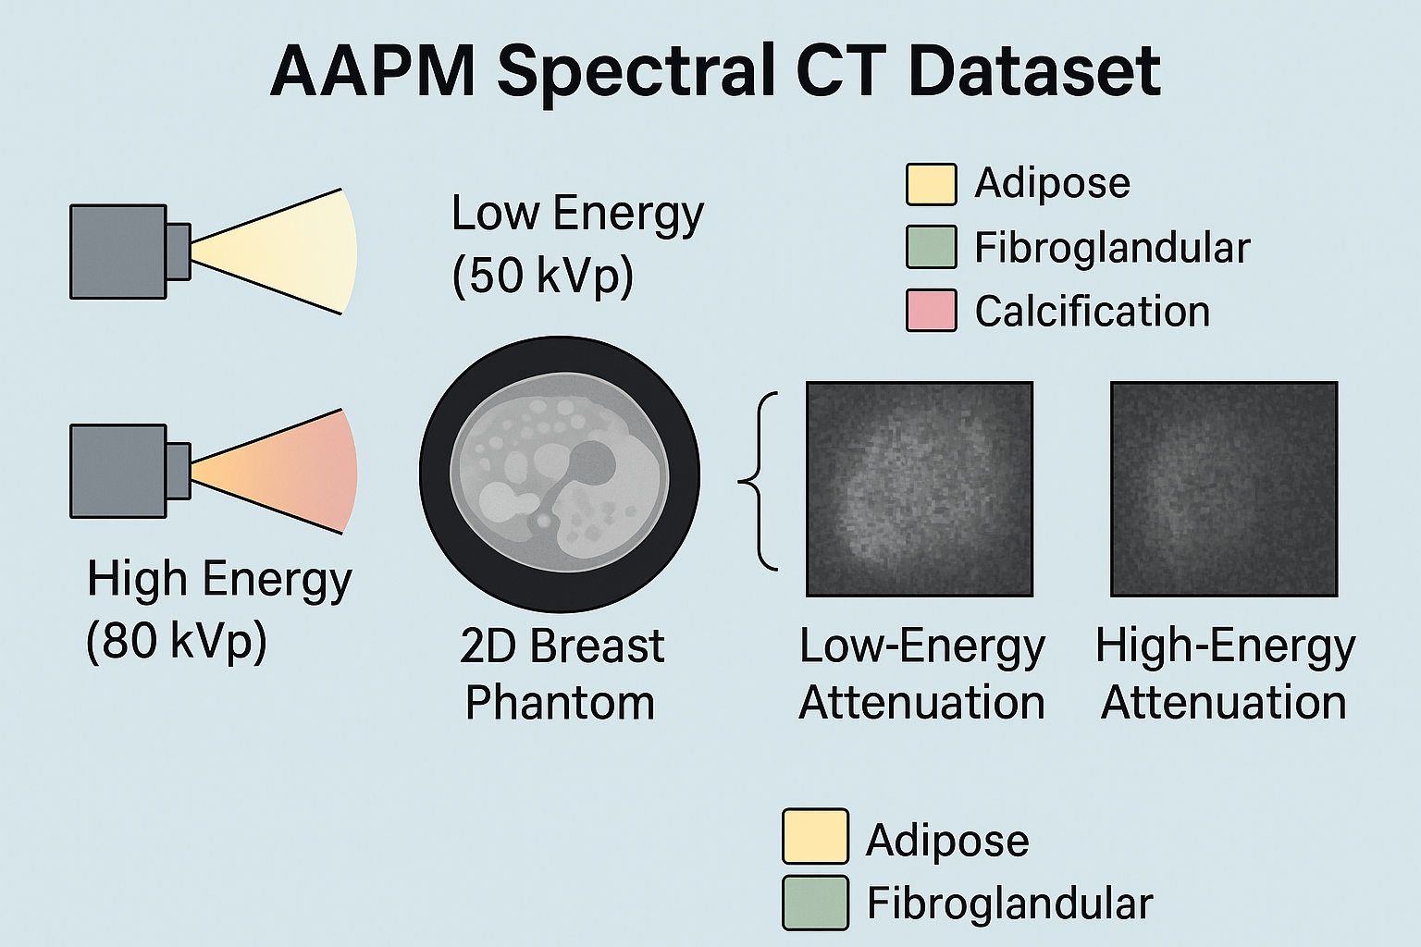
Methodology
Dataset
Duel-Energy CT Scan (Spectral CT)
Low Energy 50kVp
High Energy 80kVp
Dataset – for 50 & 80 kVp
1000x512x512 True Tissue Values
1000x256x1024 kVp Transmission

Slide 7
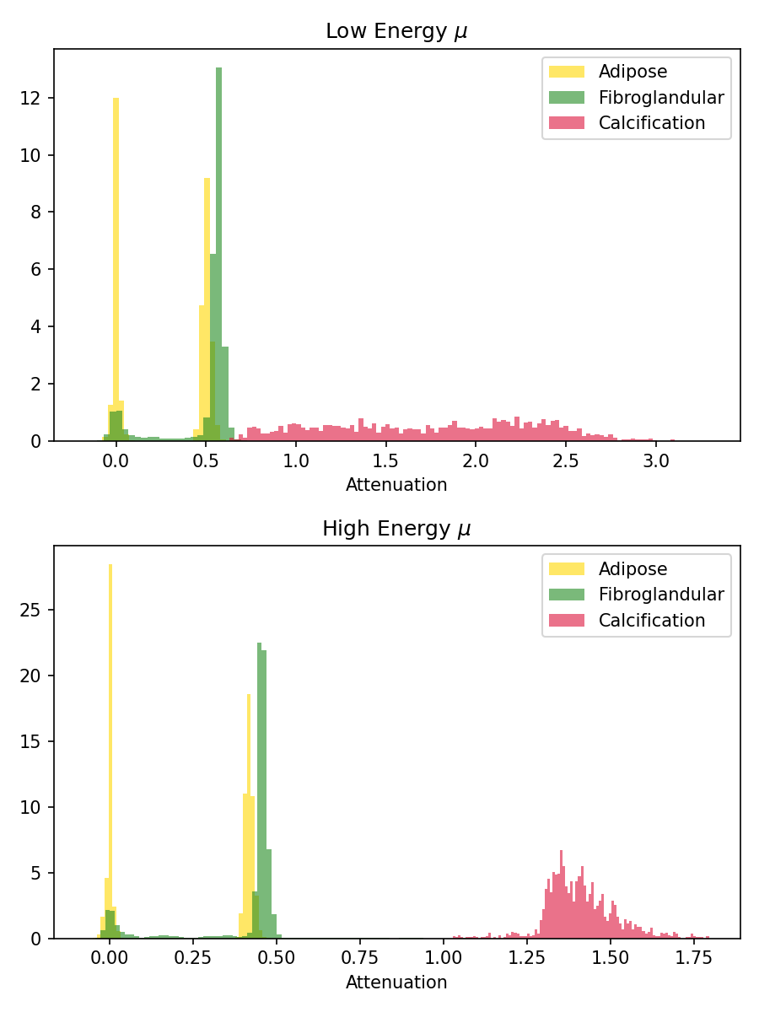
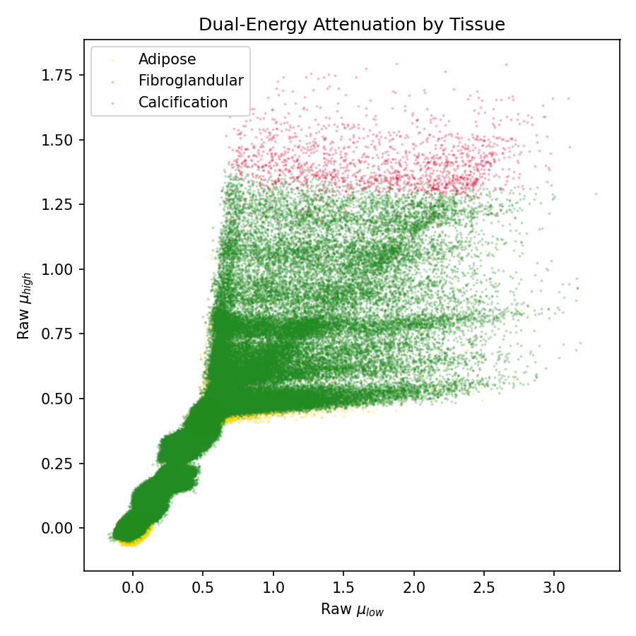
Methodology
Exploratory Data Analysis

Slide 8
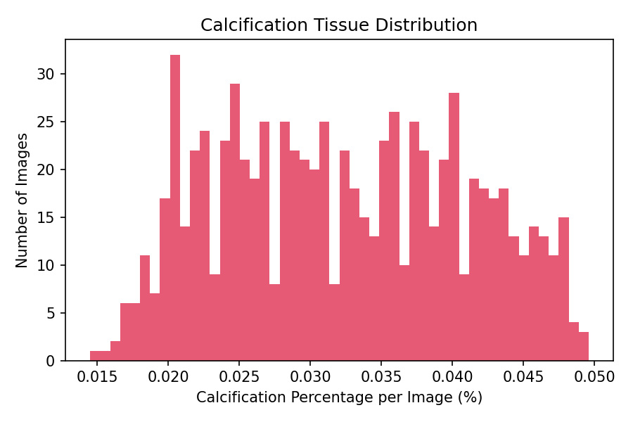
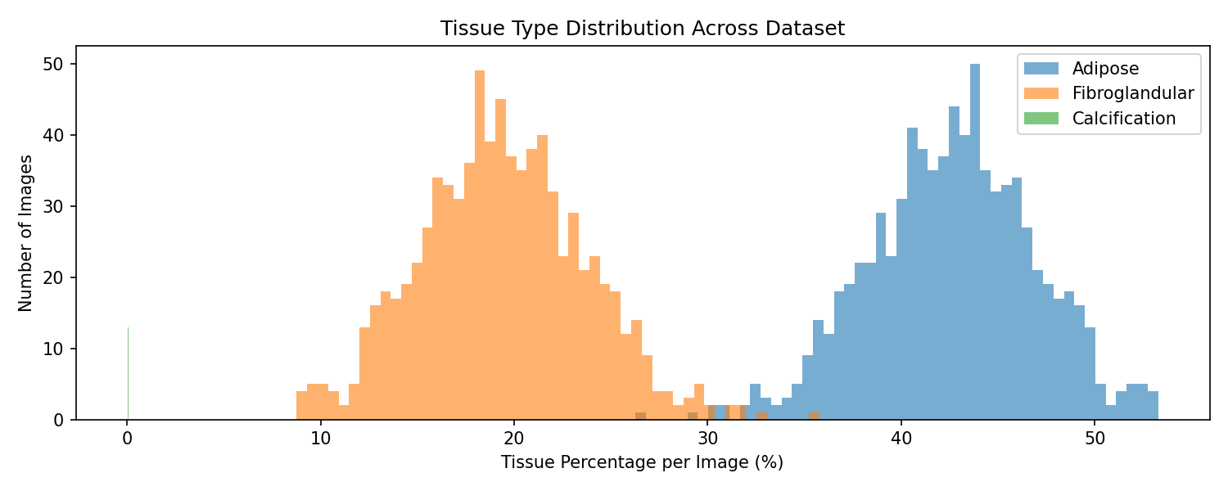
Methodology
Exploratory Data Analysis

Slide 9
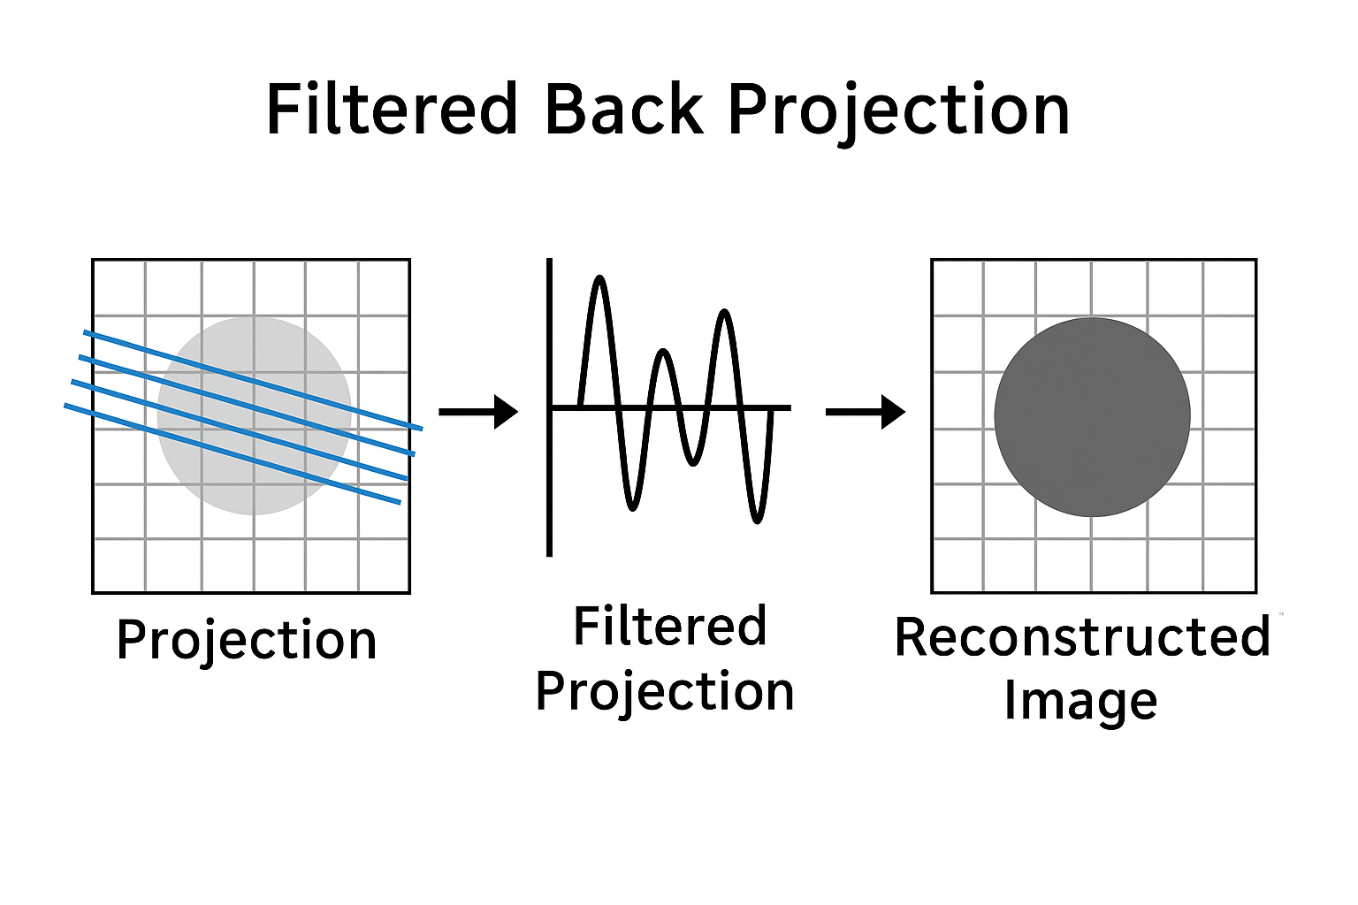
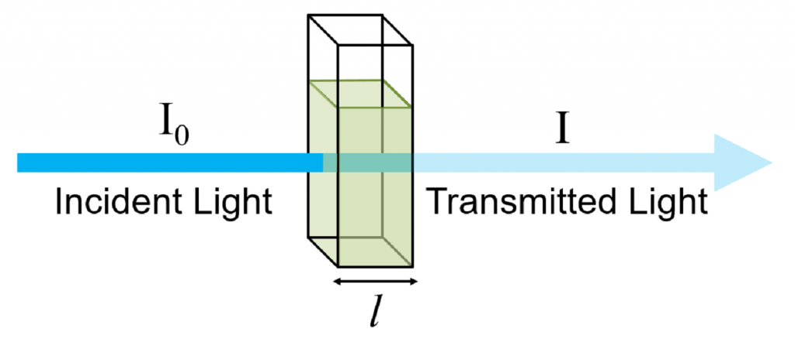
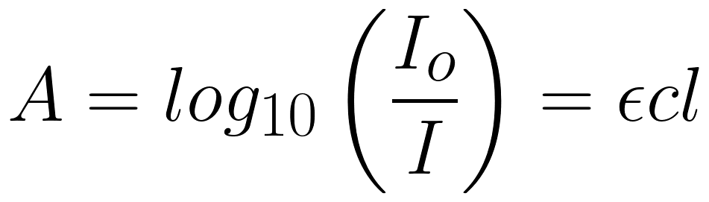
Methodology
Data Preparation
Convert the transmission data into Attenuation values.
Use Filtered BackProjection (FBP) to reconstruct kVp Images from Attenuation values [μlow, μhigh].

Slide 10
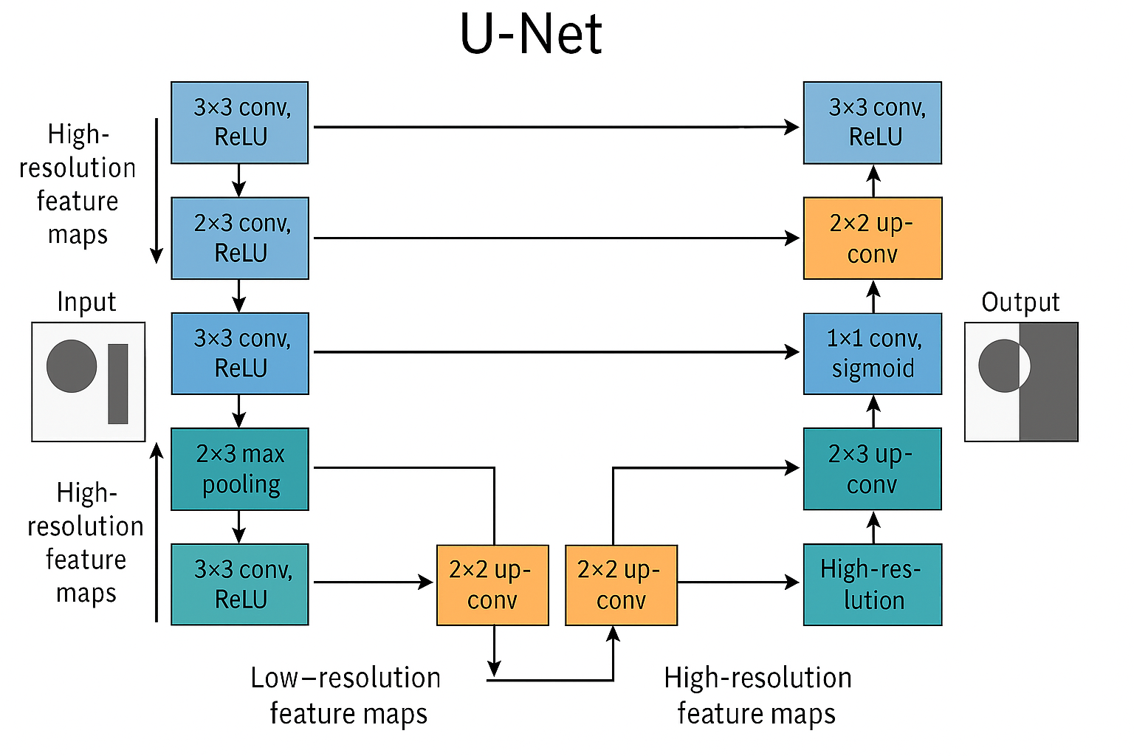
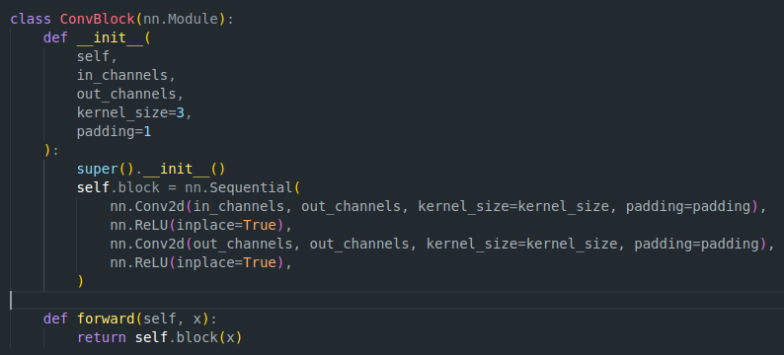
Methodology
Models
UNet256
2 encoding and decoding levels
Encodes up to 256 pixels
Faster to train but likely less expressive
UNet512
3 encoding and decoding levels
Encodes up to 512 pixels
Potential to recorder greater image complexity.

Slide 11
Evaluation & Analysis

Slide 12
Evaluation & Analysis
Hyperparameter Optimization
Tuned Hyperparameters
Filter Size: 3, 4, 5
Stride: 2, 3
Padding: 1, 2
Learning Rate: 1e-4, 1e-3, 1e-2
Batch Size: 4, 8
Epochs: 3, 5
Best Configurations
UNet256: [Val Loss: 0.0519]
  Filter Size: 4
  Stride: 3
  Padding: 2
  Learning Rate: 0.001
  Batch Size: 4
UNet512: [Val Loss: 0.0380]
  Filter Size: 5
  Stride: 3
  Padding: 1
  Learning Rate: 0.001
  Batch Size: 4

Slide 13
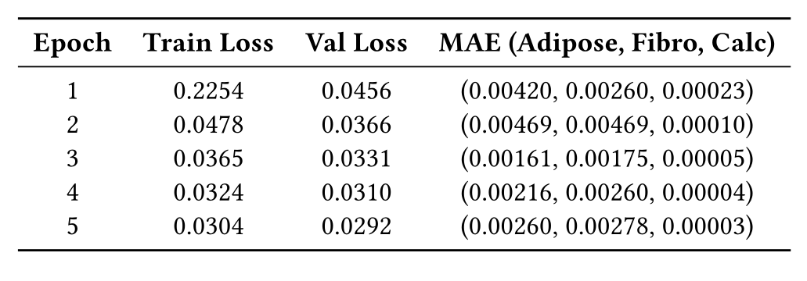
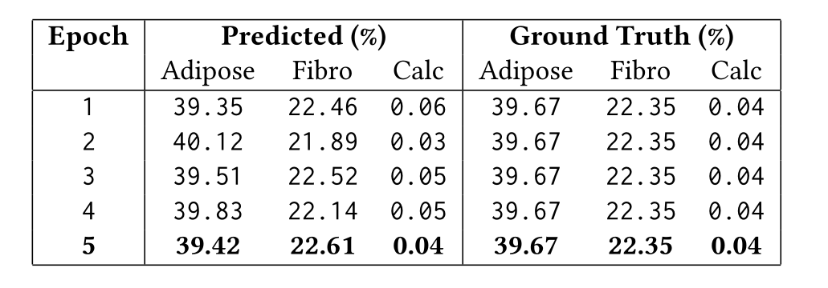
Evaluation & Analysis
Final Training Results
Loss Curves
Train Loss: Decreased from 0.2254 to 0.0304
Val Loss: Dropped from 0.0456 to 0.0292 over 5 epochs.

Slide 14
Evaluation & Analysis
Interpretation
Key Takeaways
UNet512 Outperforms UNet256
Model converges quickly
High tissue composition accuracy
Challenges & Considerations
Class imbalance
Low error doesn’t guarantee clinical interpretability
Conclusion
UNet512 demonstrates effective learning of dual-energy spectral features for multi-tissue segmentation in noiseless 2D breast CT.

Slide 15
Conclusions

Slide 16
Conclusion
Results Summary
UNet 512 achieved the best performance
  Final validation loss: 0.0292
  Tissue MAE: as low as <0.003
  Tissue compositions closely matched ground truth
Demonstrated robust performance despite class imbalance and small calcification signals

Slide 17
Conclusion
Key Contributions
Integrated Beer-Lambert attenuation law into training design
Used physically meaningful [μlow, μhigh] features for segmentation
Trained and evaluated fully end-to-end U-Net models on simulated AAPM data

Slide 18
Conclusion
Future Directions
Add data augmentation or class balancing for rare tissue types (e.g., calcification)
Extend model to noisy or real clinical data
Explore multi-task learning (e.g., decomposition + classification)

