Slide 1

CS3503 – Machine Learning PBL
Project Review
AgriSense — An ML-Based Agricultural Decision Support System for Small-Scale Farmers
Presentation by
Kartheeban C (2104251040406)
B Nishanth (2104251040127)
Computer Science and Engineering
Mentor
Ms. Rajapriya
<Designation>
Computer Science and Engineering

Slide 2
Problem & Objectives
Problem Statement
Small-scale farmers decide what to sow, and what to expect, from experience rather than from their own data.
A soil test card reports N, P, K and pH, but nothing that maps those numbers to a crop that suits them.
Affected: farmers on single small plots, who carry the full cost of one wrong sowing decision for a season.
It matters because yields in the data used here span 0.0005 to 33,089 units per hectare across 75 crops.
Per-plot agronomic advice does not scale; a model trained on existing agricultural data does.
Objective
Identify which soil and weather variables actually drive crop choice and yield
Develop two models — crop recommendation (classification) and yield estimation (regression)
Apply ML to turn a single soil test into a sowing decision a farmer can act on
Evaluate on held-out data with 5-fold cross-validation, then tune and improve
Expected Outcome
A machine-learning solution that recommends one of 22 crops from a soil test and estimates the yield of that crop on a plot.
Delivered as a React Native app over a FastAPI service.
Every figure reported comes from the training run's JSON output.

Slide 3
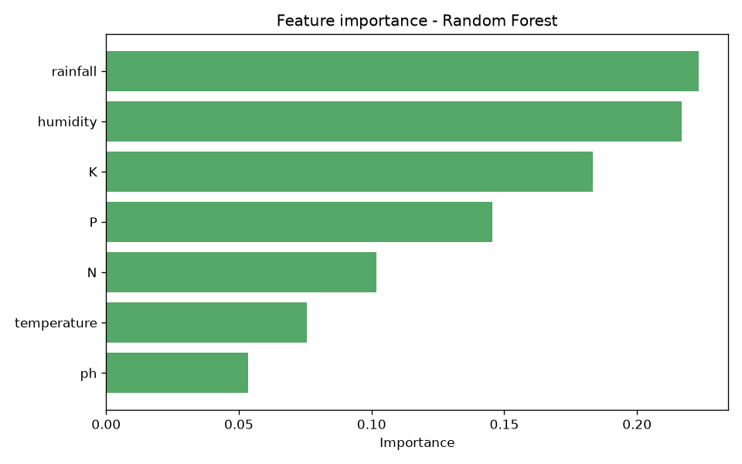
Input, Analysis & Insights
Input/ Data Sources
Crop data — 2,200 rows, 22 crops balanced at 100 each: N, P, K, temperature, humidity, pH, rainfall
Yield data — 49,999 rows, 75 crops, 6 seasons: temperature, humidity, soil moisture, area, season, crop
Both are public CSVs, committed to the repository and used as-is; no synthetic rows
Analysis/ Processing
Cleaning: 49,999 rows → 49,675 after dropping invalid area or production → 48,681 after 1st–99th percentile clipping
Yield derived as Production ÷ Area; season and crop labels stripped of whitespace, then label-encoded
Three models compared per task on one stratified split, then GridSearchCV and 5-fold cross-validation
Key Insights
Rainfall (0.223), humidity (0.217) and K (0.183) dominate crop choice; pH matters least (0.053)
For yield, crop identity (0.495) and season (0.340) outweigh every measured environmental variable
Crop classes separate cleanly — 99.55% accuracy; yield is far harder — best R² 0.740

Slide 4
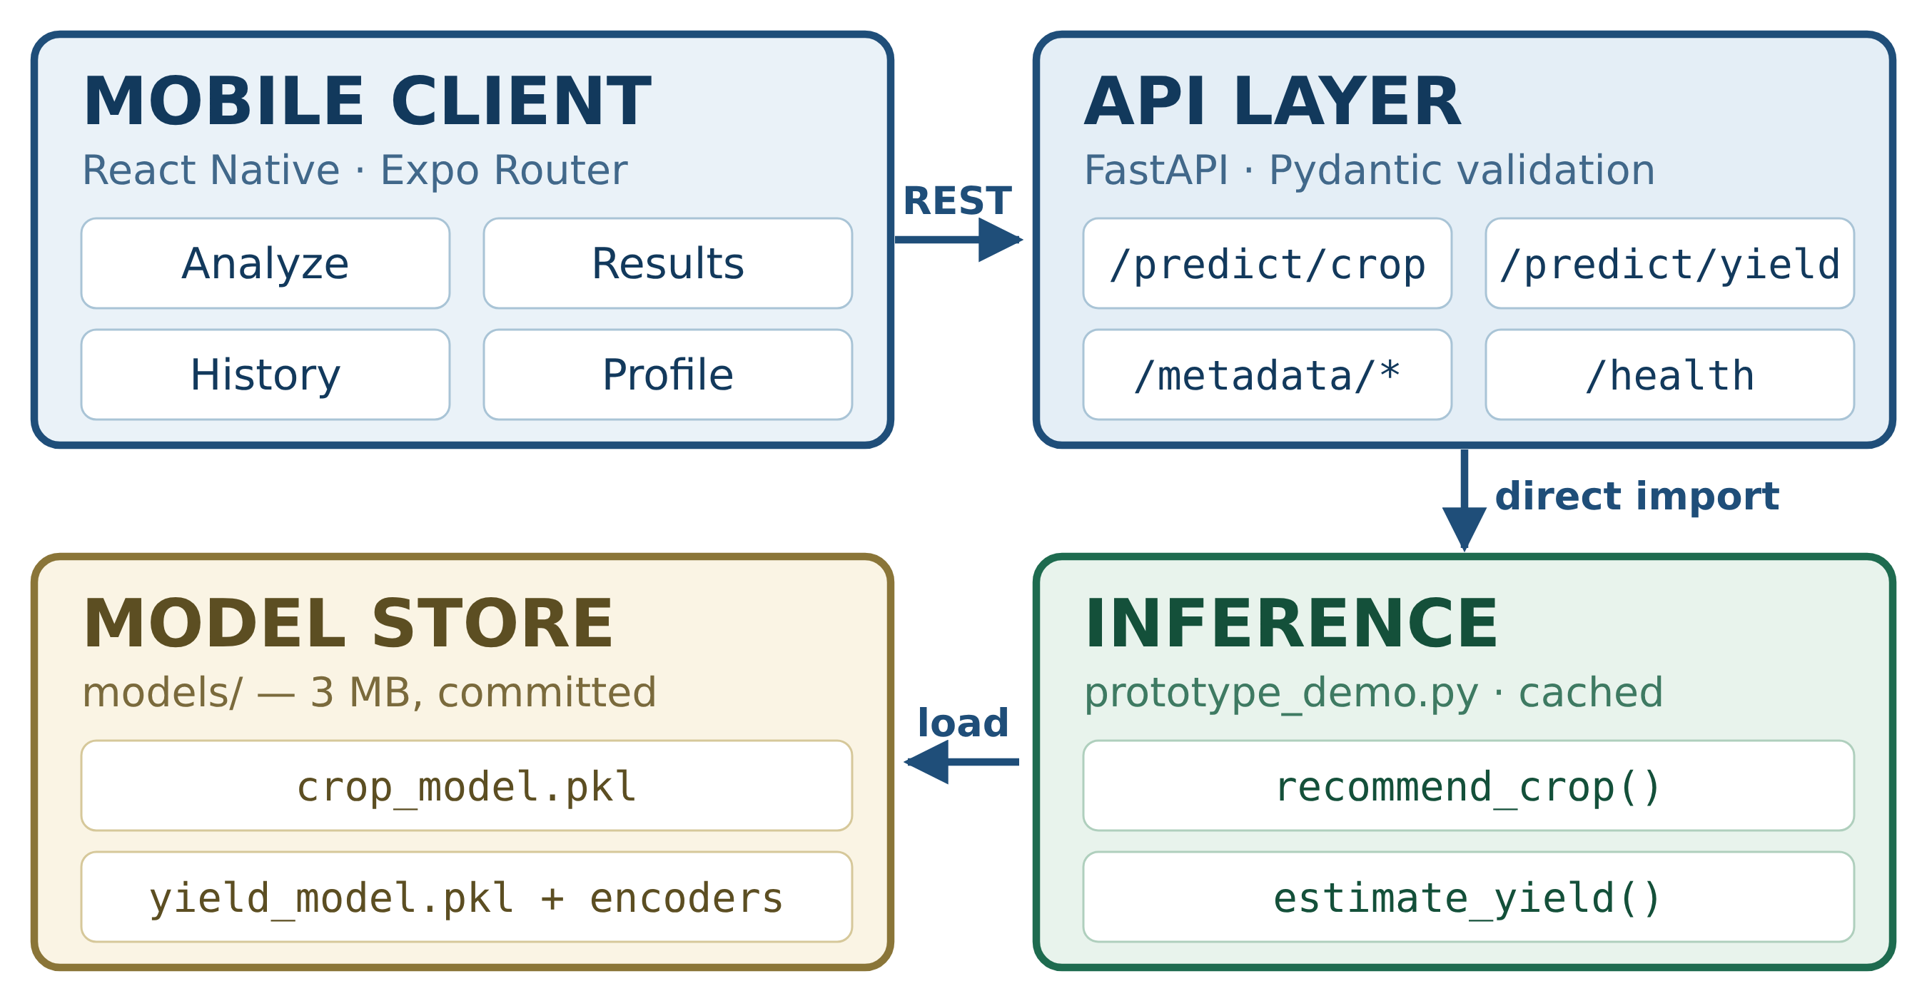
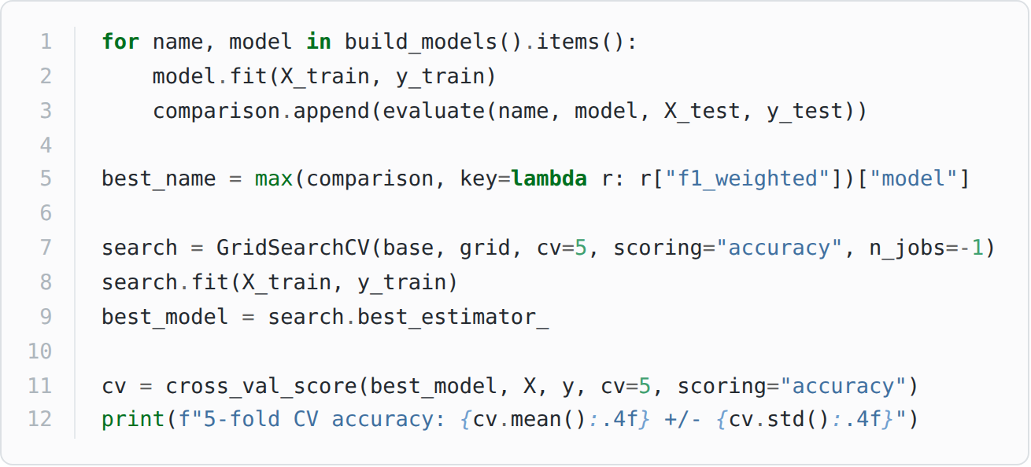
Technical Approach
Architecture
ML Methodology and Implementation Process
Load → clean → derive target → encode categoricals → stratified 80/20 train-test split
Compare three models per task on the same split, tune the winner with GridSearchCV
Confirm with 5-fold cross-validation, then persist model and encoders with joblib
prototype_demo.py is the single inference entry point; a parity test keeps API and model identical
Technology Stack
ML: Python 3.11+, pandas, NumPy, scikit-learn, XGBoost, joblib, matplotlib
Backend: FastAPI, Pydantic, Uvicorn — REST only, no ML logic of its own
Mobile: React Native, Expo SDK 57, TypeScript, Expo Router, AsyncStorage
Testing and tooling: pytest (22 tests), Git and GitHub

Slide 5
Feasibility, Risk and Challenges
Feasibility
Technical: both models train in minutes on a laptop CPU; saved artefacts total about 3 MB
Economic: open-source tooling and public data — no licence cost
Operational: a farmer enters seven values; models stay cached in memory, no retraining
Reproducible: fixed seed, pinned versions
Risk and Challenges
Yield is genuinely hard — R² 0.740 leaves about a quarter of test variance unexplained
Yield units are not uniform: the source mixes tonnes, bales and nuts, so estimates compare within a crop only
The crop dataset is perfectly balanced, which flatters accuracy against a real, skewed field distribution
Neither dataset carries the year or the region, so results cannot be validated against a specific farm
Device-to-backend networking across emulator and physical device was the main integration difficulty
Pinned native dependencies: a missing react-native-svg entry blocked the Expo bundle until it was added
Saved models are version-sensitive, so the scikit-learn and XGBoost pins must match across both requirement files
Mitigation
Present yield as a planning estimate, with the unit note on every screen that shows one
Held-out test set plus 5-fold cross-validation behind every number reported
Validation at three layers: Pydantic schemas, encoder guards, 22 automated tests

Slide 6
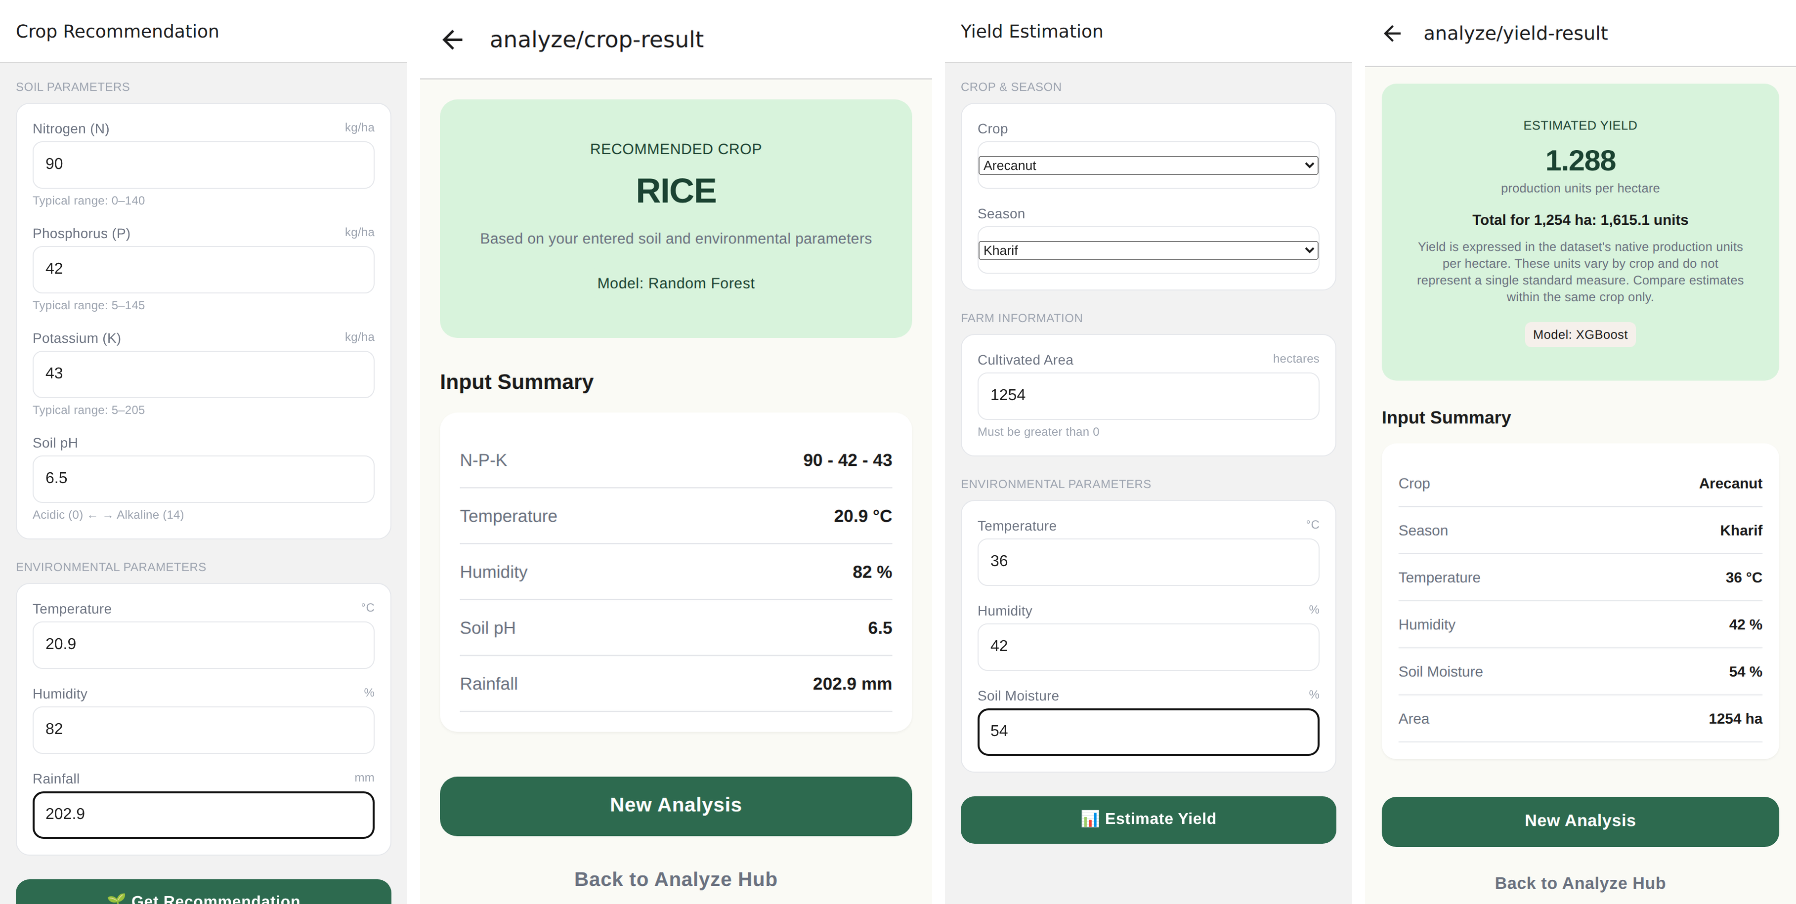
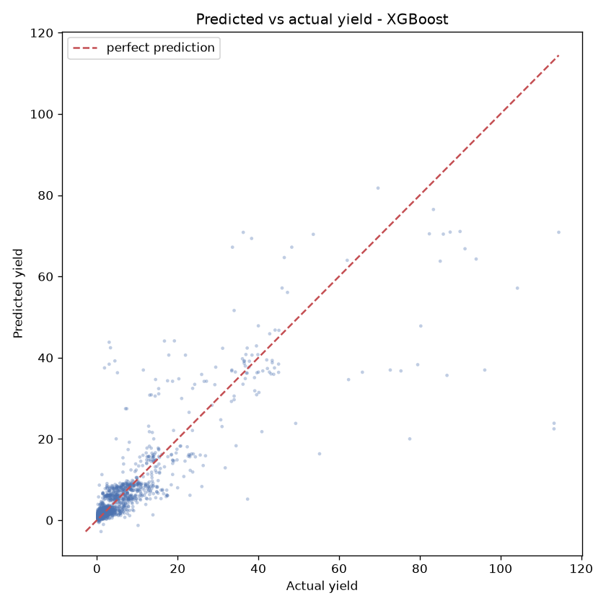
Result and Applications
Project Output
Crop recommendation — Random Forest: 99.55% test accuracy, weighted F1 0.9955, 5-fold CV 0.9927 ± 0.0039.
Yield estimation — XGBoost tuned: R² 0.740, RMSE 5.025, MAE 1.653, 5-fold CV R² 0.7428 ± 0.0254.
Applications
Pre-season sowing advice from a soil-test card · yield planning for storage and credit · advisory at farmer-producer-organisation scale · a field tool for agriculture extension officers · a teaching example of applied ML.

Slide 7
Conclusion, Limitations & Future Scope
Conclusion
We developed AgriSense, a three-layer decision support system — scikit-learn and XGBoost models, a FastAPI service and a React Native app — to answer what a small-scale farmer should sow and how much to expect from it. Trained on 2,200 soil-and-weather records and 48,681 cleaned yield records, the crop recommender reached 99.55% test accuracy (5-fold CV 0.9927 ± 0.0039) and the tuned yield estimator R² 0.740 with RMSE 5.025. A parity test keeps the app's answer identical to the model's, and all 22 tests pass on a clean checkout. The project shows that one soil test and a few weather readings are enough to give a small-scale farmer a defensible, explainable sowing decision.
Crop choice proved almost separable from soil and weather alone; yield depends far more on crop and season than on anything measured in the field.
Limitation
Dataset size and quality: 2,200 rows, perfectly balanced classes
Yield data has no year or location, so no regional validation is possible
Model constraints: R² 0.740 leaves a quarter of yield variance unexplained
No field trial yet with real farmers
Future Scope
Add region and year to the yield features; retrain per agro-climatic zone
Report a confidence interval instead of a single yield number
On-device inference so the app works without a network
Regional-language UI and voice input

Slide 8



Project Video Link
Add the Direct URL/Drive link of your project in voice over video
GitHub Repository Link
github.com/kartheeban-chelladurai/agri-decision-support-ml
Kartheeban C, B Nishanth
Computer Science and Engineering
GitHub Repository

