Slide 1
Scientific Information retrieval
Sofia Swartz, Blekinge Tekniska Högskola

Slide 2
Content
Seminar:
Basic Library Skills
Systematic Information Search
Workshop 1:
Selecting Databases
Evaluation Results
Workshop 2:
Citing Sources – Reference Management
Avoiding Plagiarism

Slide 3
Borrowing
BTH card
Check your address in Students Portal
Loan periods
3 weeks normal loan
1 week if the book is reserved
1 day for reference literature

Slide 4
Collections
Printed books
E-books
Journals
Magazines
Dissertations
Student theses

Slide 5
Interlibrary loanservice
Document requests
Check metadata, abstract
Maximum 10-15 articles/thesis

Slide 6
Information service
Information desk 10-18
Students 16-18
Level 2 08-22
Book a librarian
http://www.bth.se/eng/librarybib.nsf/pages/book-a-librarian

Slide 7
Science and popular science – differences
Scientific texts
Texts in popular science
Aimed at professionals
Aims to present research findings
Have a strict outline
Have a specialized language
Have technical terms
Have notes
Have a reference list
Aimed at the public
Aims to inform and entertain
Have an understandable language
Have few technical terms, but if they do they are always explained
Does not have any notes
Have no reference list, but may have tips for further reading
Source: Lund University Library

Slide 8
Peer-reviewed articles
Articles in scientific journals are often reviewed by other scientists in the same field to ensure the scientific quality.
The term peer-reviewed is used to indicate that an article has been checked by other scientists before it was published.
If a scientific journal contains peer-reviewed articles it is often stated on the editorial page.

Slide 9
Peer-reviewed articles - elements
Abstract – a brief summary of the article which includes purpose, method, results and conclusion.
Introduction – where purpose and problem are described, and background information for the problem area is presented.
Method – where the method used is described so thoroughly that it is possible for the reader to follow and repeat the research process.

Slide 10
Peer-reviewed articles - elements
Result – where the research result is presented in text and possibly with tables, charts and figures.
Discussion – in this part the research result is discussed as well as those principles, relations or generalizations which are supported by the result of the study. Possible weaknesses in the study are addressed here.
Bibliography – sometimes also called list of references. All documents used by the author should be included in the bibliography.

Slide 11
Metadata – what is that?
Data about data.
Metadata describes the document and allows us to find, manage, control and understand the information.
Examples: Journal title, article title, author, year, volume, issue, pages, keywords, abstract.

Slide 12
Metadata – what is that?
Data about data.
Metadata describes the document and allows us to find, manage, control and understand the information.
Examples: Journal title, article title, author, year, volume, issue, pages, keywords, abstract.

Slide 13
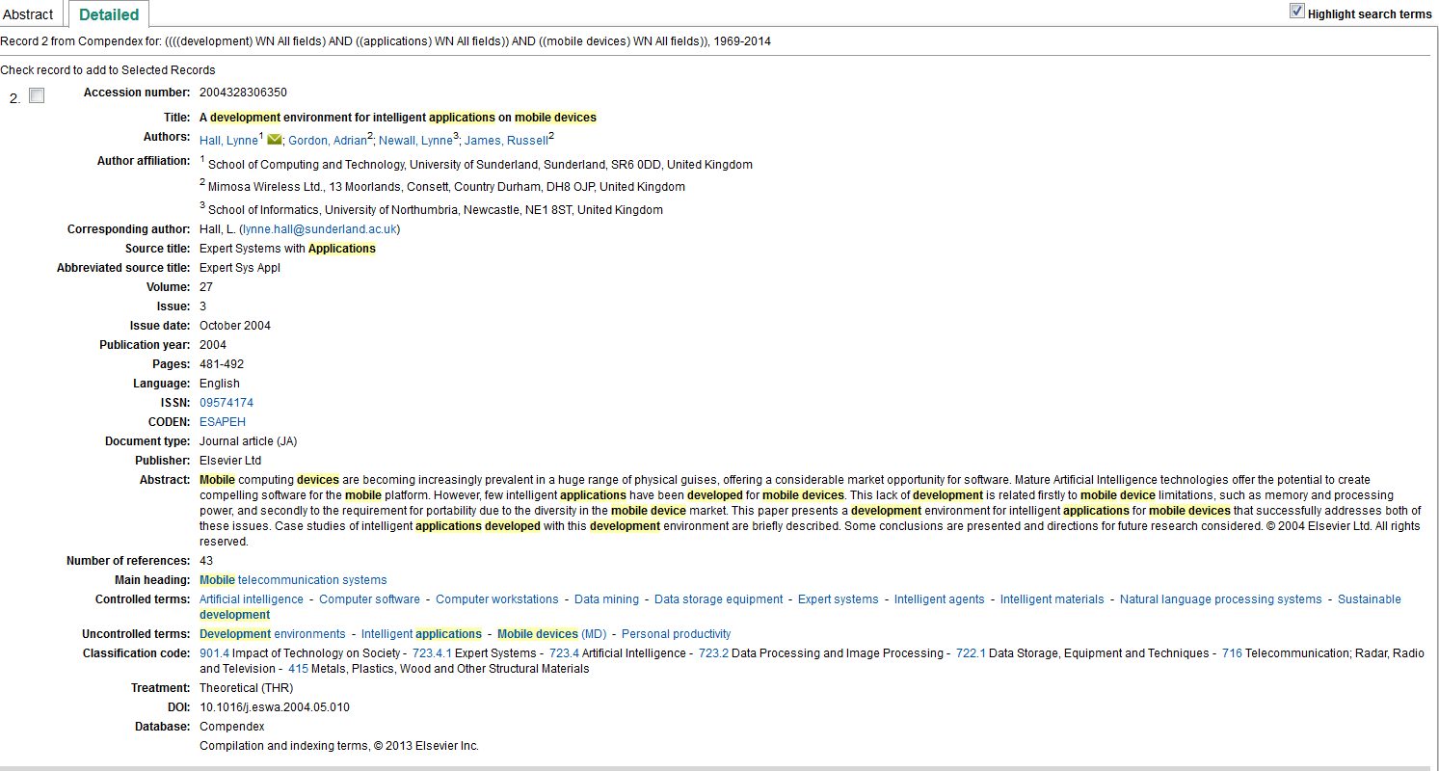
Metadata
Search: development AND applications AND mobile devices

Slide 14
Search strategy – mind map
Formulate information problem
Define keywords
Reference management
Choose sources
Document selection
Search technique
Evaluate the search result

Slide 15
Formulate information problem
What are you going to write about?
What information is needed?
Research questions

Slide 16
Define keywords
Based on your research questions – sort out significant words
Use dictionarys, encyclopedias, thesaurus, indexes…
Use the ”right” words, common ground, to put your work into a context
Use keywords to find different types of documents, for example literature reviews or systematic reviews
Notes:
Example: Google define - interaction
Example: Inspec Thesaurus
Examples of encyclopedias:
Encyclopedia of Software Engineering
Acronym Finder
McGrawHill Encyclopedia of Science & Technology (all found by ”Find Database” or ”Database List”)

Slide 17
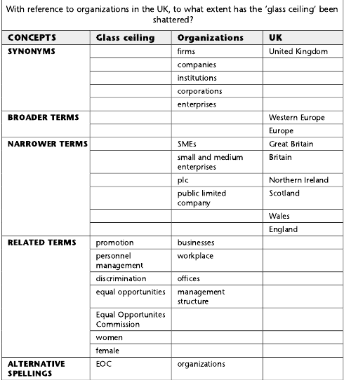
Key word collection - example
Example from
S. Rumsey, How to find information : a guide for researchers. Maidenhead: Open University Press, 2008.

Slide 18
Boolean logic
Combination of search terms, get specific about what you wish to retrieve
The results should contain certain results and ignore others
There are three Boolean connectors (operators)
AND
OR
NOT
Many databases can be used with or without relying upon Boolean operators

Slide 19
Truncation
Also stemming, root expansion
The words often have the beginning of the word (or stem) in common
Organization
Organizations
Organizational
Replace the remainder of the word with a specified symbol (varies between databases):
Organizatio*
Organizatio?
Organizatio$
Use of the incorrect symbol will result in unreliable results or no results!
Use a dictionary to help select and check truncation possibilities
Problems may arise when searching using truncation on short words
If you only require the plural form of a word, it could be better to use an OR search

Slide 20
Wildcards
A symbol that can be used in place of one character, no character or sometimes a group of characters. They may be incorporated within or at the end of a word.
Wildcards are not usually permitted at the start of words
Wildcard symbols vary between databases…
wom?n retrieves both woman and women
Depending on the database, the wildcard may also represent no character
behavio?r retrieves both behavior and behaviour

Slide 21
Phrases
Phrases can make the retrieved results more relevant as there are more criteria for the search
Be aware of the default of the database you are using.
For some – two or more words in a search query will be treated as a phrase
For some – two or more words after each other will be automatically combined with AND´s between
The effect will be quite different!

Slide 22
Parantheses
In order to structure your search and avoid ambigious search strings many databases allow the use of parantheses.
Check help function to find out which order the search commands are prioritized.
Parantheses are usually considered first
Compare:
Accessibility OR usability AND ”web development” OR ”web design”
If the database deals with AND connectors before OR connectors, the result of this search might be unlike what you wanted. Usability AND ”web development” would be solved first.
(Accessibility OR usability) AND (”web development” OR ”web design”)
Those parts of the query in parantheses will be dealt with first, followed by the remaining AND instruction.

Slide 23
How to combine terms in practice
Use your collection of relevant terms to go through them and decide how to best combine them so that all possibilities are covered.
Use wildcards and truncation to reduce the number of queries
Keep queries simple
Long, complex search strings are liable to include errors
Short search queries can be combined in different ways, more flexibility

Slide 24
How to combine terms in practice
(technique* OR method* OR approach*) AND (“web development” OR "web design" OR webdesign) AND (accessibility OR usability) AND (web pages OR webpages OR websites)
technique* OR method* OR approach*
“web development” OR "web design" OR webdesign
accessibility OR usability
web pages OR webpages OR websites
Combined searches Set number
#1 AND #2 #5
#3 AND #4 #6
#2 AND #3 #7
#1 AND #2 AND #3 AND #4 #8

Slide 25
2. Create search strings
Combine your collection of key words in one or several search strings
Consider
Wildcards
Phrases
Truncation

Slide 26
Next lecture
Information retrieval for thesis work. Literature databases: how to search, find, and stay updated.
Bring your laptop!

