Slide 1
EMV Specifications
Notes:
TS - 23.2.96 - Initial release : 1.0
TS - 6.3.96 - Release 1.1 : bugs correction, precisions ...

Slide 2
Summary
General concepts on payment systems
EMV specifications
Memory organization

Slide 3
General concepts

Slide 4
The Payment Market
100%
Credit
Debit
Cheque
Cash
Transaction
volume
Low
Medium
High
Transaction value
Market size :
Around 900 Million EMV cards
Almost 2 Billion domestic cards
A great majority is magstripe based
Smart Cards enhance your existing
application or to create new applications
Notes:
The Payment Card Market
The potential for growth in debit / credit card transactions is huge :
There should be by 2005 over 8.5 billion cards in circulation that will allow card holders to pay for goods and services and obtain cash.
Over the next 10 years production of financial transaction cards worldwide is estimated at 26.5 billion.

Slide 5
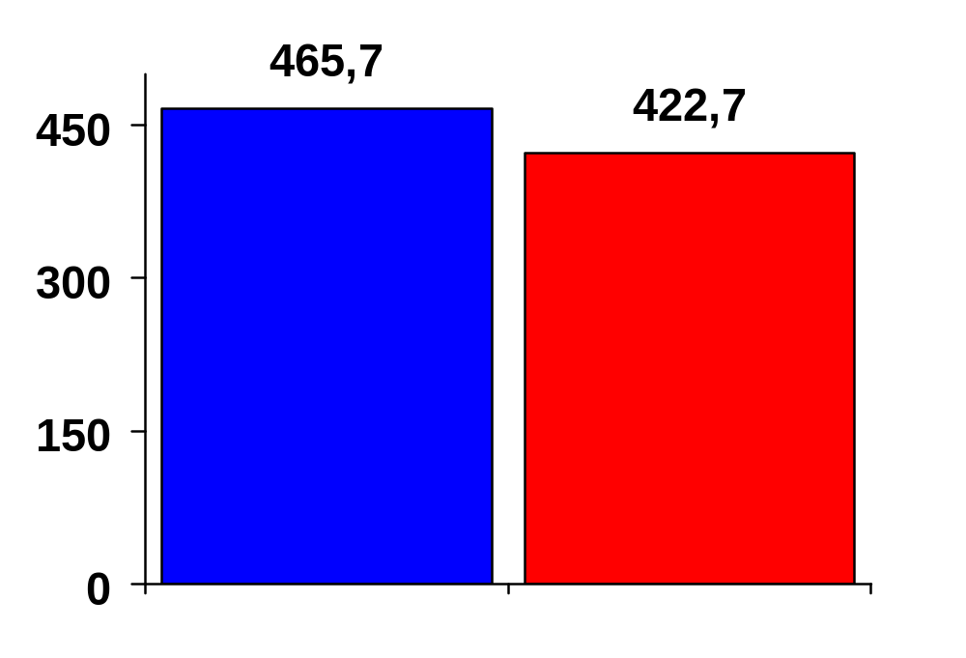



Payment Cards Issued
Cards issued in 1995 (Mu)
Source : The Nilson Report 1996

Slide 6
Some Figures
700.000.000 international banking Debit/Credit cards
  (VISA, M.C., EPI,...)
Several hundred of national payment cards schemes
Over 10 millions EFTPOS world-wide
DEBIT / CREDIT card purchase average amount
  average $ 75
Merchant commission rate
  0.6% To 5%
Global transaction processing cost
  50 cents

Slide 7
Different payment systems
Debit / Credit Cards
Electronic purse cards

Slide 8


Debit / Credit Payment Options
Purchase
I
Debit
PAY
I
Differed Debit/charge
[
]
Credit
I
I
I
E. Purse
I

Slide 9





MAGSTRIPE:
Mostly On-Line Transaction Processing
Card clearing
Center
VISA
MASTERCARD
EUROPAY
Debit of Card holder
account
Transactions
Transmission
Credit of merchant
account
9
Issuer
Authorization center
Transaction clearing
& banks settlement
7
Acquiring
Center
Acquirer
8
Authorization request
- Payment capacity
- Credit limit
3
5
transaction
record
4
Authorization response
6
Authorization
request
Authorization
response
2
.
1
Purchase
Card Holder
Merchant

Slide 10
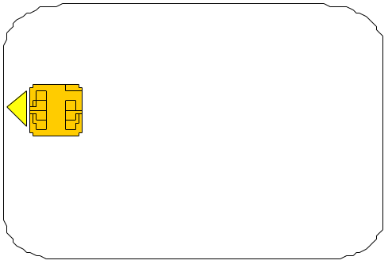
SMART CARD:
Semi Off-Line Transaction Processing.
Card clearing
Center
VISA
MASTERCARD
EUROPAY
Debit of Card holder account
Transactions
Transmission
Credit of merchant
account
10
Issuer
Authorization
center
Transaction clearing
& banks settlement
8
Acquiring
Center
Acquirer
9
Authorisation request
- Payment capacity
- Credit limit
3
4
7
Daily transac.
collection
Authorisation response
5
Authorisation
response
Authorisation
request or not
(card decision)
2
1
Purchase
Card decision
- OK
- Deny
- On-line
Merchant
Card Holder
6
transaction
record

Slide 11
Electronic Purse Main Characteristics
Real money inside the card
Prepaid
Small purchases
Floor limit inside the card
Generally no pin, or only for purchases above a certain value
Off-line payments

Slide 12


Electronic Purse vs Cash?
- Decreases expenses coins / notes management
- Decreases number of unprofitable credit/debit card or cheque transactions
- Increases float
- New transactions processing revenues opportunities
- Possibility to propose value added services to merchant and card holder
Bank
- Faster
- More secure
- No coins / notes management
- Competitive advantage
- Faster
- No coins / notes management
Merchant
Card holder

Slide 13
Dt/Cr Cards System Vs Electronic Purse
Medium to big amount purchases
Cash withdrawal allowed
Electronic or "sales draft" transactions
Post payment by the card holder
International interbanks system existing
Small amount purchases
Cash withdrawal not allowed
Electronic transactions only
Pre-payment by the cardholder
Domestic interbanks system mainly

Slide 14
EMV Specifications

Slide 15
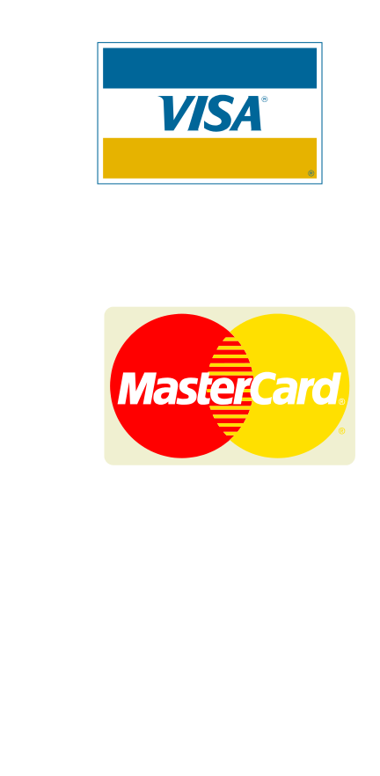
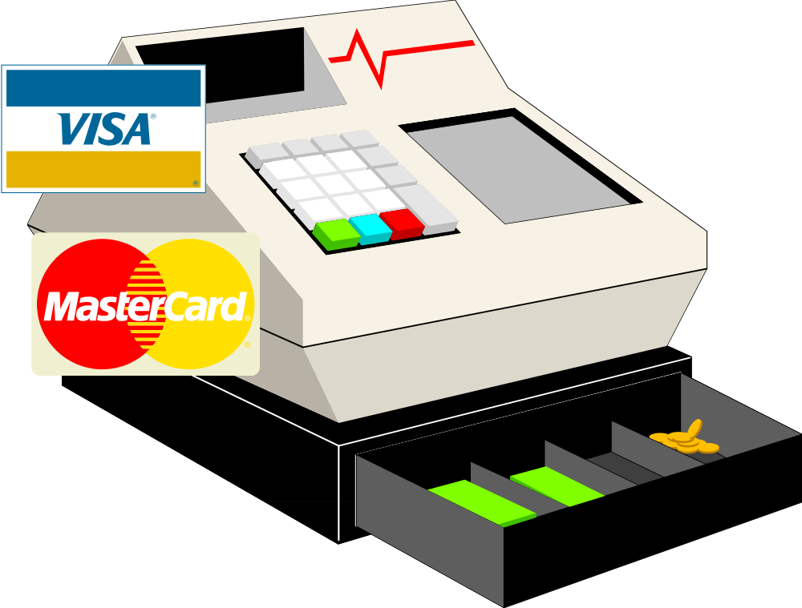
VISA/MasterCard/EUROPAY Cooperation
Interoperability of card acceptance, security, and payment functions

Slide 16





Why EMV?
- To guarantee a card / terminal interoperability all over the World
=> a VISA Chinese EMV card could be accepted and processed
in a Mastercard Senegalese EMV terminal.
VISA
MASTERCARD
Senegal

Slide 17
EMV The Different Steps
Step 1
Migration to
Smart Card
Step 2
Common
specs
Step 3
Different
EMV cards
VIS
VISA
VISA
E Pay
EMV
Specs
EPI
EPI
M Card
M.C.
M.C.
APACS
Bank X

Slide 18
Why Several EMV Cards For
One EMV Spec?
VIS
- Risk management rules
- Cryptography
- Administration functions
- Value added services
E Pay
EMV
SPECS
+
M Card
Issuer decision
APACS
Bank X
EMV Debit / Credit card: a lot of possible custom operating systems.

Slide 19
EMV Specifications
EMV is a set of specifications written by VISA, MASTERCARD and EUROPAY defining the main structures for an International Debit / Credit smart card:
  Part 1 : Physical and electrical characteristics of the card (ISO7816/1/2/3)
  Part 2 : The organization of applications within the card
  Part 3 : A set of operating system commands allowing a Debit / Credit process
What EMV doesn't define:
- The issuer risk management rules
- The "on-line" security between the card and the issuer
- The personalization functions

Slide 20
EMV Compatible/Compliant
1. A universal organization of applications inside the card :
EMV compatible level.
EMV
I have: - a VISA Dt/cr application
- a PCOS Barclays Purse
- a PCOS Mc Donald loyalty program
OK
EMV CARD
compatible
?
I have: @#~é-ç@è$¤@ !!!!
NON
EMV CARD
2. A universal debit / credit language: EMV full compliant level.
EMV
$30 TRANSACTION
OK
EMV CARD
compliant
?
$30 TRANSACTION
NON EMV Compliant card
1 + 2 = EMV full compliant level.

Slide 21
Risk Management
Unlike the magstripe card, the smart card makes the decision to: - Accept, -Deny, or -Ask for an on-line authorization to the Issuer bank.
Decision taken according to the "Risk Management" rules stored within the card at personalization stage by the Issuer bank.
Parameters of decision can be:
  Purchase amount
  Cumulative amount
  Number of consecutive transactions
  Random ...

Slide 22

Example of Card Risk Management
Bank issuer
3
Do you accept $30 Transaction
Yes, I accept it
4
Do you accept this $30 Transaction
1
On-line issuer rules:
Over $20
every 3 times
No, please ask my bank issuer ($30 >$20)
2
Give me the signature
5
Signature
EMV Terminal
6
The risk management rules are defined by each
issuer and managed by the card itself.

Slide 23
What Is Easy Entry?
4973000000012345
Visa
Example of an EMV-Compatible application
4973000000012345
Visa
Easy Entry
4973000000012345
VISA
Easy Entry
terminal
AN UNIVERSAL WAY FOR VISA TO STORE EXISTING
MAGSTRIPE CONTENT WITHIN A SMART CARD

Slide 24
Why Easy Entry?
Card clearing
Center
VISA
10
Issuer
Authorization
center
Acquiring
Center
8
Acquirer
9
3
- Payment capacity
- Credit limit
4
5
2
1
Card Holder
6
Merchant
VISA EASY ENTRY: A minimum impact on the existing magstripe system.

Slide 25
Memory organization
In MPCOS-EMV

Slide 26
Data Structure
All data objects specified in EMV are of TLV type
  T : Tag specifies which object follows
  L : Length of the data field in bytes
  V : Value of the object
Some data are seen as templates i.e. a TLV object containing other TLV objects

Slide 27
Memory Organization for EMV Compatibility
Card Memory
Payment System Environment
Other Environt.
Appli 1
Appli 2
Appli 3
Appli 1
Appli 2
Need for a Payment System Environment
Other environments may exist in the same card

Slide 28
PSE : Payment System Environment
Contains all the necessary items to manage payment (EMV compatible applications)
Made of a specific directory to identify the presence (and means of access) for EMV applications

Slide 29
Payment System Environment Implementation
The Payment System Environment is made of a specific DF called the DDF : Directory Definition File
  DF containing the Directory EF
Directory EF
  EF containing the list of ADF
  ADFs are the Applications Data Files showing where the Applications are located

Slide 30
File Organization
Refers to ISO 7816-4
Mandatory items (EMV Specification)
  Payment System Environment DDF with the name : 1PAY.SYS.DDF01
  Payment System's Directory EF, containing the entries of the ADFs
DDF : Directory Definition File
ADF : Application Data File

Slide 31
Structure of an EMV Application
An ADF : Application DF
should contain all the files of the application
An ADF must contain an FCI file
  FCI : File Control Information
  Needed for EMV to recognize the ADF as an EMV Application

Slide 32
FCI : File Control Information
FCI : File Control Information EF
Necessary for an EMV terminal to recognize the DF as an EMV application
EF with the Type (File Descriptor Byte) = O9_{H}
The EF Identifier is to have a structure xx 01

Slide 33
AEFs : Application Elementary Files
These are the files belonging to ADFs (Application DFs)
They are referred to by their SFI (Short File Identifier)
  SFI : 5 least significant bits of the Identifier
  With the following values
    1 .. 10 : Governed by EMV specifications
    11 .. 20 : Payment system specific
    21 .. 30 : Issuer specific

Slide 34
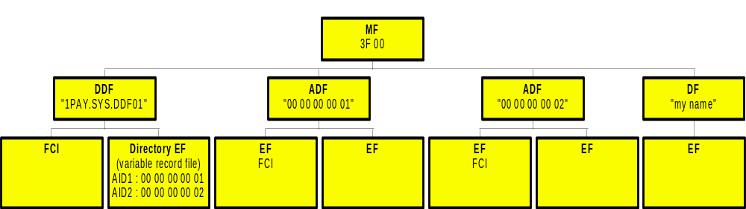
EMV Compatible Card Organization
DDF : Directory Definition File
ADF : Application Data File

Slide 35
Payment System Directory
Linear variable length record file
Directory File SFI (Short File Identifier) is to be
  in the range 1 .. 10
  stored in the Payment System DDF
Contains entries for the ADFs
  Each entry describes an application through an Application Template

Slide 36
Content of the Payment System Directory
Structure of the Application Template :
Tag
Length
Value
Presence
4F
5 .. 16
ADF Name (AID)
M
50
1 .. 16
Application label
M
M : Mandatory
O : Optional
9F12
1..16
Application Preferred Name
O
87
1
Application Priority
O
52
var
Command to perform
O
ADF Name (AID) : See Next page
Application label : Seen as a comment
Application Preferred Name: Name for common use, display, ...
Application Priority : See Next page
Command to perform : not used in MPCOS-EMV

Slide 37
Structure of the AID : Application Identifier
......
RID
PIX
RID : Registered Application Provider Identifier
  Assigned according to ISO7816-5
  Unique to an issuer
  On 5 bytes
PIX : Proprietary Application Provider Extension
  Up to 11 bytes (optional)

Slide 38
Application priority
7 6 5 4 3 2 1 0
0000 : no priority
xxxx : selection order (1 : highest priority)
RFU
0 : Application may be selected without the confirmation of the cardholder
1 : Application cannot be selected without the confirmation of the cardholder

Slide 39
MPCOS EMV Commands

Slide 40
Select File
Two modes
  EMV mode
    To select the Payment System Environment DDF
    To select the Application Data File listed in the Payment System Directory File
    Available only if the card has got the appropriate structure
  MPCOS mode
    As usual

Slide 41
Select File : SELFIL in the EMV mode
SelFil (AID, O4)
Selects the Payment System Environment DDF or an ADF
The FCI (File Control Information) can be retrieved using a GetResp
Syntax :
CLA
INS
P1
P2
Lc
Data
00
A4
04
00
Lc
AID

Slide 42
Response Message after a SelFil in EMV mode
File Control Information of the DDF or ADF selected :
Tag
Length
Value
Presence
6F
var
FCI Template
M
84
5 .. 16
DF Name
M
M : Mandatory
O : Optional
A5
var
FCI Proprietary template
M
87
1
Application Priority
O
88
1
SFI of the payment directory EF *
O
* : Only when the DDF is selected
FCI Template : Introduces the following data
DF Name : "1PAY.SYS.DDF01" or AID
FCI Proprietary template : Introduces the following data
Application Priority : As previously
SFI of the Payment Directory EF : Means to reach the Directory EF under the DDF

Slide 43
Card organization and command flow

Slide 44
Application selection scheme
1. Selection of the payment environment
Select PSE DDF
2. Selection of the DDF "1PAY.SYS.DDF01"
Get Response
3. FCI : ...., SFI of Directory EF, ....
FCI
4. Read Record : SFI Directory EF
Read Record
5. Record : ADF1 name - AID1,
ADF2 name - AID2,
......
ADF list
6. Select ADF (ADF name)
Select ADF

