Slide 1


Slide 2



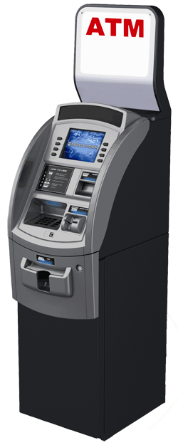


Where used - ISO 8583 Messages.

Slide 3
An ISO 8583 message is made of the following parts:
1. Message type indicator (MTI).
2. Bitmap
3. Data elements, the fields of the message.

Slide 4
Message type indicator (MTI)
0xxx -> version of ISO 8583
x1xx -> purpose of the Message
xx1x -> function of the Message
xxx0 -> source of the communication

Slide 5
1st Position of the MTI (?***)
Position | Meaning
0xxx | ISO 8583-1:1987 version
1xxx | ISO 8583-2:1993 version
2xxx | ISO 8583-3:2003 version
3xxx, 4xxx, 5xxx, 6xxx, 7xxx | Reserved for ISO use
8xxx | Reserved for National use
9xxx | Reserved for Private use

Slide 6
2nd Position of the MTI (*?**)
Position | Meaning
x1xx | Authorization Message
x2xx | Financial Messages
x3xx | File Actions Message
x4xx | Reversal and Chargeback Messages
x5xx | Reconciliation Message
x6xx | Administrative Message
x7xx | Fee Collection Messages
x8xx | Network Management Message
x9xx | Reserved by ISO

Slide 7
3rd Position of the MTI (**?*)
Position | Meaning
xx0x | Request
xx1x | Request Response
xx2x | Advice
xx3x | Advice Response
xx4x | Notification
xx5x | Notification Acknowledgement
xx6x | Instruction (ISO 8583:2003 only)
xx7x | Instruction Acknowledgement
xx8x | Reserved for ISO use.
xx9x | Reserved for ISO use.

Slide 8
4th Position of the MTI (***?)
Position | Meaning
xxx0 | Acquirer
xxx1 | Acquirer Repeat
xxx2 | Issuer
xxx3 | Issuer Repeat
xxx4 | Other
xxx5 | Other Repeat

Slide 9
MTI Examples
0100 – Authorization request
0120 – Authorization advice
0200 – Financial request
0220 – Financial advice
0420 – Reversal request
0800 – Network Management request
0810 – Network Management response

Slide 10
Bitmaps
One or more bitmaps, indicating which data elements are present
Bitmap | Defines presence of
4210001102C04804 | Fields 2, 7, 12, 28, 32, 39, 41, 42, 50, 53, 62
7234054128C28805 | Fields 2, 3, 4, 7, 11, 12, 14, 22, 24, 26, 32, 35, 37, 41, 42, 47, 49, 53, 62, 64
8000000000000001 | Fields 1, 64
0000000000000003 (secondary bitmap) | Fields 127, 128

Slide 11
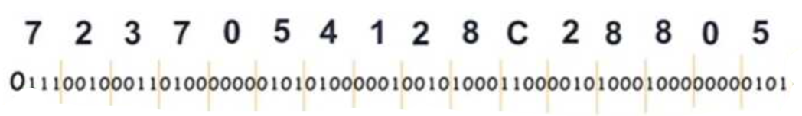
Bitmap - Decoded

Slide 12
Data elements
Abbreviation | Meaning
a | Alpha, including blanks
n | Numeric values only
s | Special characters only
an | Alphanumeric
as | Alpha & special characters only
ns | Numeric and special characters only
ans | Alphabetic, numeric and special characters.
b | Binary data
z | Tracks 2 and 3 code set as defined in ISO/IEC 7813 and ISO/IEC 4909

Slide 13
Variable Length Indicator
Type | Meaning
Fixed | no field length used
LLVAR or (..xx) | Where LL < 100, means two leading digits LL specify the field length of field VAR
LLLVAR or (...xxx) | Where LLL < 1000, means three leading digits LLL specify the field length of field VAR

Slide 14
ISO - defined data elements
Data Field | Type | Usage
1 | b 64 | Bit map (b 128 if secondary is present and b 192 if tertiary is present)
2 | n ..19 | Primary account number (PAN)
3 | n 6 | Processing code
4 | n 12 | Amount, transaction
5 | n 12 | Amount, settlement
6 | n 12 | Amount, cardholder billing
7 | n 10 | Transmission date & time

Slide 15
ISO - defined data elements
Data Field | Type | Usage
11 | n 6 | System trace audit number
12 | n 6 | Time, local transaction (hhmmss)
13 | n 4 | Date, local transaction (MMDD)
14 | n 4 | Date, expiration
15 | n 4 | Date, settlement

Slide 16
ISO - defined data elements
Data Field | Type | Usage
18 | n 4 | Merchant type
19 | n 3 | Acquiring institution country code
21 | n 3 | Forwarding institution. country code
22 | n 3 | Point of service entry mode
23 | n 3 | Application PAN sequence number
24 | n 3 | Function code (ISO 8583:1993)/Network International identifier (NII)
25 | n 2 | Point of service condition code

Slide 17
ISO - defined data elements
Data Field | Type | Usage
35 | z ..37 | Track 2 data
37 | an 12 | Retrieval reference number
38 | an 6 | Authorization identification response
39 | an 2 | Response code
41 | ans 8 | Terminal Id
42 | ans 15 | Merchant Id
45 | an ..76 | Track 1 data
52 | b 64 | Personal identification number data
55 | ans ...999 | ICC data – EMV having multiple tags

Slide 18
Normal Completion – Financial Transaction Normal Completion
Financial Transaction Normal Completion flowchart
Acquirer
0200
Issuer
0210
Time

Slide 19
DE-18 Merchant Category Code (MCC)
Type | N4
Description
 | Note: Most frequently used values are:
 | 6011 | ATM Cash withdrawal.
 | 6010 | Over the counter cash advance.
 | 4814 | Airtime purchase.
MCC is four-digit code in accordance with the
Visa/MasterCard MCC definitions. The data element is
mandatory for 01xx and 02xx request messages.
It is never present in response messages.

Slide 20
DE-39 Response Code
Type | an2
Description | This code indicates the disposition of a message as detailed tables below. Each code is associated with specific action code that is to be taken:
 | A | Approve transaction.
 | D | Decline transaction.
 | C | Decline transaction and capture card.
 | Data element is mandatory in all response messages as well as in reversal and store/forward request messages.

Slide 21
DE-37 Retrieval Reference Number
Type | an12
Description | The reference, assigned by the acquirer, to identify a transaction uniquely. It remains unchanged for all messages throughout the life of a transaction and is used for matching original message with reversal and/or store/forward messages. The data element is mandatory for 01xx, 02xx, and 04xx request messages.
Field Edits | It must be echoed in response message and all subsequent messages.

Slide 22
Thank you….
By
Balasubbulakshmi

