Slide 1
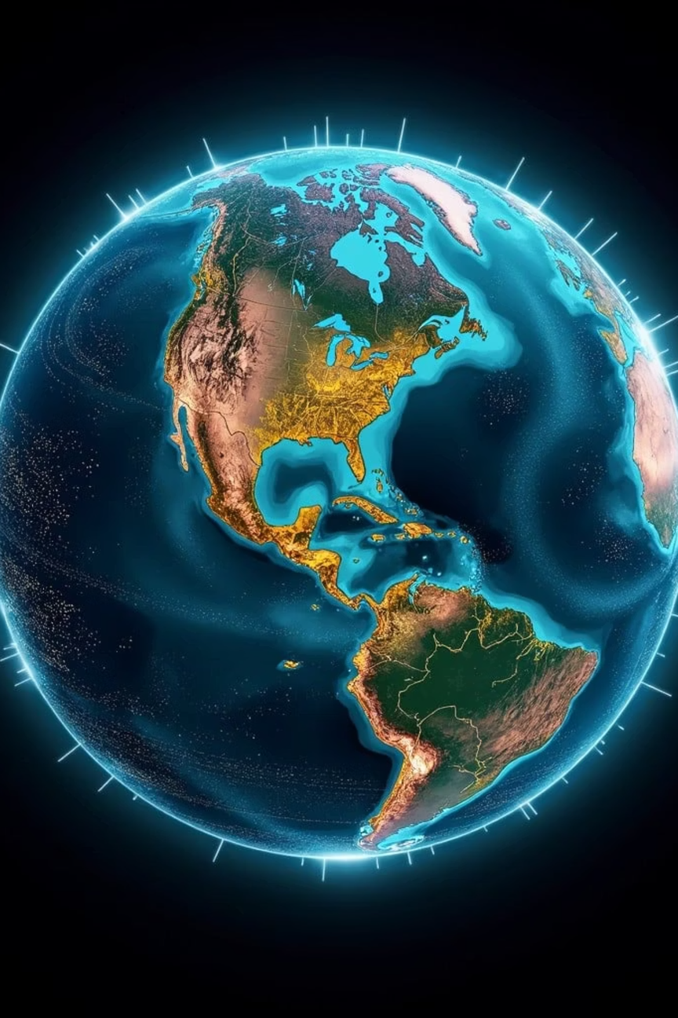
Global Weather Dashboard
An interactive, real-time 3D climate visualization platform — built end-to-end with modern full-stack web technologies.
Notes:
1

Slide 2
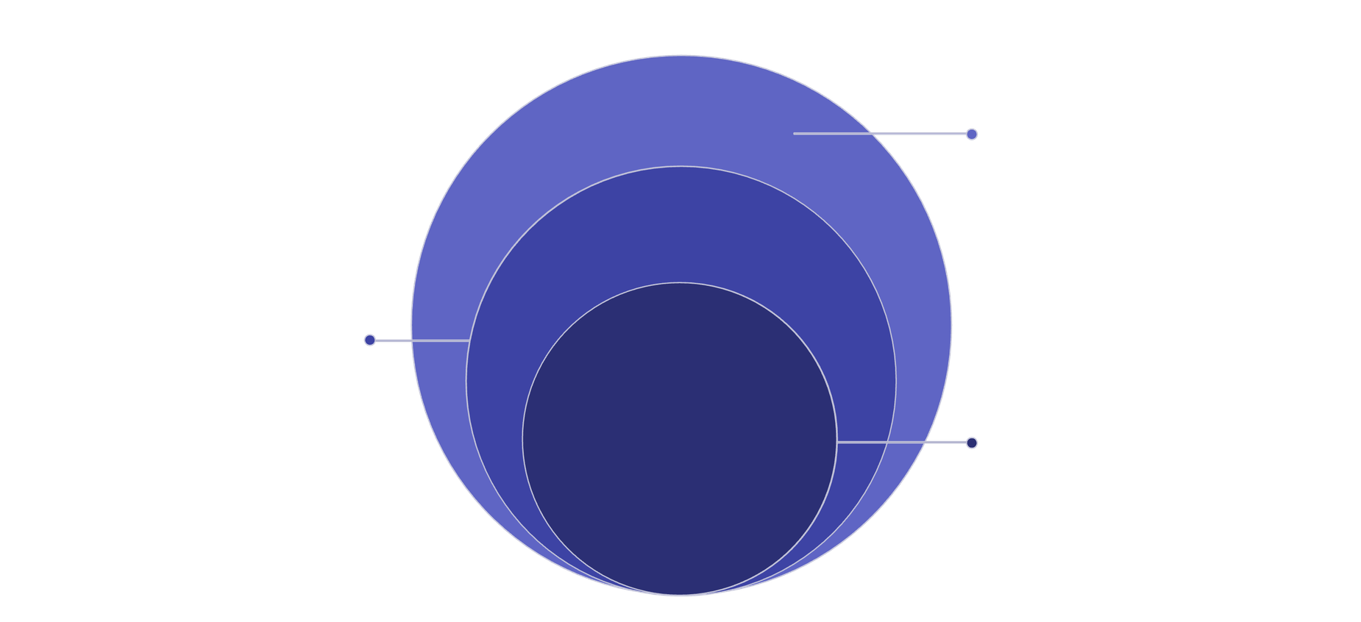
Architecture at a Glance
Three tightly integrated layers work in concert to deliver a seamless meteorological experience — from server to screen.
Outer: Backend
Python Django, database, real-time APIs and data services
Middle: Frontend
HTML, CSS, JavaScript with dark UI for visualization
Core: WebGL Render
Three.js Globe.gl 3D Earth with live wind particles
Each layer communicates in real time, ensuring the globe stays alive with current planetary conditions the moment a user interacts.
Notes:
2

Slide 3
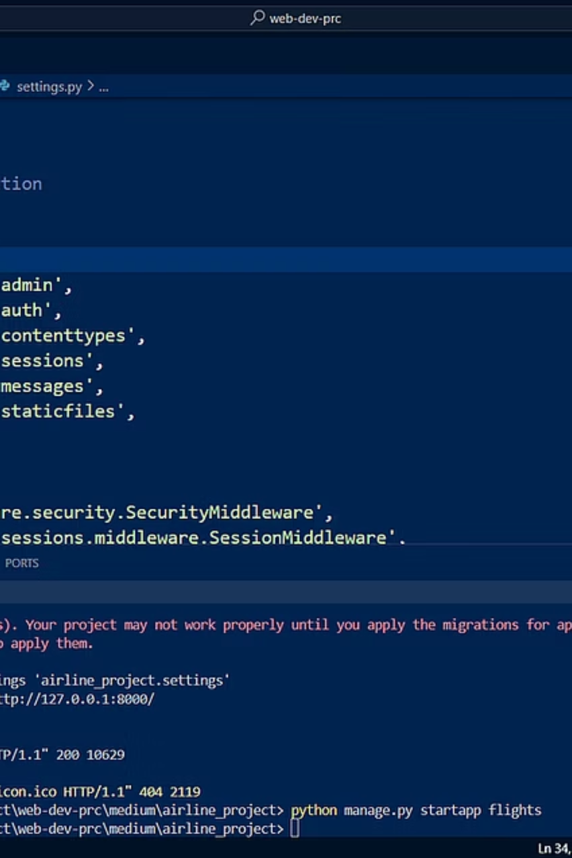

Backend: Python & Django
The server-side foundation is built on Python and the Django web framework. Django's manage.py utility handles administrative tasks and spins up the local development server, while Django automatically provisions a db.sqlite3 database to manage user authentication, admin permissions, and active sessions — keeping the application secure and organized from day one.
Notes:
3

Slide 4
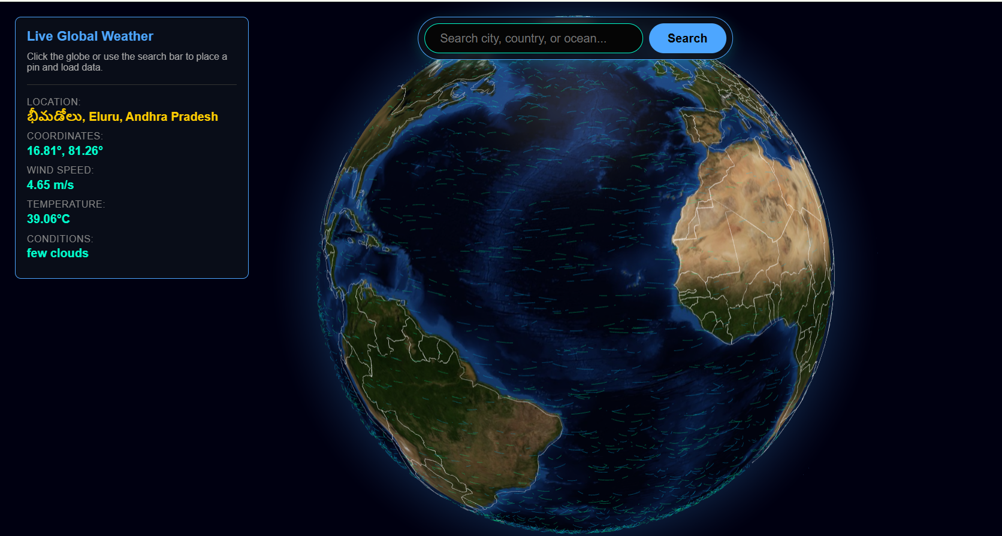
Frontend: Sleek & Responsive
HTML · CSS · JavaScript
The user-facing layer is crafted with semantic HTML, modern CSS, and vanilla JavaScript — no heavy frontend frameworks. The design features a dark-themed interface with a floating, semi-transparent data panel that overlays the globe without obstructing the view.
Minimal, distraction-free layout
Transparent overlay panels for live data
Responsive across screen sizes
Notes:
4

Slide 5
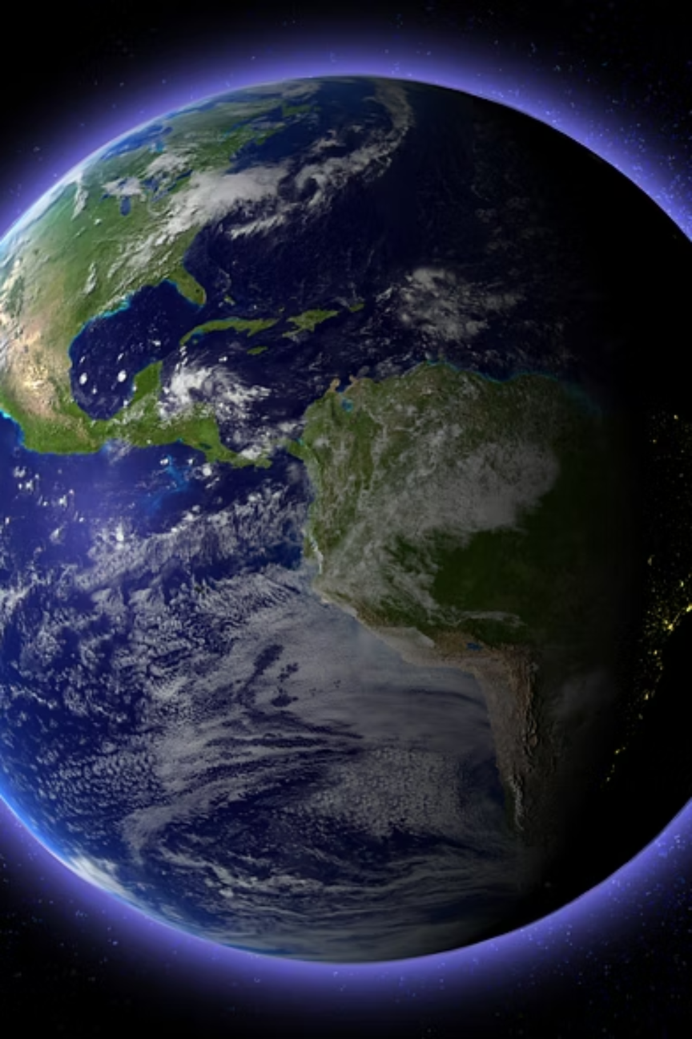
WebGL: Beyond Flat Maps
Rather than relying on traditional 2D map tiles, we leveraged Three.js and Globe.gl to harness the GPU directly. The browser renders a fully interactive, rotating 3D Earth wrapped in high-resolution satellite textures — delivering a level of realism and immersion that flat maps simply cannot match.
Notes:
5

Slide 6
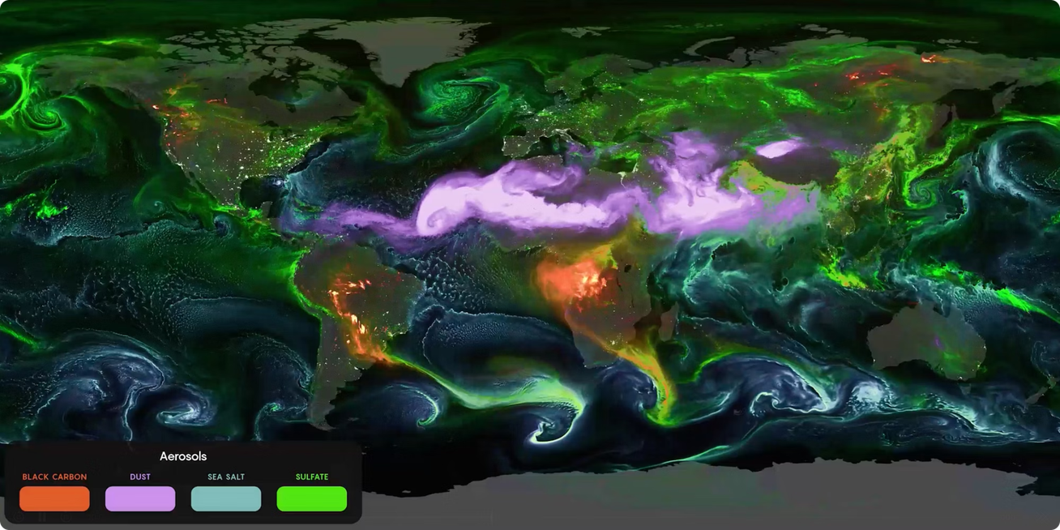

Simulating Planetary Wind
Vector Field Flow Logic
Wind isn't faked with pre-baked animations. We wrote custom mathematical flow logic that calculates a real-time vector field across the globe's surface. The browser then draws thousands of glowing particles that sweep in smooth, coherent streams — accurately mimicking real patterns like the Trade Winds and Westerlies.
Particles follow physically informed flow curves, not random chaos — producing authentic planetary weather behavior.
Notes:
6

Slide 7
Live Data via APIs
Two real-world APIs breathe live data into every click on the globe.
OpenWeatherMap API
OpenStreetMap Nominatim
Simultaneous Requests
On click, fetches live wind speed, temperature, and weather conditions for the exact coordinates — no caching, no delay.
Both APIs fire in parallel the moment a user clicks, ensuring instant, synchronized data delivery.
Performs reverse geocoding — translating raw latitude/longitude into readable place names like "Arabian Sea" or "Pacific Ocean."
Notes:
7

Slide 8
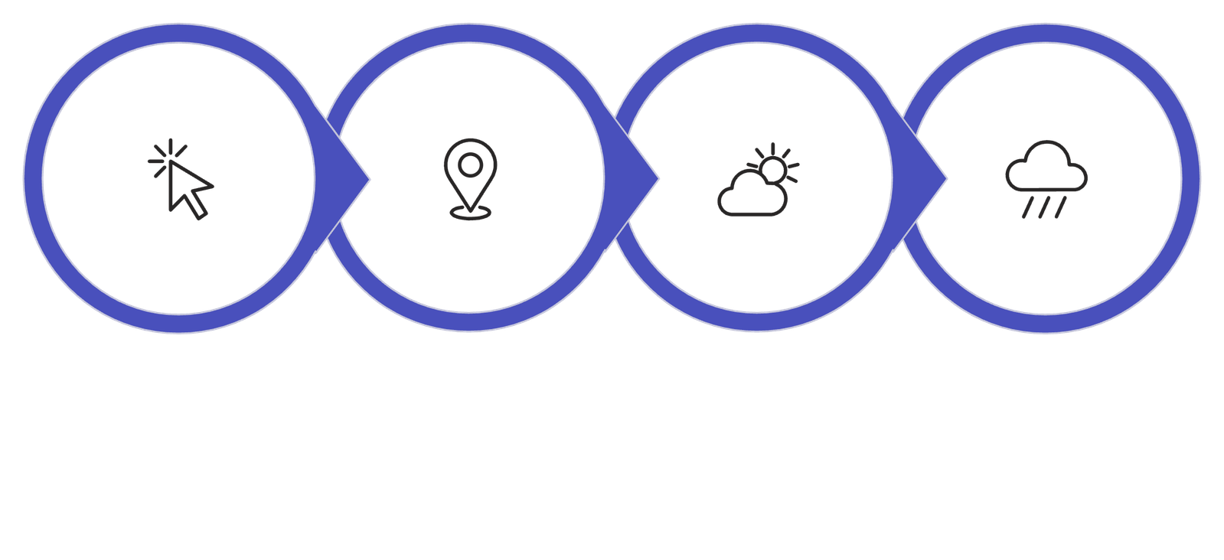
Interaction: Click → Discover
Pinpoint Drops
User Clicks
APIs Fire
Live Data
The entire interaction — from click to live data display — happens in milliseconds, creating a fluid, professional-grade meteorological tool that feels alive with every click.
Notes:
8

Slide 9
Technology Stack
Backend
Frontend
Python · Django · SQLite · manage.py
HTML5 · CSS3 · Vanilla JavaScript
3D Graphics
Live Data
Three.js · Globe.gl · WebGL GPU rendering
OpenWeatherMap API · OpenStreetMap Nominatim
Notes:
9

Slide 10
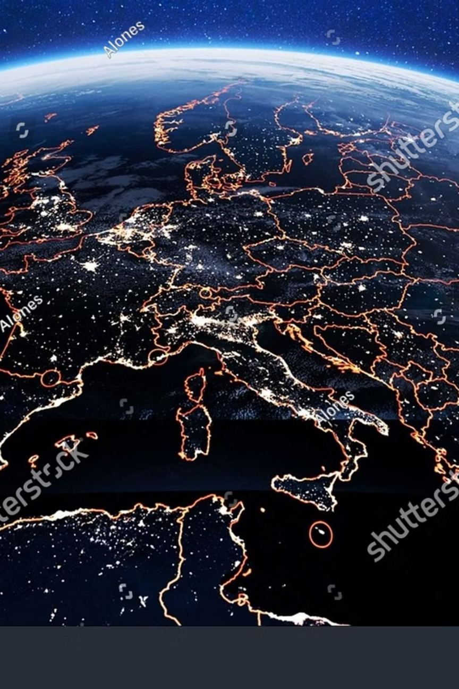
One Seamless Meteorological Tool
Global Weather Dashboard unifies backend stability, advanced 3D graphics, and live data fetching into a single, polished experience — a proof of concept for what modern full-stack web development can achieve when every layer is designed to work in harmony.
Real-Time
Live API data on every click
Immersive
GPU-accelerated 3D Earth rendering
Accurate
Vector-field wind simulation, not random particles
Notes:
10

