Slide 1

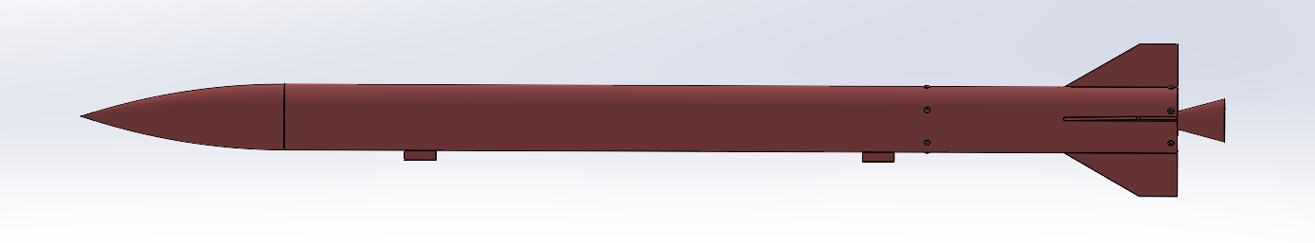


Modal Rocket configuration overview
MODEL ROCKET
Total Weight: 14.5 kg
Target Weight: 15 kg
1. AIRFRAME
(8.89 kg)
2. MOTOR
(3.00 kg)
3. ELECTRICAL SYSTEM
(1.60 kg, 22cm length,15 cm diameter)
4. CANSAT PAYLOAD
(1.00 kg,40cm length,15 cm diameter)
5. GROUND SYSTEM
1.1 Main Body(Aluminium)
4.30 kg, 177.1cm length,15 cm diameter
2.1 Solid Rocket Motor
3.00 kg
3.1 Flight Computer
0.25 kg
4.1 7U CanSat
1.00 kg
5.1 Ground Station Controller
1.2 Nose Cone
1.20 kg ,34.3cm length
3.2 Battery
0.40 kg
RF communication
LoRA-RFM95UU
868-915 MHZ
5.2 Launch Pad
1.3 Fasteners
0.05 kg
3.3 Sensors
0.35 kg
1.4 Ejection Mechanism
1.00 kg
3.4 Telemetry
LoRa:E32-900T30D
0.30 kg
3.5 Wiring Harness
0.30 kg
Figure 1: Model Rocket Design

Slide 2
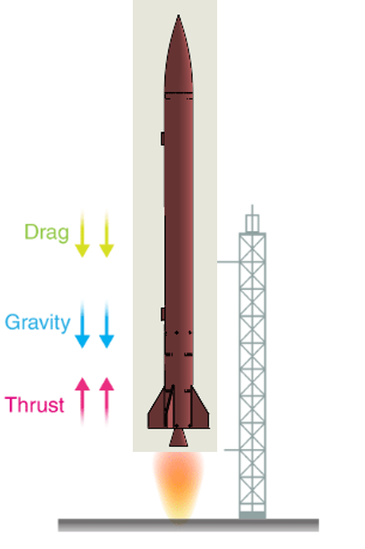
PDR Preparation Plan
Review guidelines/ Mission requirements
Prepare 3D model & review
System FMEA & DVP
DFM, DFA & DFEoc
Analysis & simulation
BOM, PDR document preparation
PDR document submission
15.06.26
PDR document Review & update
13.06.26
Notes:
This is our modal rocket workflow which we covered requirements translating into 3dmodel and followed by system fmea ,analysis simulation followed by design for manufacturing assembly to arrive Bill of material

Slide 3
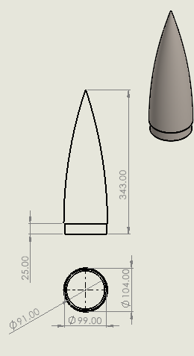
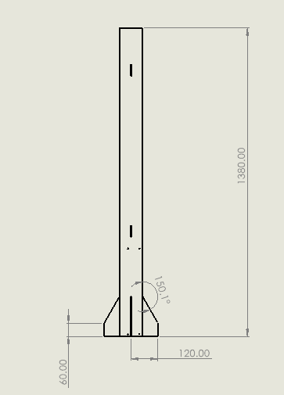
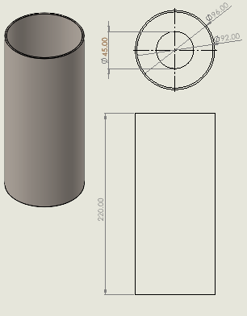
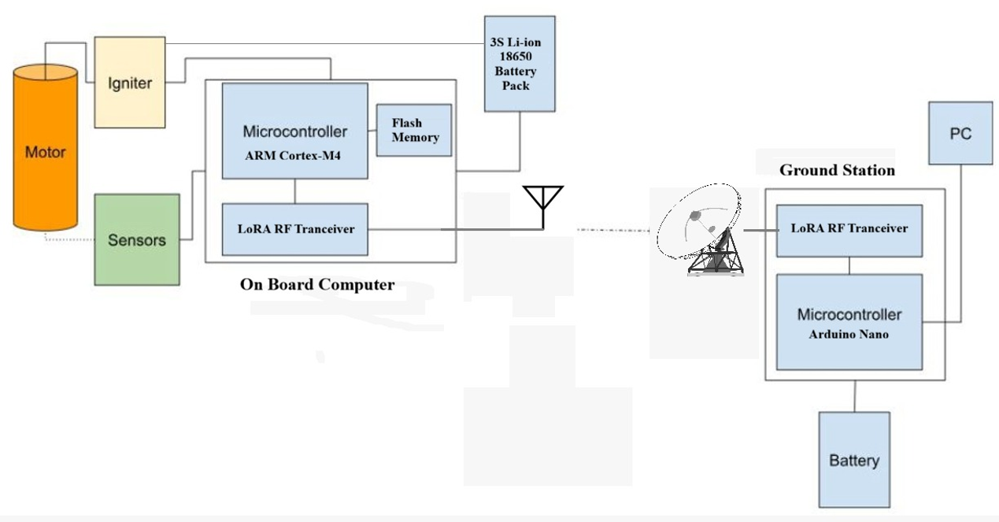

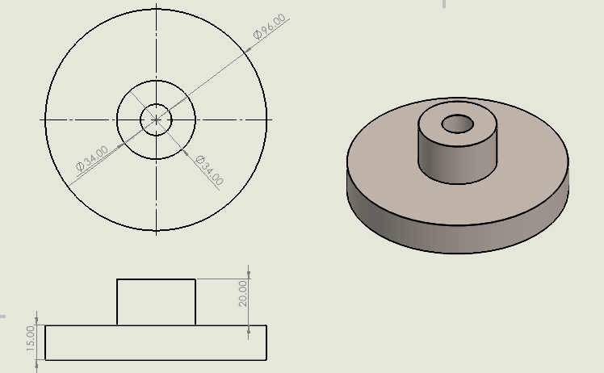
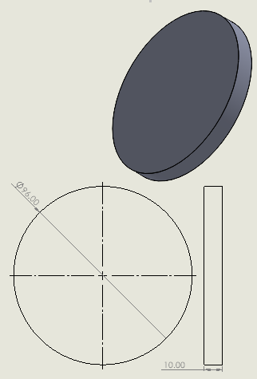
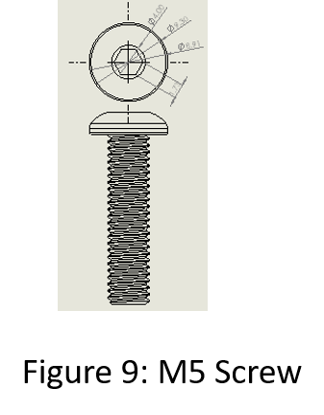
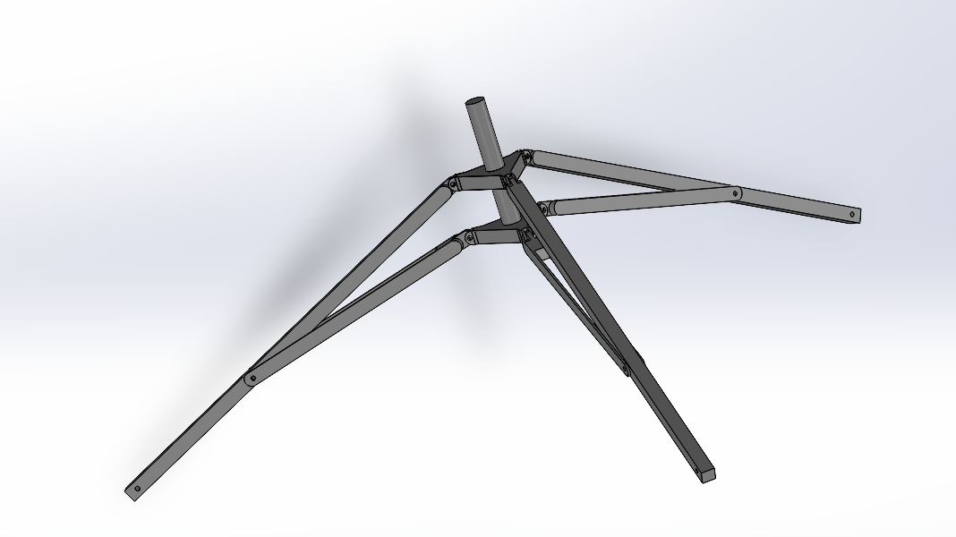
Design of subsystems including ground systems
2: Nose Cone
3: Airframe Body
4: Avionics Bay
5: Electrical Subsystem
8: M5 screw
9: Launch Pad Base
6: Thrust Plate
7: Bulkhead

Slide 4
Design of subsystems including ground systems
ROCKET ELECTRONICS HARDWARE LIST
 | Component | Part | Key Spec | Function
1 | Flight computer | STM32 Nucleo-F411RE | Cortex-M4, 100MHz | FSM + Kalman filter
2 | IMU | ICM-42688-P | ±16g/±2000dps | Inertial sensing
3-4 | Barometer ×2 | MS5611-01BA03 | 0.012mbar RMS | Altitude (primary+redundant)
5 | GNSS | 7Semi L89HA (Quectel L89 R2.0) | NavIC+GPS+Galileo+QZSS | Position/recovery
6 | LoRa radio | Ebyte E32-900T30D | 866.25MHz, 1W | Telemetry TX
7 | MicroSD | Generic breakout | FAT32 | Redundant log
8 | Power monitor | INA219BIDR | I2C | V/I telemetry
9 | Backup altimeter | Stratologger CF | Independent | Redundant separation
10,11 | Regulators | MP2315, AP2112K-3.3 | 5V/3.3V rails | Power conversion
12 | Servo | MG996R | - | Payload-door latch
13,14 | Battery+BMS | 2× 18650 30Q, DW01A | 2S1P 7.4V 3000mAh | Main power
15 | Isolation | PC817 | - | Stratologger isolation
16,17,18 | Buzzer, LEDs, switch | - | - | Beacon/indicators/power
19 | Enclosure | 6061 Al box | 160×80×40mm | Housing
CAN-7USAT ELECTRONICS HARDWARE LIST
 | Component | Part | Key Spec | Function
1 | Flight computer | ESP32-S3 DevKitC-1 | Dual-core, 240MHz | FSM + control
2 | IMU | ICM-42688-P | Same as Rocket | Inertial + roll/pitch
3 | Barometer | MS5611-01BA03 | Same as Rocket | 600m trigger reference
4 | GNSS | 7Semi L89HA | Same as Rocket | Position/recovery
5 | LoRa radio | RFM95W (868/915MHz HF variant) | 867.25MHz, 100mW | Telemetry TX
6 | Env. sensor | SHT31-DIS-B | ±0.2°C | Optional experiment
7 | Power monitor | INA219BIDR | I2C | V/I telemetry
8 | MicroSD | Generic breakout | FAT32 | Redundant log
9 | Servo | MG90S | - | Secondary chute @600m
10,11 | Regulators | FP6291, AP2112K-3.3 | 5V/3.3V rails | Power conversion
12,13 | Battery+BMS | 2× 18650 30Q, DW01A | 1S2P 3.6V 6000mAh | Main power
14,15,16 | Buzzer, LEDs, switch | - | - | Beacon/indicators/power
17,18 | Structure + PCB stack | PETG cylinder + Al bulkheads, 4× Zero-PCB | 140×380mm | Housing/backbone

Slide 5
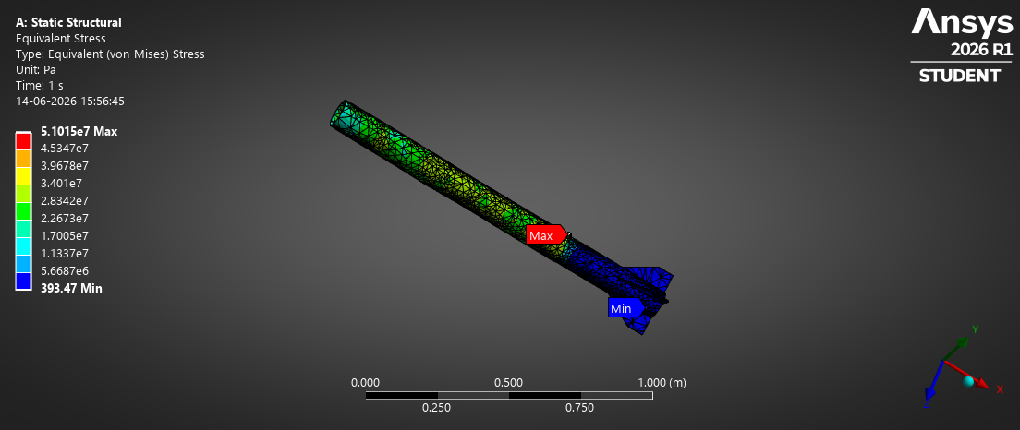
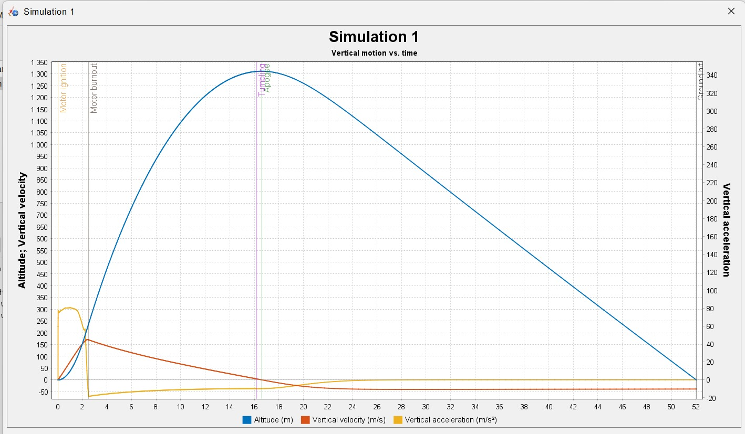
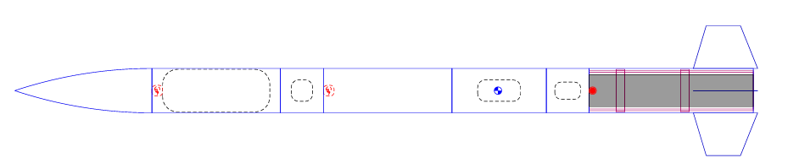
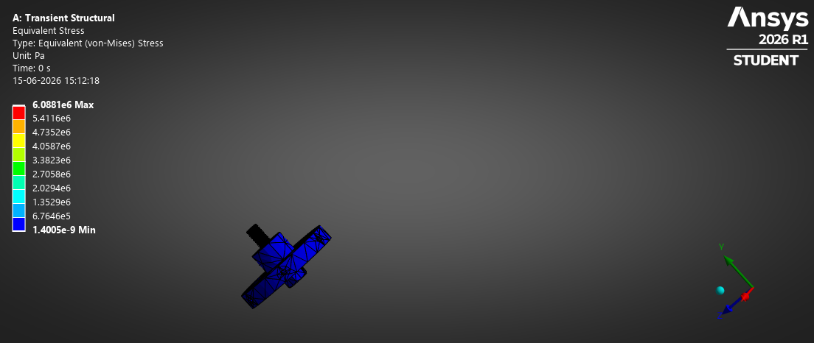

Analysis undertaken and results
Sys | Sub-Sys | Simulation Name | Specification | Results
Model Rocket |  | Open rocket Simulation | 900m – 1100m With 2497Ns | 1300
 | Airframe | Main body | 15g force simulation in ansys
 |  | Nose | CG
Figure 11: Equivalent stress simulation for 15g force
Figure 10: Open rocket simulation
Figure 12: Equivalent stress simulation for 30g force

Slide 6
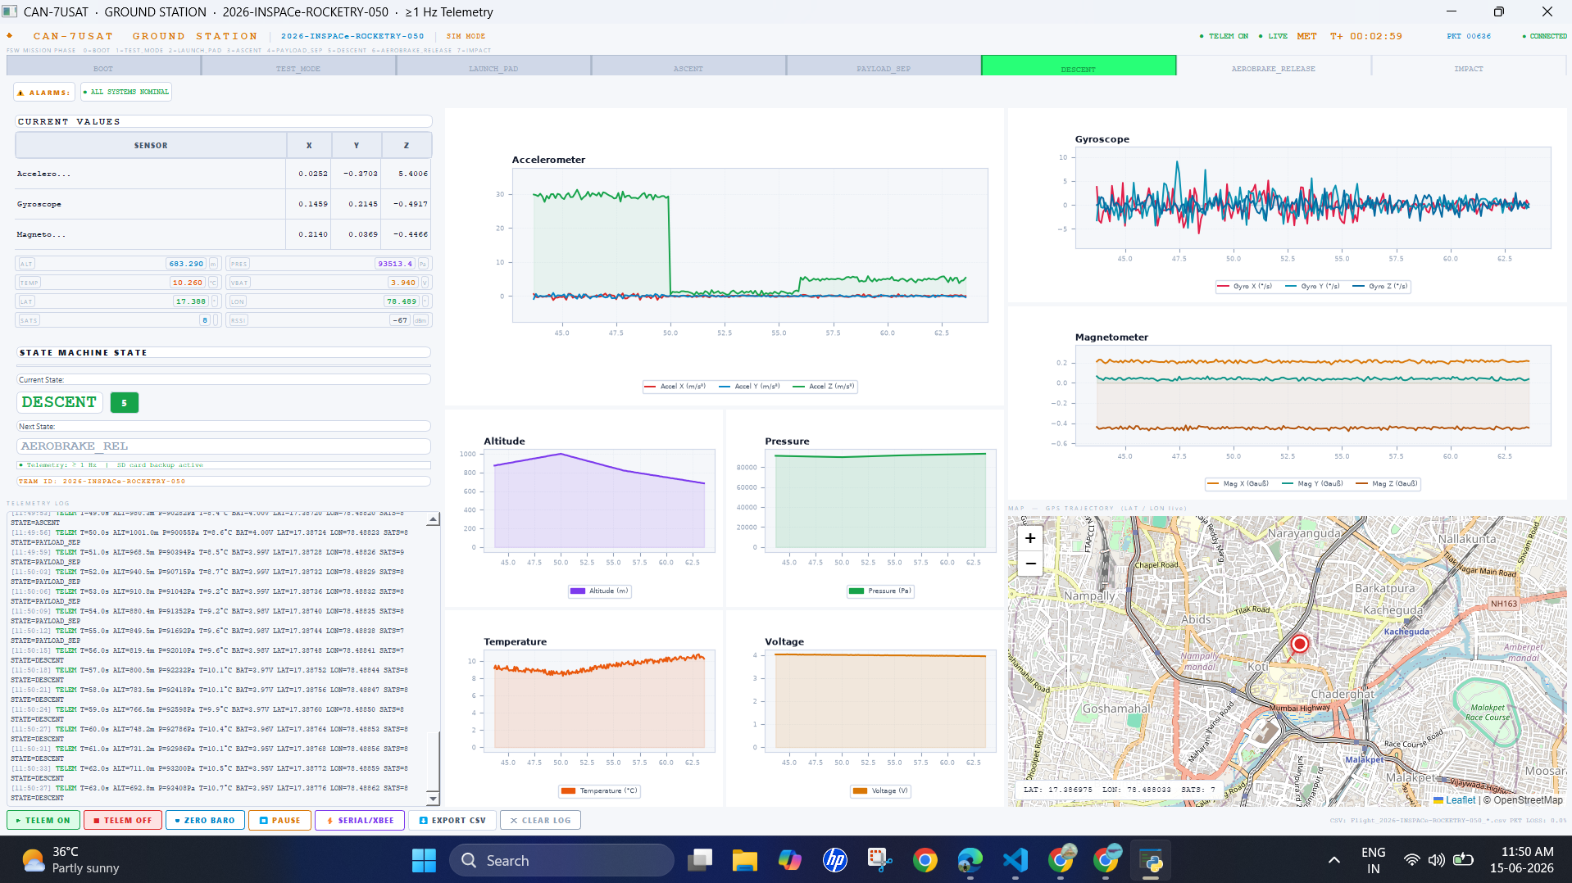
Developed using Python and PyQt5 to provide a modern, responsive, and mission-ready Ground Station interface.
Accelerometer
Alaram Health Panel
FLIGHT PHASE
Sensor Current Value
Gyroscope
Current & Next Phase indicator
GPS Location in map with latitude & Longitude
CSV data at every 1 sec
Command & Control Bar
Sensor reading graph

Slide 7
Components and hardware realization plan
Systems / Sub-system | Components | Make/ Buy | Date of PO release | Mfg /Proc Start date | Mfg /Proc End Date | Inspection & approval | Assemblying & final inspection
Model Rocket
Airframe | Main body | Make | 27.07.26 | 20.08.26 | 30.08.26 | 05.09.26 | 15.09.26
 | Nose | Make | 20.07.26 | 20.08.26 | 30.08.26 | 05.09.26 | 15.09.26
 | Tail with nozzle | Make | 20.07.26 | 20.08.26 | 30.08.26 | 05.09.26 | 15.09.26
 | Fasteners | Buy | 20.07.26 | 01.08.26 | 30.08.26 | 05.09.26 | 15.09.26
Motor |  | Buy | 20.07.26 | To be confirmed | 30.08.26 | 05.09.26 | 15.09.26
Electrical (Avionics) subsystem | Remote Controller | Buy | 20.07.26 | 01.08.26 | 30.08.26 | 05.09.26 | 15.09.26
 | Battery | Buy | 20.07.26 | 01.08.26 | 30.08.26 | 05.09.26 | 15.09.26
 | Sensors | Buy | 20.07.26 | 01.08.26 | 30.08.26 | 05.09.26 | 15.09.26
 | Wiring harness | Buy | 20.07.26 | 01.08.26 | 30.08.26 | 05.09.26 | 15.09.26
 | CAN7USAT | Make | 20.07.26 | 20.08.26 | 30.08.26 | 05.09.26 | 15.09.26
Ground Station | Host Controller | Buy | 20.07.26 | 01.08.26 | 30.08.26 | 05.09.26 | 15.09.26
 | Launch Pad | Make | 20.07.26 | 20.08.26 | 30.08.26 | 05.09.26 | 15.09.26
Ejection Mechanism | Spring loader servo | Make

Slide 8
Summary
Design completed & Met design constraints & Targets.
Materials selected
Simulation done & Results closely met
Preliminary Prototype to be made for verification
Time line available to ready with Model Rocket by 15 Oct 26

Slide 9
THANK YOU

Slide 10
Design of subsystems including ground systems
Communication
Telemetry Parameters
Parameter | Value
Radio Type | LoRa SX1278 Telemetry Module, 865–867 MHz ISM Band
XBEE NET ID / PAN ID | N/A (LoRa Point-to-Point Communication)
Separate Channels – Rocket vs CanSat | Rocket Telemetry: 865.1 MHz; CanSat Telemetry: 866.3 MHz. Independent RF channels shall be used. Ground interference testing will be conducted prior to flight qualification to verify simultaneous operation without packet loss.
Parameter | Requirement
Sampling Rate | 10 Hz minimum
Altitude Resolution | 0.1 m
Pressure Resolution | 1 Pa
Temperature Resolution | 0.1 °C
Voltage Resolution | 0.01 V
GNSS Latitude/Longitude Resolution | 0.00001°
GNSS Update Rate | 5 Hz minimum
Telemetry Range | ≥ 3 km LOS
Data Logging | 100% onboard storage of telemetry data
Battery Specification
7U-Cansat sensors
Parameter | Recommended Value
Battery Type | 3S Li-ion 18650 Battery Pack (11.1 V nominal)
Cell Type | 18650 Li-ion Cells
Capacity | 2200–2600 mAh
Energy | 24–29 Wh
Battery Mass | 140–180 g
Standby Duration | ≥ 60 minutes (launch pad + flight + recovery)

Slide 11
Design of subsystems including ground systems
Systems | Sub-Systems | components | Design Length, cm Diameter, cm | Target Length, cm Diameter, cm
Model Rocket |  |  | 177.1,15 | 180Cm, 15(Estimated)
 | Airframe | Main body | 138.0,15
 |  | Nose | 34.3
 |  | Fasteners | M5,0.2
 | Motor |  | 38.3 | 38.3cm, 9.4cm ( vendor)
 | Electrical system |  | 22
 |  | CAN7USAT | 40,14.5
 | Ground Station | Controller

Slide 12
Design of subsystems including ground systems
Systems | Sub-Systems | components | Weight, Kg | Target weight, kg | Design Length, cm Diameter, cm | Target Length, cm Diameter, cm
Model Rocket |  |  | 14.5 | 15 | 177.1,15 | 180Cm, 15(Estimated)
 | Airframe | Main body | 4.3 |  | 138.0,15
 |  | Nose | 1.2 |  | 34.3
 |  | Tail with nozzle | 2.34
 |  | Fasteners | 0.05
 |  | Ejection mechanism | 1
 | Motor |  | 3 |  | 38.3cm, 9.4cm ( vendor)
 | Electrical system |  | 1.6 |  | 22
 |  | CAN7USAT | 1 |  | 40,14.5
 | Ground Station | Controller
 |  | Launch Pad

