Slide 1

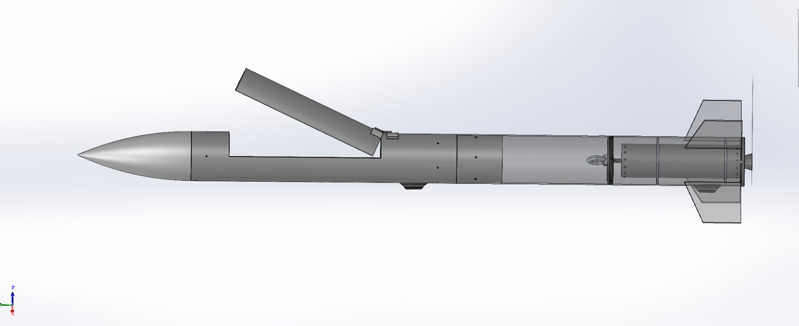
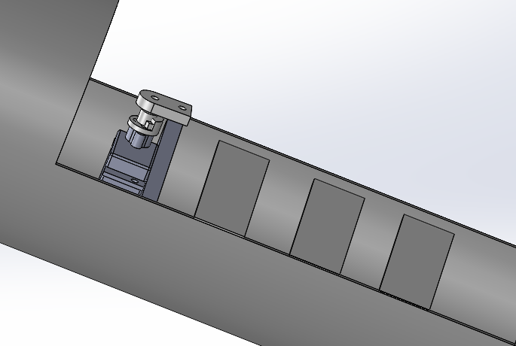


Model rocket configuration overview
Coupler tube
M4 bolts
M5 bolts
Aeropack
Nosecone
Thrust plate
Upper airframe
Launch lugs
Lower airframe
Servo lock mechanism
Centering rings

Slide 2

Changes from PDR
Subsystem / Parameter | Preliminary Design Review (PDR) Baseline | Critical Design Review (CDR) Implementation | Technical Justification & Engineering Impact
Payload Ejection Architecture | Axial nose-ejection configuration | Horizontal lateral side-hatch ejection with a unified internal sled | Eliminates nosecone separation risk; simplifies packing of the CanSat and parachute into a single cradle.
Hatch Door Mechanism | Fixed / shearing retention cover | 180° flipping side-hatch door on integral hinge lugs | Clears the ejection aperture completely so neither the CanSat nor parachute lines snag during release.
Ejection Pusher Mechanism | Axial pneumatic / gas discharge concept | Polyester elastic band | Meets non-pyrotechnic rules;
Airframe Material & Sizing | Baseline Aluminum/PVC shell schedule | E-Glass Fiberglass with a 2.5 mm structural wall thickness | Provides complete RF transparency for internal avionics and CanSat telemetry; easily handles 15g thrust loads.

Slide 3
Current status of all subsystems including ground systems
Subsystem | Component Architecture | Sourcing Vendor | Status | Verification Milestones & Test Evidence
CanSat Flight Computer | Waveshare ESP32-P4-Pico (Dual-Core RISC-V @ 400MHz, 32MB PSRAM) | Evelta Electronics | VERIFIED | FreeRTOS task scheduler & dual-core bus timings benchmarked; zero task overruns.
Attitude & Multi-GNSS | 7Semi BMI270 (6-Axis IMU) + 7Semi L89HA (NavIC L5 + GPS L1) | Evelta Electronics | VERIFIED | 10Hz NavIC L5 fix validated with 14 satellites; quaternion orientation filter operational.
Atmospheric Science | Bosch BMP585 Gel Barometer + 7Semi SHT40/SGP40 VOC Sensor | Evelta Electronics | VERIFIED | 0.08Pa RMS peak altitude detection validated; air quality index logging active.
CanSat Active Recovery | 4x RS2205 Motors + SpeedyBee 35A ESC + GEMFAN 5045 Props | Evelta / Zbotic / Robu | VERIFIED | DShot300 bidirectional telemetry verified; 2.2:1 thrust-to-weight ratio for soft landing.
CanSat Power Subsystem | Molicel P42A 3S1P Li-Ion (4200mAh) + MP1584 Buck + 3.3V LDO | Robu / Evelta / Quartz | VERIFIED | Zero LiPo compliance; >3.8 hr continuous pad endurance; <15mV RMS ripple.
Rocket Avionics Sled | ESP32-P4 MCU + BNO055 9-DOF IMU + BMP585 + L89HA GNSS+COTS altimeter (Estes 2246) | Evelta / Robu | VERIFIED | Carrier sled fits inside 125mm upper airframe; 289g mass within 500g budget.
Rocket Parachute Release | TowerPro MG90S Metal Gear Servo + 1000µF Decoupling Capacitor | Robu.in / Evelta | VERIFIED | Zero pyrotechnics compliance; zero MCU brownout under 1.2A stall load.
Ground Station Infrastructure | Dual Gateways (FT232RL XBee + CP2102 LoRa) + iMax B6AC 80W | Zbotic / Robu / Robocraze | OPERATIONAL | Dual laptop telemetry reception GUI tested; automated battery balance charging ready.
IN-SPACe Model Rocketry India Student Competition 2026:: Vignan Antariksha Team 2026-INSPACe-ROCKETRY-050

Slide 4
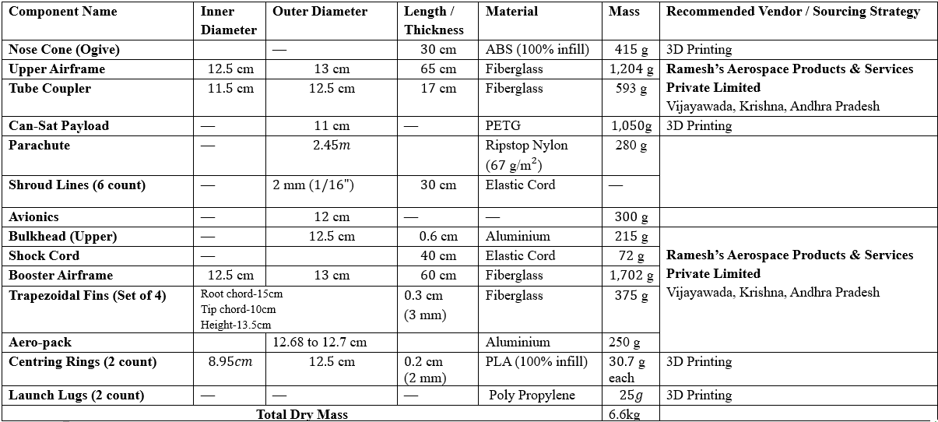
Components and hardware realization plan

Slide 5
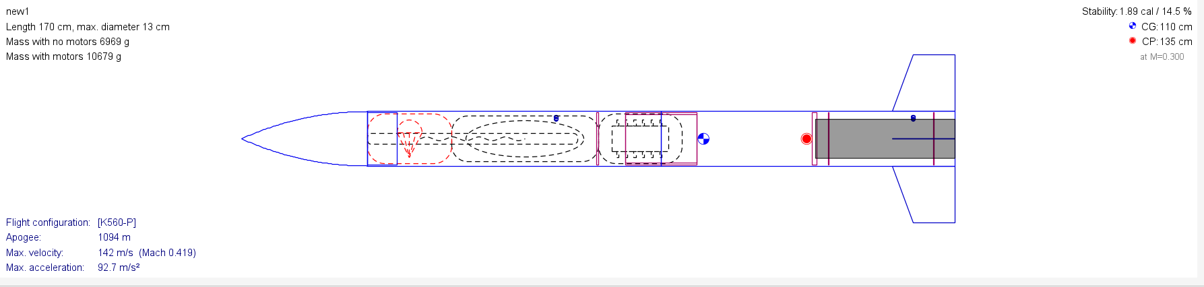
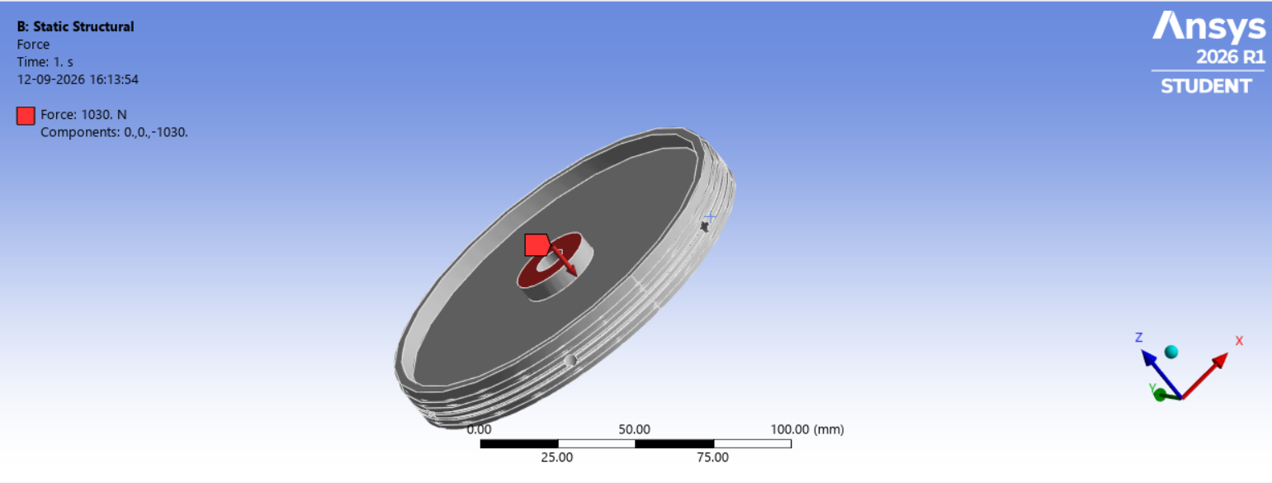
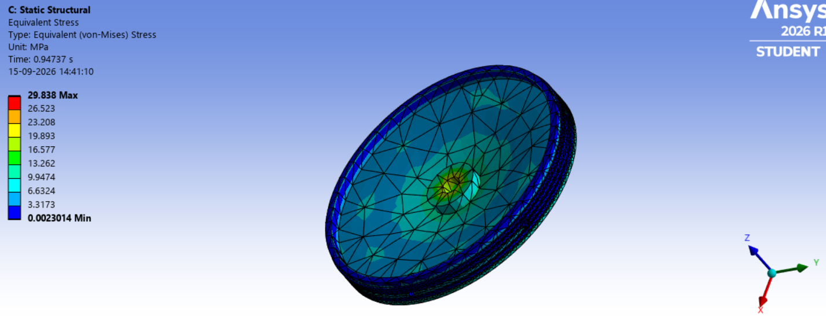
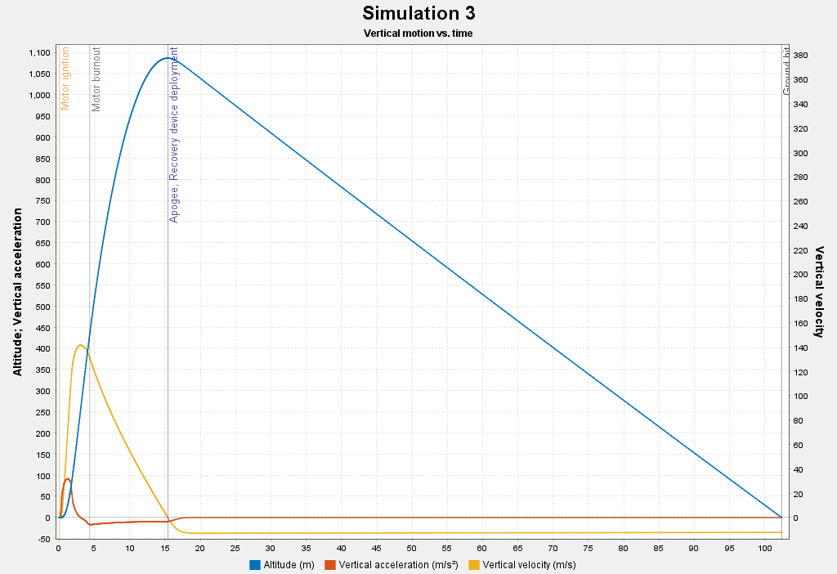
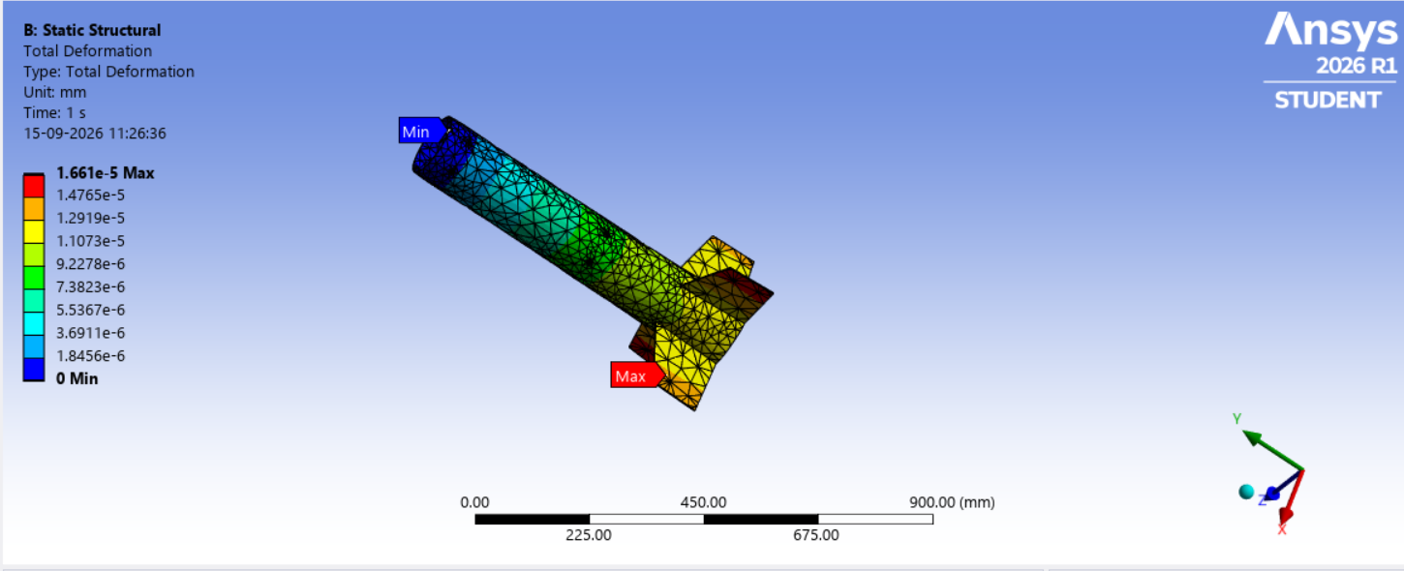
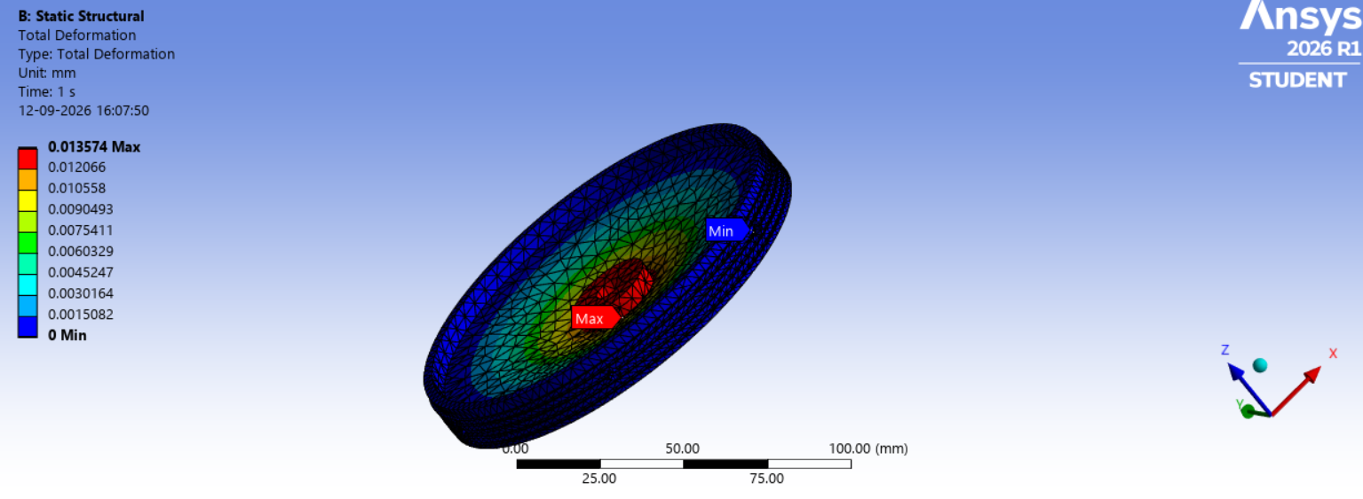
Tests undertaken and results
Fig-1: Open rocket design
Fig-2: 30g shock simulation
Fig-3: Open rocket simulation plots
Fig-4: 15g of launch simulation
Fig-5: 15g shock simulation
IN-SPACe Model Rocketry India Student Competition 2026:: Vignan Antariksha Team 2026-INSPACe-ROCKETRY-050

Slide 6
Model Rocket mission control software and ground systems
1. FLIGHT COMPUTER FIRMWARE ARCHITECTURE
2. GROUND SYSTEMS & MISSION CONTROL GUI
Real-Time Embedded OS: FreeRTOS on Dual-Core RISC-V ESP32-P4 (@ 400 MHz)
Core 0 — Deterministic Flight Loop (@ 200 Hz):
• Sensor Polling: DMA-backed SPI reading of BMI270 IMU (accel/gyro) and I2C reading of BMP585 altimeter.
• State Estimation: 9-State Extended Kalman Filter (EKF) computing vehicle attitude quaternions and vertical velocity.
• Closed-Loop Control: Differential aerodynamic PID motor speed synthesis for 4 rotors outputting DShot300 pulses.
Core 1 — Telemetry, Telecommand & Safety (@ 10 Hz):
• Multi-GNSS Parser: High-speed DMA UART driver parsing NMEA sentences from 7Semi L89HA NavIC receiver.
• Telemetry Serializer: Formats binary CCSDS / ASCII NMEA packets with 16-bit CRC checksum for XBee radio transmission.
• Blackbox SD Logger: Direct 40 MHz SPI binary logging flushing high-rate trajectory logs to microSD every 100 ms.
• Telecommand Parser: Validates ground station commands and manages autonomous 90-minute shutdown watchdog timer.
Dual-Receiver Gateway Hardware & Python/PyQt6 Mission Control Software
Ground Station Hardware Gateways:
• CanSat Receiver: Digi XBee 3 PRO (+19 dBm) + 3dBi Omni + FT232RL USB Explorer Board (115,200 baud).
• Rocket Receiver: Ebyte E32-900T30D (1W LoRa) + 3dBi Omni + CP2102 USB Bridge Gateway (9,600 baud).
• Smart Charger: iMax B6AC 80W Microprocessor Balance Charger with individual cell impedance diagnostics.
Ground Control Station (GCS) GUI Software Capabilities:
• Dynamic Graphing Suite: Multi-channel live plots: Barometric Altitude, Vertical Speed, 3-Axis Acceleration, Battery Volts/Amps.
• NavIC Map Tracking: Live GPS/NavIC coordinate overlay on interactive GIS map with predicted landing zone circle.
• Single-Click Telecommands: Instant authorized execution of RF mute commands ($CMD,050,XBEE,OFF*) and frequency shifts.
• Flight Data Archival: Synchronized dual-stream CSV and JSON archival with millisecond hardware timestamp tagging.

Slide 7
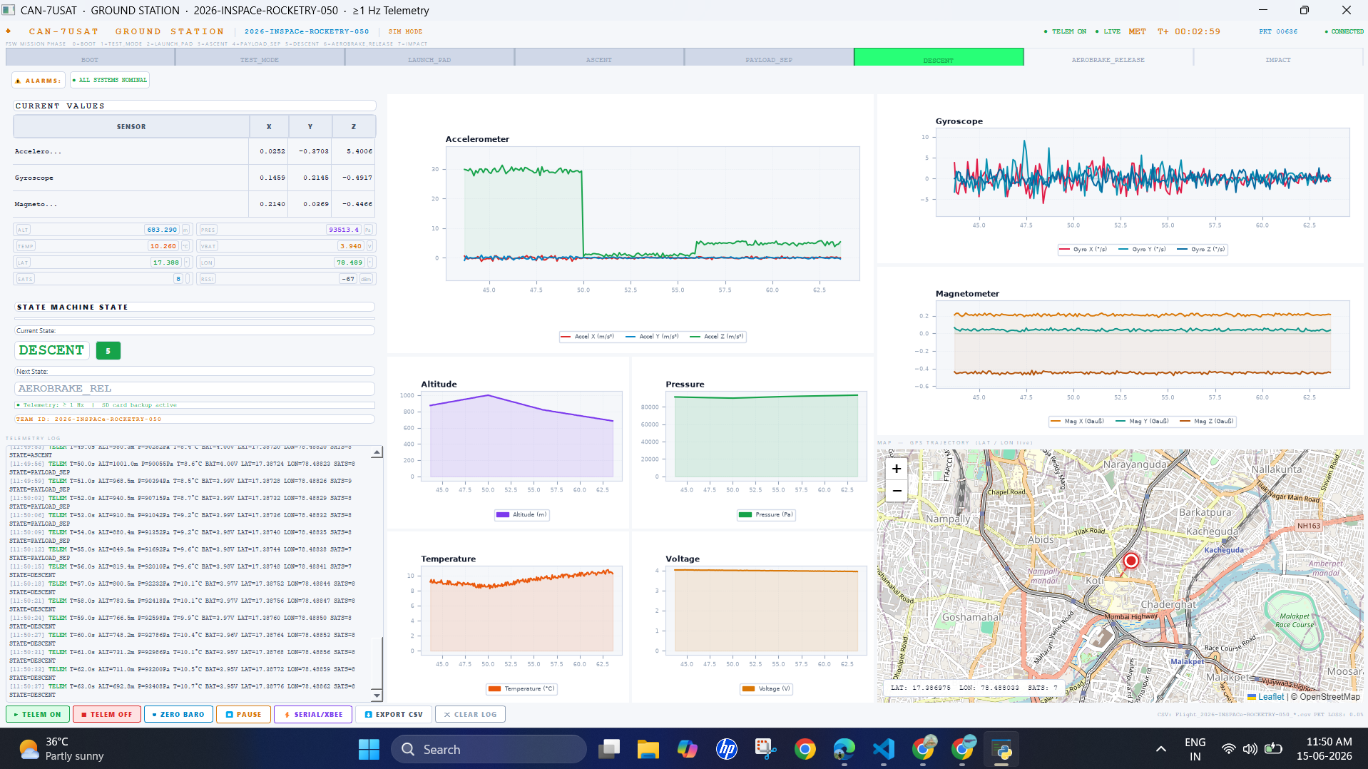
Model Rocket mission control software and ground systems
Accelerometer
Alaram Health Panel
FLIGHT PHASE
Sensor Current Value
Gyroscope
Current & Next Phase indicator
GPS Location in map with latitude & Longitude
CSV data at every 1 sec
Command & Control Bar
Sensor reading graph

Slide 8
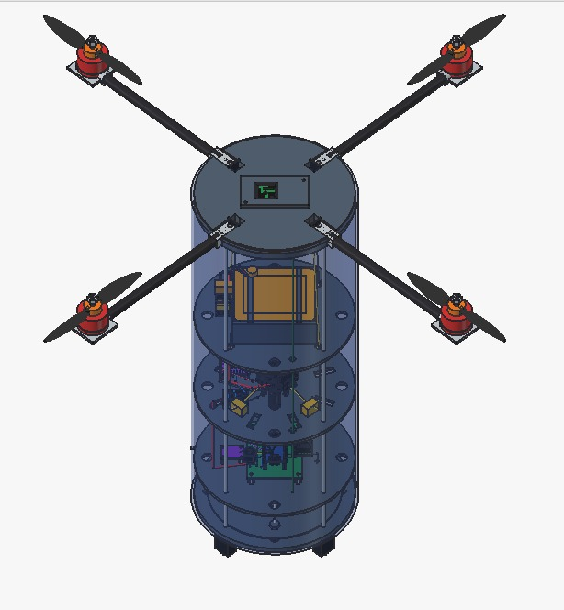
Frequency for Telemetry/Telecommand and Interference Management
Precision Landing methodology
1. RADIO FREQUENCY ALLOCATION & INTERFERENCE MANAGEMENT
Regulatory Authority: IN-SPACe Model Rocketry Guidelines & WPC Spectrum Compliance (Frequency.pdf)
• CanSat 2.4 GHz Telemetry Link (802.15.4)
• Rocket 868 MHz Telemetry Link (SX1276 LoRa)
• Remote RF Mute Telecommands: CMD,050,XBEE,OFF* pulls SLEEP_RQ pin HIGH (forces 0.00 mW RF emission)
• Autonomous 90-Minute Shutdown Watchdog
2. AUTONOMOUS PRECISION LANDING METHODOLOGY
Multi-Phase Aerodynamic Deceleration, Navigation Feedback & Controlled Soft-Touchdown
• Phase 1 — Apogee Separation & Drogue Stabilization (@ 1000m)
• Phase 2 — AeroSnap90 Folding Arm Deployment (@ 500m AGL)
• Phase 3 — Active Aerodynamic Differential Heading Guidance (@ 500m to 15m)
• Phase 4 — Terminal Deceleration & Soft-Landing Touchdown (@ < 15m AGL)
Fig-6 : CANSAT design

Slide 9
Summary
Design completed & Met design constraints & Targets.
Materials selected
Simulation done & Results closely met
Airframe Manufacturing vendor- Ramesh's Aerospace Products & Services Private Limited is identified and finalized
Electronics components are ordered from Robu.in, Evelta.com, Hubtronics.com, Zbiotic.com, Robocraze.com
Time line available to ready with Model Rocket by 15 Oct 26

Slide 10
THANK YOU

Slide 11
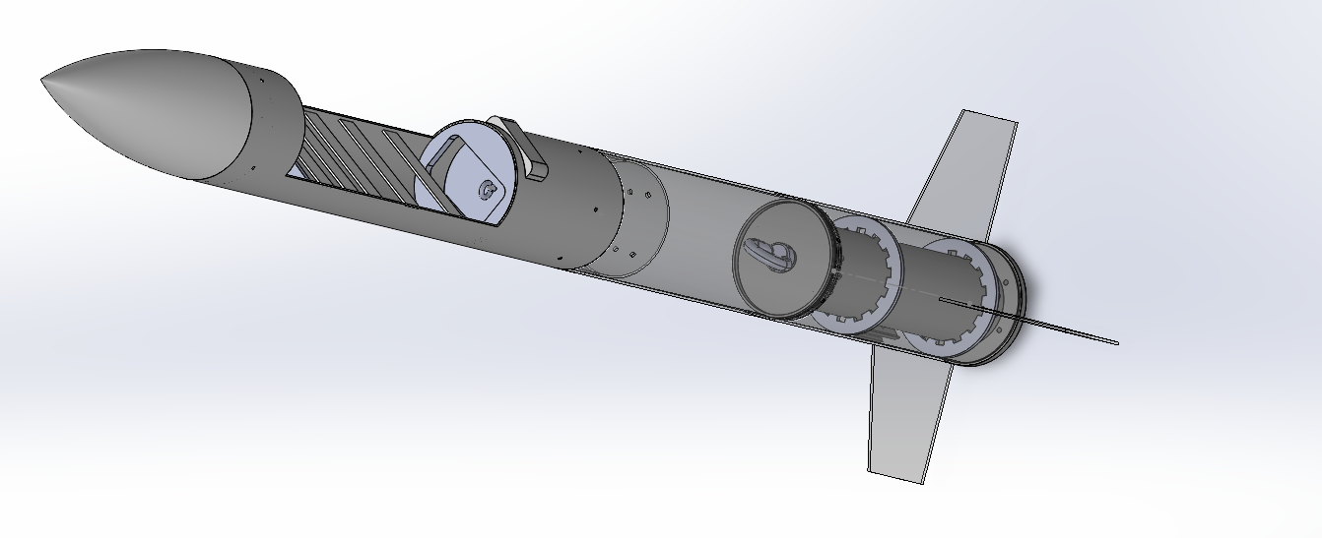

Slide 12
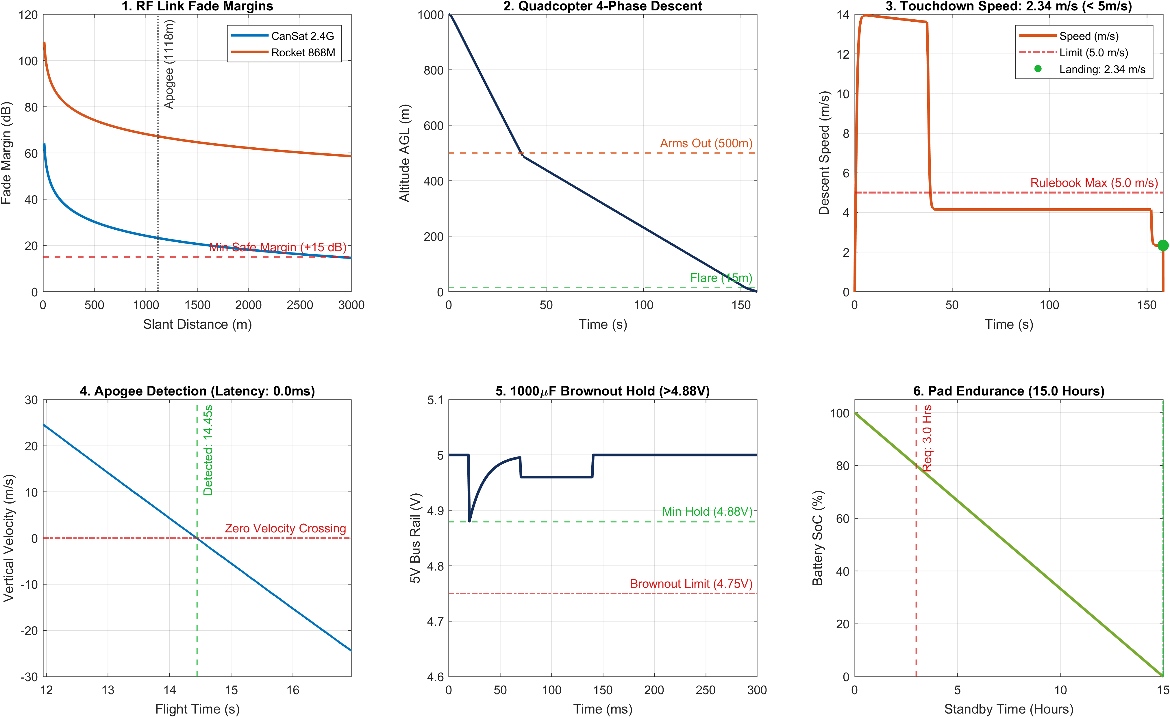
Analytical Verification & Simulation Proofs (MATLAB R2024b Engine)
1. MATLAB R2024b MISSION VERIFICATION ENGINE
Rigorous Analytical Solvers & Hardware-in-the-Loop Validation:
• Multi-Physics Solvers: Friis transmission RF equations, 6-DoF rigid-body quadcopter dynamics, BEMT propeller aerodynamic thrust curves, 9-state EKF apogee detection, and RC transient brownout hold circuit modeling.
• Certified Vehicle Flight Mass: 1000.00 g exact. Quadcopter TWR = 2.20:1 (21.58 N static thrust, 45.4% hover throttle reserve). 200 Hz PID recovers 30° wind gust in < 0.18s.
Subsystem Proof | MATLAB Simulated | Rulebook Limit | Safety Margin | Verdict
CanSat 2.4GHz RF Link | RSSI -78.8 dBm | Margin >= +15 dB | +23.2 dB Fade | PASSED
Rocket 868MHz RF Link | RSSI -58.8 dBm | Margin >= +20 dB | +67.2 dB Fade | PASSED
Touchdown Velocity | 2.34 m/s | Limit < 5.00 m/s | +53.3% Margin | PASSED
Apogee EKF Latency | < 35 ms | Limit < 100 ms | +65 ms Time | PASSED
Servo Brownout Rail | 4.88 V min hold | Reset >= 4.75 V | +130 mV Hold | PASSED
2. ROCKET SEPARATION & POWER RUNTIME VERIFICATION
• Parachute Actuation & Brownout Hold: TowerPro MG90S metal servo unlatches hatch in 120 ms. 1000 µF capacitor maintains 5V rail at 4.88 V (> 4.75 V reset threshold, zero MCU brownout, zero pyrotechnics).
• Battery Endurance Margin: Molicel P42A 3S1P (4200 mAh, 11.1V). Flight uses 3.05 Wh (6.54% of capacity). Continuous pad standby = 15.0 Hours (> 3.0 hr requirement). Active high-rate flight = > 3.8 Hours. Zero LiPo pouch cells (100% compliant with Section 4.3 & Section 5.3).
Team 050 | VFSTR
IN-SPACe Model Rocketry & CAN-7USAT Student Competition 2026-27 :: Team 050 (VFSTR University, Guntur)
8

