Slide 1
Music Genre Classification
KARTHEESWARI K
2019202024
III MCA R
PROJECT GUIDE : MS.R.L.JASMINE

Slide 2
About
Music Genre Recognition is an important field of research in Music Information Retrieval (MIR).
A music genre is a conventional category that identifies some pieces of music as belonging to a shared tradition or set of conventions, i.e. it depicts the style of music.

Slide 3
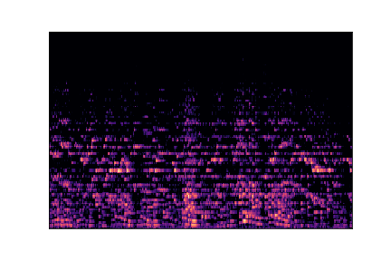
Datasets
GTZAN Genre Collection dataset was used to perform the classification.
Dataset consists of 1000 audio tracks each 30 seconds long. It contains 10 genres(Blues, Classical, Country, Disco, Hip-Hop, Jazz, Metal, Pop, Reggae and Rock), each represented by 100 tracks.

Slide 4
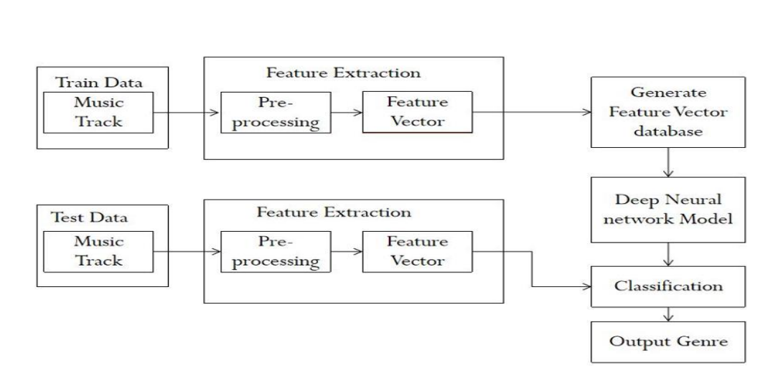
Architecture

Slide 5
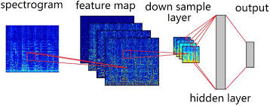
Convolutional Neural Network
CNN is a Deep Learning algorithm which can take an input image as input, assign importance to various aspects/objects in the image and be able to differentiate one from the other.
A CNN has various layer.

Slide 6
Technologies
Tools – Jupyter Notebook
Language – Python3
Libraries – Tensorflow,
Keras,
Scikit-Learn,
Tkinter,
Librosa,
Numpy,
Pandas,
Matplotlib.

Slide 7
THANK YOU!

