Slide 1
Azure Predictive Maintenance dataset
AGENTIC AI PREDICTIVE MAINTENANCE
A 7-agent, retrieval-grounded AI system that predicts equipment failure, explains its
diagnosis, and recommends action — built and validated on real historical failure data.
PROOF OF CONCEPT · CoBuildX Manufacturing AI Practice

Slide 2
THE PROBLEM
Equipment failures are still caught too late
100
real industrial machines in the benchmark dataset
Most plants run on reactive repair or fixed-schedule preventive maintenance — neither uses the early-warning signal already sitting inside the sensor data. The result: unplanned downtime, bigger repairs, and no data-driven way to decide which machine needs attention first.
761
real recorded failure events used for validation
1
Reactive
Fix after it fails — costliest and least predictable
0
2
Preventive
Fixed calendar schedule — services healthy machines, misses at-risk ones
simulated or invented data points anywhere in the pipeline
3
Predictive (this PoC)
Detects early warning signs, with real backtested lead time
Agentic AI Predictive Maintenance
2

Slide 3
THE SOLUTION
Predict. Investigate. Diagnose. Recommend. Decide.
A multi-agent AI system that monitors machine health, retrieves similar real historical failures as evidence, explains its diagnosis in plain language, recommends an action grounded in real repair history, and knows when to trust itself versus ask an engineer.
1
2
3
4
5
6
7
Predict
Investigate
Correlate
Diagnose
Recommend
Escalate
Validate
›
›
›
›
›
›
Which machine is at risk?
Sensor & error signatures
Similar past failures (RAG)
Likely component + evidence
Action from real repair history
Auto-route or human review
Backtested vs real outcomes
“Agentic AI orchestrating an existing predictive model, historical case evidence, and real repair history — not an LLM replacing the model.”
Agentic AI Predictive Maintenance
3

Slide 4
SYSTEM ARCHITECTURE
Seven agents. Each calls a dedicated tool.
Core design principle: the agent is the investigator, the ML/statistical model is a tool it calls — the LLM reasons and explains, it does not replace the predictive model.
1
Telemetry Health Agent
predict_failure_risk
Scores real-time failure risk from rolling sensor deviation
2
Prioritization Agent
get_failure_rate_stats
Ranks urgency using empirical MTBF-style failure statistics
3
Case Retrieval Agent
retrieve_similar_cases
Finds similar real historical failures (ChromaDB vector search)
4
Reasoning Agent
Claude (LLM)
Diagnoses likely component + confidence, grounded in evidence
5
Recommendation Agent
get_historical_maintenance_action
Suggests action from real repair/maintenance history
6
Decision & Routing Agent
confidence threshold
Auto-routes high confidence; escalates the rest to a human
7
Feedback / Evaluation Agent
check_against_ground_truth
Backtests predictions against real recorded failures
Agentic AI Predictive Maintenance
4

Slide 5
AGENTIC AI DESIGN
Tools compute. Agents decide.
Every agent wraps a plain function (the tool) and adds a layer of judgment on top — deciding when to call it, and what the result means for the next step in the chain.
TOOLS
AGENTS
Plain functions. No judgment, just computation.
Reasoning layer. Decide when, and what it means.
predict_failure_risk() — health score
Calls the tool for a given machine + date
get_failure_rate_stats() — MTBF lookup
Interprets the result into a next action
retrieve_similar_cases() — vector search
Hands its output to the next agent in the chain
get_historical_maintenance_action()
Adds accountability an LLM alone can't give
Agentic AI Predictive Maintenance
5

Slide 6
GENERATIVE AI · RAG
Diagnosis grounded in retrieved real evidence
Retrieval-Augmented Generation: instead of asking an LLM to guess from general training knowledge, the system retrieves real similar cases first — the LLM reasons only over that evidence.
1
Knowledge Library
761 real failure cases embedded in ChromaDB — each a plain-language summary of real sensor deviations
2
Structured + semantic retrieval
Filters on the query's own dominant sensor, then ranks by similarity — fixes a text-only-search bias found in testing
3
Claude reasons over evidence
Prompted with the retrieved cases only — cites which specific case supports its diagnosis
4
Confidence reflects evidence quality
Strong matches → high confidence; ambiguous evidence → the model says so and lowers confidence
Real diagnosis output — Machine 1, comp4, 85% confidence:
“The four most similar historical cases (Cases 1–4) all experienced comp4 failures with vibration patterns closely matching the current state… the strong pattern match outweighs the base-rate statistics in this instance.”
Agentic AI Predictive Maintenance
6

Slide 7
TECHNOLOGY STACK
Built end-to-end, orchestration to interface
ORCHESTRATION
REASONING LLM
VECTOR STORE / RAG
ML / STATISTICS
LangGraph
Claude (Anthropic API)
ChromaDB
pandas, scikit-learn
Wires all 6 agents into one automated state-machine pipeline
Grounded diagnosis, confidence scoring, plain-language explanation
761-case Knowledge Library; structured + semantic retrieval
Health scoring, MTBF stats, logistic-regression weight learning
BACKEND API
FRONTEND
RAPID PROTOTYPING UI
VERSION CONTROL
FastAPI
React + Vite
Streamlit
Git + GitHub
Serves the pipeline as web endpoints for the dashboard
Date-based ranked risk list, full diagnosis on click
Backup single-file demo interface
Full commit history — every fix and finding traceable
Agentic AI Predictive Maintenance
7

Slide 8
VALIDATION · NOT A SIMULATED DEMO
Backtested against real recorded failures
Health-scoring tool tested on 740 real failures + 300 genuinely healthy periods — 1,040 real cases, zero simulated inputs.
94.7%
93.6%
1,040
100%
RECALL
PRECISION
TEST CASES
BATCH ACCURACY
Catches nearly all real failures with 24h advance warning
Flagged risks are genuine risks — minimizes false alarms
740 real failures + 300 real healthy periods
5-machine automated LangGraph batch test, post-fix
“Prioritization driven by empirical failure-rate statistics, diagnoses grounded in retrieved real cases, recommendations grounded in real repair history, predictions backtested against actual outcomes.”
Agentic AI Predictive Maintenance
8

Slide 9
ENGINEERING RIGOR
Real bugs found, root-caused, and fixed
Every fix below was verified with a before/after re-test on real data — not assumed to work.
Missing-data guard
Found: Machine showed a confident diagnosis built on NaN sensor values
Fixed: Added validation guard — returns “insufficient data” instead of guessing
Retrieval magnitude bias
Found: Text search couldn't tell “voltage 12%” from “voltage 1%” — comp1/comp3 never surfaced
Fixed: Added a dominant_sensor structured filter, computed from real numbers
Merge-order bias
Found: Correctly filtered matches were still outranked by irrelevant broad-search results
Fixed: Fixed merge priority — accuracy on test set rose from 50% to 100%
Agentic AI Predictive Maintenance
9

Slide 10
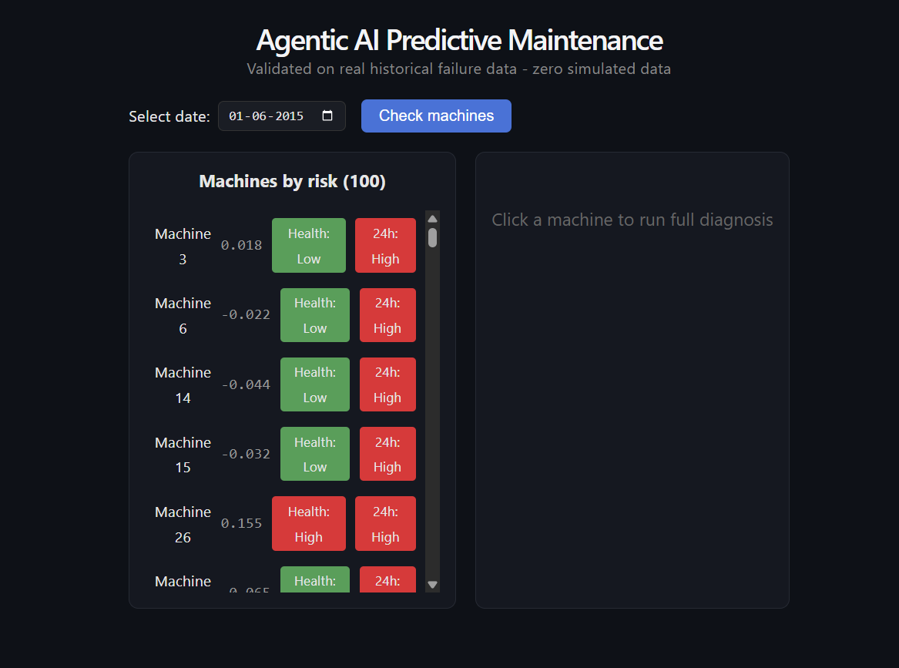
LIVE DEMO
Pick a date. See every machine, ranked by risk.
Health risk
Real-time sensor deviation from this machine's own normal baseline
24h failure probability
This machine's own historical failure pattern — how likely it fails in the next 24 hours
Sorted by real urgency
List ordered by actual failure probability, not just current symptoms
React + FastAPI — built on the same validated pipeline, no separate logic.
Agentic AI Predictive Maintenance
10

Slide 11
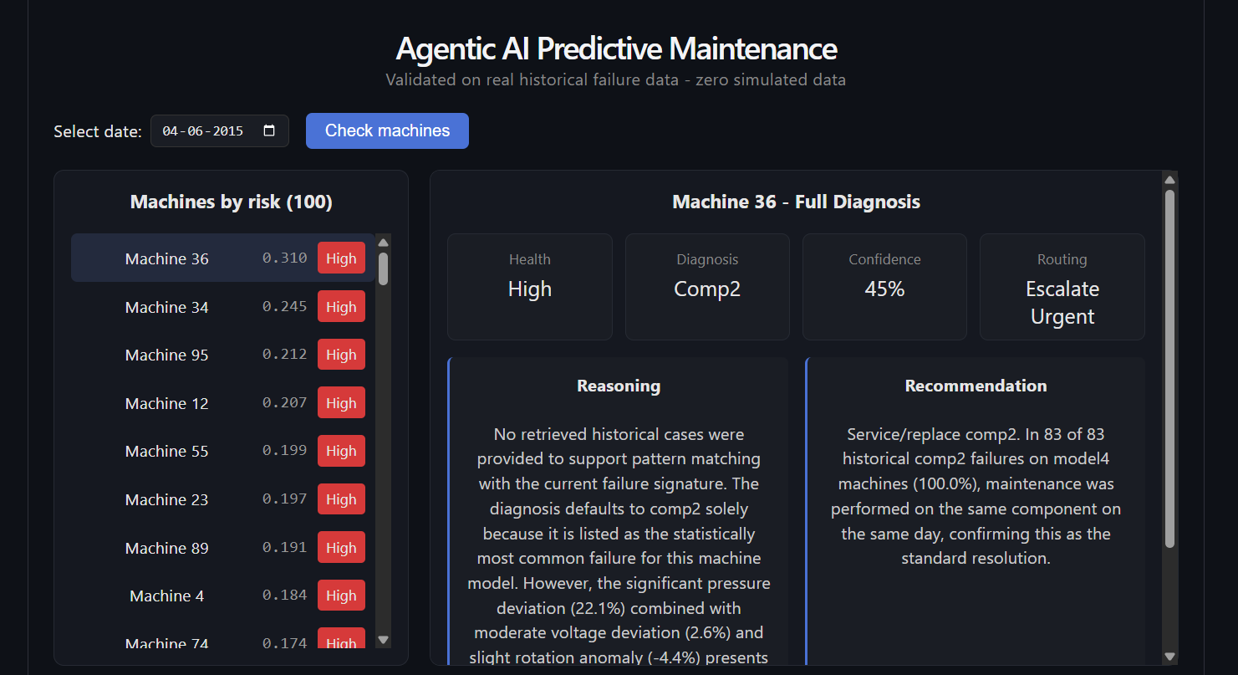
LIVE DEMO
Click a machine. Get the full agentic reasoning chain.
Diagnosis + confidence
Likely failing component, with a confidence score the routing logic can act on
Reasoning
Plain-language explanation citing the specific retrieved cases behind it
Recommendation
Action grounded in how similar past failures were actually resolved
Routing
Auto-route, engineer review, or urgent escalation — by confidence
Agentic AI Predictive Maintenance
11

Slide 12
HONEST EVALUATION
What's proven, and what's a known limitation
PROVEN
KNOWN LIMITATIONS
✓
MTBF-driven prioritization, from real failure gaps
!
Ambiguous dual-signal cases can still produce a confident wrong diagnosis
✓
Diagnoses grounded in retrieved real historical cases
!
Sensor telemetry, not raw vibration/acoustic waveform — no true NVH signal processing
✓
Recommendations grounded in real repair records
!
Reflects which component failed, not the physical root cause/mechanism
✓
94.7% recall / 93.6% precision, rigorously backtested
!
On-demand checks today — continuous monitoring & alerting not yet built
✓
Zero simulated data anywhere in the pipeline
!
A validated solution today, not yet a repeatable multi-client product
Agentic AI Predictive Maintenance
12

Slide 13
WHAT'S NEXT
From validated PoC to pilot-ready system
1
2
3
4
Continuous monitoring
Remaining Useful Life (RUL)
Learned sensor weighting
Plant pilot
Move from on-demand checks to an always-on agent that watches every machine and alerts automatically
A real time-to-failure estimate, not just a risk category — same dataset, a regression model
Adopt data-derived sensor weights (validated, ready) in place of equal weighting
Real sensor integration, site-specific criticality, validated on that plant's own failure history
Positioning today: a validated forward-deployed solution. A few paid pilot engagements establish repeatability before productizing.
Agentic AI Predictive Maintenance
13

Slide 14
Built. Tested. Validated.
7 agents · 94.7% recall / 93.6% precision · 3 real bugs found and fixed · a working demo
Questions & discussion
Agentic AI Predictive Maintenance
14

