Slide 1
Introduction to HTML

Slide 2
What is HTML?
HTML is the standard markup language for creating Web pages.
HTML stands for Hyper Text Markup Language
HTML describes the structure of Web pages using markup
HTML elements are the building blocks of HTML pages
HTML elements are represented by tags
HTML tags label pieces of content such as "heading", "paragraph", "table",...
Browsers do not display the HTML tags, but use them to render the content of the page

Slide 3
An Example
A paragraph is your content
Putting your content into an HTML tag to make it look like a paragraph is structure
<p>This is the content</p>

Slide 4
HTML Elements and Tags
An element is an individual component of HTML
paragraph, image, header,...
an element name indicates its purpose: p for paragraph
A tag marks the beginning and the end of an HTML element
Opening tag and Closing Tag
<tagname>Stuff in the middle</tagname>

Slide 5
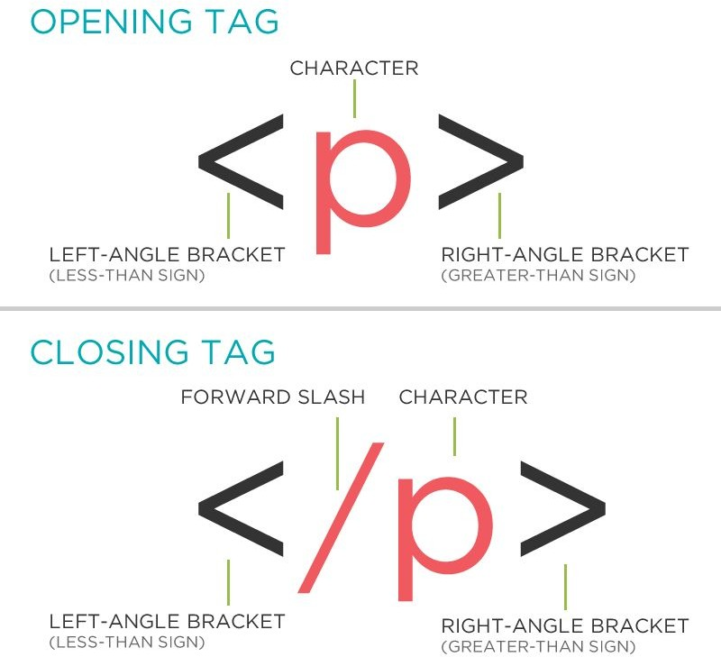
HTML Tag Breakdown
Taken from http://girldevelopit.github.io/gdi-featured-html-css-intro/class1.html#/16

Slide 6
Anatomy of an HTML element
Container Element
An element that can contain other elements or content
A paragraph (<p>content</p>) contains text
Stand Alone Element
An element that cannot contain anything else
- <br/>, <img/>

Slide 7
Anatomy of an HTML element
Attribute
Provides additional information about the HTML element
Class, ID, language, style, identity, source
Placed inside an opening tag, before the right angle bracket.
Value
Value is the value assigned to a given attribute.
Values must be contained inside quotation marks.
<img src="my_picture.jpg" />

Slide 8
HTML Page Structure
<!DOCTYPE html>
<html>
<head>
</head>
<title>My title</title>
<body>
<h1>My heading</h1>
<p>My paragraph</p>
<img src="my_src"\>My image
</body>
</html>

Slide 9
<!DOCTYPE>
The <!DOCTYPE> declaration represents the document type, and helps browsers to display web pages correctly.
It must only appear once, at the top of the page (before any HTML tags).
The <!DoCtYpE> declaration is not case sensitive.
The <!DOCTYPE> declaration for HTML5 is <!DOCTYPE html>

Slide 10
<html>,<head>,<body>
After <!doctype>, the page content must be contained between <html> tags.
The head contains the title of the page & meta information about the page. Meta information is not visible to the user, but has many purposes, like providing information to search engines.
The body contains the actual content of the page. Everything that is contained in the body is visible to the user. (Some Exceptions!)

Slide 11
Let's create our first HTML page
open a new file in your text editor and copy this code in it:
<!DOCTYPE html>
<html>
<head>
<title>Title of the page </title>
</head>
<body>
The page content here.
</body>
</html>
save the document as myfirstpage.html and open it with a browser.

Slide 12
Nesting
All elements "nest" inside one another
Nesting is what happens when you put tags inside other containing tags.
For example, you would put the <p> inside of the <body> tags. The <p> is now nested inside the <body>
<body>
<p>The paragraph goes here.</p>
</body>
Whichever element OPENS first CLOSES last

Slide 13
Headings
HTML headings are defined with the <h1> to <h6> tags.
<h1> defines the most important heading. <h6> defines the least important heading
<h1>This is heading 1</h1>
This is heading 1
This is heading 2
This is heading 3
This is heading 4
This is heading 5
This is heading 6

Slide 14
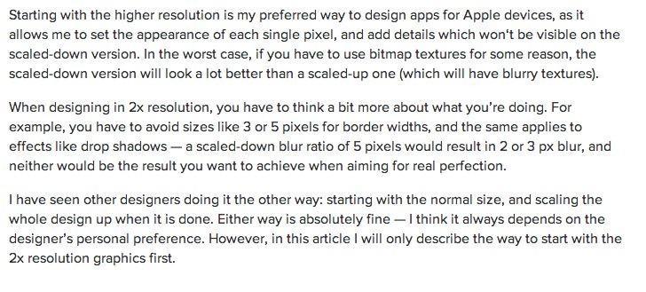
Paragraphs
HTML paragraphs are defined with the <p> tag:
<p>This is a paragraph</p> <p>Paragraph 2</p>

Slide 15
The Poem Problem and Line Breaks
This poem will display in a single line:
<p>
My Bonnie lies over the ocean. My Bonnie lies over the sea.
My Bonnie lies over the ocean. Oh, bring back my Bonnie to me.
</p>
The browser will remove any extra spaces and extra lines when the page is displayed
The <br> element defines a line break without starting a new paragraph.
<p>
My Bonnie lies over the ocean. <br> My Bonnie lies over the sea. <br> My Bonnie lies over the ocean. <br> Oh, bring back my Bonnie to me.
</p>

Slide 16
Preformatted Text
The HTML <pre> element defines preformatted text.
The text inside a <pre> element is displayed in a fixed-width font (usually Courier), and it preserves both spaces and line breaks.
<pre>
My Bonnie lies over the ocean. My Bonnie lies over the sea.
My Bonnie lies over the ocean. Oh, bring back my Bonnie to me.
</pre>
This will be shown correctly with line breaks preserved.

Slide 17
Formatted Text
<p>
Here is a paragraph with <em>emphasized</em> text and <strong>important</strong> text.
</p>
<p>
Here is another paragraph with <i>Italic</i> text and <b>Bold</b> text.
</p>
Here is a paragraph with Emphasized text and Important
text.
Here is another paragraph with Italic text and Bold text.

Slide 18
Formatted Text
<p>Here is a <mark>highlighted</mark> text and this is <small>smaller</small> text.</p>
Here is a text and this is smaller text.
Highlighted
<p>Here is <del>some deleted</del> text and this is <ins>some inserted</ins> text.</p>
Here is some deleted text and this is some inserted text.
<p>This is <sup>superscripted</sup> text and this is <sub>subscripted</sub> text.</p>
Here is ^{superscripted} text and this is _{subscripted} text.

Slide 19
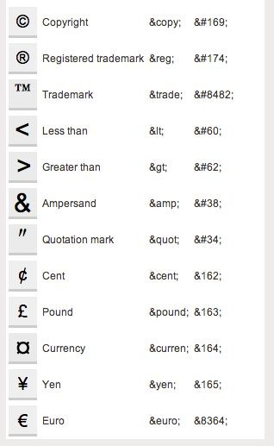
Character Codes
Many mathematical, technical, and currency symbols, are not present on a normal keyboard.
To add such symbols to an HTML page, you can use an HTML entity name or code.
One character that I use most is &nbsp; See here for a complete list

Slide 20
Links
HTML links are defined with the <a> tag
The link's destination is specified in the href attribute.
target attribute specifies where to open the linked document(_self,_blank,...)
<a href="http://www.google.com" target="_blank">This is a link to Google!</a>
This is a link to Google!

Slide 21

Images
HTML images are defined with the <img> tag.
The source file (src), alternative text (alt), width, and height are provided as attributes.
<img src="fsu-logo.jpg" alt="FSU Logo" width="104" height="142">

Slide 22
Relative vs. Absolute paths for links & Images
Relative paths change depending upon the page the link is on
Links within the same directory need no path information. "filename.jpg"
Subdirectories are listed without preceding slashes. "img/filename.jpg"
Absolute paths refer to a specific location of a file, including the domain
Typically used when pointing to a link that is not within your own domain.
http://one.fsu.edu/alumni/image/community/clubs/FSU-Seal-full-color.jpg

Slide 23
Lists
Unordered list (bullets)
<ul>
<li>List Item</li>
<li>Another List Item</li>
</ul>
List Item
Another List Item
Ordered list (sequence)
<ol>
<li>List Item</li>
<li>Another List Item</li>
</ol>
List Item
Another List Item

Slide 24
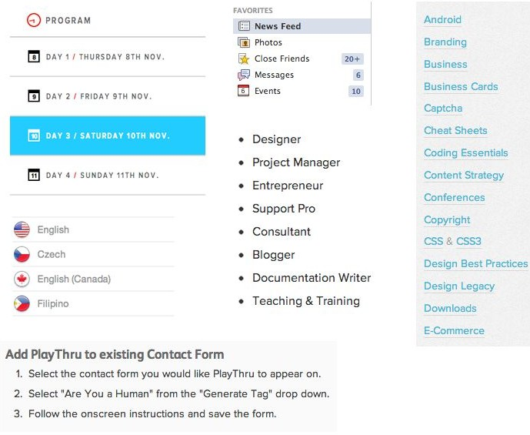
Lists
Lists are used everywhere and can be customized to look as you want

Slide 25

Tables
Tables are a way to represent complex information in a grid format.
<table>
<tr>
<th>Head</th>
<th>Head</th>
</tr>
<tr>
<td>Data</td>
<td>Data</td>
</tr>
</table>
Tables are made up of rows and columns.

Slide 26
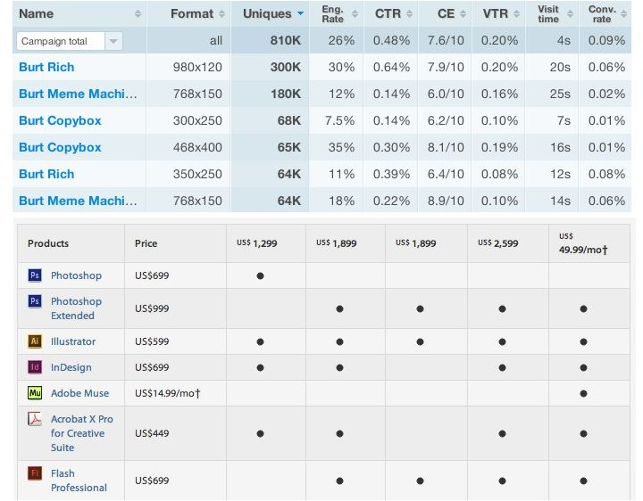
Tables
Tables can be styled with CSS to add zebra striping or to highlight important rows/columns.
Extra functionality can be added to tables like filtering or sorting rows and columns.

Slide 27
Comments
You can add comments to your code that will not be seen by the browser, but only visible when viewing the code.
Comments can be used to:
organize your code into sections
'comment out' large chunks of code to hide it from the browser.
<!-- Beginning of header -->
<div id="header">Header Content </div>
<!-- End of header -->

