Slide 1
BOOSTING
Definition:
Boosting is an ensemble learning method that combines a set of weak learners into a strong learner to minimize training errors. Boosting algorithms can improve the predictive power of your data mining initiatives.
In boosting, a random sample of data is selected, fitted with a model and then trained sequentially—that is, each model tries to compensate for the weaknesses of its predecessor. With each iteration, the weak rules from each individual classifier are combined to form one, strong prediction rule.

Slide 2
TYPES OF BOOSTING:
Adaptive boosting or AdaBoos
Extreme gradient boosting or XGBoost
LG or light Boost

Slide 3
Adaptive boosting or AdaBoos
An AdaBoost [1] regressor is a meta-estimator that begins by fitting a regressor on the original dataset and then fits additional copies of the regressor on the same dataset but where the weights of instances are adjusted according to the error of the current prediction. As such, subsequent regressors focus more on difficult cases.
The function name to use in algorithm:
from sklearn.ensemble import AdaBoostRegressor

Slide 4
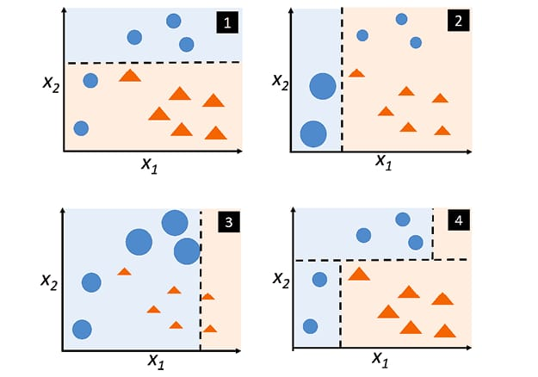
The working process of ada boost:-

Slide 5
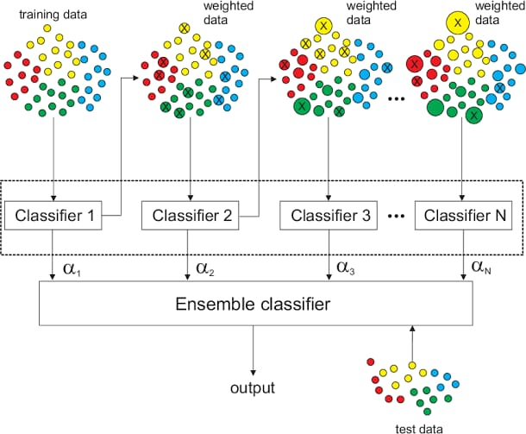

Slide 6
Advantages of Ada boost:
AdaBoost can effectively combine multiple weak classifiers to create a strong classifier with high accuracy.
It can handle complex datasets and capture intricate patterns by iteratively adapting to difficult examples.
AdaBoost is versatile algorithm that can work with different types of base classifiers, allowing flexibility in modelling.

Slide 7
Disadvantages of Ada boost:
AdaBoost can be sensitive to outliers and noisy data, negatively impacting its performance.
The training process of AdaBoost can be computationally intensive, especially when dealing with large datasets or a large number of weak classifiers.
AdaBoost may struggle with imbalanced datasets where one class has significantly more samples than the other. Additional techniques.

Slide 8
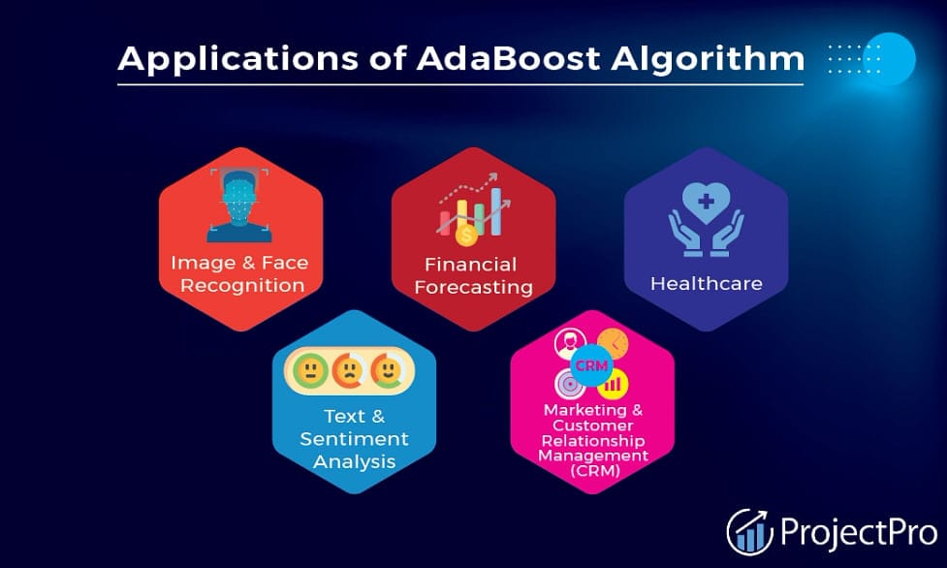
Application of adaBoost:-

Slide 9
Extreme gradient boosting or XGBoost​:-
XGBoost is an optimized distributed gradient boosting library designed to be highly efficient, flexible and portable. It implements machine learning algorithms under the Gradient Boosting framework. XGBoost provides a parallel tree boosting that solve many data science problems in a fast and accurate way.
The function name to use in algorithm:-
Import xgboost

Slide 10
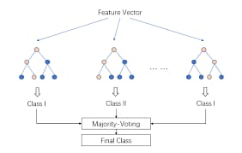
The working process of XGBoost:-

Slide 11
Advantages of XGBoost:
Efficiency: It’s fast to execute and can handle large datasets efficiently.
Handling missing data: XGBoost can handle missing data effectively, which is crucial in real-world scenarios where data may be incomplete.
Better testing error: Boosting takes slower steps, leveraging patterns in residuals to strengthen the model with weak predictions.

Slide 12
Disadvantages of XGBoost:
Sensitivity to outliers: It’s essential to handle outliers before fitting the model
Complexity: However, libraries like SHAP can help interpret the model.
Risk of overfitting: Proper tuning is necessary to avoid this issue

Slide 13
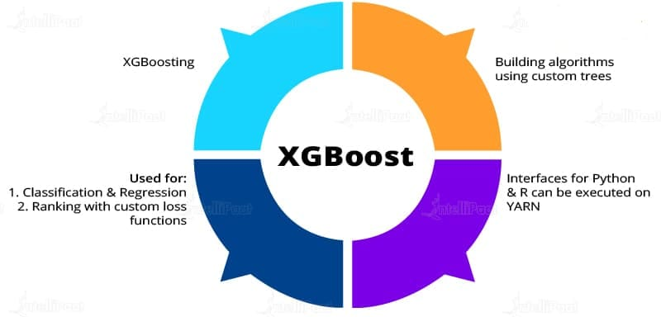
Application of XGBoost:-

Slide 14
LG or light Gradient Boost:
LightGBM is a gradient boosting ensemble method that is used by the Train using AutoML tool and is based on decision trees.
As with other decision tree-based methods, lightGBM can be used for both classification and regression.

Slide 15
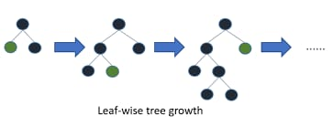
Working process of LightGBM:-

Slide 16
Advantages of lightGB:-
Compatibility with Large Datasets.
Better accuracy than any other boosting algorithm.
Lower memory usage.
Faster training speed and higher efficiency.

Slide 17
Disadvantages of LightGB:-
Overfitting: Light GBM split the tree leaf-wise which can lead to overfitting as it produces much complex trees.
Compatibility with Datasets: Light GBM is sensitive to overfitting and thus can easily overfit small data.

Slide 18
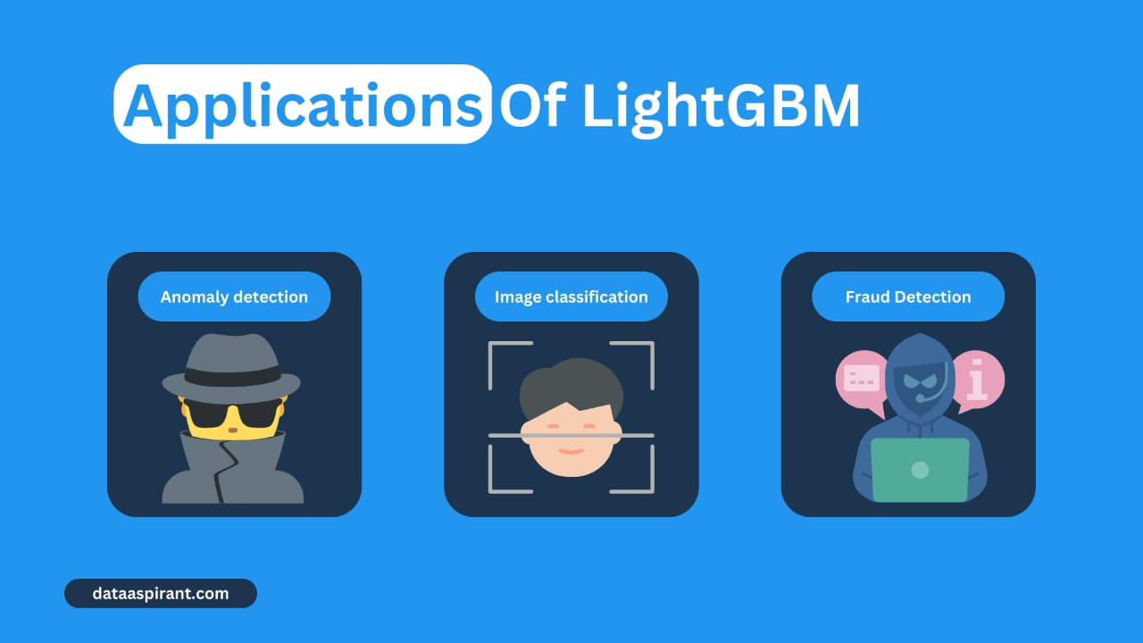
Application of LightGB:-

