Slide 1

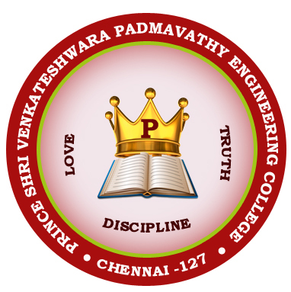
PRINCE SHRI VENKATESHWARA PADMAVATHY ENGINEERING COLLEGE
Department of Electronics and Communication Engineering
Title : Smart reading tech for visually Impaired
using OCR method
TEAM: THE MAVERICKS
Jeevanandhan E
Deepak G
Muthuselvan J

Slide 2
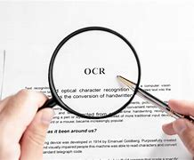
ABSTRACT- One of the largest limitations facing humanity is visual impairment, particularly in this day and age where text messages (electronic and paper-based) dominate communication over voice. Our suggested device is meant to aid those who are visually impaired. In this project, we created a tool that speaks the text from an image. The fundamental building block is an embedded system that takes a picture, isolates the region of interest (i.e., the part of the picture with text), and then speaks the text. The Raspberry Pi and Raspberry Pi camera are used to implement it. The acquired image goes through a series of image pre-processing procedures to find and eliminate only the text-containing areas of the image. They are OCR (Optical Character Recognition) software and TTS (Text-to-Speech) engines. The audio output is heard through the raspberry pi’s audio jack using speakers or earphones.

Slide 3
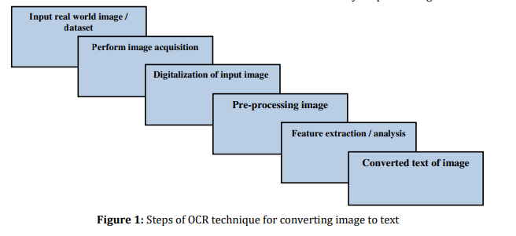
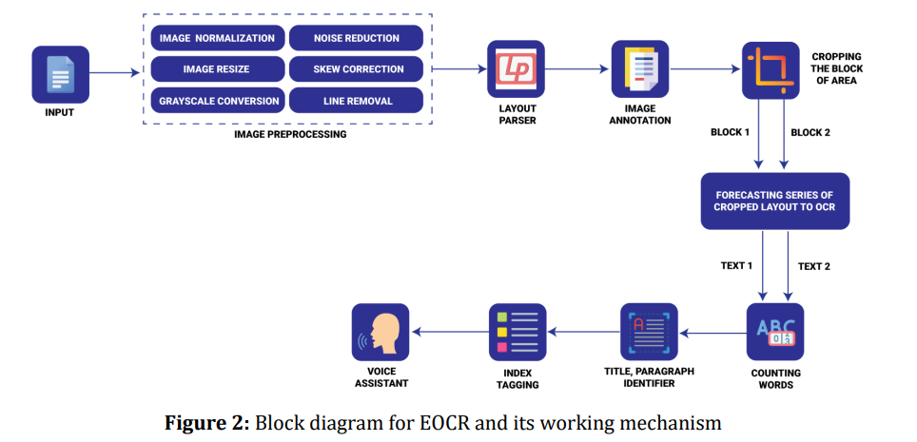
The image is adjusted to improve quality locates where text is in the image.
Separate Characters: If needed, connected characters are split.
Recognize Characters: OCR tries to figure out what each character is.
Clean up and Correct: Errors are fixed and language rules are applied.
Format Text: If there are bullet points, they're recognized and organized.
Get Text Output: The recognized text is provided in a usable format.

Slide 4
Focus and Problem Statement | Methodology | Key Findings | Objective
The first research paper primarily focuses on the development and evaluation of an Enhanced Optical Character Recognition (EOCR) algorithm to aid visually impaired individuals in reading text-based content. | Utilizes a Enhanced Optical Character Recognition (EOCR) algorithm. | EOCR algorithm outperformed traditional OCR in terms of accuracy, precision, and sensitivity. | Enhance reading for the visually impaired.
Focuses on the development of a device that converts images containing text into speech for the visually impaired. | Raspberry Pi and camera, OCR software, Text-to-Speech engines. | A device that converts image text to speech with a focus on practical implementation | Assist visually impaired individuals in reading text-based content.
. "Low-Cost Smart Glasses for Blind Individuals using Raspberry Pi 2" discusses the design of low-cost smart glasses for blind individuals using Raspberry Pi, combining object and text detection. | Raspberry Pi 2, YOLOv3 (object detection), OCR (text detection).. | Successful object and text detection using Raspberry Pi 2, with reliability and error rates reported. | Develop low-cost smart glasses for blind individuals.
. Text-To-Speech Device for Visually Impaired People" presents a device that scans and reads various text formats aloud for people with visual impairments | . Successful object and text detection using Raspberry Pi 2, with reliability and error rates reported | A device capable of processing various text inputs into voice with low error rates and processing time.. | Create a text-to-speech device for visually impaired people.
Handwritten Optical Character Recognition (OCR): provides a systematic review of research on character recognition of handwritten documents | Review of various OCR and AI/ML methods. | A comprehensive review of OCR research and identification of research directions | Summarize and analyze existing research on handwritten OCR and provide research directions.

Slide 5
CONCLUSION:
In conclusion, the reviewed journal papers highlight the significance of Smart glasses for visually Impaired in addressing the critical issue of visual impairment. They emphasize the use of advanced technologies, Optical Character Recognition (OCR), Raspberry pi to improve accuracy and realtime reading. These findings offer valuable insights for Visually impaired for reading purposes.
THANK YOU...!

