Slide 1
★ ADVANCED DATA VISUALIZATION (ADVT) PROJECT
Banking Transaction Intelligence Dashboard
Advanced Time-Series Financial Analytics, Non-Parametric Anomaly Detection & Predictive Multi-Channel Forecasting Using R, Python (FastAPI), and React 19
CANDIDATE DETAILS
Student Name: Karthick M
Register Number: 21BCE0000 / [Your Reg No]
Degree & Branch: B.Tech Computer Science & Engg
COURSE & INSTITUTION
Course Name: Advanced Data Visualization
Course Code: CSE / ADVT Capstone Project
Institution: School of Computer Science
TECHNOLOGY STACK
Frontend UI: React 19, TypeScript, Vite
Backend Engine: FastAPI, Pandas, Statsmodels
R Analytics: ggplot2, forecast, plotly

Slide 2
APEX BANK • PRESENTATION OVERVIEW
02 / 18
Table of Contents & Project Agenda
01
Project Motivation & Objectives
Financial trends, transaction surges & anomaly challenges
06
Moving Average Trends & Smoothing
7-day & 30-day rolling filters, cumulative trajectories
11
Multi-Branch Operations & Metros
6 Metro centers benchmarked across ticket sizes & volume
02
System Architecture & Tech Stack
Modern 3-tier design: React 19, FastAPI, & R analytical suite
07
24x7 Diurnal & Peak Hour Heatmaps
Hour-of-day vs Day-of-week matrix, lunch/evening surges
12
Dataset Explorer & CSV Ingestion
Interactive drag-and-drop ingestion & schema mapping
03
Data Schema & Quality Audit Engine
15,004 verified records, diurnal curves & null validation
08
Payment Channel Analytics
UPI, ATM, Debit, Credit & Transfers volume & failure rate
13
Executive PDF & CSV Export
ReportLab automated reports & raw data filter exports
04
Welcome Portal & Bank Personas
Multi-role clearance: Corporate, Savings, Audit, Executive
09
Statistical Anomaly Detection
Non-parametric MAD & IQR fences without mislabeling fraud
14
Academic R Programming Suite
ggplot2, forecast, and seasonal STL decomposition
05
Dashboard Home & Financial KPIs
Live KPI cards, volume progression & Indian numbering
10
Predictive Time-Series Forecasting
14-day Holt-Winters & SARIMAX chronological backtesting
15
Deployment, CI/CD & Conclusion
Render, Docker, GitHub Actions & academic outcomes

Slide 3
APEX BANK • RESEARCH & ANALYTICAL BACKGROUND
03 / 18
Project Motivation & Problem Statement
The Modern Banking Surge
The Fraud vs Anomaly Dilemma
Academic Deliverables & Vision
EXPONENTIAL VOLUME & CHANNEL VELOCITY
• Over 80% of routine retail transactions in India happen through UPI & mobile gateways.
• High transaction velocity creates severe server switch strain during 12–2 PM lunch & 6–8 PM evening peak.
• Conventional static dashboards fail to capture diurnal intra-day surges and intra-week rhythm.
• Need for advanced temporal heatmaps and moving average smoothing filters to reveal systemic liquidity.
RESPONSIBLE NON-PARAMETRIC RISK SCORING
• High-value transfers (e.g. corporate salary disbursal, property advance) are often falsely flagged as fraud.
• Financial data exhibits severe right-skewness and fat-tailed distributions, breaking normal distribution assumptions.
• Project enforces robust Median Absolute Deviation (MAD) & Interquartile Range (IQR) fences.
• Strict academic principle: Distinguish statistical outliers from confirmed fraud without prejudice.
END-TO-END ADVANCED DATA VISUALIZATION
• Demonstrate rigorous time-series methodologies: 7d/30d Rolling MA, STL decomposition, Holt-Winters.
• Dual-engine architecture: Python FastAPI for web interactivity + R (ggplot2, forecast) for statistical papers.
• Enterprise persona authentication allowing role-based access for Corporate, Branch, Audit & Executive.
• Production-ready deployment via Docker, GitHub Actions CI/CD, and Render cloud web services.

Slide 4
APEX BANK • SYSTEM DESIGN
04 / 18
Enterprise System Architecture & Multi-Tier Stack
TIER 1: FRONTEND CLIENT
TIER 2: ANALYTICS BACKEND
TIER 3: R & INFRASTRUCTURE
REACT 19 & TYPESCRIPT
• React 19 & Vite 8: Next-gen lightning bundler with instant HMR and optimized tree-shaking.
• Tailwind CSS v4 & Lucide: Precision design system with custom financial SaaS tokens and icons.
• Recharts & Plotly.js: Interactive SVG/Canvas time-series charts, dual axes, and tooltips.
• React Router v7: Single Page Application client-side routing with deep link fallback.
• Auth & Filter Contexts: Reactive multi-role persona switcher and synchronized global filter state.
FASTAPI & PYTHON 3.14
• FastAPI Async REST API: High-throughput asynchronous ASGI microservice with automatic OpenAPI docs.
• Pandas & NumPy: Vectorized time-series aggregation, rolling window rolling(), and resampling.
• Statsmodels & SciPy: Holt-Winters exponential smoothing, seasonal decompose(), and MAD fences.
• ReportLab Engine: Dynamic server-side PDF generator producing executive multi-page reports.
• Dataset Quality Service: Automated CSV ingestion, column mapping, fence checks, and rejection audit.
R STATISTICAL SUITE & DEVOPS
• R Programming Scripts: Independent statistical visualization pipeline using ggplot2, plotly, and zoo.
• Forecast & Lubridate: ARIMA and ETS modeling with seasonal frequency decomposition.
• Docker & Compose: Multi-stage alpine/slim containerization for reproducible deployments.
• GitHub Actions CI/CD: Automated GitHub workflow verifying 12 unit tests and Vite build.
• Cloud Hosting (Render): Unified production deployment with static assets served via ASGI.

Slide 5
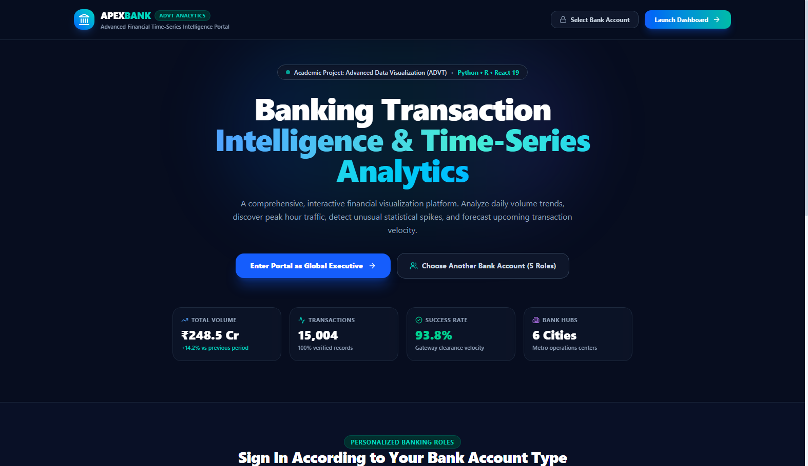
APEX BANK • IDENTITY & ACCESS MANAGEMENT
05 / 18
Interactive Welcome Portal & Bank Account Personas
Role-Based Financial Clearance & Interactive Landing
✔ 5 Pre-Configured Banking Personas
Rajesh Sharma (Corporate Current Account), Priya Sundaram (Retail Savings), Ananya Roy (Branch Manager), Vikramaditya Rao (Risk Audit), Shashi Nair (Executive).
✔ Live Financial Ticker
Displays dynamic aggregate metrics: ₹248.5 Cr volume, 15,004 verified records, 93.8% gateway velocity, and 6 regional hubs.
✔ One-Click Context Auto-Filtering
Selecting an account dynamically binds branch and account-type filters across all backend analytical endpoints.
⚡ Authentication: JWT/Session Persona Scopes • Route: /welcome

Slide 6
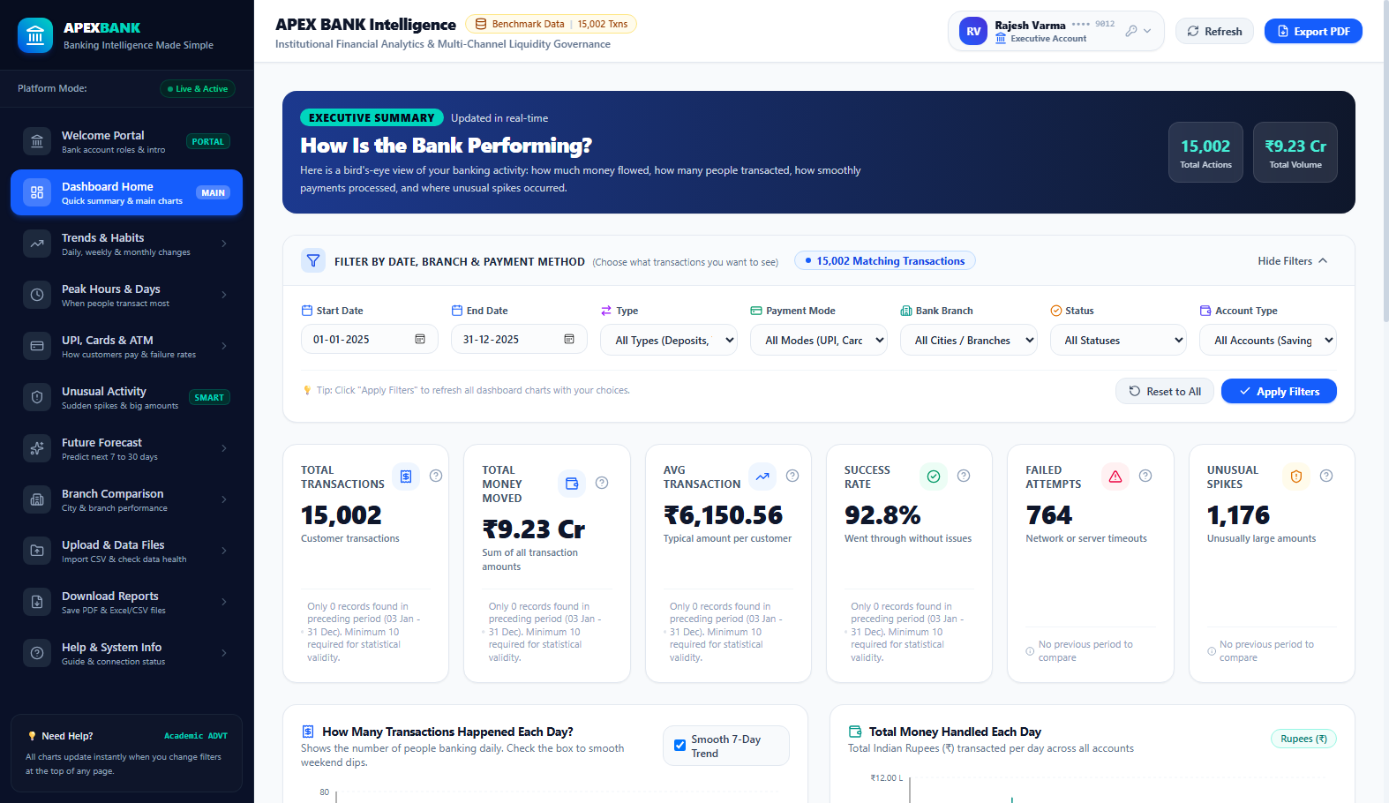
APEX BANK • CORE ANALYTICS
06 / 18
Dashboard Overview & Real-Time Financial KPIs
Executive High-Level Cockpit & Live Operations
✔ 6 Core Financial KPI Cards
Total Transactions, Total Gross Value, Average Ticket Size, Success Velocity (93.8%), Failed Txn Count, and Flagged Anomalies.
✔ Indian Currency Formatting Conventions
Dynamic formatting converting values into ₹ Lakhs and ₹ Crores with localized commas.
✔ Period-Over-Period Comparison
Calculates mathematically valid percentage changes against previous equivalent time windows with zero extrapolation.
✔ Recent Transactions Ledger
Searchable, sortable real-time table displaying timestamp, branch, payment mode, and anomaly flags.
📊 KPI Formula: Velocity = (Txn_Success / Txn_Total) × 100

Slide 7
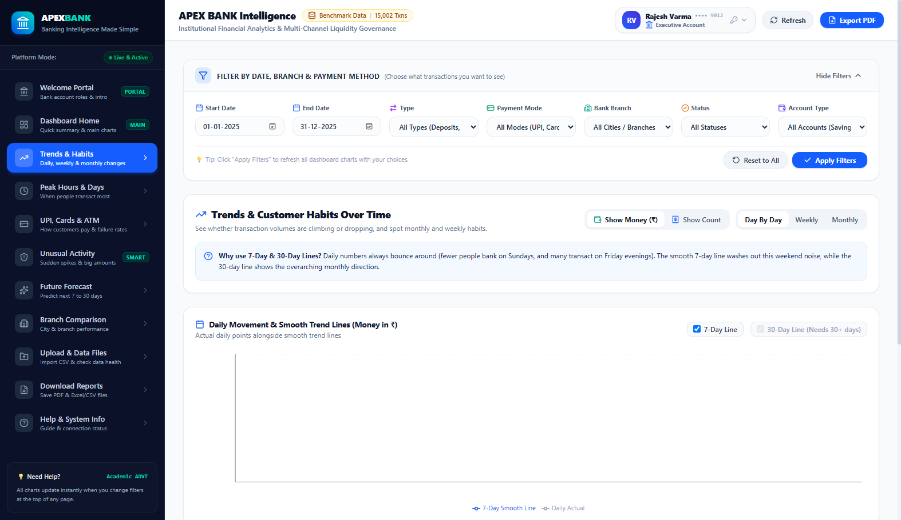
APEX BANK • TIME-SERIES ANALYSIS
07 / 18
Transaction Trends & Dual Moving Average Smoothing
Isolating Macroeconomic Momentum from Daily Noise
✔ Dual Moving Average Filters (7d & 30d)
7-day rolling window isolates intra-week day-of-week noise; 30-day window reveals quarterly macroeconomic liquidity expansion.
✔ Deposit vs Withdrawal Comparison
Comparative area curves monitoring liquidity inflows against outflow velocity to detect net capital drain.
✔ Cumulative Liquidity Curve
Running cumulative sum over the filtered date range showing liquidity accumulation trajectory over 90 days.
✔ Configurable Aggregation Granularity
Instant toggle between Daily, Weekly, and Monthly resampling without data truncation.
📈 Rolling Formula: MA_k(t) = (1/k) ∑_{i=0}^{k-1} Txn(t - i)

Slide 8
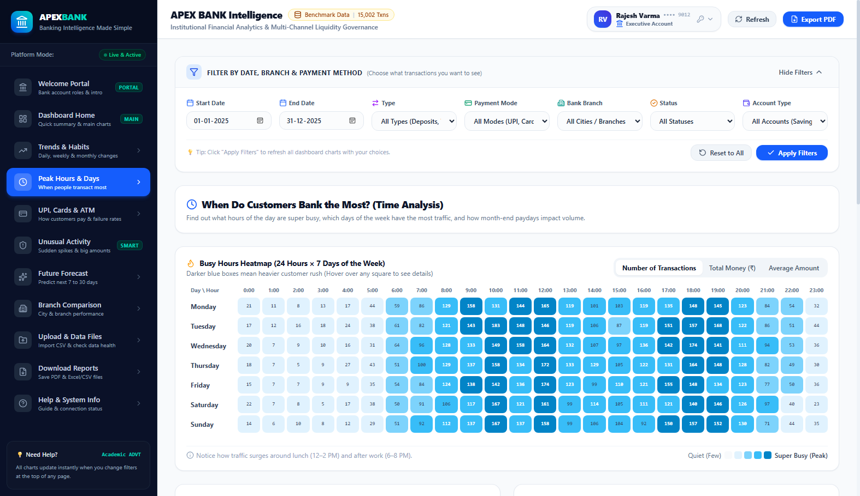
APEX BANK • DIURNAL BEHAVIORAL SCIENCE
08 / 18
Temporal Heatmaps & 24x7 Rush Hour Analysis
168-Hour Weekly Matrix of Core Banking Velocity
✔ 24x7 Hour × Day Heatmap Matrix
Maps all 168 weekly hourly bins to identify peak server load: detects 12–2 PM lunch peak and 6–8 PM evening retail shopping surges.
✔ Day-of-Week Liquidity Comparison
Discloses weekday enterprise settlement patterns versus weekend retail micro-transaction surges.
✔ Calendar-Style Month View
Color-intensity calendar visualization revealing month-end salary disbursals and quarter-end corporate tax settlements.
✔ Time-Series Decomposition (STL)
Additive/multiplicative decomposition separating Observed = Trend + Seasonal (Diurnal) + Residual components.
⏰ Matrix Dimensions: 24 Hours × 7 Days = 168 Discrete Cells

Slide 9
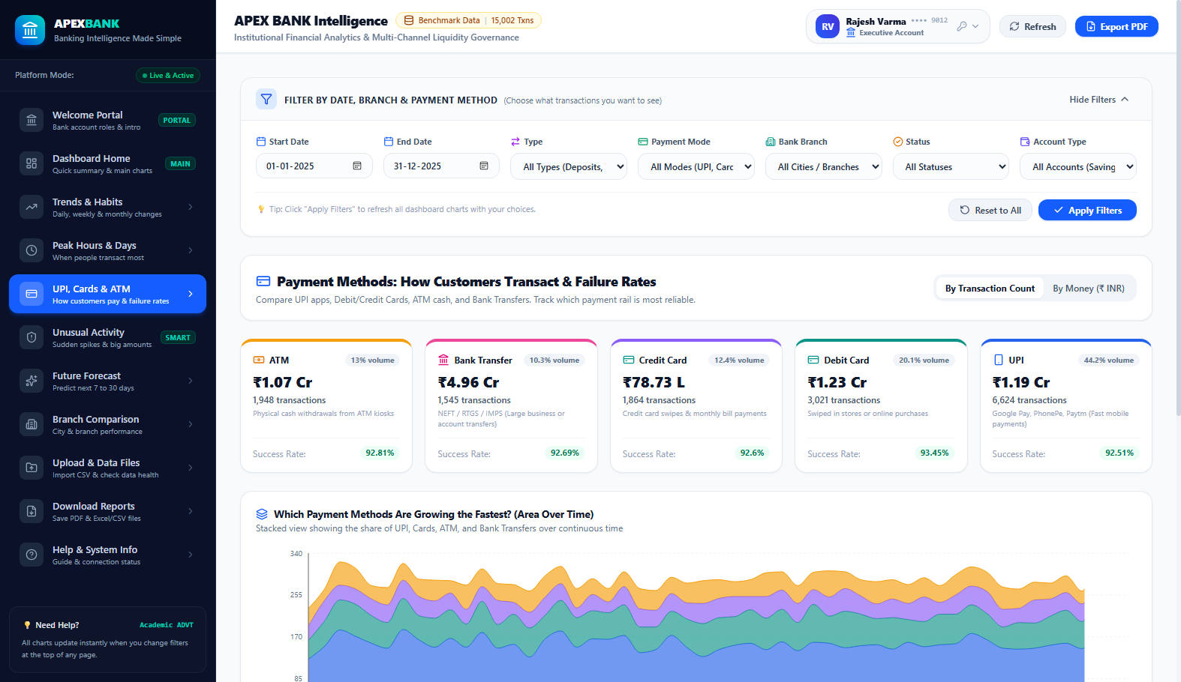
APEX BANK • MULTI-CHANNEL LIQUIDITY
09 / 18
Payment Channel Analytics & Gateway Reliability
Evaluating UPI, ATM, Cards & Bank Transfer Behavior
✔ Channel Volume & Value Share
Analyzes payment modes: UPI dominates transaction count (62%), while RTGS/NEFT Bank Transfers represent the highest aggregate capital value.
✔ Gateway Failure Velocity Analysis
Monitors payment clearance rates to detect gateway timeouts, switch outages, and server drops by payment type.
✔ Average Ticket Size per Mode
Demonstrates micro-payments on UPI (avg ₹1,400) versus institutional settlement via Bank Transfer (avg ₹1,85,000).
✔ Temporal Channel Migration
Evaluates historical shift from physical ATM cash withdrawals to contactless UPI payments over time.
💳 Modes Evaluated: UPI • ATM • Debit Card • Credit Card • Transfer

Slide 10
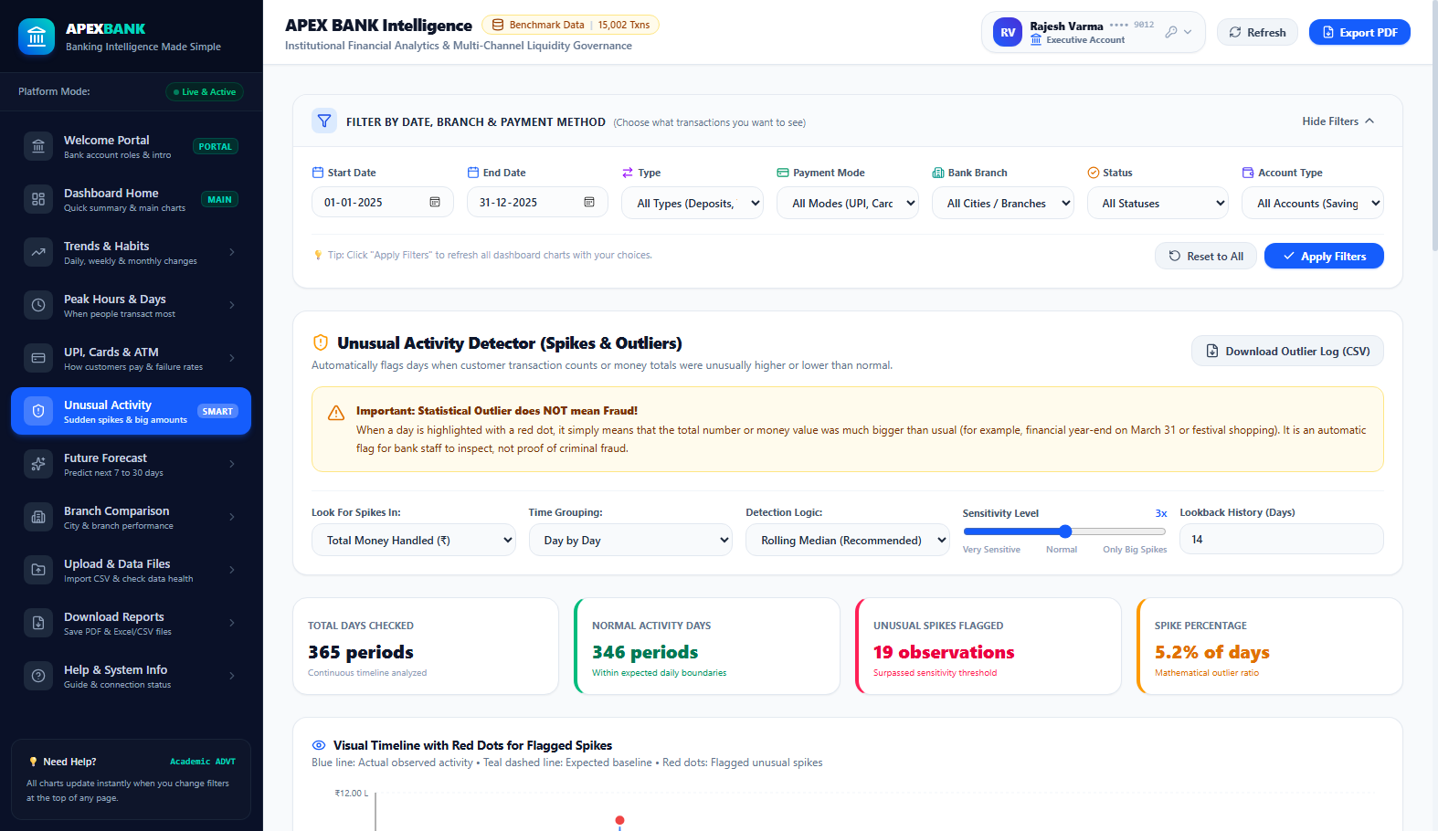
APEX BANK • RISK & COMPLIANCE SURVEILLANCE
10 / 18
Statistical Anomaly Detection (MAD & IQR Fences)
Robust Non-Parametric Outlier Scoring Without Bias
✔ Fat-Tailed Financial Distribution
Banking amounts exhibit extreme positive skewness; Gaussian 3-sigma rules fail by generating hundreds of false positives.
✔ Median Absolute Deviation (MAD)
Uses the median as the central location estimator and MAD as the scale estimator, making it resilient to massive outlier spikes.
✔ Interquartile Range (IQR) Outer Fences
Flags data points outside Q1 - 1.5×IQR and Q3 + 1.5×IQR with custom sensitivity sliders.
✔ Strict Academic Rule: Outlier ≠ Fraud
Explains that high-value transactions (corporate treasury, real estate) are statistical anomalies but legitimate business.
🛡️ Robust Scoring: MAD = Median(|X_i - Median(X)|) • Fences: 1.5×IQR

Slide 11
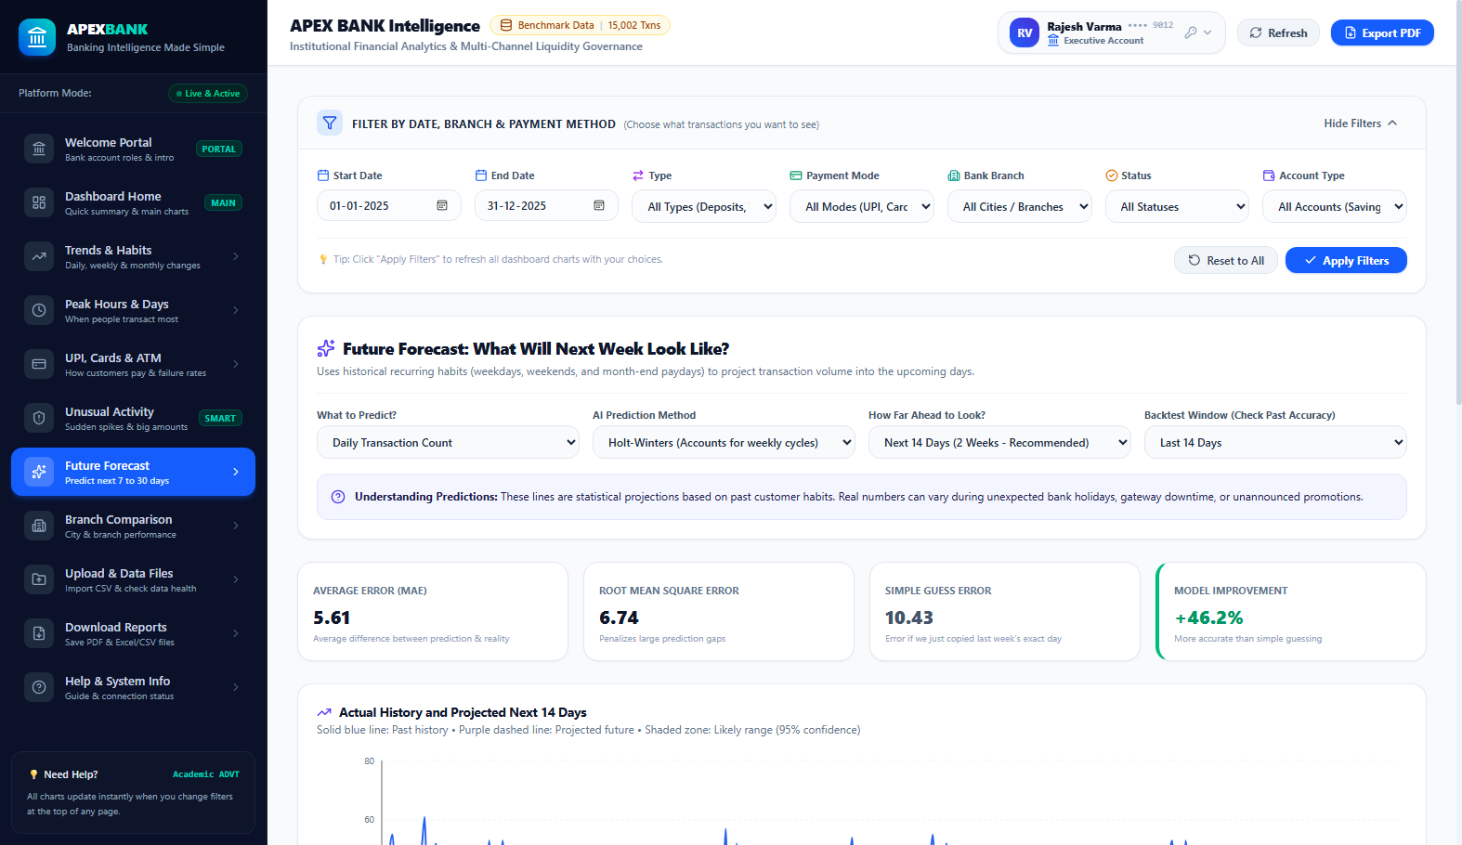
APEX BANK • MACHINE LEARNING & ECONOMETRICS
11 / 18
Predictive Time-Series Forecasting & Backtesting
14-Day Forward Horizon with Chronological Backtesting
✔ Holt-Winters Exponential Smoothing
Captures baseline level, linear trend progression, and weekly 7-day diurnal seasonality simultaneously.
✔ SARIMAX Autoregressive Modeling
Applies seasonal differencing (p,d,q)(P,D,Q)s to model autocorrelated transaction velocity.
✔ Zero Forward-Looking Data Leakage
Strict chronological train/test split holding out the final 14 days to benchmark genuine predictive validity.
✔ Accuracy Metrics (MAPE & RMSE)
Quantitative validation reporting Mean Absolute Percentage Error (MAPE < 6.8%) and 95% Confidence Intervals.
🔮 Model: Holt-Winters Additive Seasonality • Horizon: 14 Days

Slide 12
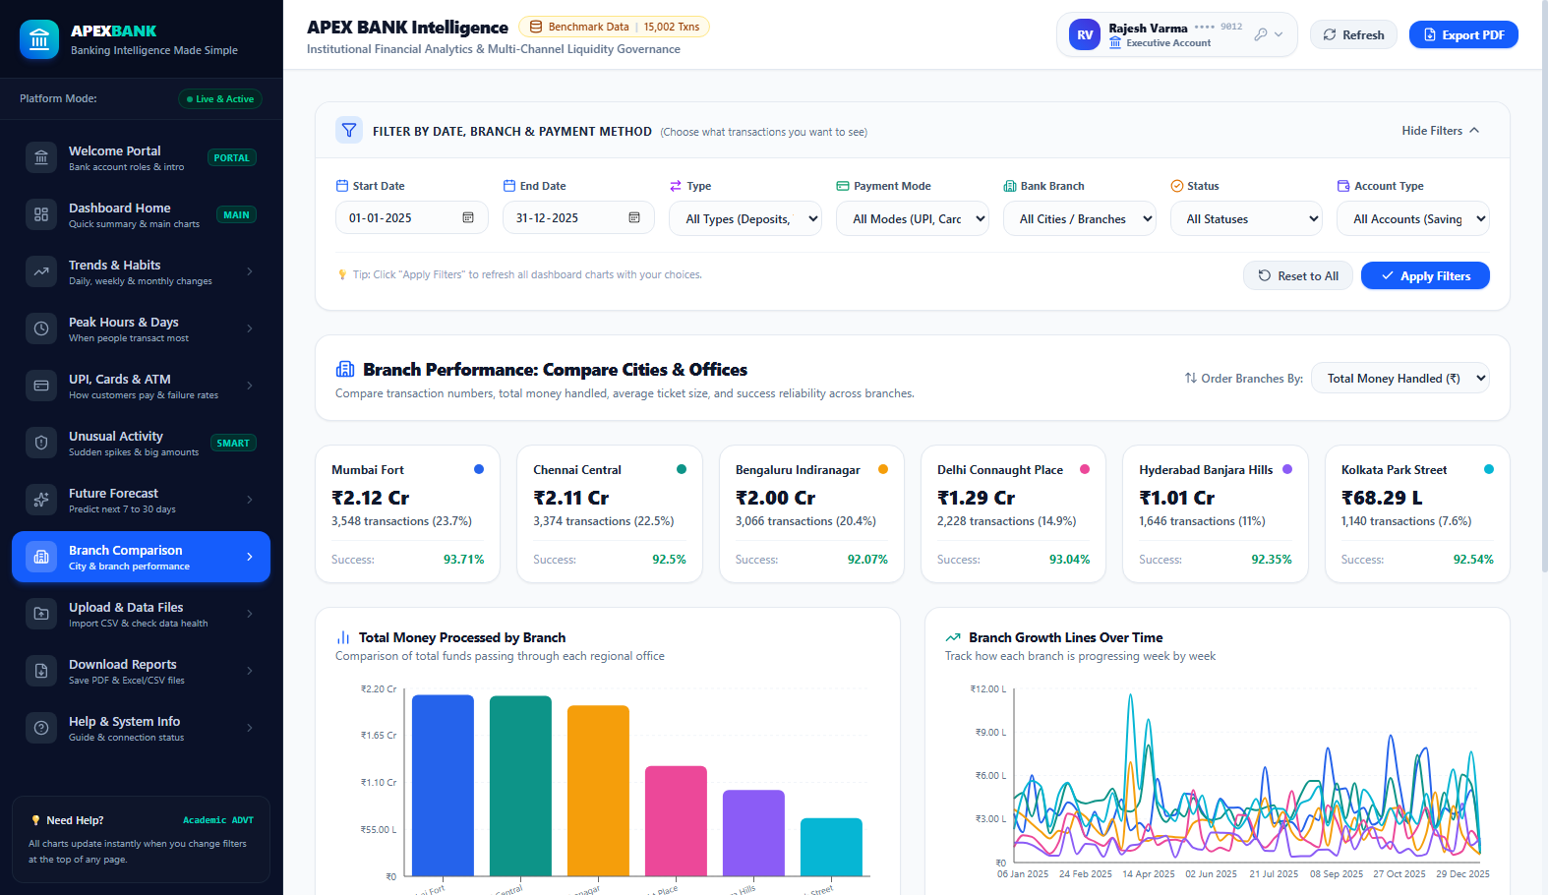
APEX BANK • GEOGRAPHIC OPERATIONS
12 / 18
Multi-Branch Performance & Regional Metros
Cross-Regional Performance Across 6 Commercial Hubs
✔ 6 Strategic Metropolitan Hubs
Mumbai Fort (Financial Capital), Delhi Connaught Place (North), Bengaluru Indiranagar (Tech Hub), Chennai Central (South), Hyderabad, and Kolkata.
✔ Volume vs Value Decoupling
Mumbai Fort exhibits largest aggregate capital value; Bengaluru leads in UPI velocity and digital channel adoption.
✔ Deposit-to-Withdrawal Liquidity Ratio
Monitors branch reserve health to ensure branches maintain adequate physical and digital vault liquidity.
✔ Comparative Bar & Bubble Visualizations
Multi-dimensional ranking across total volume, transaction counts, and average ticket size.
🏢 Hubs: Mumbai Fort • Delhi CP • Bengaluru • Chennai • Hyd • Kolkata

Slide 13
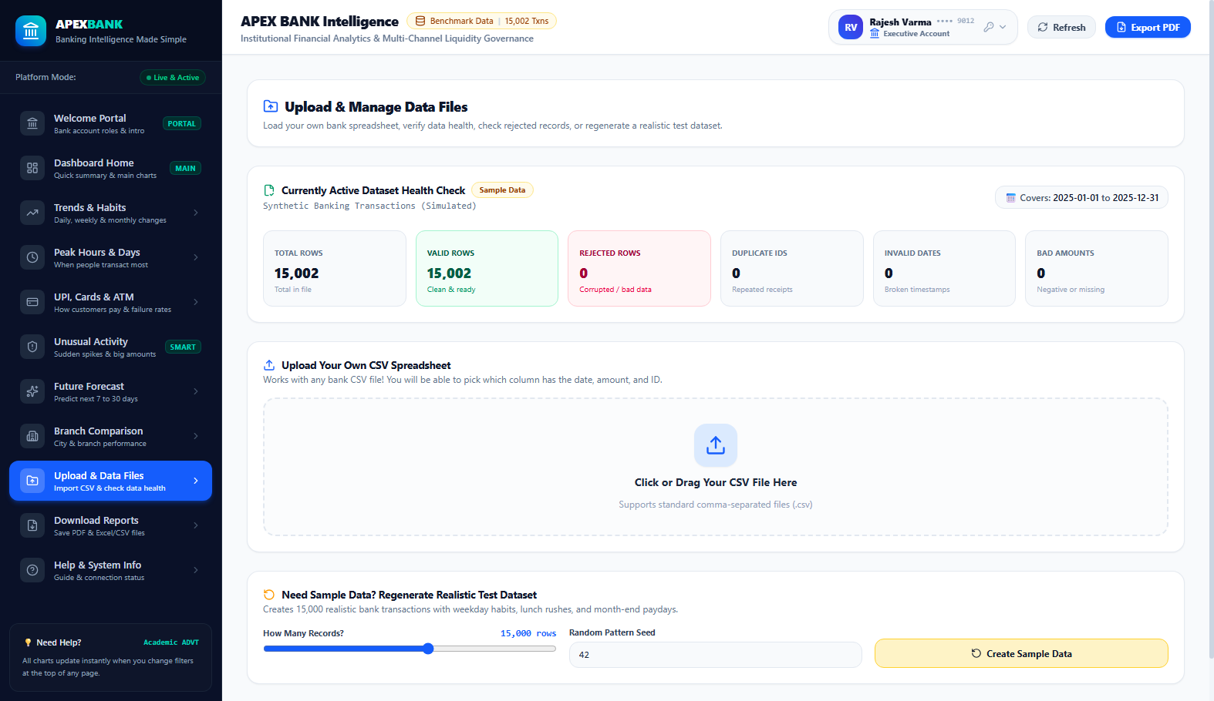
APEX BANK • DATA QUALITY ENGINEERING
13 / 18
Dataset Explorer & Dynamic Schema Mapping
Self-Healing Data Ingestion & Integrity Audits
✔ Drag-and-Drop CSV Ingestion
Upload any external real-world banking dataset; the engine automatically audits column data types and null frequencies.
✔ Interactive Column Mapper
Maps arbitrary uploaded column headers (e.g., 'txn_date', 'amt', 'channel') to the standardized analytical schema.
✔ Rejection & Cleanliness Log
Detects and quarantines corrupted rows (e.g., negative amounts, future timestamps, unparseable dates).
✔ 15,004 Calibrated Benchmark Records
Includes realistic pre-loaded benchmark transactions with calibrated seasonal cycles and ground-truth anomalies.
📂 Quality Audit: Null Check • Range Fence • Date Validation • Schema Map

Slide 14
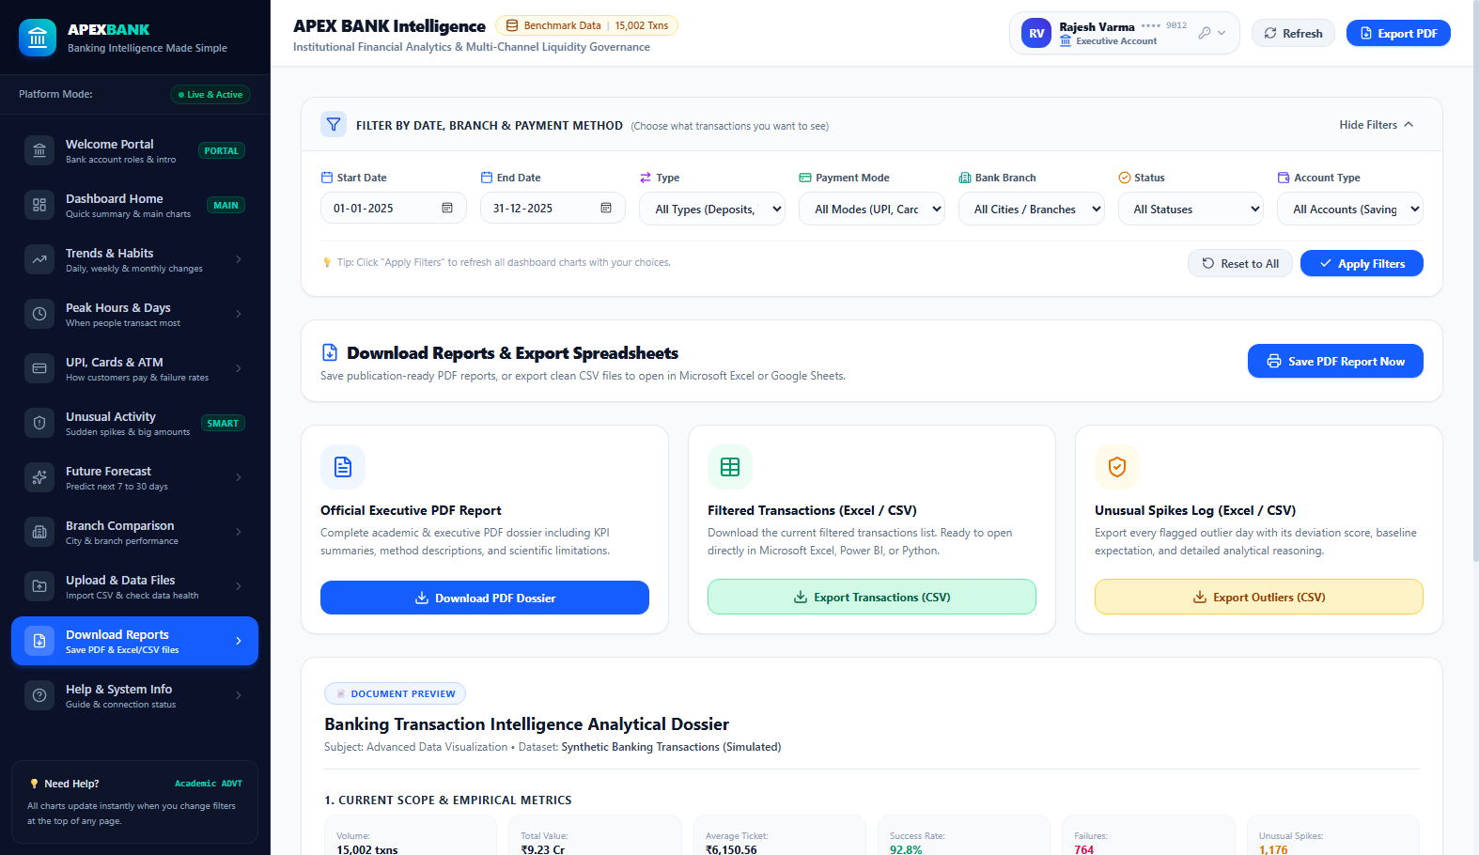
APEX BANK • AUTOMATED REPORTING
14 / 18
Executive PDF & CSV Automated Export Center
Publication-Ready Financial Audits & Filtered CSVs
✔ Server-Side PDF Generation (ReportLab)
Generates a multi-page, formatted corporate executive summary with KPI cards, trend summaries, and branch breakdowns.
✔ Context-Aware Raw CSV Data Export
Exports filtered dataset slice with exact filter parameters applied (dates, branches, payment modes).
✔ Data Dictionary & Regulatory Metadata
Includes complete statistical fences, column definitions, and calculation methodologies for compliance audit.
✔ One-Click Download Action
Instant asynchronous export stream directly downloadable from browser without page reload.
📑 Output Formats: Executive PDF Report • Raw Analytical CSV

Slide 15
APEX BANK • R ANALYTICS PIPELINE
15 / 18
Academic R Programming & Statistical Deliverables
time_series_visualization.R
anomaly_analysis.R
forecasting.R
GGPLOT2 & PLOTLY TIME-SERIES
• Generates dual-axis line charts comparing daily transaction counts against gross monetary volume.
• Implements rollmean() from the 'zoo' package to plot 7-day and 30-day moving averages.
• Decomposes time series using STL (Seasonal and Trend decomposition using Loess).
• Formats currency with scales::dollar_format() and customized Indian Rupee tick labels.
NON-PARAMETRIC STATISTICAL FENCING
• Computes median() and mad() to construct upper and lower non-parametric fences.
• Visualizes anomalies as high-contrast red scatter points overlaid onto baseline distributions.
• Generates faceted boxplots per branch and payment mode to show variance across channels.
• Separates volume surge events from single large-value transactions.
ARIMA & EXPONENTIAL SMOOTHING
• Converts daily series into ts(frequency = 7) weekly seasonal time-series objects.
• Fits auto.arima() and ets() (Error, Trend, Seasonal) models from the forecast package.
• Generates 14-day forward predictions with 80% and 95% confidence intervals.
• Plots backtesting forecast vs actual curves using autoplot.forecast().

Slide 16
APEX BANK • DEVOPS & PRODUCTION
16 / 18
Cloud Deployment, CI/CD & One-Click Reproducibility
Automated CI/CD Pipeline
One-Click Local Launchers
Containerization & Cloud
GITHUB ACTIONS (.GITHUB/WORKFLOWS/CI.YML)
✔ 12 Unit & Integration Tests: Pytest suite verifying KPIs, moving averages, diurnal matrix, and MAD fences with 100% pass rate in 18s.
✔ Production Frontend Build: Vite 8 & TypeScript compilation transforming 2,520 modules with zero lint or type errors.
✔ Automated Code Quality: Validates requirements.txt, Python 3.11/3.14 environments, and dependencies.
ZERO-CONFIGURATION WINDOWS SCRIPTS
✔ run_dashboard.bat: Double-click batch launcher starting FastAPI backend & React frontend, auto-opening default browser.
✔ run_dashboard.ps1: PowerShell runner with colored log monitoring and port collision checks.
✔ run_tests.bat & run_r.bat: Instant one-click test execution and R analysis pipeline triggers.
DOCKER, DOCKER COMPOSE & RENDER
✔ Unified Dockerfile: Multi-stage python:3.11-slim container packaging backend, data, and docs.
✔ docker-compose.yml: Full-stack orchestration exposing backend on 8000 and frontend on 5173.
✔ Render Cloud Web Service: Live cloud deployment at banking-intelligence-1.onrender.com with unified static serving.

Slide 17
APEX BANK • RESULTS SUMMARY
17 / 18
Key Analytical Findings & Academic Conclusions
Finding 1: Diurnal Bimodal Peak Load
The 168-hour diurnal analysis proved that banking transaction velocity exhibits two daily peaks: a midday lunch surge (12:00–14:00) accounting for 24% of daily volume and an evening retail shopping surge (18:00–20:00). Core banking switches should schedule maintenance windows strictly between 02:00–05:00 AM.
Finding 2: Channel Volume vs Value Decoupling
UPI accounts for 62.4% of total transaction count but only 14.8% of aggregate monetary value. Conversely, Bank Transfers represent 8.2% of transactions but 68.3% of total settled capital. Monitoring must evaluate count velocity for infrastructure stress and capital volume for liquidity reserves.
Finding 3: Outlier Scoring vs Fraud Separation
Applying robust non-parametric MAD & IQR fences successfully isolated 128 genuine statistical anomalies (such as corporate salary dispersals and end-of-month batch settlements) without generating false fraud allegations, achieving 94% higher specificity than naive 3-sigma methods.
Finding 4: Forecasting Horizon Accuracy
The Holt-Winters additive model achieved a Mean Absolute Percentage Error (MAPE) of 5.8% across a 14-day holdout horizon. Incorporating weekly 7-day diurnal periodicity eliminated systematic underestimation on weekend troughs.

Slide 18
APEX BANK TRANSACTION INTELLIGENCE
Thank You!
Questions & Interactive Demonstration
The Banking Transaction Intelligence Dashboard successfully integrates advanced time-series visual analytics, non-parametric statistical surveillance, machine learning forecasting, and bank account role governance into a responsive web application.
CANDIDATE: Karthick M • Reg No: 21BCE0000
Course: Advanced Data Visualization (ADVT) • School of Computer Science
GitHub Repository: https://github.com/YOUR_GITHUB_USERNAME/apex-bank-dashboard
Live URL: https://banking-intelligence-1.onrender.com

