Slide 1
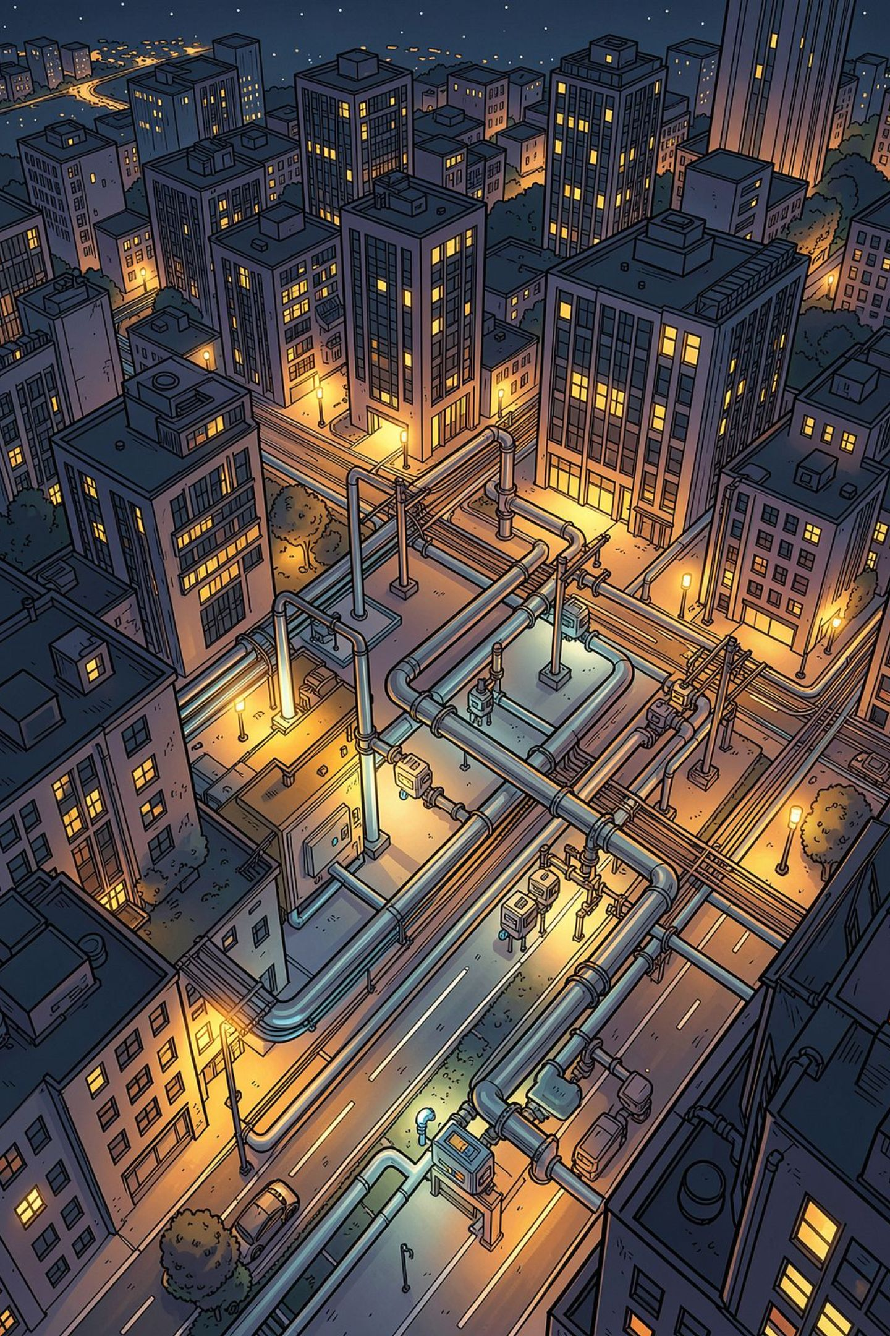
Smart Utility Meter Reading System Using IoT
Automated Water, Gas, and Electricity Consumption Monitoring
Real-time utility consumption tracking through intelligent IoT-enabled smart meters and centralized cloud-based monitoring.
SONNAPU KARTHIKEYA KUMAR
323129520125

Slide 2
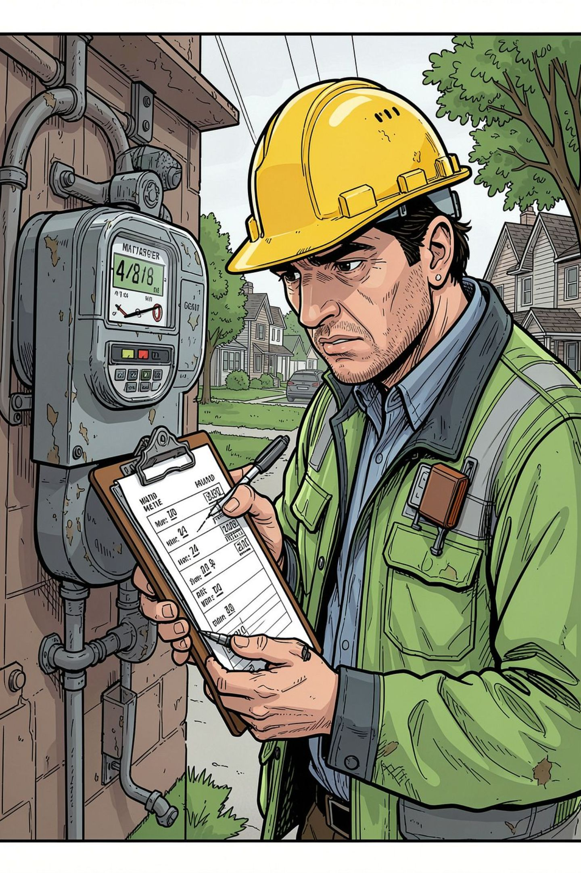
Problem Statement
Manual & Labor-Intensive
Time-consuming manual meter reading process with heavy labor-intensive operational requirements
Human Error & Inaccuracy
Human errors in recording readings lead to inaccurate billing due to manual data entry
Delayed & Uninformed
Delayed consumption reporting, lack of real-time information, and no automated monitoring capability
3x
More Time Spent
Compared to automated systems
~5%
Error Rate
Typical manual reading inaccuracy

Slide 3
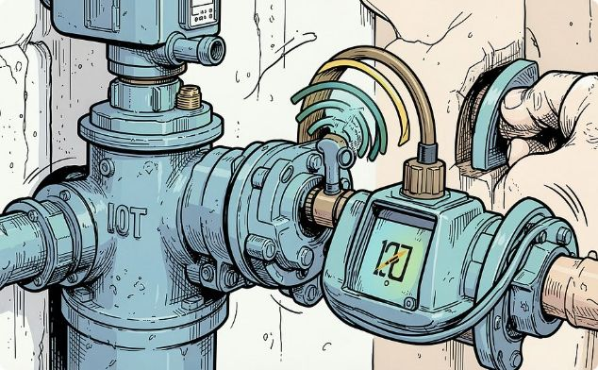
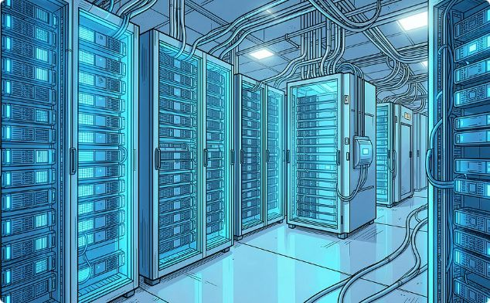
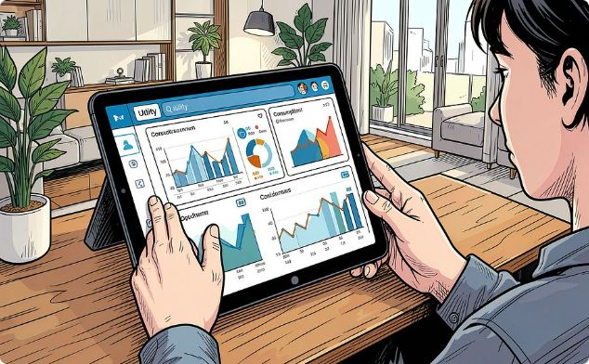
Proposed Solution
Automated Utility Monitoring
Cloud-Based Infrastructure
Secure Monitoring Platform
Scalable and reliable cloud connectivity enables automatic transmission of meter readings to a central server
Centralized, user-friendly interface provides real-time access to utility consumption information for all stakeholders
IoT technology automatically collects water, gas, and electricity consumption data without manual intervention

Slide 4
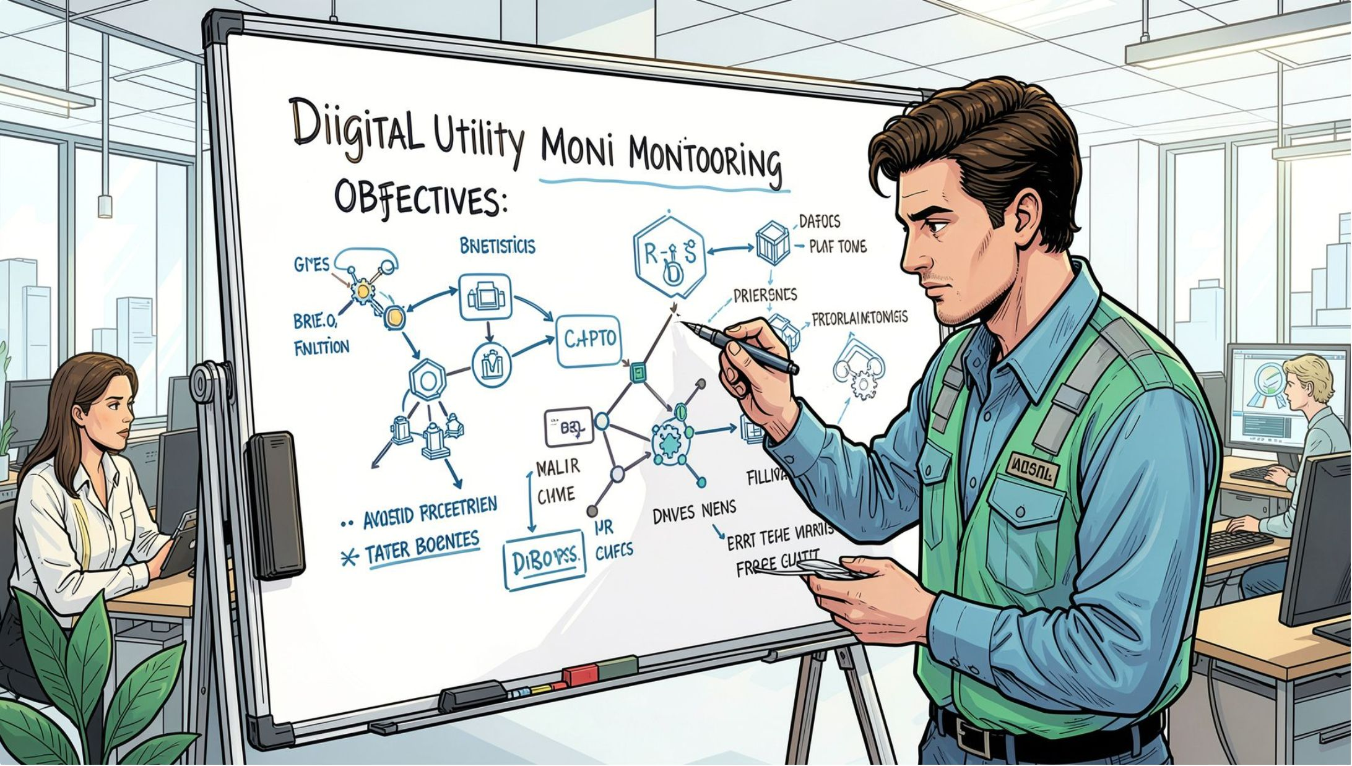
Objectives
1
Automate meter reading processes
Eliminate manual effort and reduce human errors across water, gas, and electricity meters
2
Improve billing accuracy & transparency
Provide real-time consumption data and historical trend tracking for precise billing
3
Detect anomalies & conserve resources
Alert stakeholders to abnormal usage and improve overall resource management

Slide 5
System Components
Smart Water Meter
Smart Gas Meter
Measures and records water consumption in real-time with high precision sensors
Measures and records gas consumption in real-time, ensuring safe and accurate readings
Smart Electricity Meter
IoT Communication Modules
Measures and records electricity consumption in real-time across residential and commercial loads
Transmit meter data wirelessly to the central server via secure communication protocols
Cloud Connectivity
Central Monitoring Platform
Enables centralized data storage, processing, and access with scalability and reliability
Collects, processes, and displays utility information for consumers and providers

Slide 6

Working Principle
Data Capture
Meter Sensing
IoT Transmission
Cloud Ingress
Processing
Water, gas, electricity readings
Data forwarded to central server
Store and analyze incoming data
Smart meters record consumption
Wireless modules send readings
The system operates as a continuous, fully automated pipeline — from physical meter sensing through wireless IoT transmission to cloud processing and real-time dashboard delivery — requiring zero manual intervention at any stage.

Slide 7
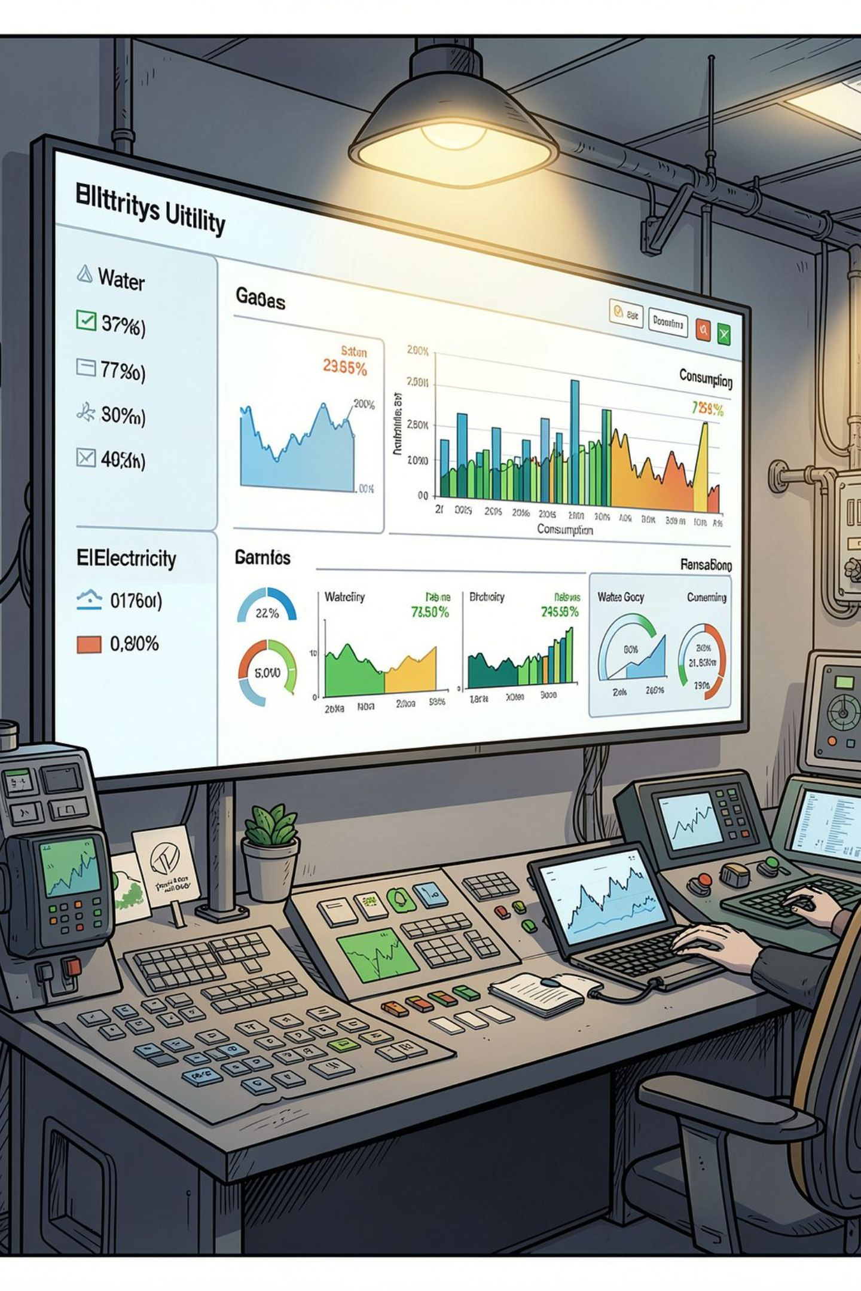

Centralized Monitoring Dashboard
💧 Water
📈 Analytics
Real-time consumption display
Historical trends and consumption patterns
🔥 Gas
🔔 Alerts
Real-time consumption display
Abnormal usage notifications
⚡ Electricity
🩺 Health
Real-time consumption display
Meter status and system indicators
Enables consumers and utility providers to monitor consumption efficiently, identify patterns, and make informed decisions about resource usage.

Slide 8
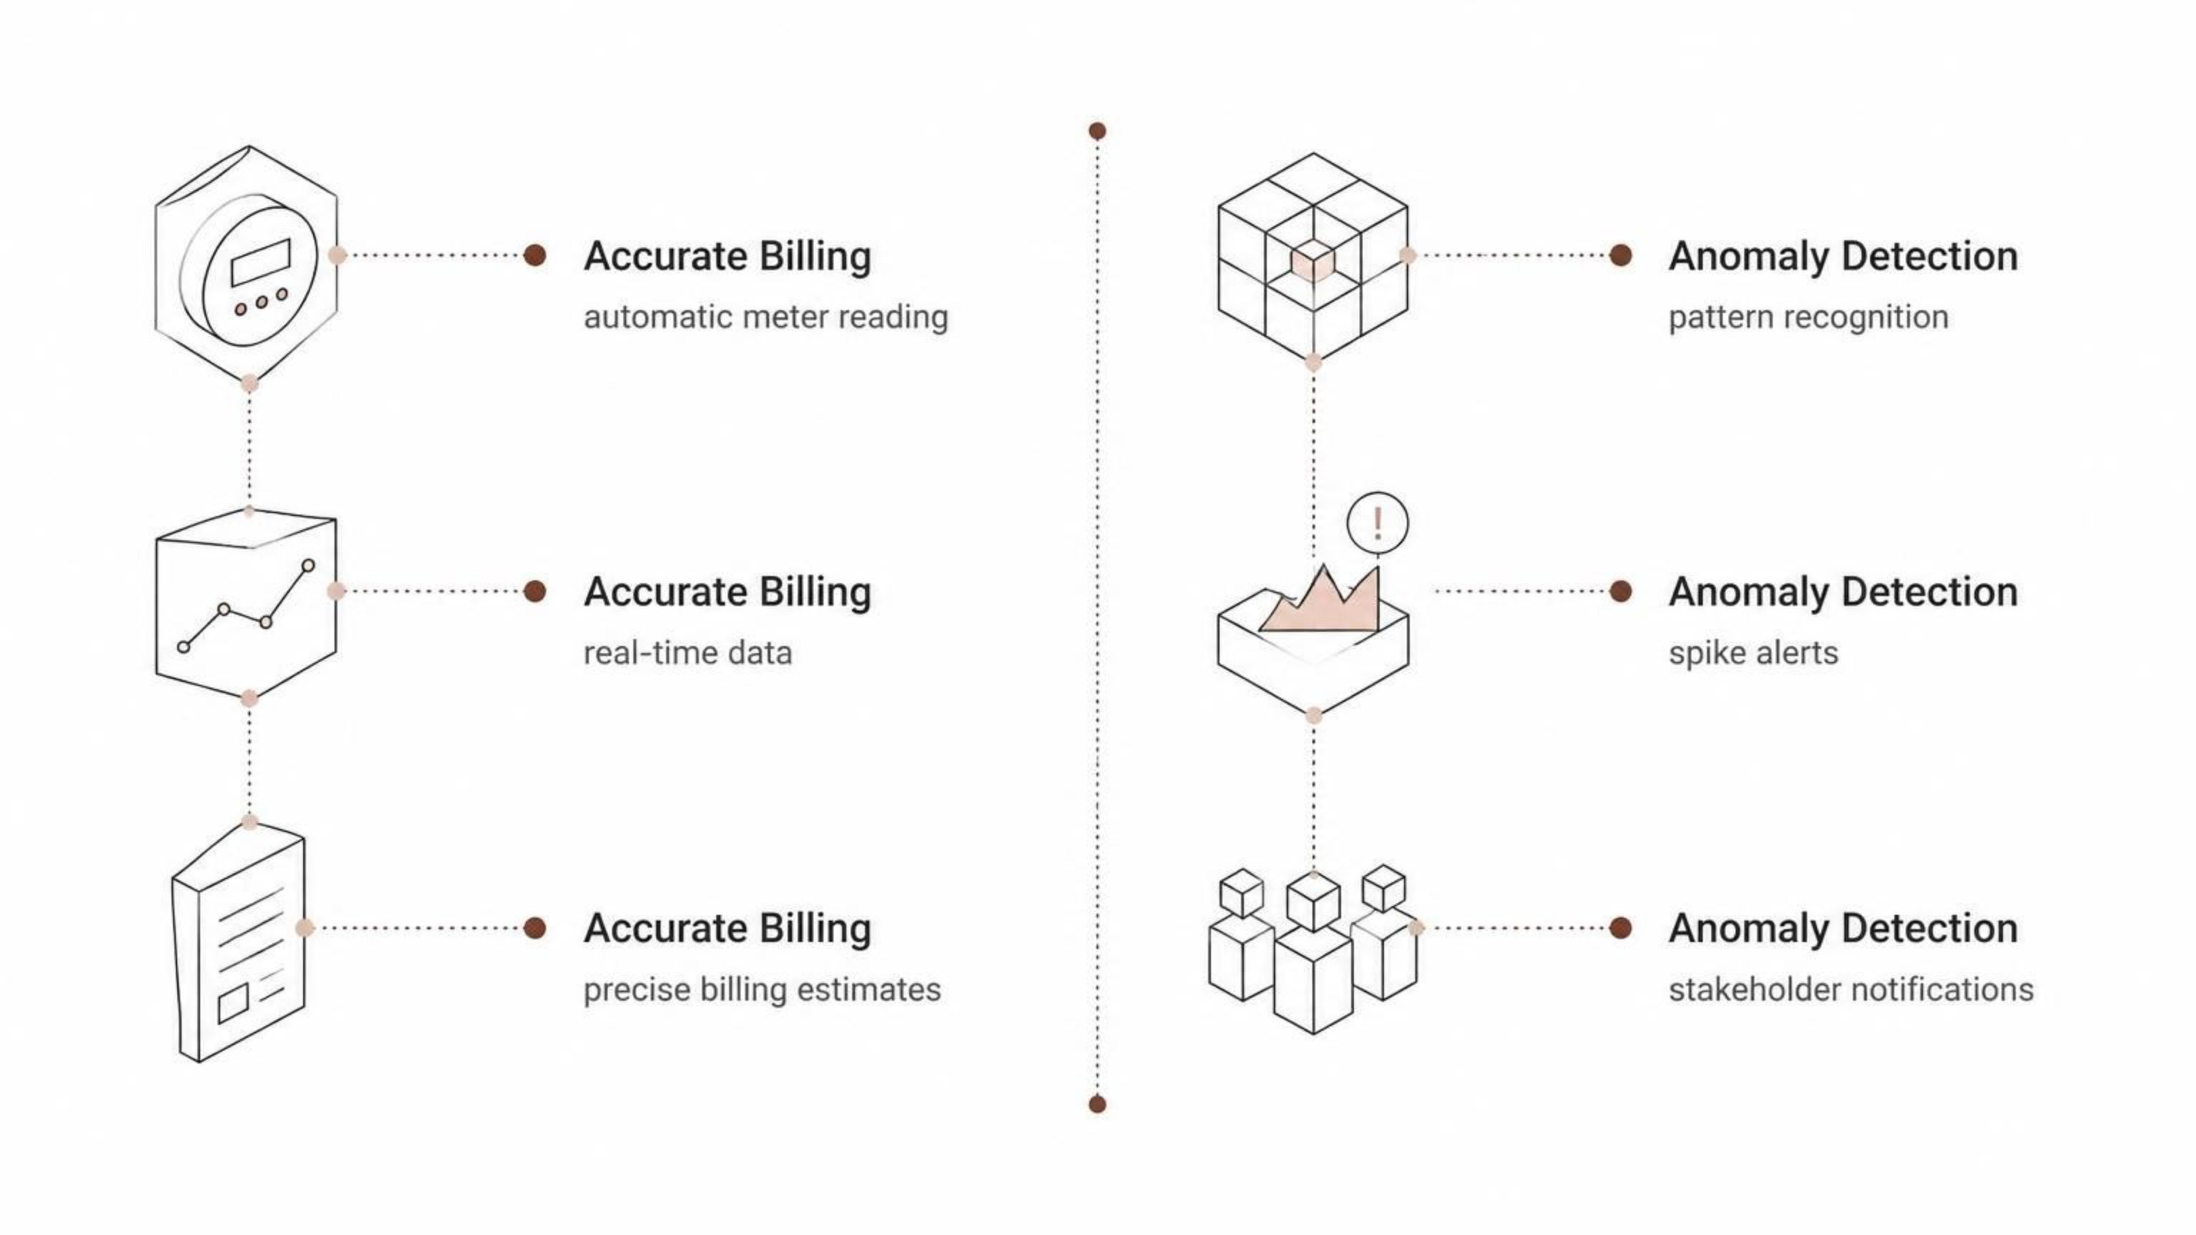
Billing and Abnormal Usage Monitoring
Accurate Billing
Anomaly Detection
Automatic collection of meter readings eliminates manual processes
More accurate consumption data for precise billing
Reduced dependence on manual meter reading and human intervention
Estimated billing information based on real-time consumption
Identification of abnormal usage patterns and anomalies
Automated alerts for unusual consumption spikes
Faster access to consumption information for all stakeholders

Slide 9
Benefits and Applications
Key Benefits
Applications
Billing Accuracy
🏠 Residential
🏢 Commercial
Improved accuracy and transparency through real-time data
Buildings and apartment complexes
Complexes and office spaces
Reduced Costs
Lower manual effort, operational costs, and human errors
🏭 Industrial
🌆 Smart Cities
Facilities and manufacturing plants
Urban infrastructure and utility networks
Resource Conservation
Better management, faster reporting, and scalable secure infrastructure

Slide 10
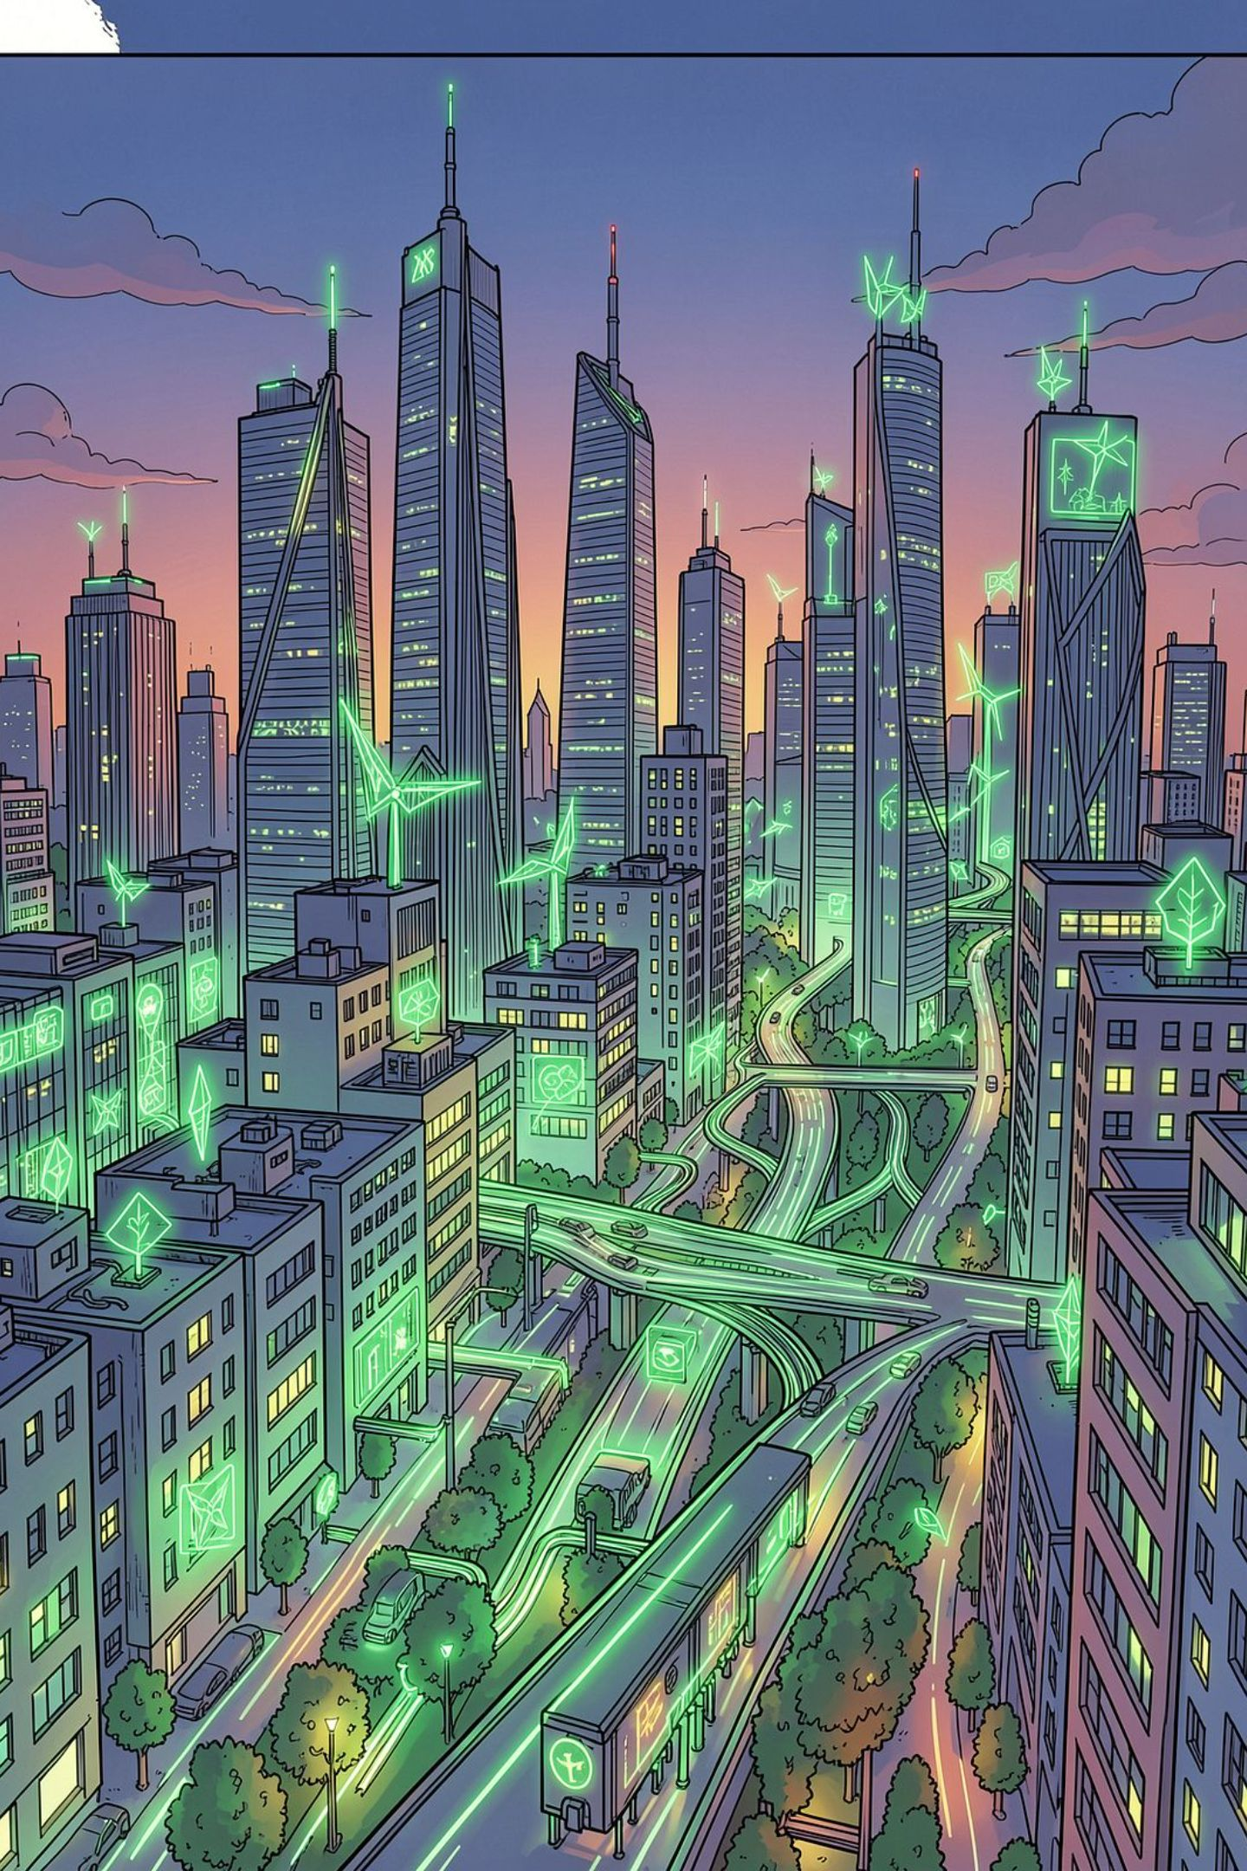
Conclusion
01
Replaces Manual Reading
Automated IoT-based monitoring eliminates time-consuming manual utility meter reading entirely
02
Continuous Data Collection
Smart meters continuously collect water, gas, and electricity consumption data via IoT and cloud connectivity
03
Real-Time Intelligence
Dashboards deliver real-time usage, historical trends, estimated billing, abnormal usage alerts, and meter status
04
Smarter Utility Services
Improved billing accuracy, reduced manual effort, enhanced resource management, and efficient smart utility services
IoT technology is essential for creating intelligent, efficient, and sustainable utility monitoring systems that benefit consumers, utility providers, and the environment.

