Slide 1
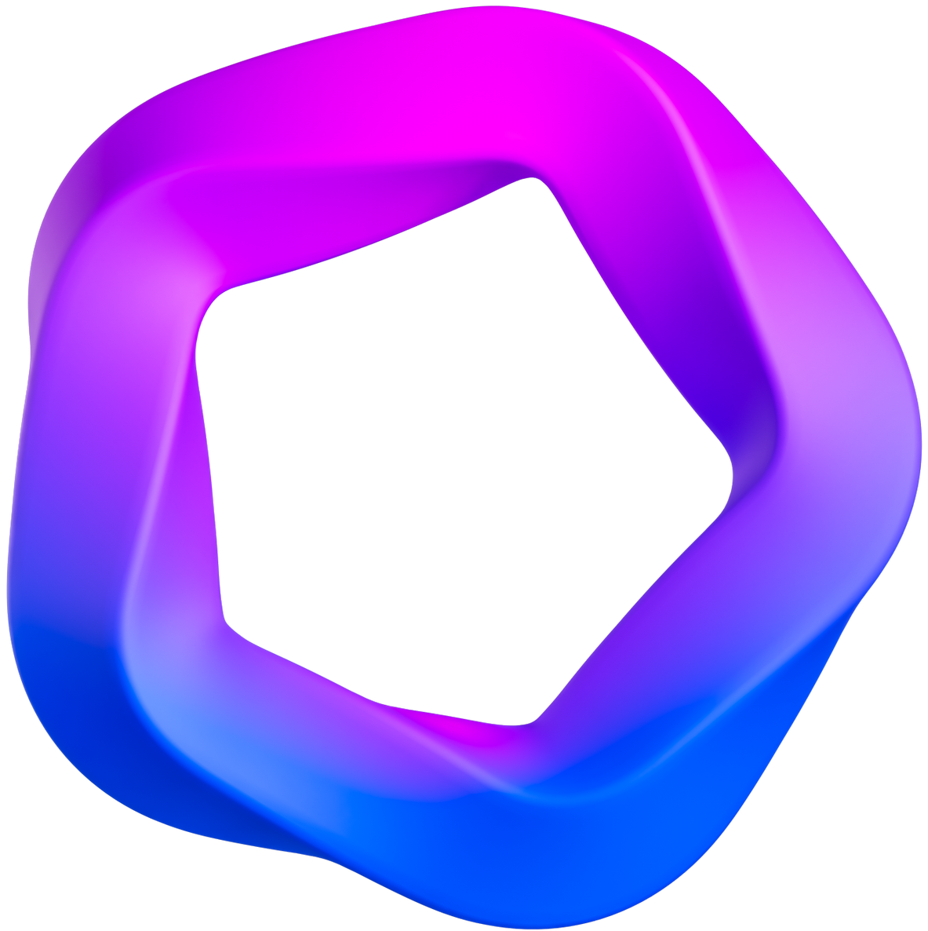
CHATBOT FOR GOVERNMENT SCHEMES
KAMAL PRASHANTH C (210701102)
KARTHIC S (210701107)
KARTHICK RAGAV (210701108)

Slide 2



Problem Statement
and Motivation
Accessing relevant Government schemes in India can be a complex and confusing process for citizens. The vast number of programs, along with their eligibility requirements and application procedures, can be overwhelming
The goal of this project is to use PyTorch to create an accessible chatbot that would help Indian citizens learn about and apply for Government initiatives. The chatbot will be able to retrieve and display data on several government funding programs .
The project promotes transparency by providing a user-friendly platform for citizens to explore various government initiatives. Users can explore various schemes, check eligibility, and get help with applications.

Slide 3
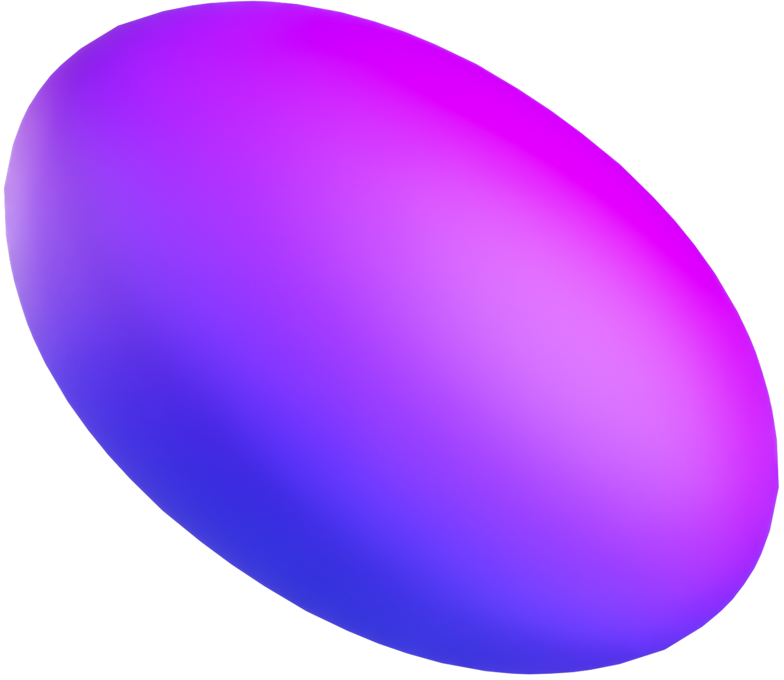



Objectives
This project aims to empower Indian citizens to navigate and access government schemes effectively by developing a user-friendly chatbot powered by PyTorch.
The chatbot will have access to and be able to display comprehensive data regarding a range of Government programs that are arranged according to pertinent topics.
Users can browse by category or perform targeted scheme searches with ease.
Objective 1
Objective 2
Objective 3

Slide 4
ABSTRACT
This PyTorch-powered chatbot empowers Indian citizens to explore Government schemes, bridging the gap between citizens and often-complex government programs.
To accomplish its functions, the chatbot makes use of PyTorch's powerful data processing and analysis features.
The chatbot retrieves and presents information about various government schemes categorized by areas like education, agriculture, and social welfare.

Slide 5
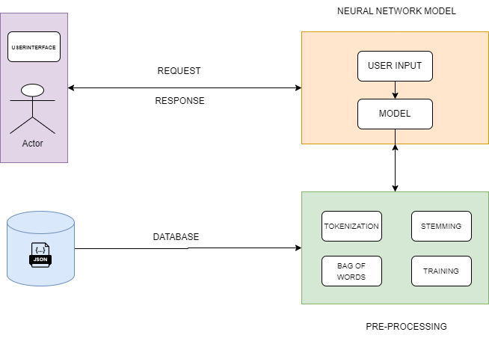
SYSTEM ARCHITECTURE
The chatbot's objective is providing information and advice on government financial schemes—and its target audience, Indian residents, front and center.
PyTorch is used for data processing, our initial project might not require a complex neural network model for intent classification.
During each iteration, the model makes predictions about the user intent based on the input text. These predictions are compared to the actual labels in the data, and the model is adjusted to minimize the difference between its predictions and the correct labels.

Slide 6

01
Requirement Analysis: Identify the project's goals and specifications for the chatbot. Establish the target audience, functionalities, and scope. Specify the kinds of interactions that the chatbot will facilitate and the data that it must deliver.
02
Data Collection: Collect relevant data to help the chatbot learn. Conversation logs, FAQs, and other text-based data sources might be examples of this. Indicate the goal or significance of each message by adding labels or intents to the data.
MODULE DESCRIPTION
03
Data Preprocessing: To get the data ready for training, clean it up and perform some preprocessing. Tokenization, lemmatization, stop word removal, and text conversion into numerical representations appropriate for machine learning models are some of the activities involved in this.
04
Select a suitable architecture for the chatbot's machine learning or deep learning model. Utilizing the pre-processed data, train the chosen model. Adjust the hyperparameters and assess the model's performance with metrics such as F1 score, accuracy, precision, and recall.

Slide 7
05
Develop the backend of the chatbot using a web framework like Flask. Create API endpoints to handle user requests, predict intents using the trained model, and generate appropriate responses.
06
1Frontend Development: Design and implement the user interface (UI) for the chatbot. Tkinter and JavaScript are used to create an intuitive and user-friendly interface where users can interact with the chatbot. Implement features like message input, message display, and dynamic updates.
MODULE DESCRIPTION
07
1Verify that the chatbot system is reliable, functional, and easy to use by providing it an in-depth test. Examine for a range of situations, including as typical interactions, uncommon situations, and handling errors. Get input from stakeholders and users to determine what needs to be improved.
08
Deploy the chatbot system in a live setting so that people can access it. Maintain a tab on the security, scalability, and performance of the system. Update and enhance the chatbot frequently in response to user input and shifting needs.

Slide 8
IMPLEMENTATION AND RESULTS
This project bridged the gap between Indian citizens and valuable government financial schemes by developing a user-friendly chatbot.
The chatbot performs well, handling user messages and producing responses with quickness.
The application's strong capabilities, scalability, performance, and user-friendly design make it an invaluable tool for resolving user inquiries and improving overall user experience

Slide 9
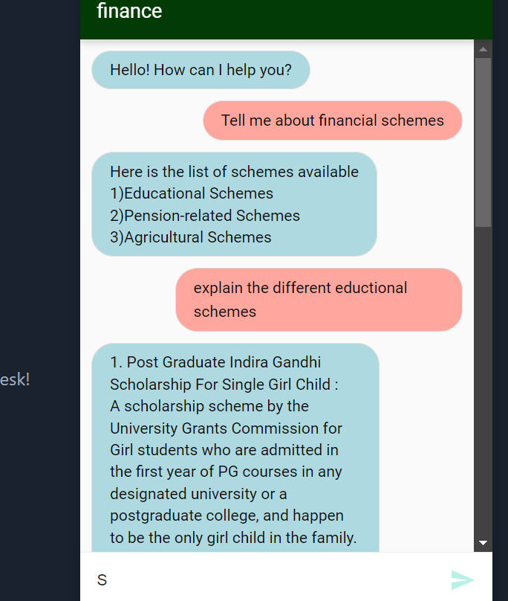
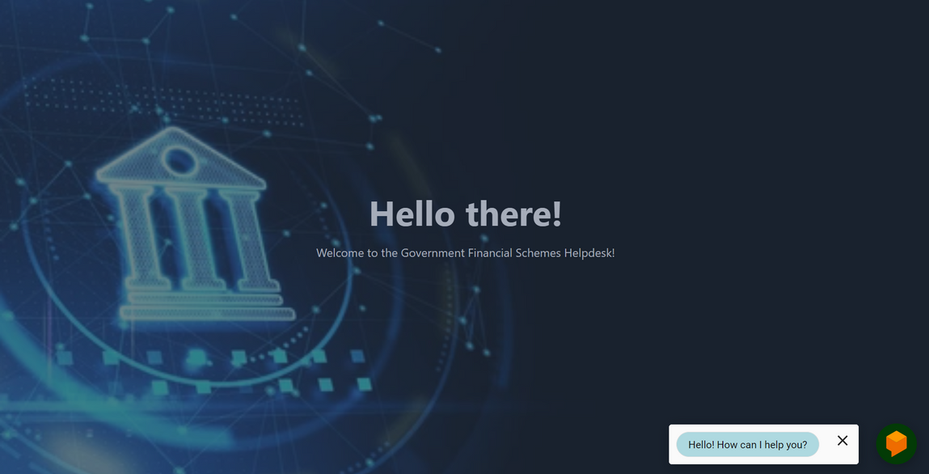
OUTPUT SCREENSHOTS

Slide 10
CONCLUSION
In conclusion, this project successfully developed a user-friendly chatbot that empowers Indian citizens to navigate the landscape of government financial schemes
FUTURE ENHANCEMENTS
Use NLP approaches to help the chatbot comprehend user inquiries more deeply and provide responses that seem natural.
To promote a more organic and interesting dialogue with users, use elements like follow-up questions and clarification prompts we can use conversational flow.
By simplifying access to information and assisting with the application process, the chatbot empowers individuals to explore and potentially benefit from government programs designed to improve their financial well-being.

