Slide 1
CS8611 : MINI PROJECT Online Salon Booking
Team members
Hari Krishnan b
Jeevanantham N
Karthick kumar p

Slide 2
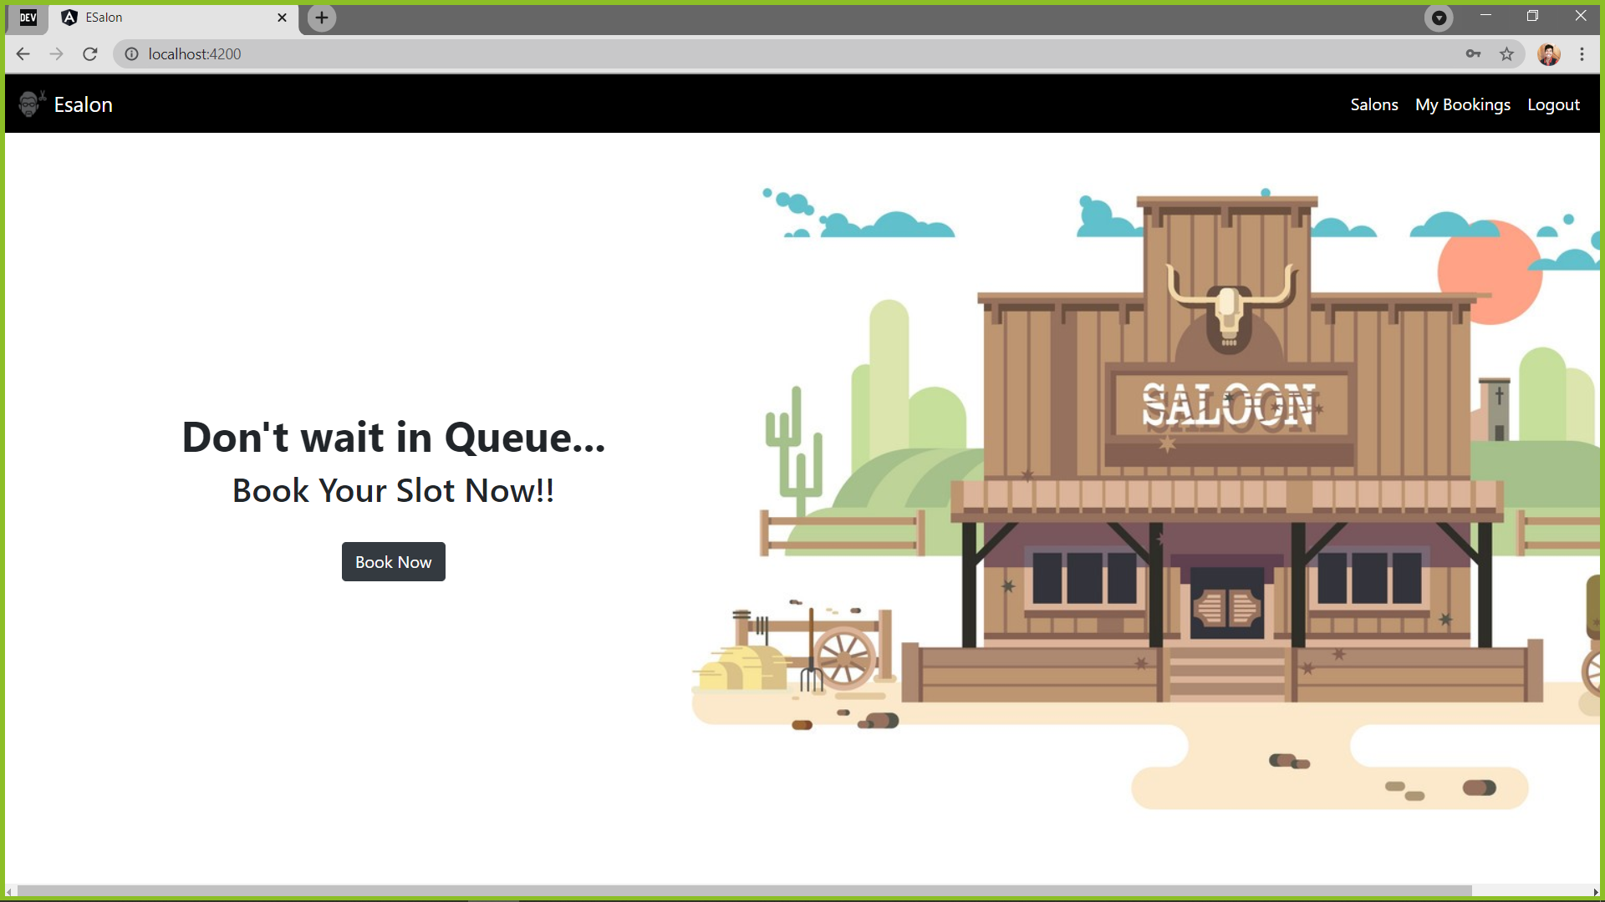
Introduction
Online salon Booking is a Website where user can reserve the time slot in a salon at available date.
Admin maintains the shop details and other stuffs.

Slide 3
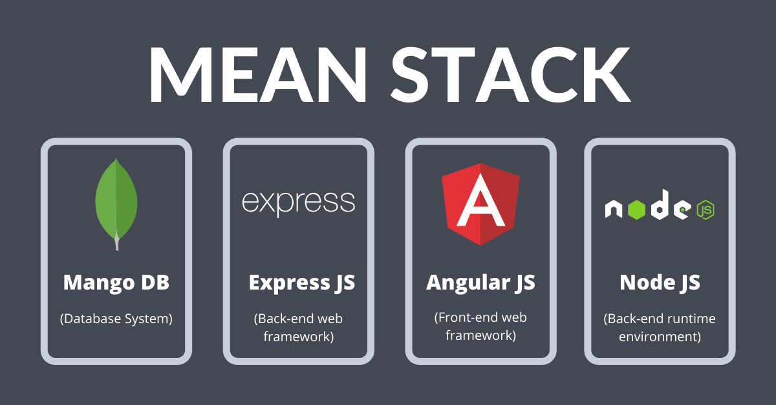
Technology
MEAN Stack (Angular , Node js , Mongo DB , Express) is used to Develop the Entire Application.

Slide 4
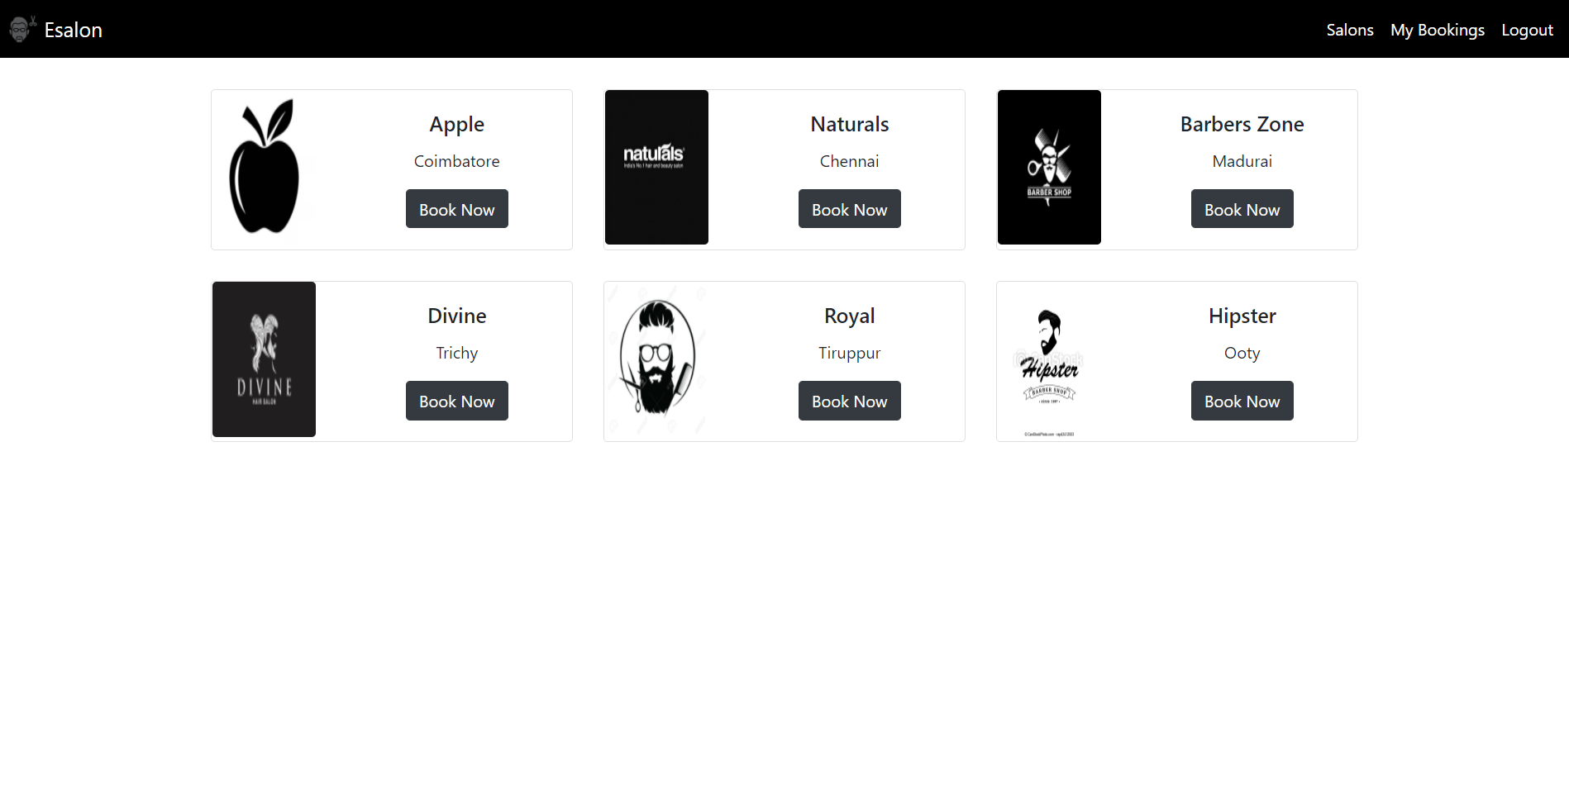
Advantage
User can book their services as per convenient date and time. So that they don't need to wait for the service in a salon at Queue.
User can easily identify where he can Get the required Service
User Friendly Application

Slide 5
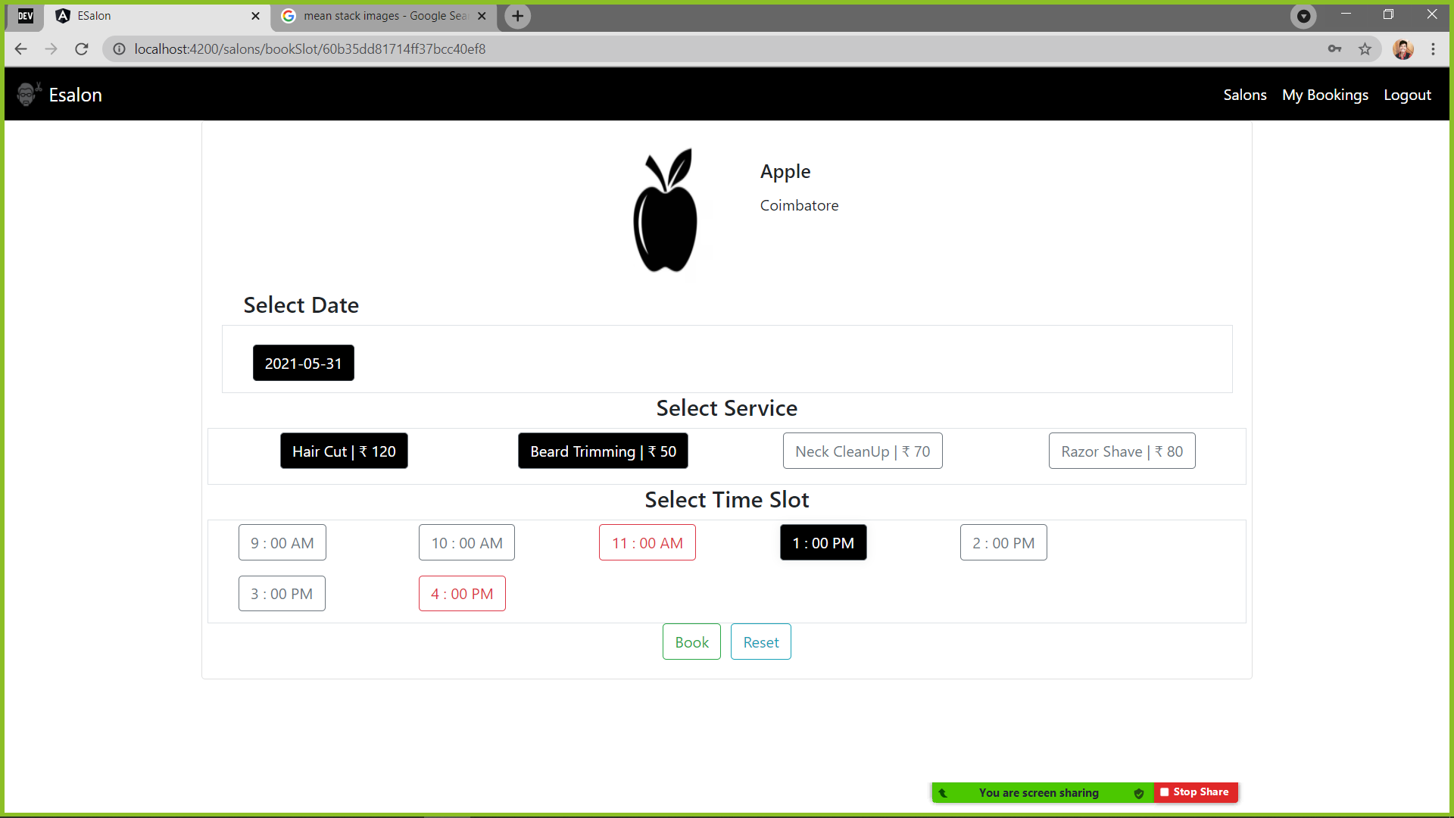
Working Process
Only an Registered user can Reserve a slot , a new user should signup to proceed with booking.
User Selects the Shop then redirects to a page where Available slots , Dates , services are Displayed.
User has to choose the date and available slot along with the required Service.
User can not choose a slot which is already Reserved.
User needs to Confirm the booking by clicking confirm
User can checkout his Bookings at My Bookings Module

Slide 6
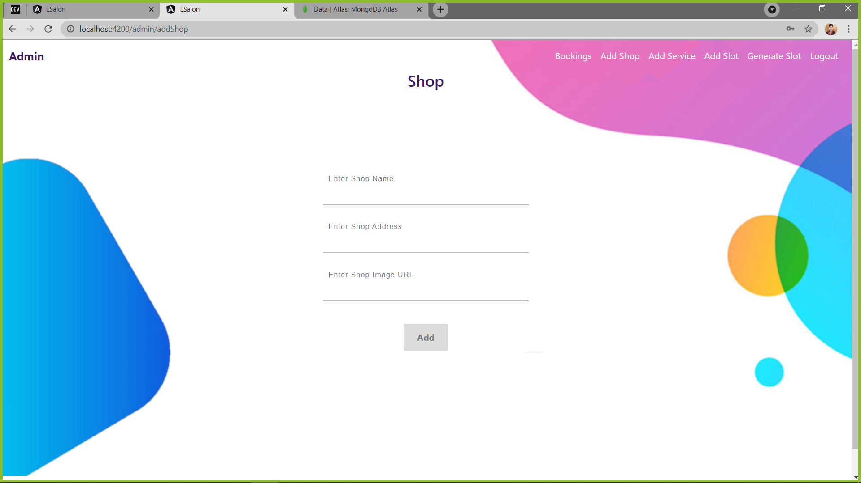
Admin
Admin maintains the Shop Details , updating , Service , slot , Date and all booking details at one place.

Slide 7

Future Enhancement
Booking Confirmation Mail is send to the User on Successful Booking.
Each shop owner can have a separate admin Login so that shop owner can maintain shop details , services , slot and Bookings.
Introducing Payment Gateway system before Booking Confirmation.

Slide 8

Conclusion
This project aims to reduce the wating time of a customer in Salon.
The project is designed in such a way that the user can easily Reserve a available slot in the salon.

Slide 9


