Slide 1

SENTIMENT AND SITUATION ANALYSIS OF COVID-19
Karthick Vedapudi Kumar

Slide 2
Outline
Objectives
INTRODUCTION
Sentiment analysis : TWITTER Data
Situation analysis : Tracking data
SUMMARY
FUTURE SCOPE

Slide 3

Objectives
The objective of the project is:
To extract twitter data and tracking website data about Corona Virus using Twitter APIs and various other python libraries.
To utilize Machine Learning algorithms to perform sentiment analysis and situation analysis of the scraped data.
To visualize the twitter data and tracking website data to gain insights about the latest COVID-19 situation.

Slide 4

Introduction
Accessing historical data from feeds on social media can be very helpful in performing study of emotions and interpreting consumer behavior against a specific case, product or comment.
In late 2019, coronavirus had been reported across China and by 2020 in many other countries around the globe.
People around the world are worried about the spread of corona virus and are expressing their thoughts on social media. Some of the commonly observed emotions of the people are fear, anger, sadness, hope, etc. I will be exploring these reactions using sentiment analysis techniques.
To effectively combat the covid-19 situation, it is important to conduct a situation analysis and identify the impact of corona pandemic.

Slide 5
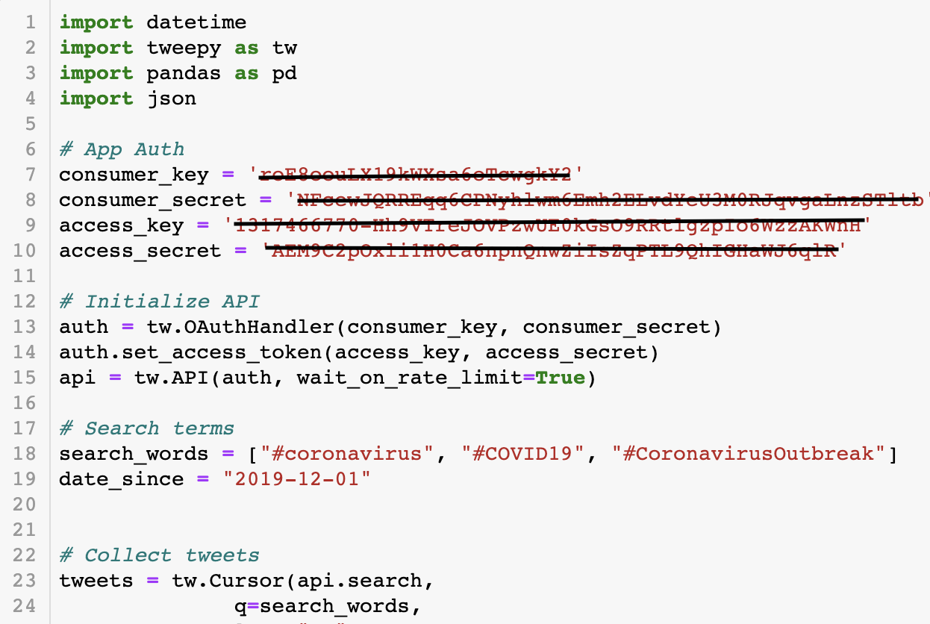
Sentiment analysis : TWITTER DATA
DATA EXTRACTION
The major contributor to our analysis was the data from Twitter. To extract data from Twitter, it is required by the user to create an API through the twitter developer platform. Post this I have implemented the code to extract the data at two different levels.
Keyword level
Account handle level

Slide 6
DATA PREPARATION
File
Json to csv
Aggregate multiple csv's
Pre-Processing
Data Cleansing
Labelling
Manual
Model

Slide 7
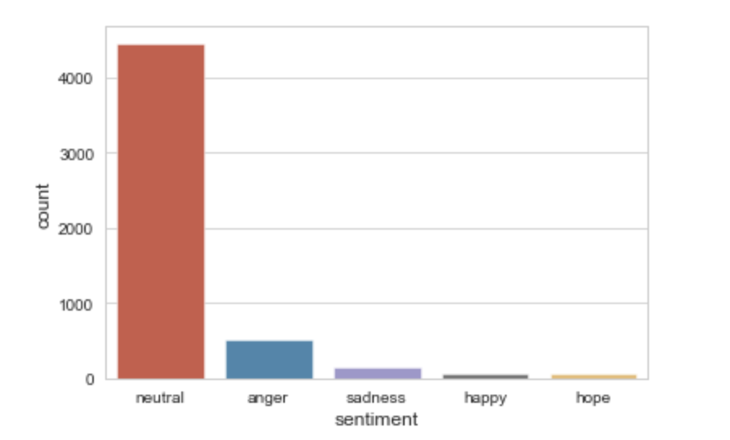

Slide 8
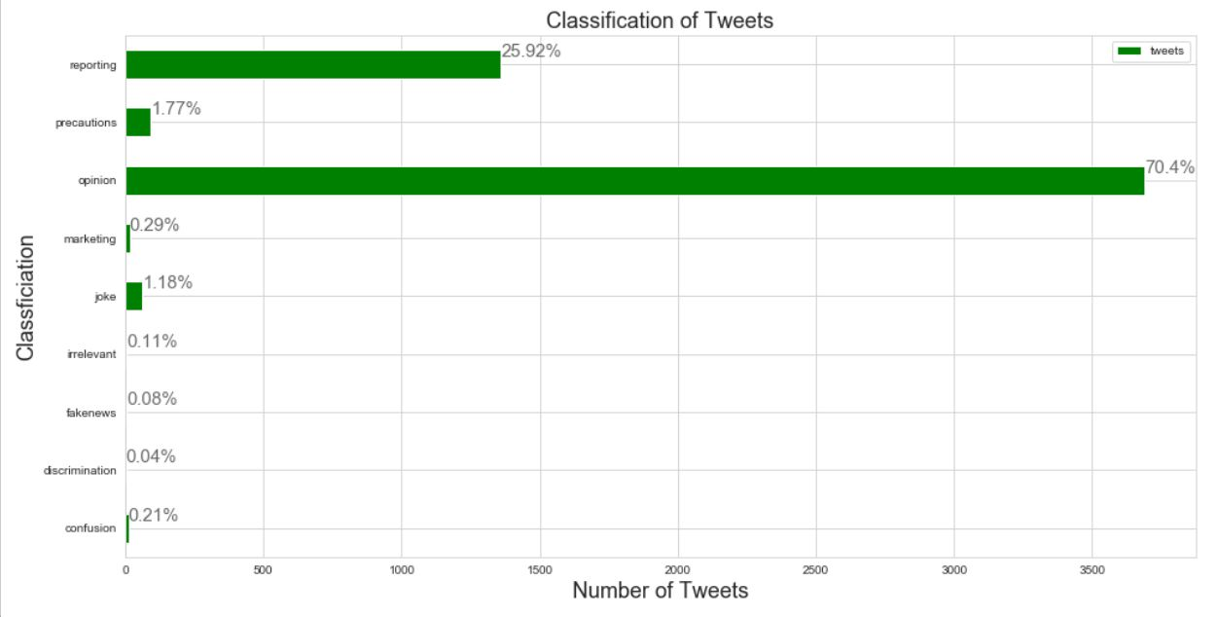

Slide 9
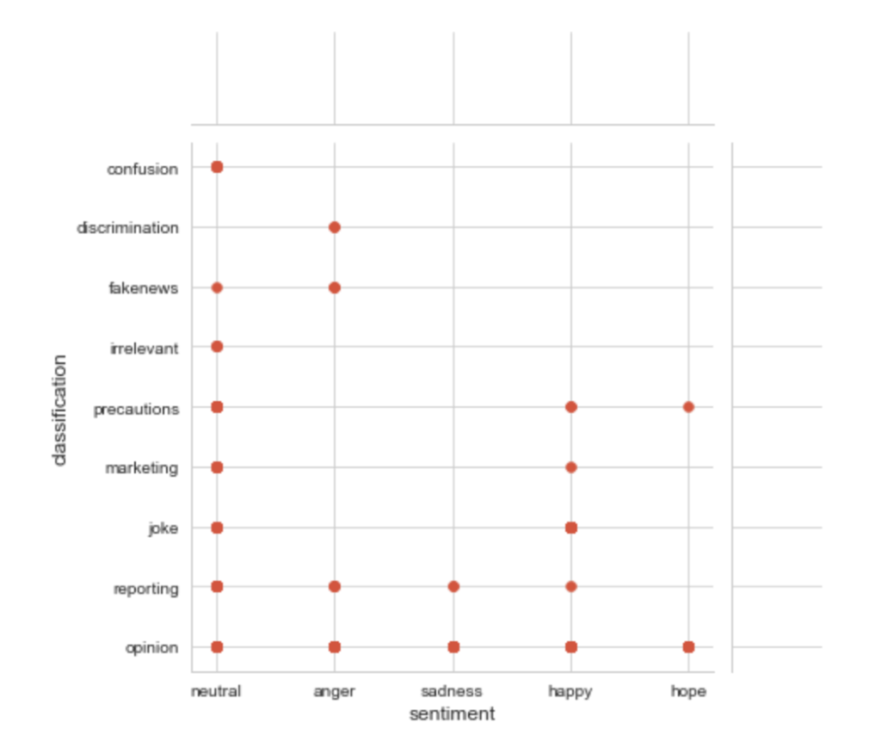
Intersection of classification and Sentiment of tweets

Slide 10
It can be seen that some types of tweets fall under multiple sentiments. Example: “fakenews” type falls under both neutral and anger. This is because people who tweet fakenews are classified under neutral and people who are condemning fakenews are classified under anger. It is not surprising to see that discriminating tweets exhibit angry emotion. Another interesting insight is that reporting tweets fall under every category except hope. It shows that there is a constant increase in corona cases leading to less hope amongst people.

Slide 11
Reactions towards world’s top leaders twitter handles.

Slide 12
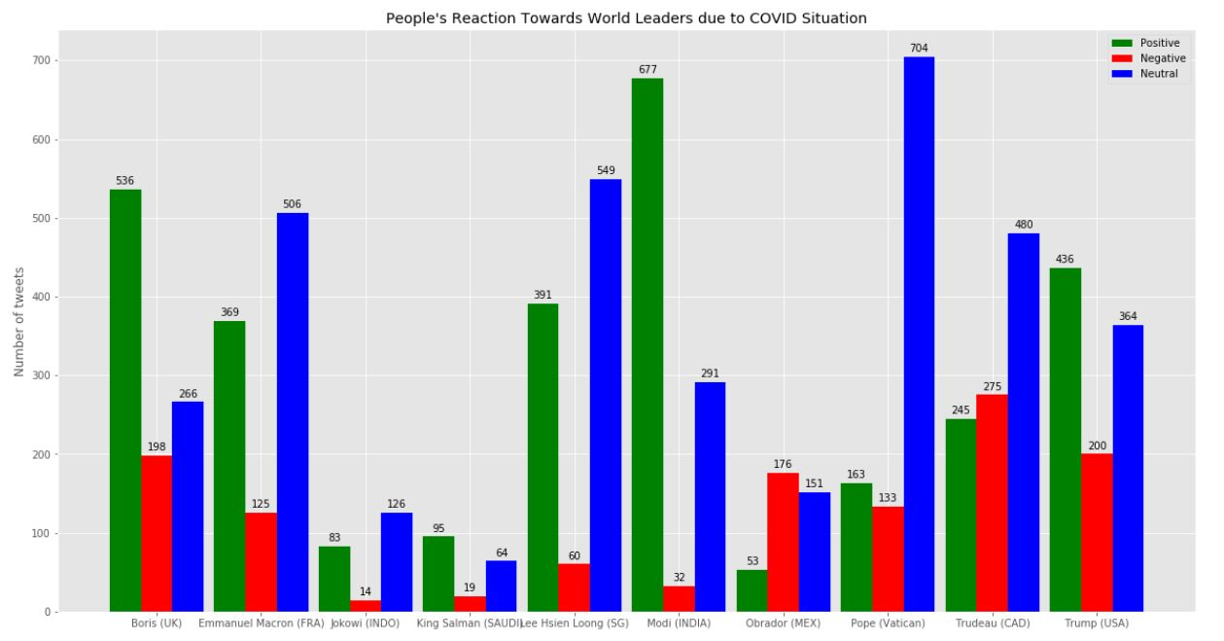

Slide 13
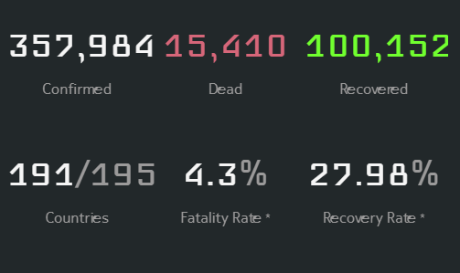
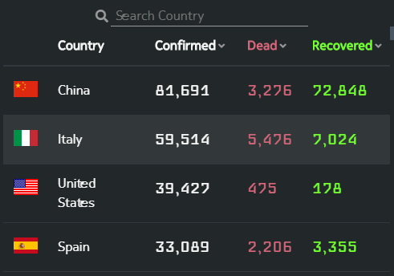
Situation analysis : Tracking Data
DATA EXTRACTION
Statistics obtained from https://www.trackcorona.live/ .
Libraries used:
Cloudscraper : To bypass Cloudflare's anti-bot page.
BeautifulSoup : To parse HTML elements

Slide 14
DATA PREPARATION
World-wide Statistics
Country-wise Statistics
Saved into a Dataframe
Saved into a dictionary
Dataframe converted into csv file

Slide 15

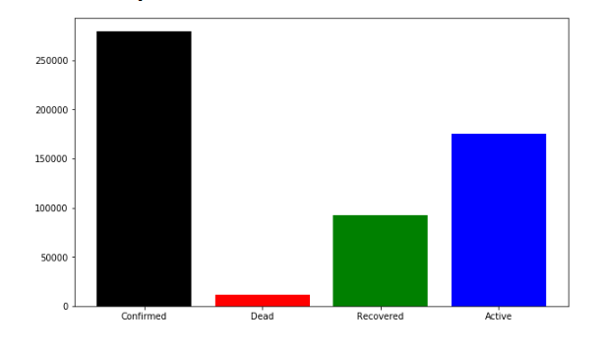
WORLD-WIDE STATISTICS

Slide 16

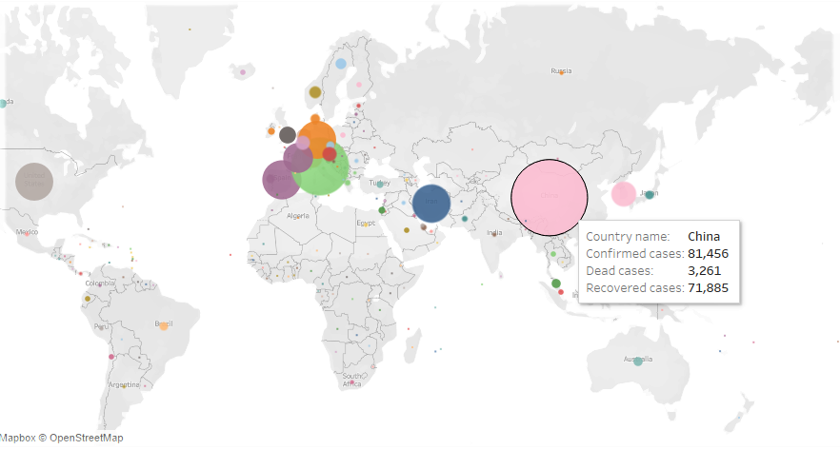
COUNTRY-WISE STATISTICS

Slide 17
Limitation and Future scope
LIMITATIONS
Twitter API data limits issue.
Unable to tap tweets and other sources published in Chinese, Italian ,Spanish due to language constraints.
FUTURE SCOPE
Aspect based sentiment analysis can help to identify more sentiments towards specific aspect such as leadership.
Language tools and interpreters can be used for data from regions like China, Italy, Spain etc.

Slide 18
Summary
Majority tweet sentiments were neutral.
Neutral tweets mostly were related to
Precautions and reporting - which shows people are empathizing and taking precautionary measures.
Out of the 10 world leaders, people reacted most positively towards Modi and most negatively towards Justin Trudeau. This might be because of the fact that when I have extracted tweets, wife of Canadian leader has been affected by Covid-19. So people exhibit lot of sad reactions which led to negative sentiment. So Aspect based sentiment analysis can help to identify more specific sentiments than traditional sentiment analysis done in this project. Government can do this kind of analysis and retrospect about their leaders.
Corona pandemic is spreading fast throughout the world. Amongst the infected cases, many are recovering but few are also facing death.

