Slide 2
Definition
Big data is high-volume, high-velocity and/or high-variety information assets that demand cost-effective, innovative forms of information processing that enable enhanced insight, decision making, and process automation.

Slide 3
Bigdata Definition
Volume –if we got the proper resource(traditional) for handling these much data as this IDC(International data corporations) in 2025.
https://www.red-gate.com/blog/database-development/whats-the-real-story-behind-the-explosive-growth-of-data
Velocity
Variety
Veracity
Value

Slide 4
Volume
The name ‘Big Data’ itself is related to a size which is enormous.
Volume is a huge amount of data.
To determine the value of data, size of data plays a very crucial role. If the volume of data is very large then it is actually considered as a ‘Big Data’. This means whether a particular data can actually be considered as a Big Data or not, is dependent upon the volume of data.
Hence while dealing with Big Data it is necessary to consider a characteristic ‘Volume’.
Example: In the year 2016, the estimated global mobile traffic was 6.2 Exabytes(6.2 billion GB) per month. Also, by the year 2020 we will have almost 40000 ExaBytes of data.

Slide 5
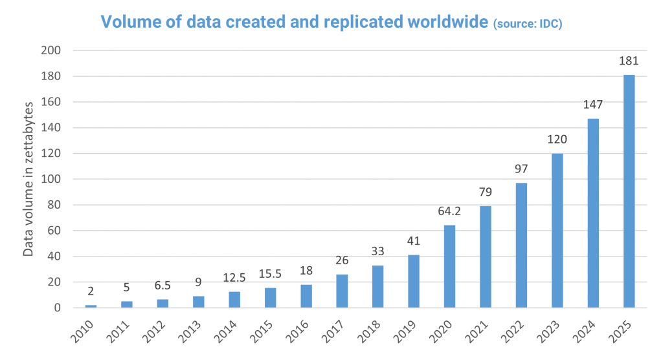

Slide 6
Velocity
Velocity refers to the high speed of accumulation of data.(data is streaming at fast pace)
In Big Data velocity data flows in from sources like machines, networks, social media, mobile phones etc.
There is a massive and continuous flow of data. This determines the potential of data that how fast the data is generated and processed to meet the demands.

Slide 7
Velocity
Google handles 3.8 million searches per minute on average across the globe. That comes out to 228 million searches per hour, 5.6 billion searches per day, or 2 trillion searches per year! That's a lot of searches!
Every second, on average, around 6,000 tweets are tweeted on Twitter, which corresponds to over 350,000 tweets sent per minute, 500 million tweets per day and around 200 billion tweets per year.
243,055 new photos are uploaded to Facebook every minute. 23 . There are 127 photos uploaded on average per Facebook user.
500 hours of video are uploaded to YouTube every minute. We watch over 1 billion hours of YouTube videos a day, more than Netflix and Facebook video combined. 70% of YouTube views come from mobile devices.

Slide 8
Variety
Structured(data with schema)
Semi-Structured(data either schema/schemeless)
Unstructured(no schema) around 85% data (video, audio, pictures, text)

Slide 9
Veracity
Messiness of the data(data cleansing)
If you data is not cleaned and maintained, it will be really hard to make the right decisions on the right time and also the information's will be inaccurate

Slide 10
Value
If you the 4vs -> we will gain the actionable insights
Data insights refers to the deep understanding an individual or organization gains from analyzing information on a particular issue.

Slide 11
Terminologies
Database -> schema based structural data that deal with 2 dimensional(OLTP)
Data Warehousing -> Schema based structural data that deal with multi dimensional data(OLAP)
Data Mart -> subset of data warehousing
Data Lake

Slide 12
Data Lake
Central repository for all the types of data
Structured, Unstructured and semi-structured
Can accept the data from disparate data sources
Inhouse
External
Keep the data in raw format
Process this data using various tech tools like spark directly

Slide 13
Hadoop 1 -> HDFS(distributed storage module) + MapReduce(distributed computing module) -> JAVA
Hadoop 2 -> HDFS(distributed storage module) + MapReduce(distributed computing module) + YARN

Slide 14
Daemons -> process (Hadoop v1)
HDFS(distributed storage = master + slave)
Master -> name node
Slave -> data node
MAPREDUCE(distributed processing = master + slave)
Master -> Job Tracker
Slave -> Task Tracker

Slide 15
Daemons -> process (Hadoop v2)
HDFS(distributed storage = master + slave)
Master -> name node
Slave -> data node
MAPREDUCE(distributed processing = master + slave)
Master -> Resource Manager
Slave -> Node Manager

Slide 16
In Hadoop 1, there is HDFS which is used for storage and top of it, Map Reduce which works as Resource Management as well as Data Processing. Due to this workload on Map Reduce, it will affect the performance.
In Hadoop 2, there is again HDFS which is again used for storage and on the top of HDFS, there is YARN which works as Resource Management. It basically allocates the resources and keeps all the things going on.

Slide 17
Hadoop Architecture
Sqoop
H
I
V
e
Hba
S
e
core
sql
streaming
ml
Graphx
Impala
Kafka
Nifi
search
HUE
OOZIE/
Airflow
Hive LLAP
Map Reduce
(Java)
Tez
(Java)
Spark
(Scala)
YARN(yet another resource negotiator)
Distributed OS Layer
Distributed File System
HDFS/HBASE/NOSQL/S3/KUDU/Azure Data Lake Storage
JAVA(Java Development Kit)
Operating System(File System(ext1,ext2,ext3,ext4,xfs))
Hardware(Cloud Hardware/ On-premises)

Slide 18
History
Hadoop -> 2006 -> Doug Cutting
He designed the Hadoop framework with the base of google whitepaper
Google GFS -> 2003
Google MR -> 2004

Slide 19
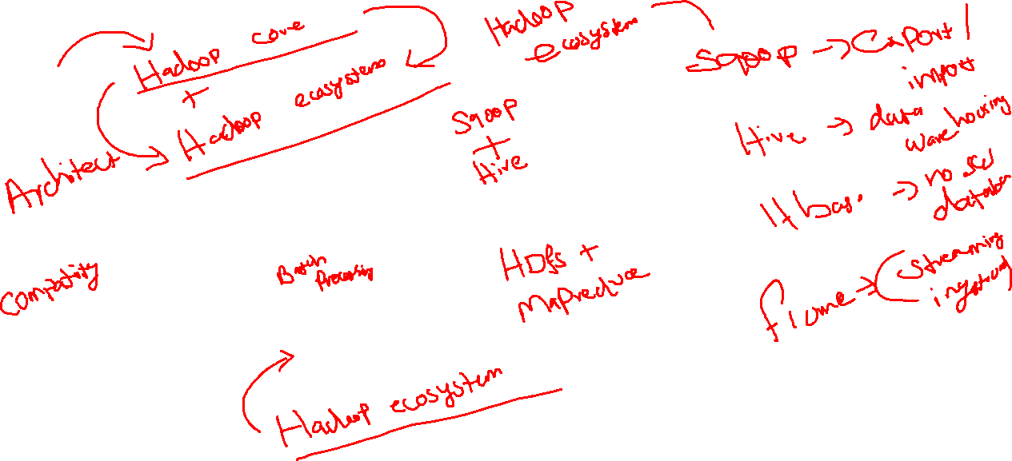

Hadoop
Core

Slide 20
hdfs-site.xml
dfs.data.dir | ${hadoop.tmp.dir}/dfs/data | Determines where on the local filesystem an DFS data node should store its blocks. If this is a comma-delimited list of directories, then data will be stored in all named directories, typically on different devices. Directories that do not exist are ignored.
dfs.name.dir | ${hadoop.tmp.dir}/dfs/name | Determines where on the local filesystem the DFS name node should store the name table(fsimage). If this is a comma-delimited list of directories then the name table is replicated in all of the directories, for redundancy.

Slide 21
mapreduce.framework.name | local | The runtime framework for executing MapReduce jobs. Can be one of local, classic or yarn

Slide 22
JVM, JDK, JRE
Java Runtime Environment -> Compiler for our java program to convert the java -> Machine Code
.java -> javac -> .class(byte code)
JVM -> will be the place where your byte codes will run
JDK -> Java Development kid -> help you to develop the java program in an efficient manner(tools/lib)

Slide 23

JDK => JVM + JRE + Tools/Lib(required for java developers)
Daemon -> Long running Unix/Linux process
HDFS(distributed storage = master + slave)
Master -> name node
Slave -> data node
MAPREDUCE(distributed processing = master + slave)
Master -> Resource Manager
Slave -> Node Manager
.jar -> collection of byte codes(collection of multiple java program)
Daemon -> Collection of multiple jar files -> run on top of JVM

Slide 24
3 types of deployment(top of JDK)
Single node -> all the required daemons everything will run on one OS and in one JVM -> Testing purpose
Single node(Pseudo Distribution) -> all the required daemons everything will run on one OS and in multiple JVM
Multi Node Cluster -> all the required daemons will run on multiple OS and Multiple JVM

Slide 25


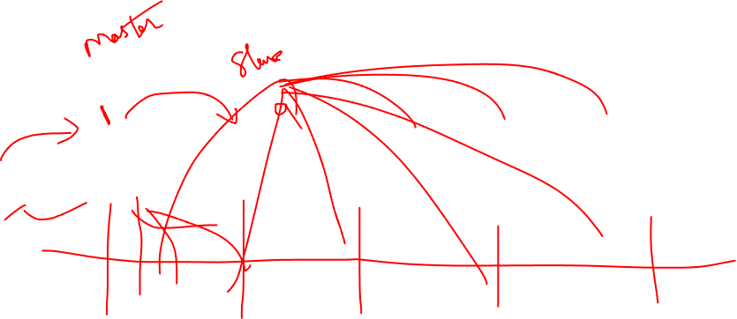

Slide 26
Hadoop Overview
Hadoop
Core

Slide 27
Hadoop got 2 ways
Administrator
Developer -> Java, Scala and Python
Is there any way will be the for the developers to work without any kind of administrative overhead
Hadoop -> Readymade
Hortonworks + Cloudera -> 2019
Databricks -> Spark
Confluent -> Kafka
Anaconda -> Python

Slide 28
HDFS(Hadoop Distributed File System)
Pros:
Fault Tolerant on commodity hardware(because of failure possibilities will be available lot in commodity hardware)
Horizontally Scalable(if in the case of architecture reach the maximum limitation we need to add one more system to that architecture, so it can automatically fetch those ne system resource and increase the storage capacity automatically)
Scaling horizontally is the same as scaling by adding more machines to a pool or resources — but instead of adding more power, CPUs, or RAM, you scale back to existing infrastructure.

Slide 29
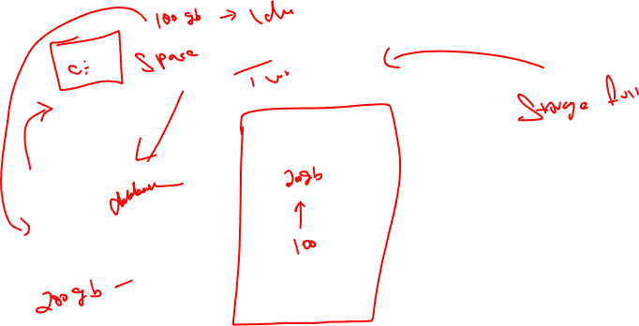

Slide 30
Cons:
We cant update the data in HDFS(kind of architecture that will based on metadata(like Datawarehouse), whatever the data inside this architecture they will call it as OLAP )
It is not good for random read/random write -> alternatively HBase will support for random read/ random write

Slide 31
Difference between small file system and large file system
Small File System(ext4, NTFS, FAT, FAT32, XFS) | Large File System(HDFS)
Vertically Scalable | Horizontally Scalable
Small block sizes(in KBs) | Large block size(in MBs) Version1 -> 64 MB Version2 -> 128MB
No Replication of data | Data is replicated Version 2 -> 1 +2(default replication policy) 200gb -> will occupy 200 + 400 GB
Stateful($pwd,$cd) | Stateless(always absolute path)
Updates are allowed | Updates are not allowed

Slide 32
HDFS Architecture
Master Node
Master
Name Node
Data Node 1
Data Node 2
Data Node 3
Data Node 4

Slide 33
HDFS Architecture
Master Machine(Name Node Daemon)
it wont stores the actual data
Responsible for receiving the heartbeats from the Data Node(to check the node was alive)
Receive the Block Reports(information about data occupied)
Worker Node(Data Node Daemon)
It will be the responsible to store the actual data
By default Data Node save the data in the format of Blocks
Blocks -> Unit of data(Degree of parallelism)
V1 -> default block size is 64MB
V2 -> Default block size is 128MB
Ex: 200 MB actual data v2 architecture -> 2 block -> 1st block -> 128, 2nd block size ->72MB

Slide 34
HDFS Architecture
As per the replication policy v2 -> 200 MB -> 600MB of data
V3 -> Erasure Coding (EC) can be used in place of replication, which will provide the same level of fault-tolerance with less storage overhead. -> 200MB -> 300MB

Slide 35
MapReduce
Distributed Processing Engine -> run on top of YARN
Fault Tolerant processing engine on commodity hardware(Retry of Tasks)
Horizontally Scalable
Solve Big data problems:
No low level programming
Failures taken care by framework automatically
Focus on writing business logic
Partial Failures / Handle the data automatically

Slide 36
Maximum of 100 lines -> Java
1 million lines of byte code -> java + add more resources to the existing machine
1 Billion ->MapReduce Cluster(in the distributed environment with the help of JDK)
Before 2006 -> companies used the data warehousing concept to do the large scale data analysis
After 2006 -> Companies move to bigdata -> beyond database -> large volume + ML(by means of Hadoop + Mahout)

Slide 37
MapReduce
It is an distributed computing engine that is used to perform our jobs in Hadoop architecture
It is one of main component in Hadoop architecture
To perform the job on JVM, Mapreduce -> Development(JDK), Compile time(JRE), integration with HDFS Storage(Java based Distributed Storage)
Idea behind MapReduce will be core for lots of distributed architecture to do data analysis in an efficient way, so we need to understands the physical view and logical view in an clear

Slide 38
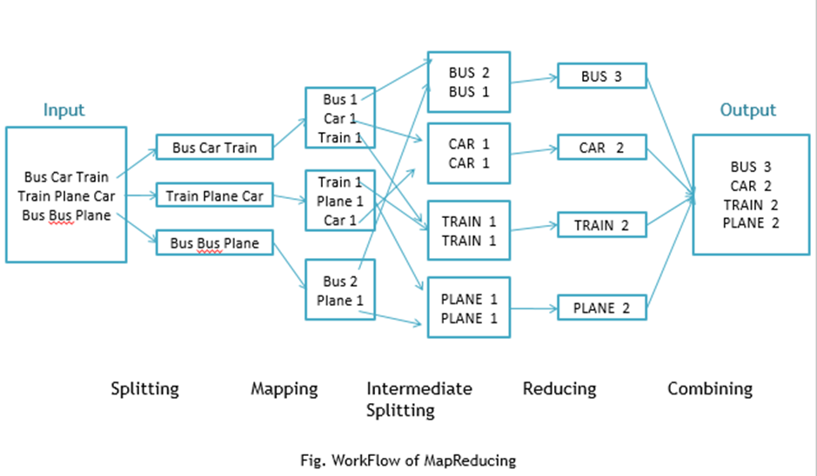

Slide 39
MapReduce Operation
Mapper
Extract
Filter
Parse
Transform
Reducer
Statistical Operation(Aggregation)

Slide 40

MapReduce -> Logical View
Input and Output data Only from HDFS -> why? -> Java based Distributed storage with Fault Tolerant, Horizontally Scalable
Input
Data
From
HDFS
Mapper
Phase
Local File System
Of Mapper
Machine
Sorting and Shuffling
Phase
Local File System
Of Reducer
Machine
Reducer
Phase
Output
Data
From
HDFS
Step 1
Step 2
Step 3
Step 4
Step 5
Step 6
1
2
3
4
5
6
7
Bus,1
Car,1
Train,1
Train,1
Plane,1
Car,1
Bus,1
Bus,1
Plane,1
Bus Car Train
Train Plane Car
Bus Bus Plane

Slide 41
MapReduce -> Physical View
Job Tracker
Local FS
Local FS
Local FS
Local FS
Sort and Shuffling
Sort and Shuffling
Sort and Shuffling
Task Tracker 1
Task Tracker 2
B1
Mapper
Local FS
Mapper
Local FS
Task Tracker 3
Task Tracker 4
B2
B3
Mapper
Local FS
Local FS
Reducer
B4

Slide 42

MapReduce -> Physical View
Job Tracker
Local FS
Local FS
Local FS
Local FS
Sort and Shuffling
Sort and Shuffling
Sort and Shuffling
Task Tracker 1
Task Tracker 2
B1
Mapper
Local FS
Mapper
Local FS
Task Tracker 3
Task Tracker 4
B2
B3
Mapper
Local FS
Local FS
Reducer
B4
B1
Mapper
B1
Mapper

Slide 43
MapReduce -> Physical View
Master
Worker 1
Worker 2
Worker 3
Worker 4

Slide 44
Master Machine
Task Tracker
Worker Node
Heartbeat
HDFS Master Daemon
Job Tracker
HDFS Worker Daemon

Slide 45
B1
B2
Bus Car Train
Train Plane Car
Bus Bus Plane
B3

Slide 46
Stage 1
Stage 2
Bus,1
Car,1
Train,1
Train,1
Plane,1
Car,1
Bus,1
Bus,1
Plane,1
Bus Car Train
Train Plane Car
Bus Bus Plane

Slide 47
YARN(Yet another Resource Negotiator)
Version 2 -> Mapreduce V1 -> Resource allocation and Job Handling
In version2 -> Hadoop -> they see prated the job handler and the resource allocation by means of 2 principles
MapReduce v2 -> Actual job will run on MapReduce v2 under the guidance YARN
YARN -> Allocating the resources that is required for running the job

Slide 48
YARN(Yet another Resource Negotiator)
It was developed by the company Horton Works
Idea was introduced this technology which will act as OS
YARN -> Distributed OS -> interface to manage the cluster hardware(entire cluster)
Cluster Capacity -> only from the Worker Nodes
Worker Machine -> 16GB Ram + 8 Core Processor
30% -> OS(5GB,3Core)
Daemons -> (HDFS, YARN, MapReduce)(2GB ram + 2 Core)
Remaining Resource-> 9 GB Ram+ 3 Core Processor
In our cluster 1000 Worker Nodes will be there means
(9 TB Ram and 3000 Core Processor) Resource available to run our work on Hadoop -> Cluster Capacity

Slide 49
YARN
Distributed OS
Managing the Cluster Hardware(Cluster Capacity)
Resource allocation for Apps/Tasks
Monitor the heal of entire cluster(Worker Node down, it will try to run the job somewhere else, wait for heartbeat from the worker nide which is down)
Heartbeat -> kind of communication message that is send from Worker node to Master node(inform the worker node is alive)
Logging -> log file aggregation property is there
Pluggable -> install(Spark, Tez, MapReduce)
Prioritization -> priority to job

Slide 50

Resource Manager
Node Manager
Data
Name Node
Data Node
Application Master
Yarn Master
HDFS Master
Step 1
Step 5
Step 2
Step 3
Step 4
Worker Node 1
Worker Node 2
Worker Node 3
Worker Node 4

Slide 51
Jar ->
Develop ->

Slide 52
Create the local file in demo.txt
Put the file in hdfs mkdir , put, ls, cat
hadoop jar /usr/local/hadoop/share/hadoop/mapreduce/hadoop-mapreduce-examples-2.6.0.jar wordcount /data/karthick.txt /output3

Slide 53
Break -> 04.30

Slide 54
Sqoop Handson -> 04.00
karthick1808.c0lf9xyp8cv9.ap-south-1.rds.amazonaws.com
Welcome!123

Slide 55
Hive -06.00
Create database.
Create tables
Difference between internal and external table
Load the data from hdfs
bucket

Slide 56
Purpose of Secondary Name node in Hadoop
Many people think that Secondary Name node is just a backup of primary Name node in Hadoop. If you are one among them, then the time has come for you to assimilate the real potential of the Secondary Name node.
Whenever we restart a Hadoop cluster, we knew that metadata will be loaded in to main memory. Not the entire metadata, only a part of metadata will be loaded in to main memory.

Slide 57
Components of metadata in Hadoop :
editlogs – This keeps tracking of each and every change that is being done on HDFS. (Like adding a new file, deleting a file, moving it between folders..etc). It resides in Primary Name Node
fsimage – Stores the inode details like modification time, access time, access permission, replication.
Any change that we do to HDFS will be tracked in edit logs, not in the fsimage. So the edit logs file will keep on growing whereas the fsimage size remains the same. This won’t have any impact unless or until we restart the cluster. When we restart the cluster, the fsimage needs to get loaded in to the main memory. Since all changes are present in the editlogs not in the fsimage, hadoop will try to write editlogs changes to fsimage(this takes some time depends on the size of the editlogs file).
If you have not restarted your cluster for months together and if you are about to do it, then there will be a vast down time as editlogs size would have grown like anything.

Slide 58
Benefits of Secondary namenode :
The solutions for this problem is to have a secondary namenode. How does secondary namenode solve this problem ?
Secondary namenode does something called checkpoint process.
1. Secondary namenode gets editlogs and fsimage periodically from primary NN.
2. Secondary loads both the fsimage and editlogs to main memory by merging and applies each operation from edits to fsimage.
3. The secondary copies new fsimage to primary and also updates the modified time of fsimage to fstime file, so now fsimage is now updated.
Since fsimage is updated, there will be no overhead of copying of edit logs at the moment of restarting the cluster. At the same time editlogs file size will be always minimal(since changes are flushed to fsimage), adding up to the performance as well.

Slide 59
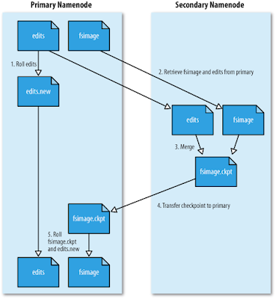

Slide 60
Formats for Hadoop
Text/CSV
A plain text file or CSV is the most common format both outside and within the Hadoop ecosystem. The great disadvantage in the use of this format is that it does not support block compression, so the compression of a CSV file in Hadoop can have a high cost in reading.
SequenceFile
The SequenceFile format stores the data in binary format. This format accepts compression; however, it does not store metadata and the only option in the evolution of its scheme is to add new fields at the end. This is usually used to store intermediate data in the input and output of MapReduce processes.
Avro
Avro is a row-based storage format. This format includes in each file, the definition of the scheme of your data in JSON format, improving interoperability and allowing the evolution of the scheme. Avro also allows block compression in addition to its divisibility, making it a good choice for most cases when using Hadoop.
Parquet
Parquet is a column-based (column-based) binary storage format that can store nested data structures. This format is very efficient in terms of disk input / output operations when the necessary columns to be used are specified. This format is very optimized for use with Cloudera Impala.
RCFile (Record Columnar File)
RCFile is a columnar format that divides data into groups of rows, and inside it, data is stored in columns. This format does not support the evaluation of the scheme and if you want to add a new column it is necessary to rewrite the file, slowing down the process.
ORC (Optimized Row Columnar)
ORC is considered an evolution of the RCFile format and has all its benefits alongside with some improvements such as better compression, allowing faster queries. This format also does not support the evolution of the scheme.

Slide 61
Why we are using the winrar and winzip
Data compression to reduce the size of the file
Data loss
OLAP -> data editing is not recommended

Slide 62
Floppy and CD/DVD -> cd/dvd drive -> insert the cd/dvd to recover the data in it -> 100% data in it

Slide 63
Sequential File Format
Sequence file processing -> save the data in sequential block in the HDFS Storage
Sequence files are binary files containing serialized key/value pairs.
You can compress a sequence file at the record(kay-value) or block level
In the Hadoop processing of small files through Mapreduce -> time consuming
Serialized files means -> it will complete the work as early as possible -> sequential manner

Slide 64

10 TB of videos -> 30-40 GB
10 TB of videos -> 30-40 GB
10 TB of Files -> 1kb to 200 MB
10 TB of Files -> 1kb to 200 MB

Slide 65
Partitioners, Combiners and Distributed Cache

