Slide 2
Definition
Big data is high-volume, high-velocity and/or high-variety information assets that demand cost-effective, innovative forms of information processing that enable enhanced insight, decision making, and process automation.

Slide 3
Bigdata Definition
Volume –if we got the proper resource(traditional) for handling these much data as this IDC(International data corporations) in 2025.
https://www.red-gate.com/blog/database-development/whats-the-real-story-behind-the-explosive-growth-of-data
Velocity
Variety
Veracity
Value

Slide 4
Volume
The name ‘Big Data’ itself is related to a size which is enormous.
Volume is a huge amount of data.
To determine the value of data, size of data plays a very crucial role. If the volume of data is very large then it is actually considered as a ‘Big Data’. This means whether a particular data can actually be considered as a Big Data or not, is dependent upon the volume of data.
Hence while dealing with Big Data it is necessary to consider a characteristic ‘Volume’.
Example: In the year 2016, the estimated global mobile traffic was 6.2 Exabytes(6.2 billion GB) per month. Also, by the year 2020 we will have almost 40000 ExaBytes of data.

Slide 5
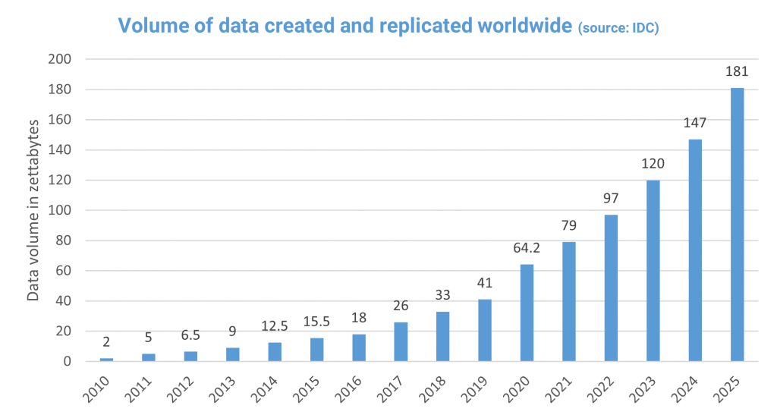

Slide 6
Velocity
Velocity refers to the high speed of accumulation of data.(data is streaming at fast pace)
In Big Data velocity data flows in from sources like machines, networks, social media, mobile phones etc.
There is a massive and continuous flow of data. This determines the potential of data that how fast the data is generated and processed to meet the demands.

Slide 7
Velocity
Google handles 3.8 million searches per minute on average across the globe. That comes out to 228 million searches per hour, 5.6 billion searches per day, or 2 trillion searches per year! That's a lot of searches!
Every second, on average, around 6,000 tweets are tweeted on Twitter, which corresponds to over 350,000 tweets sent per minute, 500 million tweets per day and around 200 billion tweets per year.
243,055 new photos are uploaded to Facebook every minute. 23 . There are 127 photos uploaded on average per Facebook user.
500 hours of video are uploaded to YouTube every minute. We watch over 1 billion hours of YouTube videos a day, more than Netflix and Facebook video combined. 70% of YouTube views come from mobile devices.

Slide 8
Variety
Structured(data with schema)
Semi-Structured(data either schema/schemeless)
Unstructured(no schema) around 85% data (video, audio, pictures, text)

Slide 9
Veracity
Messiness of the data(data cleansing)
If you data is not cleaned and maintained, it will be really hard to make the right decisions on the right time and also the information's will be inaccurate

Slide 10
Value
If you the 4vs -> we will gain the actionable insights
Data insights refers to the deep understanding an individual or organization gains from analyzing information on a particular issue.

Slide 11
Terminologies
Database -> schema based structural data that deal with 2 dimensional(OLTP)
Data Warehousing -> Schema based structural data that deal with multi dimensional data(OLAP)
Data Mart -> subset of data warehousing
Data Lake

Slide 12
Data Lake
Central repository for all the types of data
Structured, Unstructured and semi-structured
Can accept the data from disparate data sources
Inhouse
External
Keep the data in raw format
Process this data using various tech tools like spark directly

Slide 13
Hadoop 1 -> HDFS(distributed storage module) + MapReduce(distributed computing module) -> JAVA
Hadoop 2 -> HDFS(distributed storage module) + MapReduce(distributed computing module) + YARN

Slide 14
Daemons -> process (Hadoop v1)
HDFS(distributed storage = master + slave)
Master -> name node
Slave -> data node
MAPREDUCE(distributed processing = master + slave)
Master -> Job Tracker
Slave -> Task Tracker

Slide 15
Daemons -> process (Hadoop v2)
HDFS(distributed storage = master + slave)
Master -> name node
Slave -> data node
MAPREDUCE(distributed processing = master + slave)
Master -> Resource Manager
Slave -> Node Manager

Slide 16
In Hadoop 1, there is HDFS which is used for storage and top of it, Map Reduce which works as Resource Management as well as Data Processing. Due to this workload on Map Reduce, it will affect the performance.
In Hadoop 2, there is again HDFS which is again used for storage and on the top of HDFS, there is YARN which works as Resource Management. It basically allocates the resources and keeps all the things going on.

Slide 17
Hadoop Architecture
Sqoop
H
I
V
e
Hba
S
e
core
sql
streaming
ml
Graphx
Impala
Kafka
Nifi
search
HUE
OOZIE/
Airflow
Hive LLAP
Map Reduce
(Java)
Tez
(Java)
Spark
(Scala)
YARN(yet another resource negotiator)
Distributed OS Layer
Distributed File System
HDFS/HBASE/NOSQL/S3/KUDU/Azure Data Lake Storage
JAVA(Java Development Kit)
Operating System(File System(ext1,ext2,ext3,ext4,xfs))
Hardware(Cloud Hardware/ OnPremisis)

Slide 18
History
Hadoop -> 2006 -> Doug Cutting
He designed the Hadoop framework with the base of google whitepaper
Google GFS -> 2003
Google MR -> 2004

Slide 19
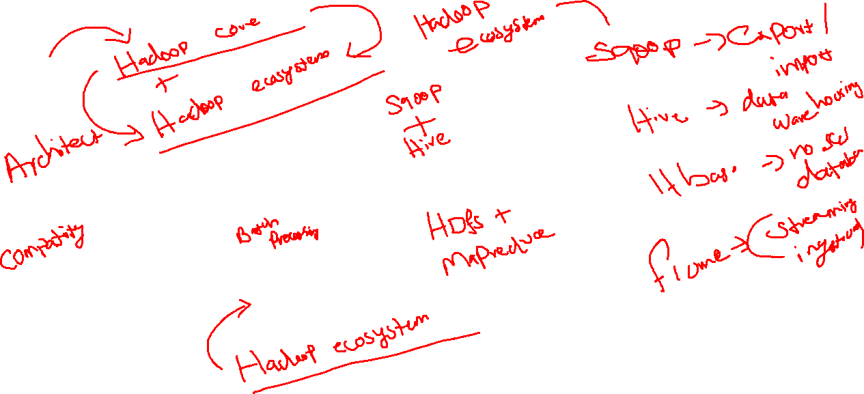
Hadoop
Core

