Slide 1
IAM
Karthick Selvam

Slide 2
Centralized user and privilege control management service in AWS Cloud

Slide 3
Set the user
They created 2 separate URL to sign in for root and IAM account
Create the IAM Users login link

Slide 4
VPC
Local Network -> it will be the local area network that been formed via cable nor wifi
Global Network

Slide 5
IP Address
IP Address -> unique name that has been given to the IP supported devices
IANA -> Internet assigned number authority -> USA Govt
Types of IP address
IPV4
IPV6

Slide 6
IPV4
Internet Protocol Version 4
Logical name that has been allocated for IP supported devices
Structure
Dotted decimal number
Bits -> bits
Ipv4 -> 32 bits
4 octets -> 4*8=32
Each and every octets has been divided with the help of .

Slide 7
IPV4
11111111.11111111.11111111.11111111
00000000.00000000.00000000.00000000
0->0
00000000 -> 0
1->1
11111111 ->255
Numbers of each and every octets ranges from 0 -255
255.255.255.255

Slide 8
Class of IPV4
Class A -> 0-126
Class B -> 128-191
Class C -> 192-223
Class D -> 224-249
Class E -> 240-255

Slide 9
Class of IPV4
Overall space of ipv4 is 2^32 = 4.7 billion
Is it possible to use IP address like your phone number?
Class A,B,C -> General normal users
Class D -> Multicasting purpose
Class E -> Experimental and Research purpose

Slide 10
Private range IP Address
Class A -> 10.0.0.0 10.255.255.255
Class B -> 172.16.0.0 172.31.255.255
Class C -> 192.168.0.0 192.168.255.255
PAT Concept

Slide 11
Subnet Mask
Is nothing but the information that we are going to give to the network about my network size.
Default Subnet Mask are
Class A -> 255.0.0.0 -> 11111111.00000000.00000000.00000000
Class B -> 255.255.0.0 -> 11111111. 11111111. 00000000.00000000
Class C -> 255.255.255.0 -> 11111111.11111111.11111111.00000000
1 -> host
0-> network
While communicate with 2 machine -> the source subnet mask and destination subnet mask should need to be equal

Slide 12
192.168.1.1
Class:C
Subnet Mask: 255.255.255.0
192.168.1.100
Class:C
Subnet Mask: 255.255.255.0

Slide 13
172.16.1.1
Class:B
Subnet Mask: 255.255.0.0
172.16.10.1
Class:B
Subnet Mask: 255.255.0.0

Slide 14
192.168.1.0 -> 255.255.255.0
Class C
192.168.1.0
192.168.1.255
256 host -> Single Network

Slide 15
172.16.0.0
Class -> B
Subnet mask -> 255.255.0.0
Range -> 172.16.0.0,172.16.0.255,1.0,1.255,255.0,172.16.255.255
No host in single network -> 65536(256*256)

Slide 16
10.0.0.0
Class: A
Subnet Mask: 255.0.0.0
Range -> 10.0.0.0 10.255.255.255
256*256*256 = 16777216 System

Slide 17
Home network
Network engineer -> save IP address wastage, increase QOS
20
Class C -> 256 -2=254 -20 = 234
Class B -> 65536 -2=65534 -20 = 65514
Class A-> 16777216 -2=16777214 -20 = 16777194

Slide 18
Is there any other possibilities will be there to reduce the IP address wastages.
IP -> binary numbers -> binary division is it possible to divide that?
Yes, it is possible
Subnetting
Super netting Concept

Slide 19
Subnetting

Slide 20
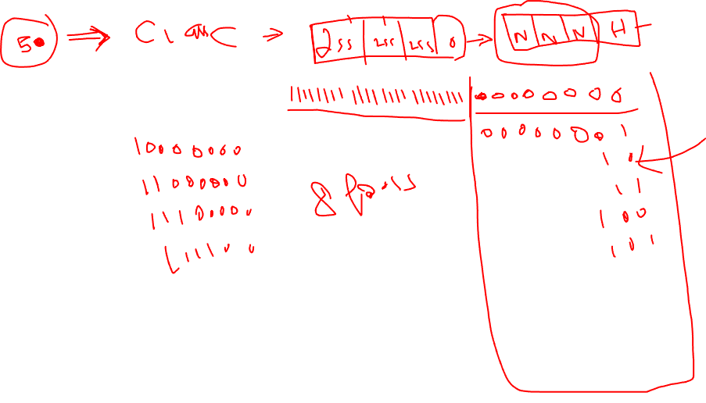

Slide 21
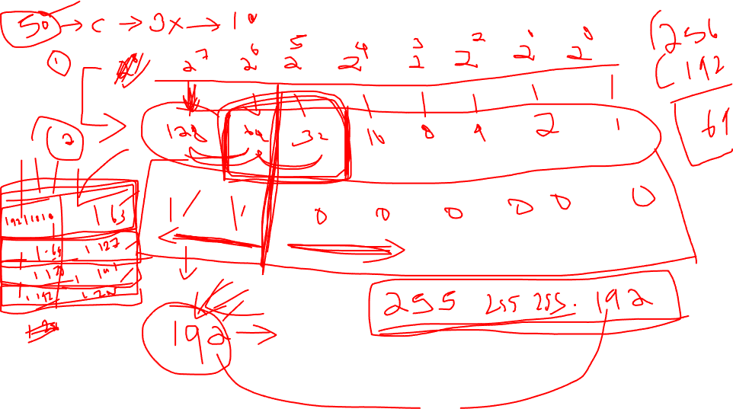

Slide 22
CIDR
255.0.0.0 -> /8
255.128.0.0 -> /9
255.192.0.0 -> /10
255.224.0.0 -> /11
255.240.0.0 -> /12
255.248.0.0 -> /13
255.252.0.0 -> /14
255.254.0.0 -> /15
255.255.0.0 -> /16

Slide 23
CIDR
255.255.128.0 -> /17
255.255.192.0 -> /18
255.255.224.0 -> /19
255.255.240.0 -> /20
255.255.248.0 -> /21
255.255.252.0 -> /22
255.255.254.0 ->/23
255.255.255.0 -> /24

Slide 24
CIDR
10000000 -> 255.255.255.128 -> /25
11000000 -> 255.255.255.192 -> /26
11100000 -> 255.255.255.224 -> /27
11110000 -> 255.255.255.240 -> /28
11111000 -> 255.255.255.248 -> /29
11111100 -> 255.255.255.252 -> /30
11111110 -> 255.255.255.254 -> /31
11111111 -> 255.255.255.255 -> /32

Slide 25
192.168.1.0/26

