Slide 1
AWS Glue
Karthick Selvam

Slide 2
ETL
ETL process has been designed for specifically for the transferring the data from multiple data sources to data warehouse.
However the challenges and complexity of ETL can make t hard to implement successfully for all your enterprise data’s.

Slide 3
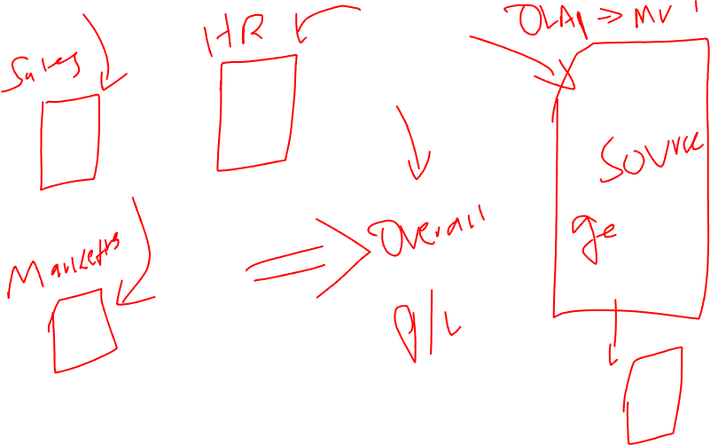

Slide 4
If you are going for these kind of scenarios, we need to get the data's from multiple sources
Structural -> MySQL, SQL, Postgres, MariaDB, Oracle, Aurora
Semi-Structural -> Excel, JSOM, XML
Convert all multiple formatted data in to Single format data that will be supported for Data Warehouse.
Applications -> Few formatted data's, License, Cost per GB
Programming -> JAVA, Python, Scala

Slide 5
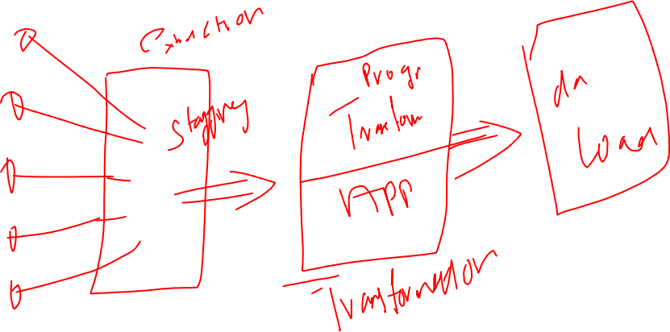

Slide 6


Slide 7
What is AWS Glue
AWS Glue is fully managed ETL Service that makes it simple and cost-effective to Categorize your data, Clean it, Enrich it and move it reliably between various data sources.
It consist of central meta-data repository known as data catalogue.
ETL engine automatically generate the Python/Scala/Java code and Flexible Schedular that handles dependency resolutions, Job Monitoring and Retries.
AWS Glue is serverless so that no infra-structure will ne not needed to setup and maintain.

Slide 8
When do we use AWS Glue?
To build a Datawarehouse to organize, cleanse, validate and format data’s.
You can transform and move the AWS Cloud data into datastore, you can also load the data from desperate sources in to your data warehouse for regular reporting and analysis.
By storing into data warehouse you can move the information's from different parts of your business and provide the common storage/source of data for decision making.

Slide 9
When do we use AWS Glue?
When you run serverless queries against your s3 data lake
S3, AWS glue can catalogue the s3 data, making it available with Amazon Athena, Amazon Redshift.
With Crawlers, your metadata stays in sync with underlying data catalogue.
Athena, Redshift can query your data directly from s3(data lake) using the data catalogue.
Aws Glue can access and analyze the data through one unified interface without loading the original data in to it.

Slide 10
When do we use AWS Glue?
When you want to create the event driven ETL pipelines
You can run your ETL jobs as soon as new data available in amazon s3 by invoking your AWS Glue ETL jobs through AWS Lambda function.
You can register this new data set from AWS Glue data catalogue as the part of ETL jobs.

Slide 11
When do we use AWS Glue?
To understand the data assets.
You can store your data using various AWS Services and still maintain the unified view of data using AWS Glue Data Catalogue
You can view that data Catalogue to quickly search and discover the data sets that you own and maintain relevant metadata in your on central mete data repository.
The data catalogue also serve as drop and replacement for your external apache hive mete store.

Slide 12
Benefits of AWS Glue
Less-Hassle
Glue integrates with wide range of AWS services that will run on same and different networks.
Glue natively support for data stored in Amazon Aurora, RDS, Redshift, S3 and other common database engines.
Cost-Effective
If you compare the competitive services such as Apache Spark, Oracle Software, this will be cost-effective
More-Power
Glue Crawler
Glue own Code
Glue Data catalogue

Slide 13
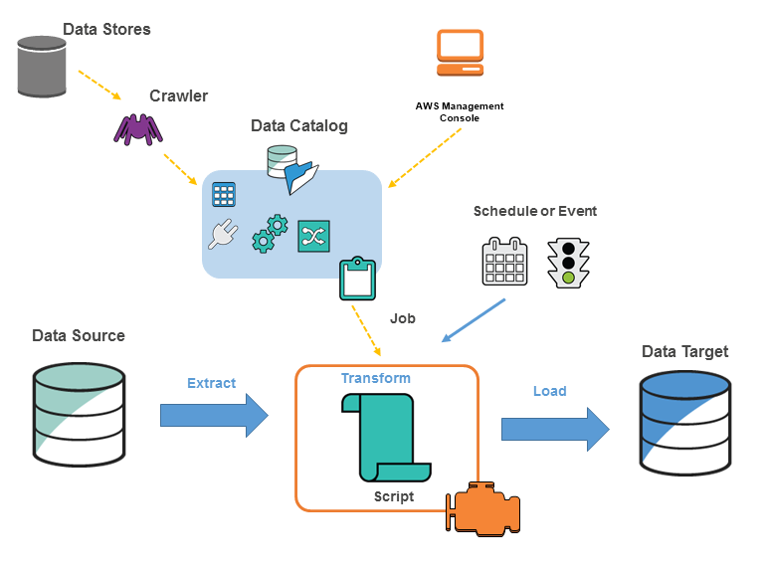
Glue Architecture

