Slide 1
Amazon Redshift

Slide 2
Redshift
Data warehousing tool available in AWS Cloud
It’s the kind of PAAS

Slide 3
Redshift
Amazon Redshift is a fully managed data warehouse service in the cloud. Its datasets range from 100s of gigabytes to a petabyte.
The initial process to create a data warehouse is to launch a set of compute resources called nodes, which are organized into groups called cluster. After that you can process your queries.

Slide 4
Data Warehousing
Storing and managing data from different sources
used for analysis purpose or to make business decisions
storage of large amount of information

Slide 5
Data Warehousing
What will be the need of data warehousing concept?
Ex:
20 software's -> is it possible to deploy all the software's backend from single database source.
Because of we are using various data sources, it will be very difficult to analyse the data's available in various sources and get the clear result.
It will be really difficult to maintain and scale up and scale down whenever it will necessary

Slide 6
Data Warehousing
Moving the data's from various data sources to single repository -> data warehousing
ETL -> concept is really mandatory to move the data from various data sources to single repository.
MySQL are comma separated data(columns are separated by comma and lines are terminated by \n)
Oracle –> tab separated data's
Json
Xml

Slide 7
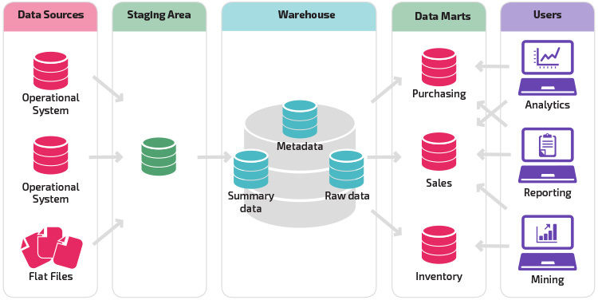
Data Warehousing Architecture

Slide 8
Terminologies
Database
Data ware housing
DataMart’s
A data mart is a simple section of the data warehouse that delivers a single functional data set. ... Data marts might exist for the major lines of business, but other marts could be designed for specific products.
Data Lake
Is the single point of repository that will save all the formats of the files.
It doesn't have any limitations on space.

Slide 9
AWS Redshift
It is massively parallel, column-oriented database deployed on AWS Platform that makes it simple and cost-effective to analyse all your data across your data warehouse and data lake.

Slide 10
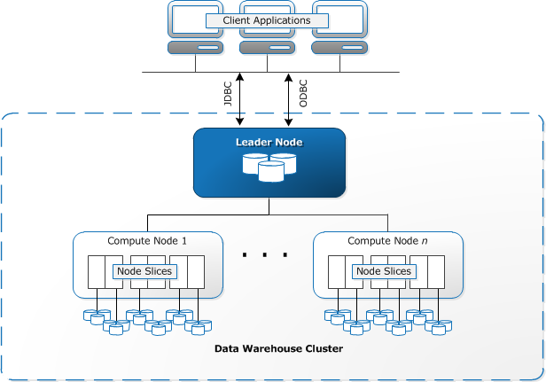

Slide 11
Client applications
Amazon Redshift integrates with various data loading and ETL (extract, transform, and load) tools and business intelligence (BI) reporting, data mining, and analytics tools. Amazon Redshift is based on industry-standard PostgreSQL, so most existing SQL client applications will work with only minimal changes. For information about important differences between Amazon Redshift SQL and PostgreSQL, see Amazon Redshift and PostgreSQL.
Connections
Amazon Redshift communicates with client applications by using industry-standard JDBC and ODBC drivers for PostgreSQL. For more information, see Amazon Redshift and PostgreSQL JDBC and ODBC.
Clusters
The core infrastructure component of an Amazon Redshift data warehouse is a cluster.
A cluster is composed of one or more compute nodes. If a cluster is provisioned with two or more compute nodes, an additional leader node coordinates the compute nodes and handles external communication. Your client application interacts directly only with the leader node. The compute nodes are transparent to external applications.

Slide 12
Leader node
The leader node manages communications with client programs and all communication with compute nodes. It parses and develops execution plans to carry out database operations, in particular, the series of steps necessary to obtain results for complex queries. Based on the execution plan, the leader node compiles code, distributes the compiled code to the compute nodes, and assigns a portion of the data to each compute node.
The leader node distributes SQL statements to the compute nodes only when a query references tables that are stored on the compute nodes. All other queries run exclusively on the leader node. Amazon Redshift is designed to implement certain SQL functions only on the leader node. A query that uses any of these functions will return an error if it references tables that reside on the compute nodes. For more information, see SQL functions supported on the leader node.
Compute nodes
The leader node compiles code for individual elements of the execution plan and assigns the code to individual compute nodes. The compute nodes execute the compiled code and send intermediate results back to the leader node for final aggregation.
Each compute node has its own dedicated CPU, memory, and attached disk storage, which are determined by the node type. As your workload grows, you can increase the compute capacity and storage capacity of a cluster by increasing the number of nodes, upgrading the node type, or both.
Amazon Redshift provides several node types for your compute and storage needs. For details of each node type, see Amazon Redshift clusters in the Amazon Redshift Cluster Management Guide.

Slide 13
Node slices
A compute node is partitioned into slices. Each slice is allocated a portion of the node's memory and disk space, where it processes a portion of the workload assigned to the node. The leader node manages distributing data to the slices and apportions the workload for any queries or other database operations to the slices. The slices then work in parallel to complete the operation.
The number of slices per node is determined by the node size of the cluster. For more information about the number of slices for each node size, go to About clusters and nodes in the Amazon Redshift Cluster Management Guide.
When you create a table, you can optionally specify one column as the distribution key. When the table is loaded with data, the rows are distributed to the node slices according to the distribution key that is defined for a table. Choosing a good distribution key enables Amazon Redshift to use parallel processing to load data and execute queries efficiently. For information about choosing a distribution key, see Choose the best distribution style.
Internal network
Amazon Redshift takes advantage of high-bandwidth connections, close proximity, and custom communication protocols to provide private, very high-speed network communication between the leader node and compute nodes. The compute nodes run on a separate, isolated network that client applications never access directly.

Slide 14
Databases
A cluster contains one or more databases. User data is stored on the compute nodes. Your SQL client communicates with the leader node, which in turn coordinates query execution with the compute nodes.
Amazon Redshift is a relational database management system (RDBMS), so it is compatible with other RDBMS applications. Although it provides the same functionality as a typical RDBMS, including online transaction processing (OLTP) functions such as inserting and deleting data, Amazon Redshift is optimized for high-performance analysis and reporting of very large datasets.
Amazon Redshift is based on PostgreSQL. Amazon Redshift and PostgreSQL have a number of very important differences that you need to take into account as you design and develop your data warehouse applications. For information about how Amazon Redshift SQL differs from PostgreSQL, see Amazon Redshift and PostgreSQL.

Slide 15
Compute Nodes
Dense Storage
Dense Compute
You can select the node depends on
Data Quantity
Complexity of the queries
Downstream Systems

Slide 16
Advantages of RedShift
Easy to Setup , Deploy and Manage
Sale up and down depends on your requirements
10x better performance than other data warehousing tools because of columnar Data Store
Cost-Effective
Allows you to run the queries directly from data lakes
Data is more secure in Redshift.

