Slide 2
Need of Data Base
Instead of handle the files in Semi-structured and Un-Structured way, Structed data will provide the better mechanism to store and retrieve the data in a faster and efficient way
Instead of using general purpose computing method, to store and retrieve the data they are using the DB Engine which provides enhanced features to store and retrieve the data in a faster and efficient way

Slide 3
Database vs DBMS
1. Storage
Besides computers, databases can even be maintained in physical ledgers, books or papers.
In a database management system (DBMS), all the records are maintained only on a computer.
2. Data Retrieval
The retrieval of information from the databases can be done manually, through queries or by using programs (C, C++, Java etc.).
We can retrieve the data from the database management system through queries written in SQL.
3. Speed
As databases can be handled manually or via computers, when SQL is not used to retrieve information, it can be very slow.
As a computer system is involved in a database management system, the retrieval of information is very quick.

Slide 4
Database vs DBMS
4. Access
The databases are not designed for a large number of people who can access data at the same time, rather it is designed for a very small number of people (preferably few people) who access data at different times.
The database management system is designed for a large number of people who can access the data at the same time.
5. Data Manipulation
In case of the databases, very less information can be modified at a time.
In the database management system (DBMS), a lot of information can be changed at one time (as it can have many users using it at the same time).
6. Backup and Recovery
The databases do not ensure that the data will be available after failure arises.
The database management system (DBMS) ensures that the data will always be available even after system failures.

Slide 5
DBMS Architecture
DBMS design depends upon its architecture, the basic client/server architecture is used to deal with a large number od PCS, Web Server, Database Server and Other components that are connected with the same networks.
The Client/Server architecture consist of Many PC’s and the Work station which are connected via network
DBMS Architecture depends on how users are connected to the database and to get their request done

Slide 6
DBMS Architecture
Server -> .exe and you need to install the server components that are required for the corresponding software
Client -> if you want to access you server you need some frontend application to access that, that corresponding front end supported package
Instead of installing the server application in one system, they will install the server application in cluster based software for better failover and load balancing

Slide 7


DBMS Architecture
Request
Response

Slide 8
Types of DBMS Architecture
Tier 1
Tier 2
Tier 3

Slide 9
Tier 1
In this Architecture, the database is directly available to the user, it means the user can directly sit on the DBMS and uses it
Any changes done here will directly be done on the database itself
The 1-tier architecture is used for the development of local application, where the programmers can directly communicate with the database for quick response

Slide 10
Tier 2
The Tier 2 architecture is same as basic Client-server model. In this 2 Tier Architecture application on the client end can directly communicate with the database at the server side(drivers JDBC,ODBC,API)
The user interfaces and application programs are run on the client-side
The server side is responsible for provide the functionalities like query processing and transaction management
To communicate with the DBMS, Client-side application establish connection with server side.

Slide 11
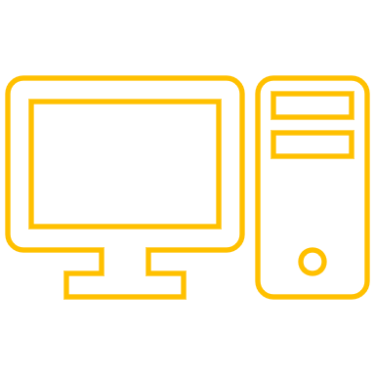
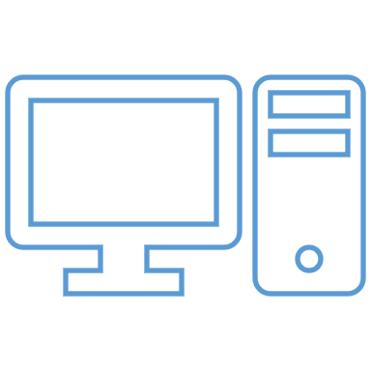
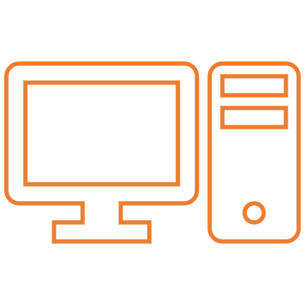
Tier 3
Server Software on these 3 Systems
Application Interface

Slide 12
Tier 3
3 – Tier Architecture contains another layer between the client and server, in this architecture , client cant directly communicate with server
The application on client-end interacts with an application server which further communicates with database systems
Ends user has no idea about the existence of the database beyond the application server. The database also has no idea about any other user beyond the application

Slide 13
2-Tier
Database System
Request
Response
Client Application(Workbench)
End User

Slide 14
3-Tier
Database System
Database System
Database System
Database System
Server Application
Response
Request
Client Application(Workbench)
End User

Slide 15
Data Models
Data model is the modelling of the data description, data semantics and consistency constraints of the data.
It provides the conceptual tools for describing the design of the database at each level data abstraction.
4 types of data models
Relational Data model
Semi Structured Data Model
Entity Relationship Data Model
Object Based Data Model

Slide 16
Relational Data Model
This type of model designs the data in the form of rows and columns with in the table.
Thus, a relational model uses tables for representing data and in-between relationships.
Tables are also called as relations.
This model was initially described by Edgar f. Codd in 1969.
This relational data model is the widely used model which is primarily used by commercial data processing applications.

Slide 17
Entity-Relationship Data Model
An ER Model is the logical representation of the data as objects and relationship among them.
These objects are known as entities and relationship is an association among the entities
This model was designed by Peter chen and Published in 1976.
This model widely used in database designing
A set of attributes describe the entities(student_name, student_id)
A set of entities that got relationship among them they call it as entities set
And set of same type of relationship is knows as relations set.

