Slide 2
Broadcast and Accumulators
Dataset
Spark Streaming

Slide 3
Broadcast and Accumulator + RDD 12 transformations
Hamza Shereef M Mohammed
Ashokkumar Balasubramani
Snehapriya Mohan
Vaishnavi Anguraj
MANIBHARATHI VELUMANI
RAHUL RAJENDRAN
Rathish Venkatesh
Sujith Kumar

Slide 4
Dataset + DataFrames
MANIKANDAN UNNIKRISHNAN
Manoj Rajendran
Ram Prakash Ganesh
MANIKANDAN SANKAR
SARAVANAN SHANMUGASUNDARAM
SAJEEVKRISHNA HARIRAJ
POORNIMA ARUMUGAM
prasad rameshkumar

Slide 5
Spark Streaming
anto bernat
MIDUNCHAKRAVARTHICHAKRAVARTHI JAGANATHAN
kiruthika Ravindaran
SANTHIYA S SELVARAJ
Anu Harshini Ravi
Vithyavarshini Arunachalam
VARUNMOHANRAJ NALLASAMY
Santhini yuvaraj
MEKHALA RAVIKUMAR

Slide 6
Spark Streaming introduction
Spark streaming demo

Slide 7
AWS Topics
Usage, core concepts such as elasticity, scalability, virtualization
IaaS, PaaS, SaaS
Overview of DW and Data Lake related services, such as, EMR, Glue, Redshift, Athena
Region, Availability Zone, Edge Locations
IAM user, roles, policies

Slide 8
Cloud introduction

Slide 9
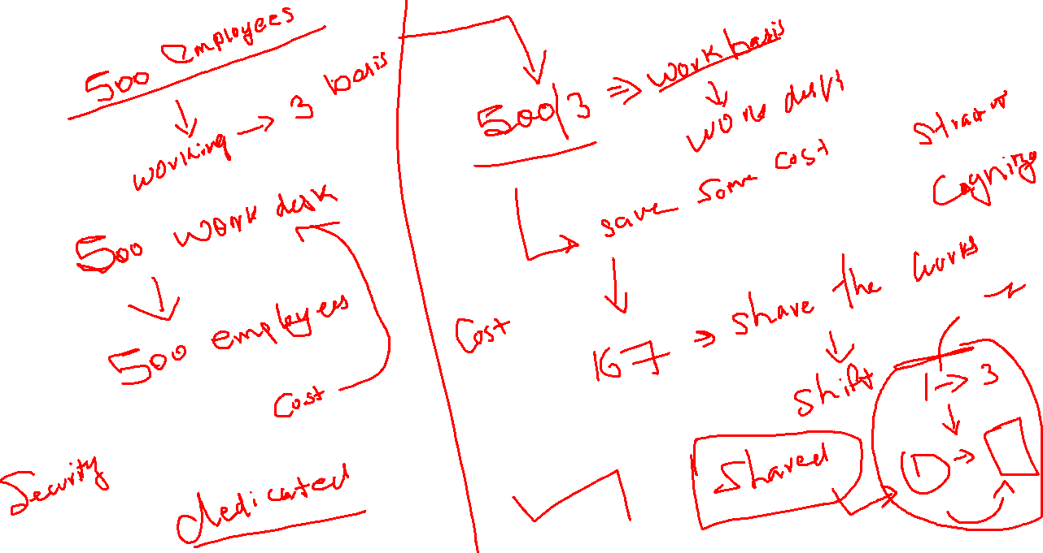

Slide 10
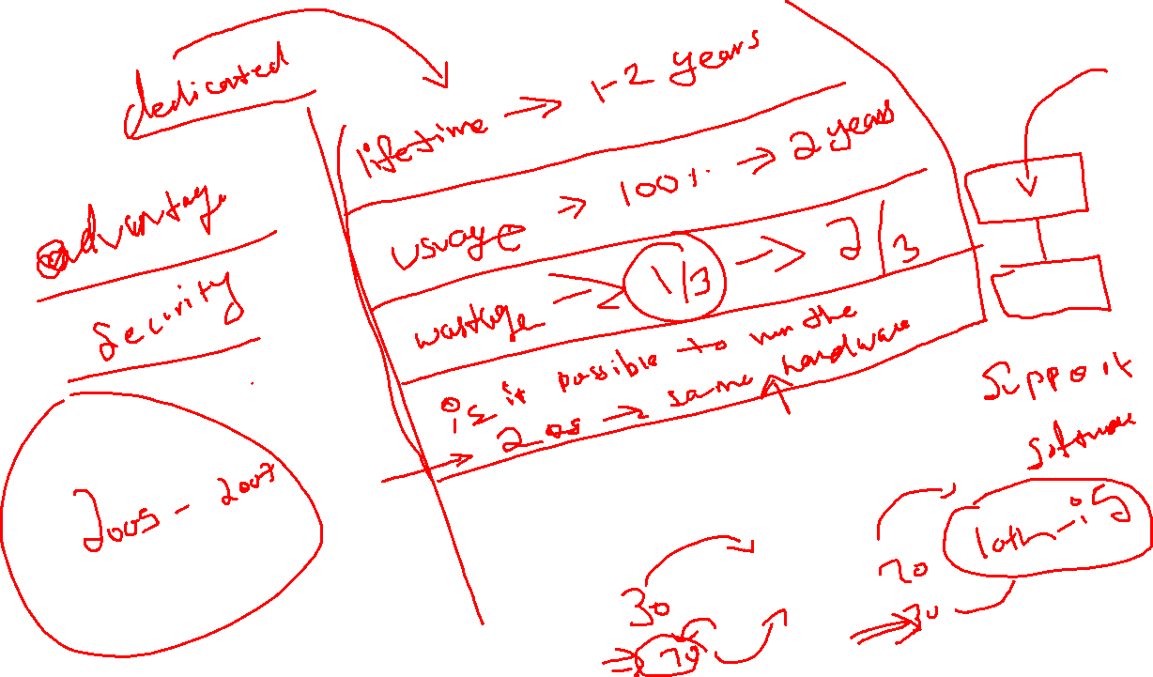

Slide 11
Some company they came up with the concept of running multiple operating systems in the single machine hardware
They call those concept of supporting multiple OS run on singe hardware as virtualization

Slide 12
Definition for virtualization
Process of creating the fake environment that your OS will trust those fake environment hardware, bios, and post process and boot the operations system
There are 2 types of virtualization are there
Type 1
Type 2

Slide 13
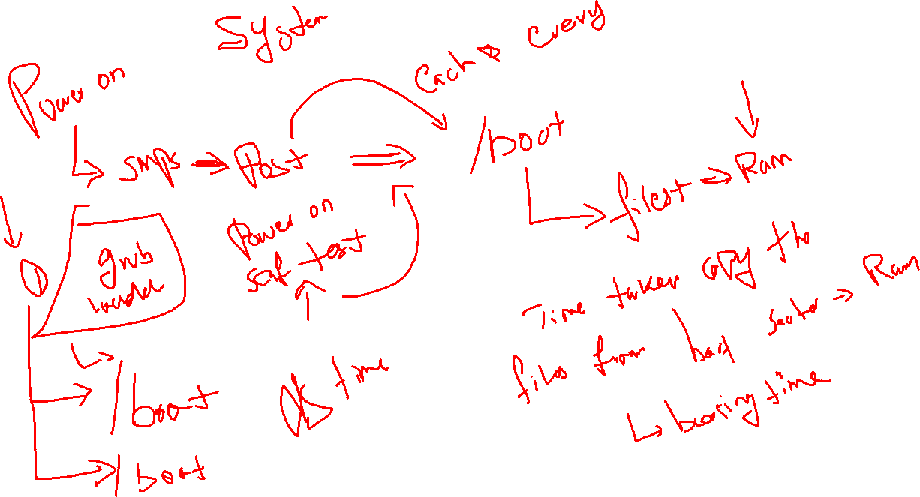

Slide 14
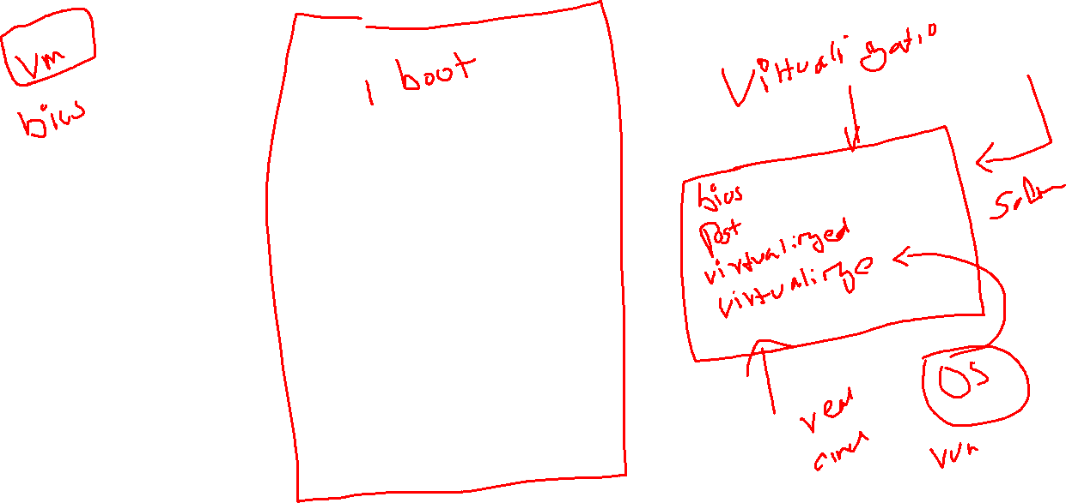

Slide 15
Type 2
Creating the fake environment as an application layer
Because of it will run the OS on application layer, if the underlying OS was busy in other processing and resources are utilized up to 100%
It will result you in performance issue

Slide 16
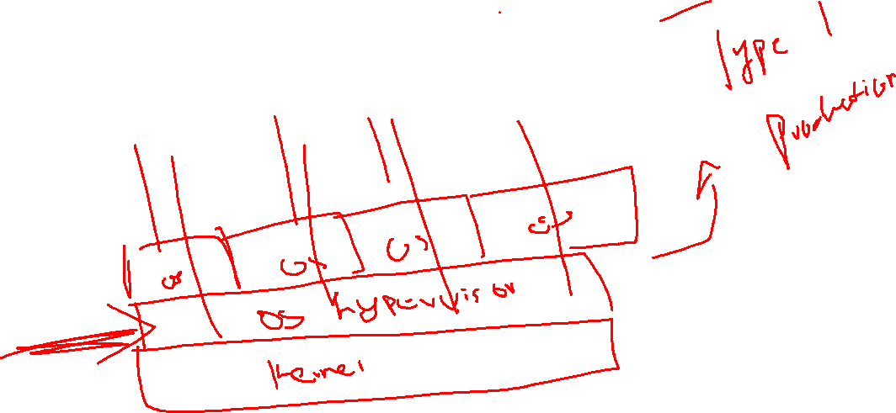
Type 1
Create the fake environment with the OS layer itself

Slide 17
Cloud Introduction
The extended version of Type 1 virtualization is Cloud.
Type 1- Administrations to maintain the virtual hardware, networking, user management , OS Management – Man Power
If the administrator turns against your company means is your data secured?

Slide 18
Cloud
They automated the maintenance of Operation system automatically though separate user friendly GUI and they gave the direct access to the customers directly
So that customers don’t need to have the knowledge on in deep administrator view
Why should I trust cloud?
Google, Amazon and Azure - >we got our trust -> US based companies if some thing happened to your data you can go legal
Main reason all the giant companies they bloomed on Cloud industry

Slide 19
4 types of clouds
Public cloud -> created by public vendor and user by multiple users belong to public, aws, google, amazon
Private Cloud -> created and used for only one company, VMware
Hybrid Cloud -> if the cloud is created by one company and used it by its vendors
Community Cloud -> cloud will be created by one private company and used it by multiple groups of vendors

Slide 20
Categorizes of Cloud
Being an cloud company what kind of services will you offer?
The categorize the services in to 3 types
IAAS -> Infrastructure as Service
PAAS -> Platform as service
SAAS -> Software as service

Slide 21
PAAS ->
Ram + CPU + networking + OS Template + platform + license(OS + platform) + API(CLI + WEB UI) + data lost + security
SAAS ->
Ram + CPU + networking + OS Template + software + license(OS + Software) + API(CLI + WEB UI) + data lost + security
IAAS–> only hardware as rental
Ram + CPU + networking + OS Template -> data lost + security -> install applications, firewall maintenance

Slide 22
IAAS
We need separate network expert, firewall expert, storage expert, application expert will be needed to maintain the architecture.
Cost is cheap

Slide 23
SAAS

Slide 24
PAAS

