Slide 2
MapReduce
Distributed Computing model used in Hadoop Framework
With the advantage of cluster computing they used distributed storage and distributed computing resources which is distributed among multiple systems.

Slide 3
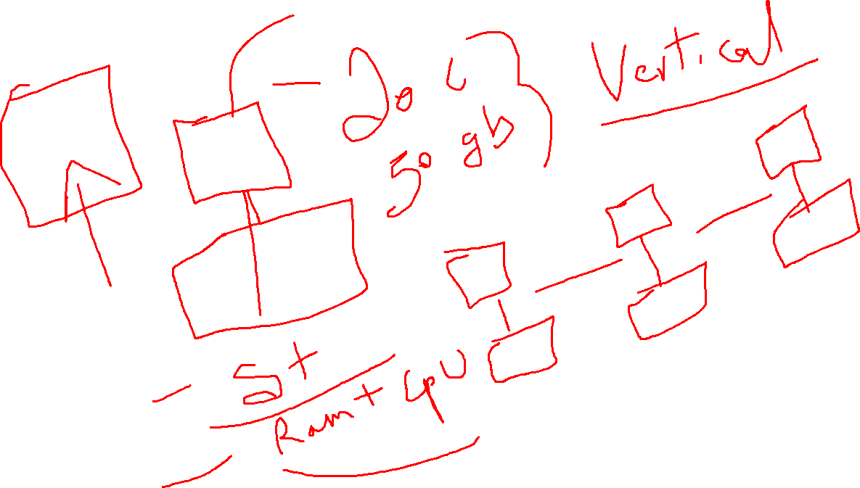

Slide 4
Versions of MapReduce
MapReduce Version 1
MapReduce Version 2
Job Tracker: NameNode and DataNodes store details and actual data on HDFS. This data is also required to process as per client’s requirements. A Developer writes a code to process the data. Processing of data can be done using MapReduce. MapReduce engine sends the code across DataNodes, creating jobs. These jobs are to be continuously monitored; Job tracker manages those jobs.
Task Tracker: The jobs given by Job trackers are actually performed by Task trackers. Each DataNode will have one task tracker. Task trackers communicate with Job trackers to send statuses of the jobs.

Slide 5
Job Tracker
Hadoop clients communicate with the JobTracker to submit or kill jobs and poll for jobs' progress
JobTracker validates the client request and if validated, then it allocates the TaskTracker nodes for map-reduce tasks execution
JobTracker monitors TaskTracker nodes and their resource utilization, that is, how many tasks are currently running, the count of map-reduce task slots available, decides whether the TaskTracker node needs to be marked as blacklisted node, and so on
JobTracker monitors the progress of jobs and if a job/task fails, it automatically reinitializes the job/task on a different TaskTracker node
JobTracker also keeps the history of the jobs executed on the cluster

Slide 6
TaskTracker initializes a new JVM process to perform the MapReduce logic. Running a task on a separate JVM ensures that the task failure does not harm the health of the TaskTracker daemon.
TaskTracker monitors these JVM processes and updates the task progress to the JobTracker on regular intervals.
TaskTracker also sends a heartbeat signal and its current resource utilization metric (available task slots) to the JobTracker every few minutes.

Slide 7
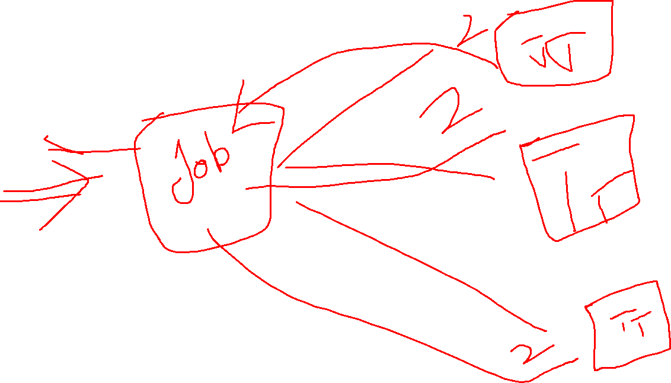

Slide 8
Map Reduce version 2.0
Mapreduce 1.0
Node manager and computing manager
Mapreduce + yarn
YARN
Resource Manager Runs on master daemon and manages the resource allocation in the cluster
Node Manager
They run on the slave daemons and are responsible for the execution of a task on every single data node
Application Master
Manages the user job life cycle and resources needs of individual application. It works along along with the node manager and monitors the execution of the job.

Slide 9
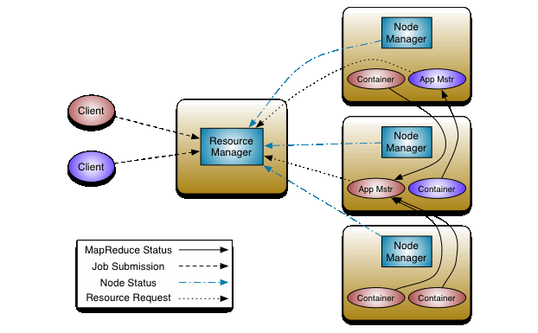

Slide 10
Apache Spark
Apache spark is a lightening fast cluster computing design for the fast computation purpose.
It was built on top of Hadoop MapReduce and it extends the MapReduce model to efficiently use more types of computations which includes interactive queries and stream processing.

Slide 11
Hadoop Framework
HDFS - Storage
MapReduce – Computation
Because of MapReduce will process the entire computation approach by multiple iterations
While transferring the data between the intermediate iterations MapReduce will use the Disk based I/O Transfer between the stages.
Mapreduce will be little slower because of Multiple Disk I/O will need to take place between iterations.

Slide 12
Apache Spark
They designed the RAM based distributed computing model like Mapreduce and Apache Spark
Already data was in my HDFS can we use the same data storage in Apache Sark?
Is it possible to use Apache spark as stand alone ?
I want to use external storage instead of HDFS?
By default MapReduce will support for batch processing data's only, but Apache spark by default they came up with batch processing and stream processing as default.

Slide 13
Batch Processing
Stream data

Slide 14
Apache Spark
Industries are using Hadoop Extensively to analyse their datasets. The reason is that Hadoop Framework is based on simple programming model (MapReduce) and it enables a computing solution that is scalable, flexible , fault tolerant and cost effective.
Here, the main concern is to maintain the speed in processing the large datasets in terms of waiting time between queries and waiting time to run the program.

Slide 15
Apache Spark
Spark was introduced by Apache software Foundation for speeding up the Hadoop computational software process
As against the common belief , Spark is not a modified version of Hadoop and id not really dependent on Hadoop because Apache Spark has its own cluster management service, Hadoop is one of the way to implement the spark.
Spark is designed to cover a wide range of workloads such as batch applications, iterative algorithms , interactive queries and streaming by default.
Apart from supporting all these workload in a respective system, it reduce the management burden of maintaining separate tools.

Slide 16
Features of Apache Spark
Speed – Spark helps to run an application in Hadoop Cluster, up to 100 times faster in memory, and 10 times faster when running on disk. This is possible by reducing number od read/write operations to the disk, it stores the intermediate processing data in memory.
Supports multiple Languages – Spark provides built-in API in Java , Scala and Python. Therefore you can write application in different languages. Spark comes up with 80 high-level operators for interactive querying.
Advance Analytics -> SQL queries, Streaming data, Machine Learning and Graph algorithms and R Programming.

Slide 17
Spark Built
Standalone- because of Spark got their own cluster management capability
SIMR -> Spark in MapReduce -> with the Hadoop Version 1 -> Spark
Hadoop YARN -> in Hadoop Version 2 -> Spark -> using this (2.6.0)

Slide 18
Components of Spark
Apache Spark Core –
is the underlying general execution engine for spark platform that all other functionality is built upon.
It provides the in memory computing and referencing data sets in external storage systems.
Spark SQL
This is build for especially managing the structured data
Spark Streaming
This is built for streaming data
MiLB
Machine learning algorithms
Graphx
Graph based algorithms

Slide 19
Components of Spark
Spark SQL
Spark Streaming
MLIB
Graphx
Spark Core

Slide 20
Architecture of Spark
The Driver Program is a process that runs the main() function of the application and creates the SparkContext object. The purpose of SparkContext is to coordinate the spark applications, running as independent sets of processes on a cluster.
To run on a cluster, the SparkContext connects to a different type of cluster managers and then perform the following tasks: -
It acquires executors on nodes in the cluster.
Then, it sends your application code to the executors. Here, the application code can be defined by JAR or Python files passed to the SparkContext.
At last, the SparkContext sends tasks to the executors to run.

Slide 21
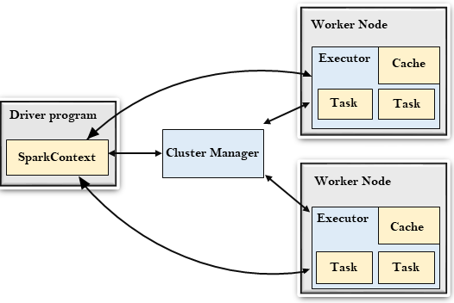

Slide 22
Architecture of Spark
Cluster Manager
The role of the cluster manager is to allocate resources across applications. The Spark is capable enough of running on a large number of clusters.
It consists of various types of cluster managers such as Hadoop YARN, Apache Mesos and Standalone Scheduler.
Here, the Standalone Scheduler is a standalone spark cluster manager that facilitates to install Spark on an empty set of machines.
Worker Node
The worker node is a slave node
Its role is to run the application code in the cluster.

Slide 23
Architecture of Spark
Executor
An executor is a process launched for an application on a worker node.
It runs tasks and keeps data in memory or disk storage across them.
It read and write data to the external sources.
Every application contains its executor.
Task
A unit of work that will be sent to one executor.

Slide 24
Spark Architecture
The Spark follows the master-slave architecture. Its cluster consists of a single master and multiple slaves.
The Spark architecture depends upon two abstractions:
Resilient Distributed Dataset (RDD)
Directed Acyclic Graph (DAG)

Slide 25
Spark Architecture
Resilient Distributed Datasets (RDD)
The Resilient Distributed Datasets are the group of data items that can be stored in-memory on worker nodes. Here,
Resilient: Restore the data on failure.
Distributed: Data is distributed among different nodes.
Dataset: Group of data.
Directed Acyclic Graph (DAG)
Directed Acyclic Graph is a finite direct graph that performs a sequence of computations on data. Each node is an RDD partition, and the edge is a transformation on top of data. Here, the graph refers the navigation whereas directed and acyclic refers to how it is done.

Slide 26
Resilient Distributed Dataset
RDD is a fundamental data structure of Spark
It is an immutable distributed collection of objects.
Each dataset in RDD is divided into logical partitions, which may be computed on different nodes of the cluster.
RDDS can contain any type of objects supported to Python , JAVA, SCALA and user defined objects .
Formally an RDD is a read only , partitioned collection of records, that can be created through deterministic operations on either data on the stable storage or other RDD.
RDD is a fault tolerant collection of elements that can be operated in parallel.

Slide 27
Resilient Distributed Dataset
There are about 2 ways we can create the RDD
Parallelizing an existing data in your driver program..
Reference the data set in you external storage systems such as shared file systems, HDFS, HBASE or any data source offering a Hadoop input Format.
Spark makes use of the concept of RDD to achieve faster and efficient MapReduce Operations

Slide 28
12.10
How iterative and interactive operations will take place in MapReduce?
How iterative and interactive operations will take place in Apache Spark?
How Data Sharing will take place on Spark?

Slide 29
Transformations
Actions

