Slide 1
EC2

Slide 2
EC2
is the service that is available as IAAS.
Elastic Compute Cloud
Elastic -> it got ability to extend and shrink depends on your need
Compute -> referring to the components that is used to run the computer
Cloud -> entire infrastructure was available in some others architecture, so that we need to access those architecture via Internet.
EC2- AWS IAAS component that is used provide you the computing resources that got capability to extend or shrink itself at any level of requirement that is available on AWS Cloud.

Slide 3
Billing Procedure for EC2
In EC2 they are offering you the different kinds of plan for computing resources such as (CPU + ram+ network) as one plan and Storage as different plan

Slide 4
Compute Resource plan
There are 5 types of plan they offer you to deploy your ec2 mahines
On-Demand
Spot
Dedicated
Reserved
Savings

Slide 5
On-Demand Plan
With On-Demand instances, you pay for compute capacity by the hour or the second depending on which instances you run. No longer-term commitments or upfront payments are needed. You can increase or decrease your compute capacity depending on the demands of your application and only pay the specified per hourly rates for the instance you use.
On-Demand instances are recommended for:
  Users that prefer the low cost and flexibility of Amazon EC2 without any up-front payment or long-term commitment
  Applications with short-term, spiky, or unpredictable workloads that cannot be interrupted
  Applications being developed or tested on Amazon EC2 for the first time

Slide 6
Spot instances
Amazon EC2 Spot instances allow you to request spare Amazon EC2 computing capacity for up to 90% off the On-Demand price. Learn More.
Spot instances are recommended for:
Applications that have flexible start and end times
Applications that are only feasible at very low compute prices
Users with urgent computing needs for large amounts of additional capacity

Slide 7
Spot instances
With Spot Instances, you pay the Spot price that's in effect for the time period your instances are running. Spot Instance prices are set by Amazon EC2 and adjust gradually based on long-term trends in supply and demand for Spot Instance capacity. To learn more about pricing, visit the Spot Instance history page. The following table displays the Spot price for each region and instance type (updated every 5 minutes).
Spot Instances are available at a discount of up to 90% off compared to On-Demand pricing. To compare the current Spot prices against standard On-Demand rates, visit the Spot Instance Advisor.
Spot Instances are also available to run for a predefined duration – in hourly increments up to six hours in length – at a discount of up to 30-50% compared to On-Demand pricing.

Slide 8
Dedicated instances
A Dedicated Host is a physical EC2 server dedicated for your use. Dedicated Hosts can help you reduce costs by allowing you to use your existing server-bound software licenses, including Windows Server, SQL Server, and SUSE Linux Enterprise Server (subject to your license terms), and can also help you meet compliance requirements. Learn more.
Can be purchased On-Demand (hourly).
Can be purchased as a Reservation for up to 70% off the On-Demand price.

Slide 9
Reserved
Depends in timeline you can reserve you compute need, and log term commitment and well a
Reserved Instances provide you with a significant discount (up to 75%) compared to On-Demand instance pricing. In addition, when Reserved Instances are assigned to a specific Availability Zone, they provide a capacity reservation, giving you additional confidence in your ability to launch instances when you need them.s upfront fees are applicable for this plan

Slide 10
Savings plan
Savings Plans are a flexible pricing model that offer low prices on EC2 and Fargate usage, in exchange for a commitment to a consistent amount of usage (measured in $/hour) for a 1 or 3 year term.

Slide 11
By default, on-demand plan will be available for everyone
We don’t worry about upfront fees, commitments
Whenever you need deploy, work and destroy

Slide 13
AMI
AMI -> store
Multiple OS along with/without software packages
Charges also applicable for some AMI for OS License and Software License/ Bring you own license

Slide 14
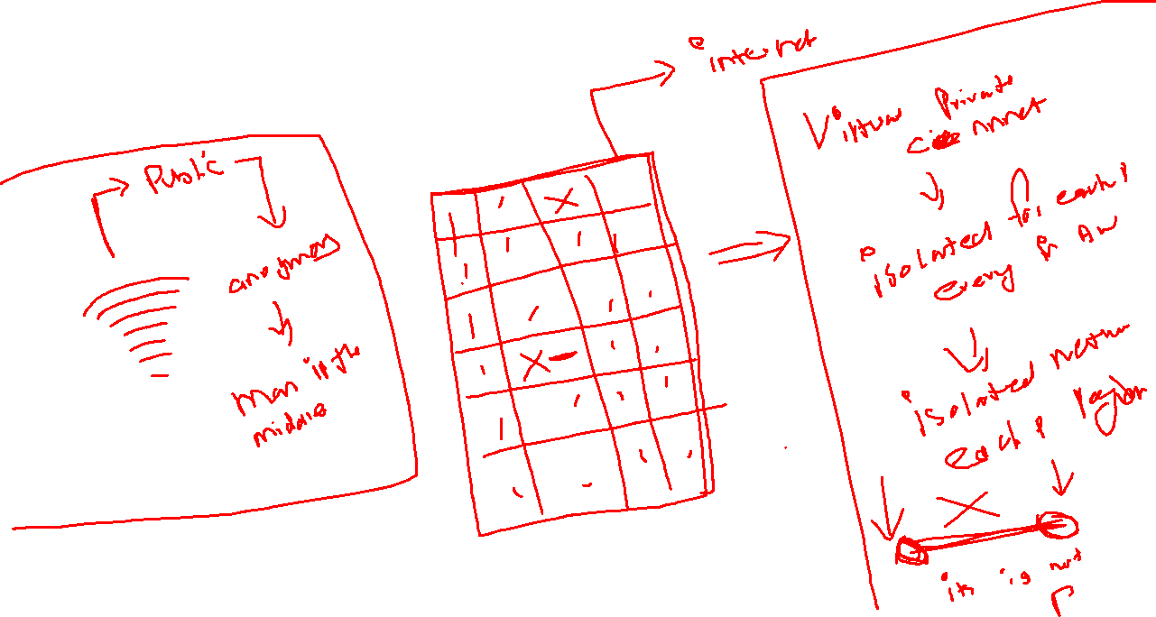
Networking

Slide 15
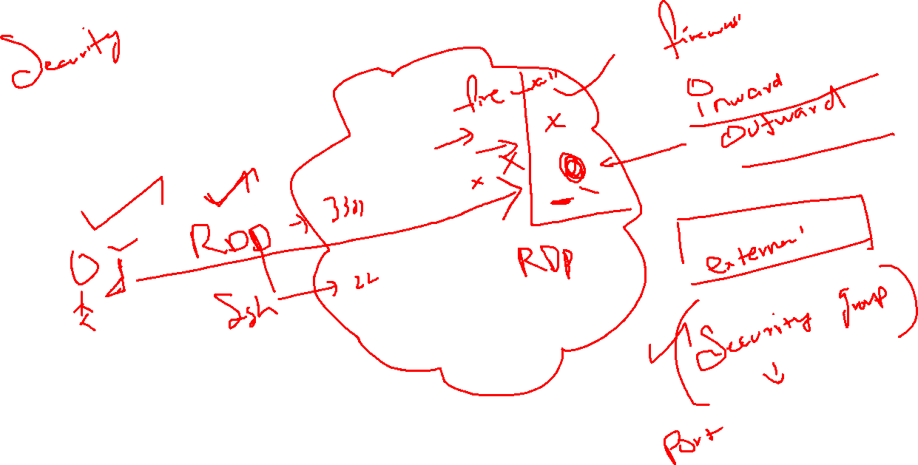

Slide 16
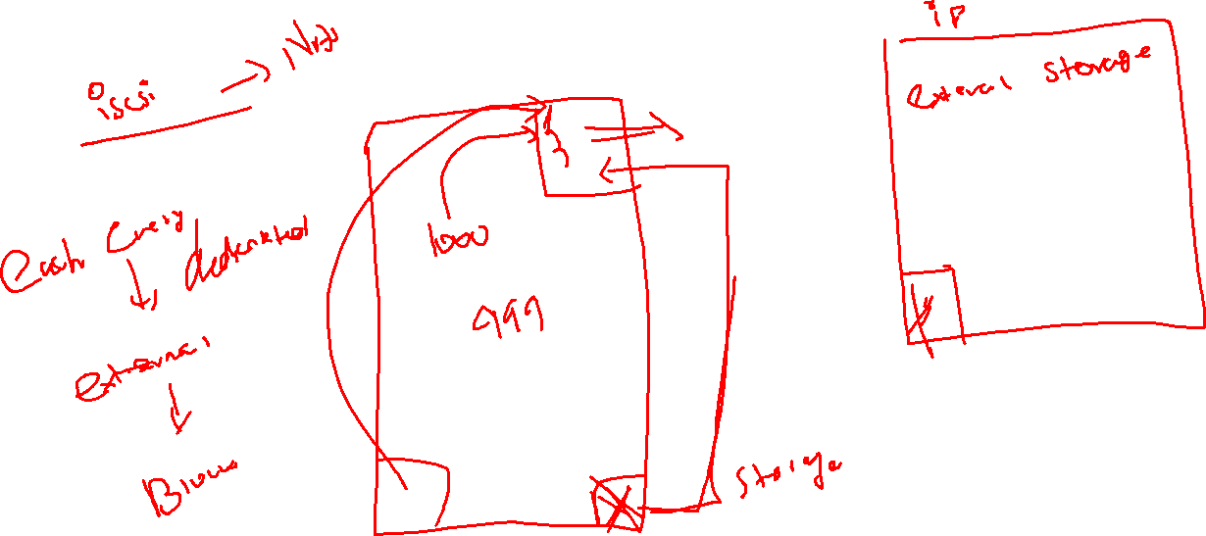
Storage

Slide 17
EBS
Elastic Block Storage -> external storage
SSD -> reboot/stop
Provisioned IOPS –> reboot/stop
Magnetic -> internal -> reboot /stop

Slide 18
Authentication
Symmetric
Asymmetric

Slide 19
Lab – 05.30
https://cloudacademy.com/lab/create-your-first-amazon-ec2-instance-windows/
https://cloudacademy.com/lab/create-your-first-amazon-ec2-instance/creating-an-ec2-instance/
https://cloudacademy.com/lab/managing-instance-volumes-using-ebs/
https://cloudacademy.com/course/compute-fundamentals-for-aws/introduction-to-aws-compute-fundamentals/?context_resource=lp&context_id=241

Slide 20
Is it possible to use same keypair and same security group for bot Linux and Windows system?
Is it possible to check the status of my instances via screenshot?

Slide 21
If you want to attach the additional hard drive for your machines
Check and find the machine is running on which availability zone

Slide 22
Extra demo
AMI
Autoscaling
Load balancing

