Slide 1
VPC

Slide 2
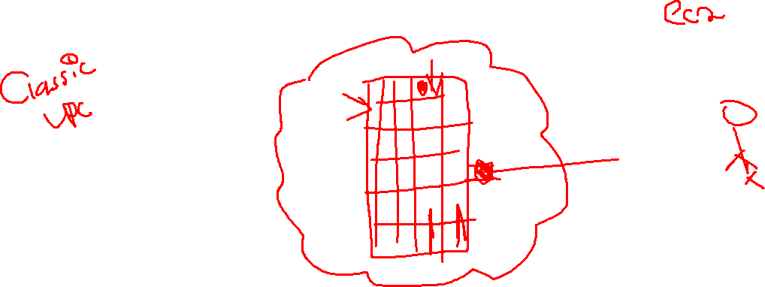
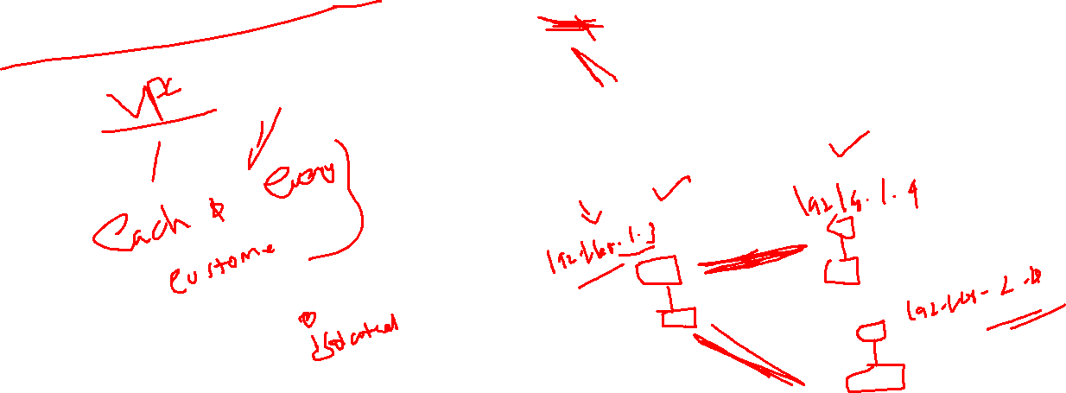

Slide 3
VPC
VPC – Virtual Private Cloud.
Service that is available for created the user defined network.
Through that user defined network, we can deploy/isolate the services that belong to different environment.

Slide 4
Prerequisites
Network.
IPV4.
IPV6.
IPv4 subnetting concepts.
Subnets.
How to do the subnets(Class a,b,c)
CIDR – class less interdomain routing values.

Slide 5
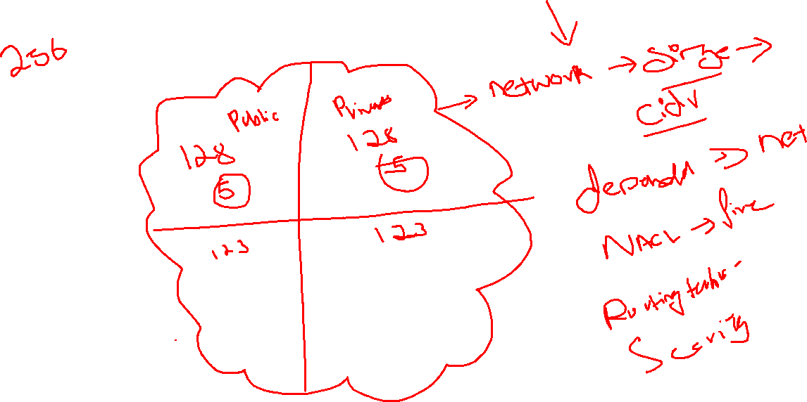

Slide 6
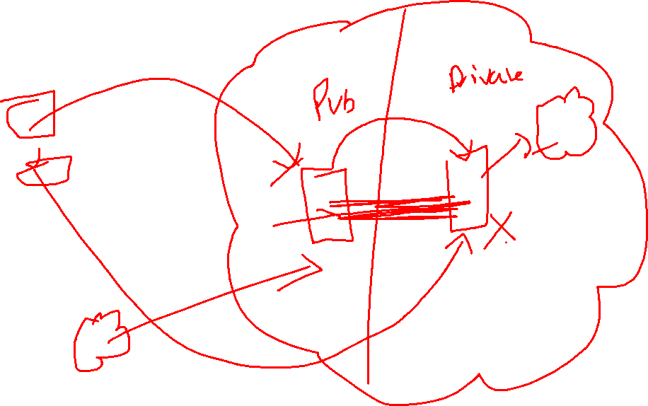

Slide 7
IPV4, Subnet mask and CIDR
936629
936799
936846
936733
936853
936879
936715

Slide 8
Subnetting
936742
936662
936642
936717
936716
936721
936701

Slide 9
VPC
936722
936824
936843
936844
936723
936848

Slide 10
VPC – Internet Gateway and Nat gateway
936724
936726
936865
936727
936594
936828

