Slide 2
Types of Storages
File based Storage -> binaries, give priority to the folder
Block based Storage -> it will deal everything as block(extended storage) ex: SCSI in this approach for better I/O you can op in for Fibre optics
Object level Storage -> here they deal everything as objects, because of everything as object we will achieve better I/O and enhanced security.

Slide 3
S3
Simple storage service
Its PAAS Service
Because of its pass, we can use cant able to edit and we cant able to access OS
Object based storage mechanism for better I/O and enhanced security.
Here in this approach the place where we save our data's they call it as buckets
You can apply the security features to entire buckets also and for individual objects also
You can encrypt, decrypt, replication policy, and Life cycle for your objects inside your buckets easily.

Slide 4
Rules and regulation to create the buckets
Bucket names must be between 3 and 63 characters long.
Bucket names can consist only of lowercase letters, numbers, dots (.), and hyphens (-).
Bucket names must begin and end with a letter or number.
Bucket names must not be formatted as an IP address (for example, 192.168.5.4).
Bucket names must be unique within a partition. A partition is a grouping of Regions. AWS currently has three partitions: aws (Standard Regions), aws-cn (China Regions), and aws-us-gov (AWS GovCloud [US] Regions).

Slide 5
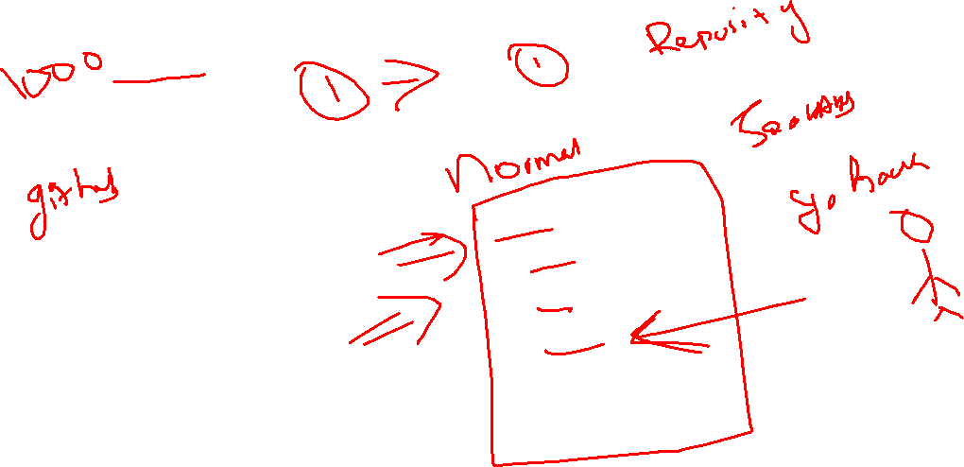

Slide 6
Labs
https://cloudacademy.com/lab/create-your-first-amazon-s3-bucket/uploading-a-file-to-s3/https://cloudacademy.com/lab/handling-s3-objects-with-life-cycle-policies/creating-an-s3-bucket/
https://cloudacademy.com/lab/configuring-static-website-s3-and-cloudfront/

Slide 7
Bucket names must be between 3 and 63 characters long.
Bucket names can consist only of lowercase letters, numbers, dots (.), and hyphens (-).
Bucket names must begin and end with a letter or number.
Bucket names must not be formatted as an IP address (for example, 192.168.5.4).
Bucket names must be unique within a partition. A partition is a grouping of Regions. AWS currently has three partitions: aws (Standard Regions), aws-cn (China Regions), and aws-us-gov (AWS GovCloud [US] Regions).

Slide 8
Storage Concept created and maintained by AWS
They will consider all the data as priority data/ is there any sub classes will be there for giving the custom priority

Slide 9
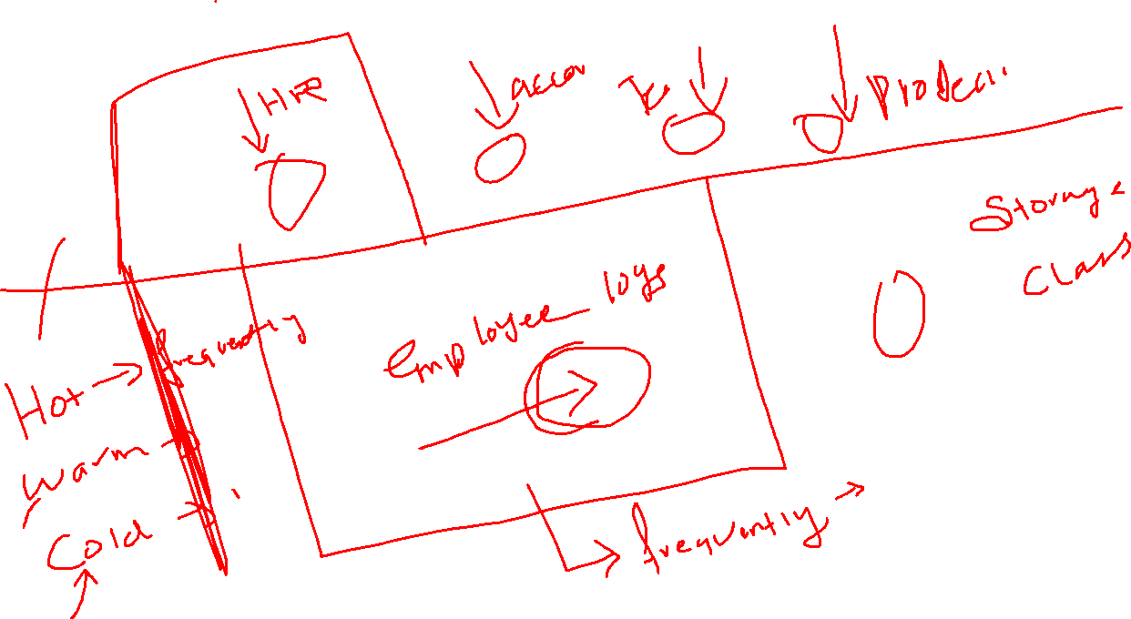

Slide 10
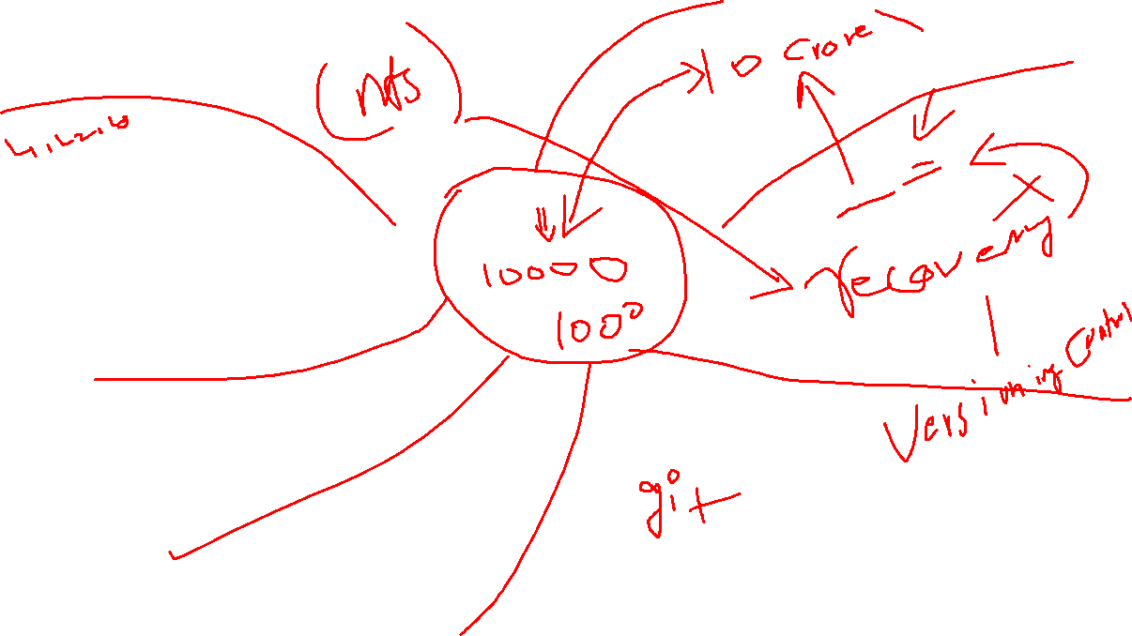

Slide 11
S3 - pending
How to access the s3 via python
Python boto3
AWS SDK

