Slide 1
AWS Cloud

Slide 2
AWS Overview
"Usage, core concepts such as elasticity, scalability, virtualization IaaS, PaaS, SaaS"
Overview of DW and Data Lake related services, such as, EMR, Glue, Redshift, Athena
Region, Availability Zone, Edge Locations
IAM user, roles, policies

Slide 3
EC2
When and why needed
EC2 instance type, storage etc.
elasticity, scalability,

Slide 4
S3
Core concepts of object store
S3-storage class, Lifecycle, replication
S3 file handling using Boto3

Slide 5
DynamoDB
Detailed architecture, NoSQL concepts
DynamoDB data structures, organization, Key etc
CRUD, Query, Scan. Detailed level
Case Study on a sample schema

Slide 6
Lambda
Handling S3 events
Handling DynamoDB events
Handling SQS, SNS events along with DynamoDB, S3 events
Parsing S3 source files into different format

Slide 7
Redshift
Redshift Architecture, Building blocks
Redshift data structure, Key, Compression
Populating Redshift
Connecting, Querying and Consuming data using Python

Slide 8
Database
Datawarehouse
ETL
PYSPARK
AWS Cloud
They want you to deploy and work with all the services that is related to data analytics
Database -> SQL -> OLTP -> RDBMS
Data Warehousing -> OLAP
Big data -> OLAP -> Spark -> Python

Slide 9
Cloud Services
EC2 -> Elastic Compute Cloud -> IAAS -> Database, Data Warehouse, Teradata
S3 -> Data Lake -> Upgraded Storage Solution -> flat files -> Google Drive
DynamoDB -> NoSQL Database
RedShift -> Cloud Datawarehouse -> Deploy, access, load the data, unload the data
Lambda -> Cloud Triggering Service -> if some thing happen we need do something automatically
VPC, EMR, Glue, Athena

Slide 10
VPC
Amazon Virtual Private Cloud is a commercial cloud computing service that provides users a virtual private cloud, by "provision[ing] a logically isolated section of Amazon Web Services Cloud".
Enterprise customers are able to access the Amazon Elastic Compute Cloud over an IPsec based virtual private network
Regions, Availability Zones

Slide 11
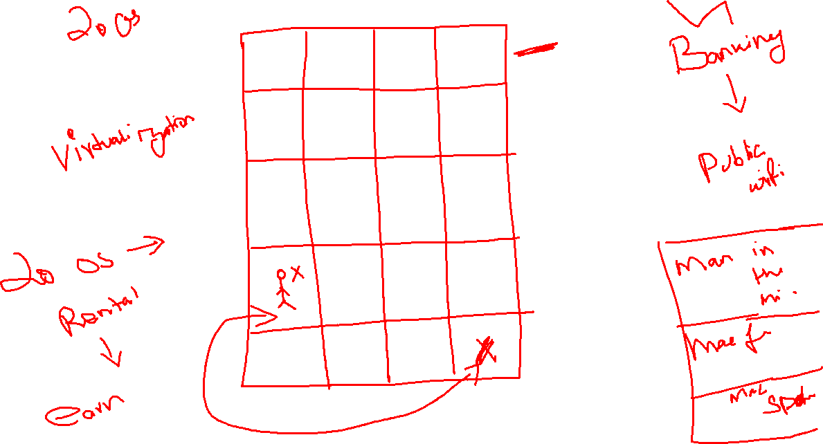

Slide 12
VPC -> isolated virtual network -> that will separate your network traffic from the other shared machines
AWS -> 23+2 Regions -> 23 will public access regions and 2 will be GOVT Cloud
AWS -> they will give you 23 VPC -> 1 VPC -> 1 Regions -> each and every account will get 23 VPC by default
If some services are running in one network that will not reflect in other network -> services -> 1 region -> other region -> we cant interconnect the services running on multiple regions

Slide 13
Is it possible to create our own VPC -> yes it is possible

Slide 14
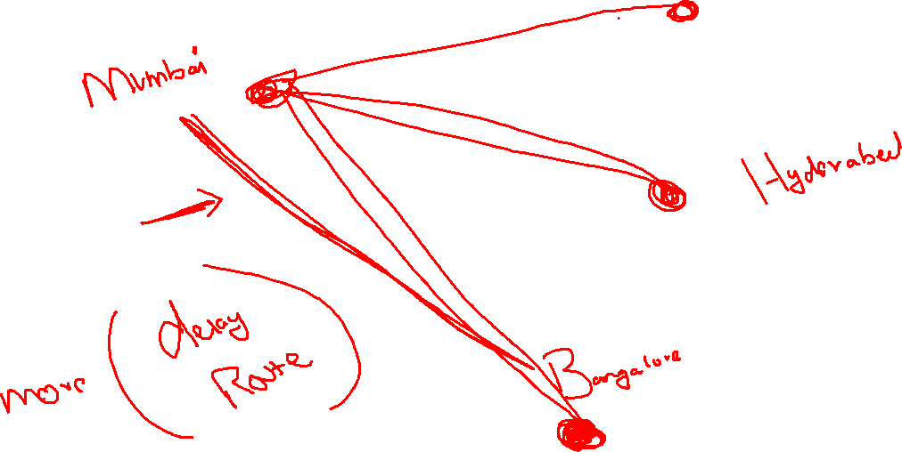
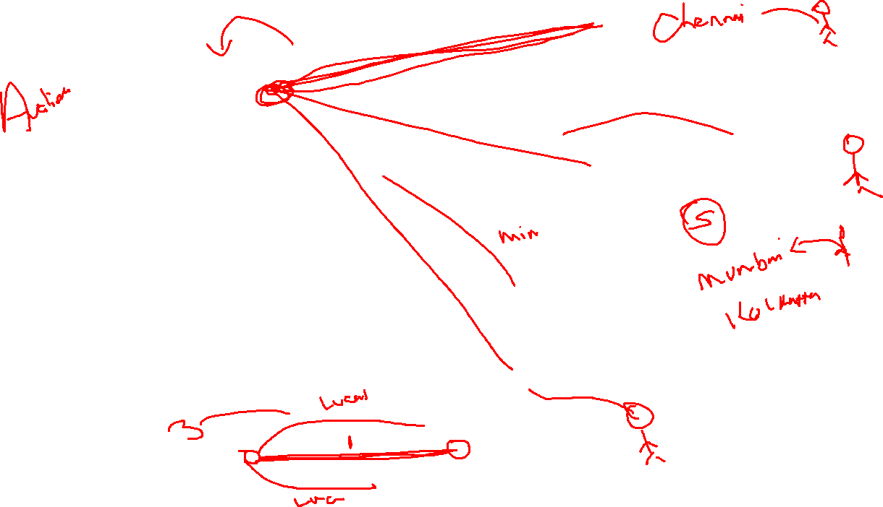

Slide 15
Overview of DW and Data Lake related services,
EMR,
Glue,
Redshift,
Athena

Slide 16
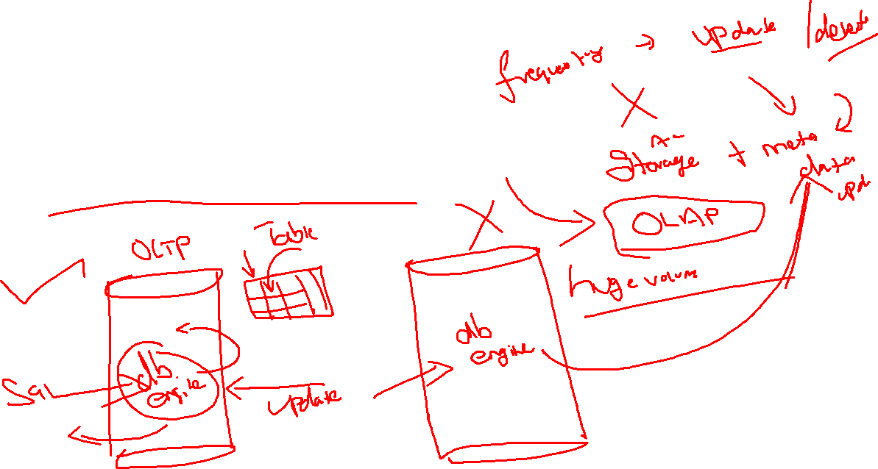
OLAP -> multi dimensional data
Work principle -> data warehousing

Slide 17
S3
Storage Solution -> Object oriented Storage -> in this storage everything it considered it as objects -> it doesn’t have any limitation on file types
Storage limitations -> higher security
Simple Storage Service -> S3 -> Data Lake - >Flat Files Respository
A data lake is a storage repository that holds a vast amount of raw data in its native format until it is needed for analytics applications. While a traditional data warehouse stores data in hierarchical dimensions and tables, a data lake uses a flat architecture to store data, primarily in files or object storage

Slide 18
EMR
Elastic Map Reduce
Data Bricks -> from data bricks cloud we deployed our spark cluster and we used it
EMR -> Architect level ready made solution for your Hadoop and spark architecture
15 mins
Amazon EMR is a cloud big data platform for running large-scale distributed data processing jobs, interactive SQL queries, and machine learning (ML) applications using open-source analytics frameworks such as Apache Spark, Apache Hive, and Presto.

Slide 19
Athena
Amazon Athena is an interactive query service that makes it easy to analyze data in Amazon S3 using standard SQL. Athena is serverless, so there is no infrastructure to manage, and you pay only for the queries that you run.

Slide 20
AWS GLUE
ETL tool that is available on AWS Cloud
Hardware, software configuration -> service for rental -> while doing the ATL -> time to run charge
You will run this ETL only in AWS Cloud, Local installation is not possible
Script based ETL Tool -> Python, Java, Scala(programming scripts) to perform the ETL Jobs by means automated way/ Manual

Slide 21
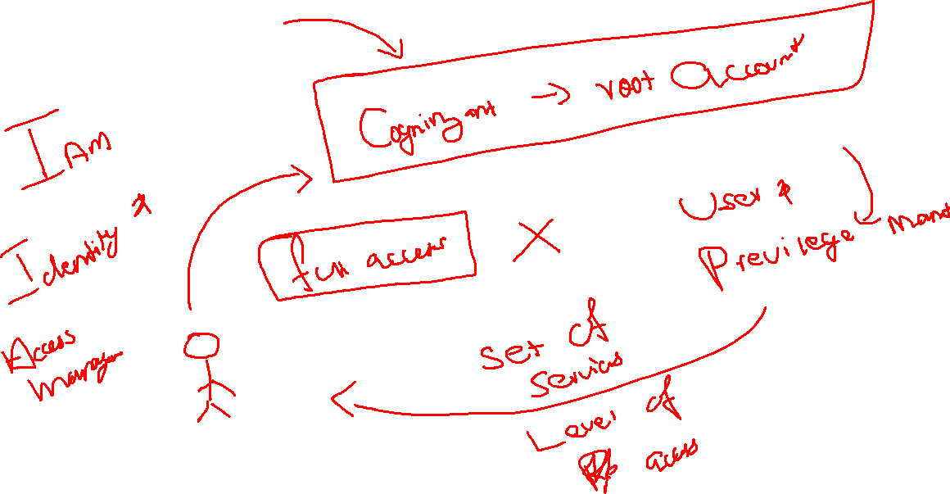
AWS Cloud

Slide 22
From your AWS Cloud -> 200 fully featured services -> 200 domains
AWS Identity and Access Management (IAM) provides fine-grained access control across all of AWS. With IAM, you can specify who can access which services and resources, and under which conditions. With IAM policies, you manage permissions to your workforce and systems to ensure least-privilege permissions.
IAM is a feature of your AWS account and is offered at no additional charge. To get started using IAM or if you have already registered with AWS, go to the AWS Management Console.

Slide 23
Udemy
IAM
VPC

Slide 24
EC2
Elastic Compute Cloud
Elastic -> it got the nature of expand and shrink itself depends on our requirement
Compute -> components that are required to run the computer
Cloud -> the computing components are available in some other premises, from there we will remotely deploy and access it
Computing components available in cloud that got nature to expand and shrink itself depends on our computing requirement
Amazon Elastic Compute Cloud is a part of Amazon.com's cloud-computing platform, Amazon Web Services, that allows users to rent virtual computers on which to run their own computer applications

Slide 25
EC2
Is the kind of IAAS -> Infra structure as the service
Cloud provider is responsible for basic under lying components to run the computer(CPU + RAM + Storage + Network)
OS + OS Firewall + Network Firewall , its under customer responsibility
On top of once we deployed the OS, it will be the responsibility for us

Slide 26
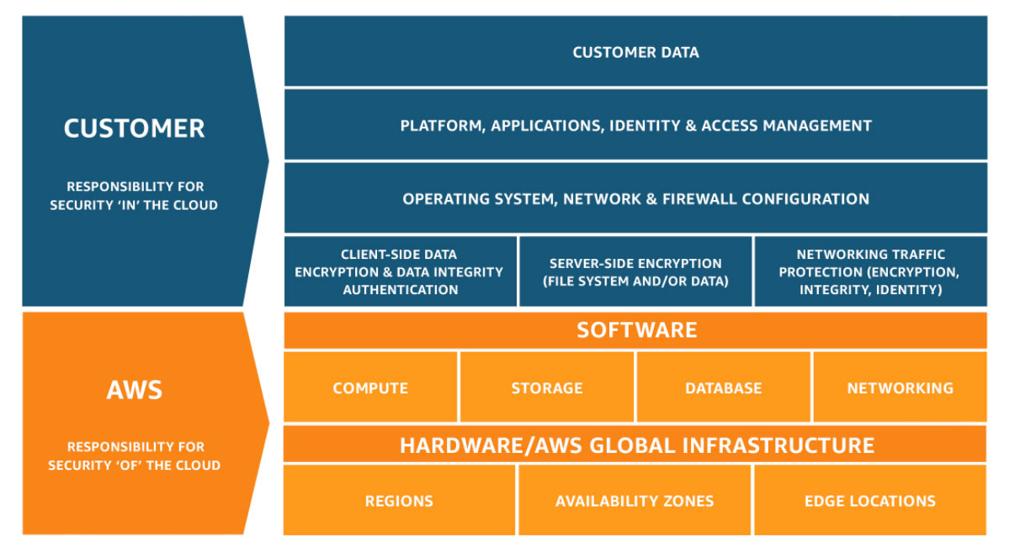

Slide 27
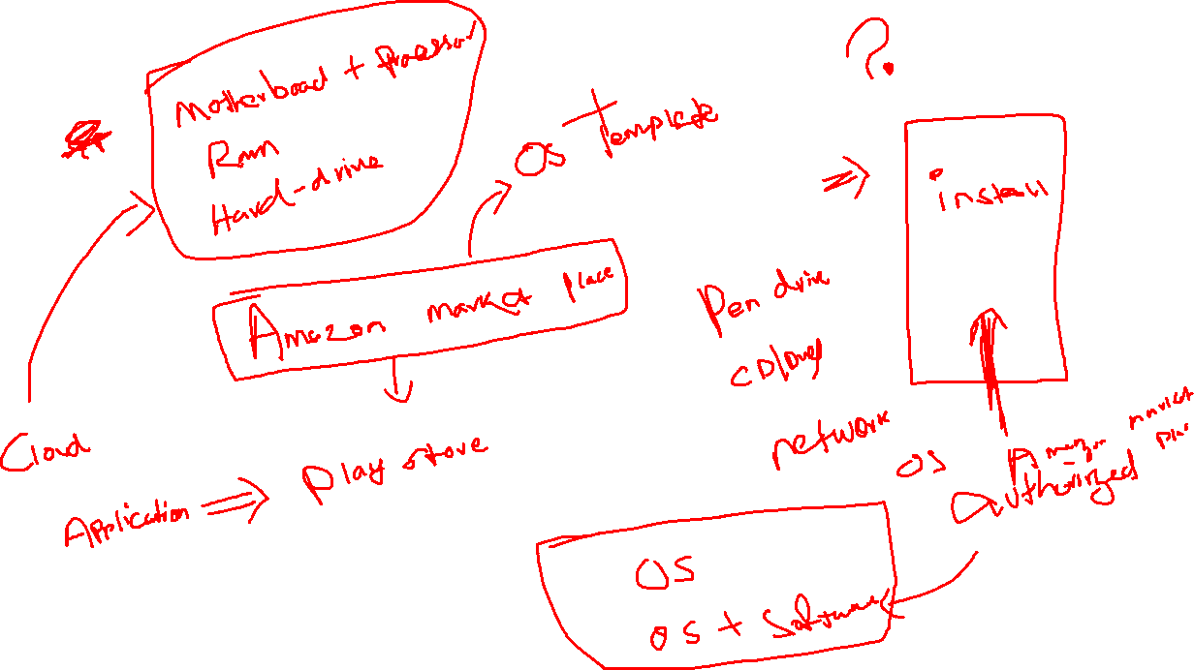
Amazon Machine Image

Slide 28
AWS Market Place -> Play store -> .apk
AWS Market Place -> OS Template -> Amazon Machine Image

Slide 29
There are five ways to pay for Amazon EC2 instances:
On-Demand
Savings Plans
Reserved Instances
Spot Instances
You can also pay for Dedicated Hosts which provide you with EC2 instance capacity on physical servers dedicated for your use.

Slide 30
On-Demand
With On-Demand instances, you pay for compute capacity by the hour or the second depending on which instances you run.
No longer-term commitments or upfront payments are needed.
You can increase or decrease your compute capacity depending on the demands of your application and only pay the specified per hourly rates for the instance you use.
On-Demand instances are recommended for:
Users that prefer the low cost and flexibility of Amazon EC2 without any up-front payment or long-term commitment
Applications with short-term, spiky, or unpredictable workloads that cannot be interrupted
Applications being developed or tested on Amazon EC2 for the first time

Slide 31
Savings Plans
Savings Plans are a flexible pricing model that offer low prices on EC2 and Fargate usage, in exchange for a commitment to a consistent amount of usage (measured in $/hour) for a 1 or 3 year term.

Slide 32
Amazon EC2 Reserved Instances (RI) provide a significant discount (up to 72%) compared to On-Demand pricing and provide a capacity reservation when used in a specific Availability Zone.

Slide 33
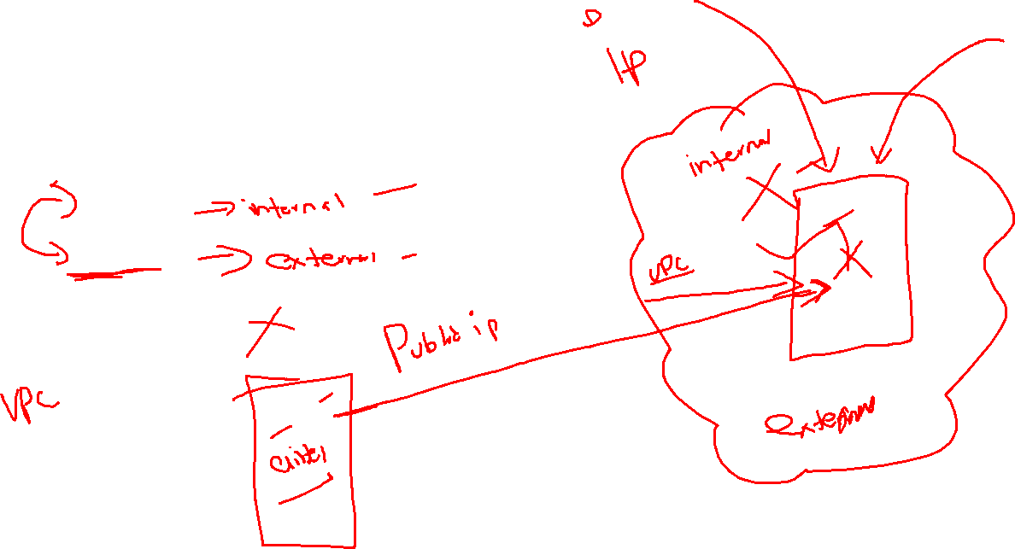
Each and every system will get 2 ip
Private ip
Public ip

Slide 34
Step 1: How to fetch the AMI(OS Template)
Step 2: select you hardware plan -> default select t2.micro
Step 3: map your private ip to public(networking) Recommended don’t touch it
Step 4:

Slide 35
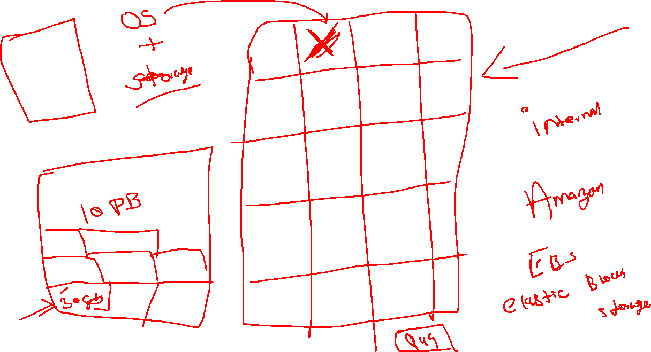

Slide 36
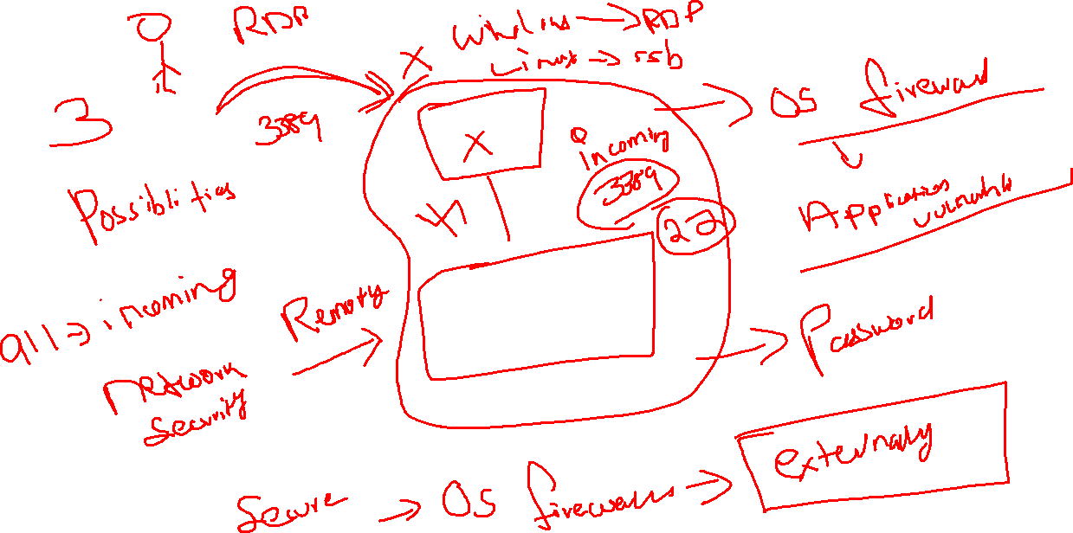

Slide 37
Login mechanism
Symmetric -> pre shared key> source and destination will use the password to authentication
Asymmetric -> Public/Private Key ->

Slide 38
15 mins
Windows 2019
T2.micro
30gb -> General Purpose gp2
Name -> empid
Security -> employee id -> 3389 -> anywhere
Keypair -> empid -> default(RSA) -> pem

Slide 39
15 mins
Ubuntu 20.04
T2.micro
8gb -> General Purpose gp2
Name -> empid
Security -> employee id -> 22(ssh) -> anywhere
Keypair -> empid -> default(RSA) -> pem

Slide 40
Storage
Ami
Mount extra hard drive
Mount EFS
Autoscaling
Load balancing

