Slide 1
Spark Curriculum
Karthick Selvam

Slide 2
Spark
Introduction to Spark
Transformations, Actions, RDD, Dataset
Key Value Methods and Caching Data
Distribution and Parallelism
Spark Streaming
Optimization
Data Exploration and Analysis
Transforming and Cleaning Unstructured Data
Summarizing Data Along Dimensions
Broadcasting and Accumulator

Slide 3
Handling Data Apache Spark SQL and Streaming
Introduction
Querying Data with the DataFrames
Improving Type Safety with Datasets
Processing Data with the Streaming API
Optimizing, Structured Streaming, and Spark 2.x

Slide 4
AWS Curriculum
Karthick Selvam

Slide 5
AWS Overview
"Usage, core concepts such as elasticity, scalability, virtualization
IaaS, PaaS, SaaS"
Overview of DW and Data Lake related services, such as, EMR, Glue, Redshift, Athena
Region, Availability Zone, Edge Locations
IAM user, roles, policies

Slide 6
EC2
When and why needed
EC2 instance type, storage etc

Slide 7
S3
Core concepts of object store
S3-storage class, Lifecycle, replication
S3 file handling using Boto3

Slide 8
DynamoDB
Detailed architecture, NoSQL concepts
DynamoDB data structures, organization, Key etc
CRUD, Query, Scan. Detailed level
Case Study on a sample schema

Slide 9
Lambda
Handling S3 events
Handling DynamoDB events
Handling SQS, SNS events along with DynamoDB, S3 events
Parsing S3 source files into different format

Slide 10
Redshift
Redshift Architecture, Building blocks
Redshift data structure, Key, Compression
Populating Redshift
Connecting, Querying and Consuming data using Python

Slide 11
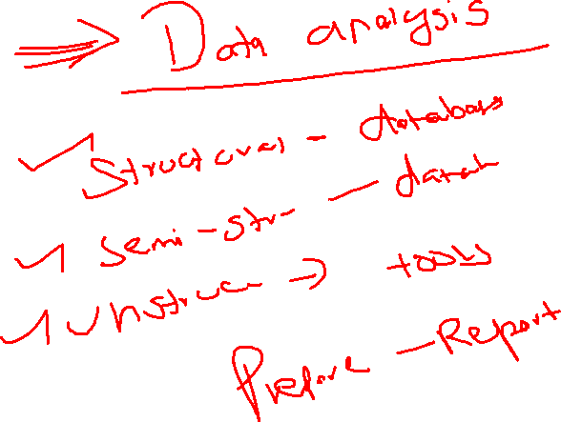
Curriculum
Database basics
MYSQL
Oracle Pl/SQL
Data Warehousing
Teradata
Python
Spark
AWS Cloud Fundamentals

Slide 12
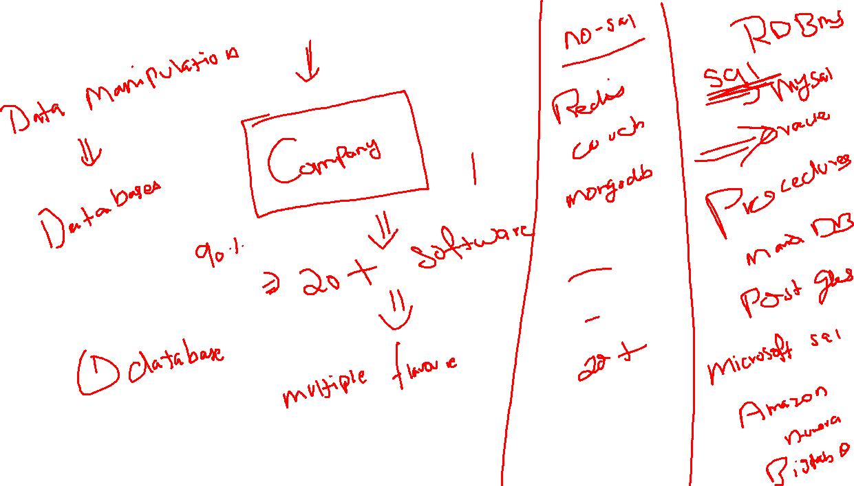


Slide 13
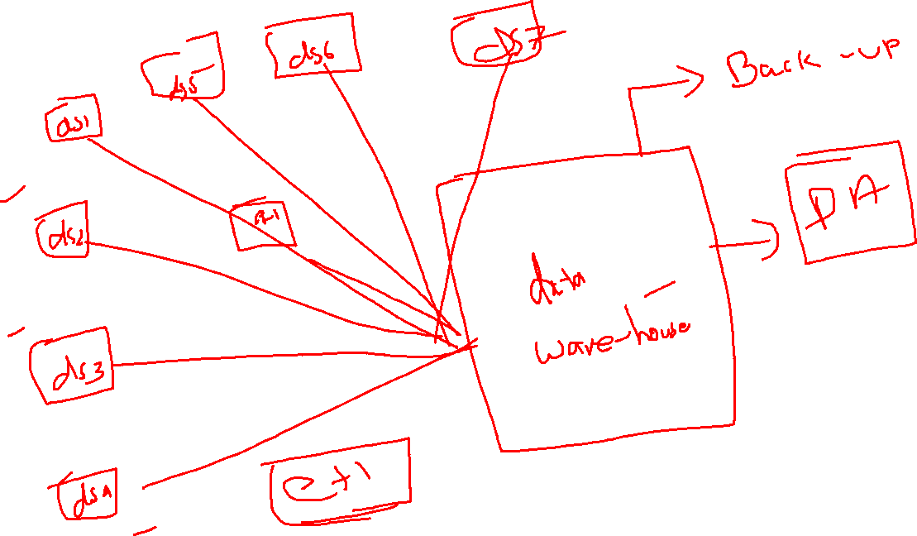

Slide 14
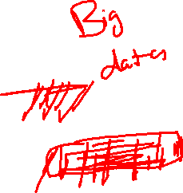

Slide 15
Bigdata
Big data is a field that treats ways to analyze, systematically extract information from, or otherwise deal with data sets that are too large or complex to be dealt with by traditional data-processing application software

Slide 16
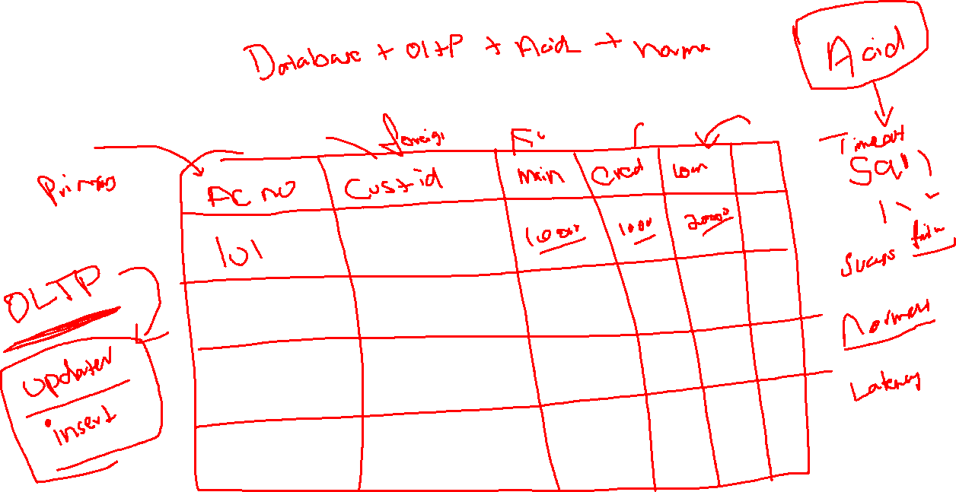
When do we move to Data Warehousing or Bigdata
We are using the website for doing the bank wise transactions?

Slide 17

Databases -> DB Engine + Storage
We are running on Single system -> Software -> one OS
Limitations
Storage Limitation -> 65535 TB -> Cross limit
DB Engine -> 64 logical processors -> Cross Limit

Slide 18
Industrial Technological Growth
Software Architecture Growth
Because of the technological growth and software competitions avail now -> Data we are generating day by day is more
You can easily reach the maximum limitation of database with in few years
Once the database reach the maximum limitation
RAID

Slide 19
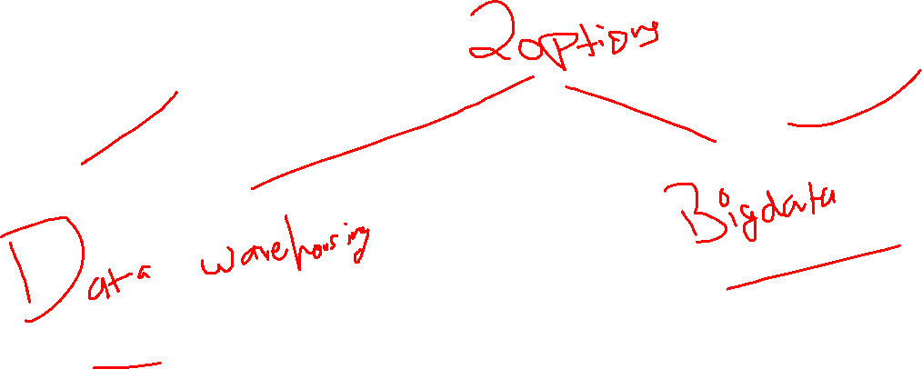
When do we move to Data Warehousing or Bigdata
If my data is OLAP?

Slide 20
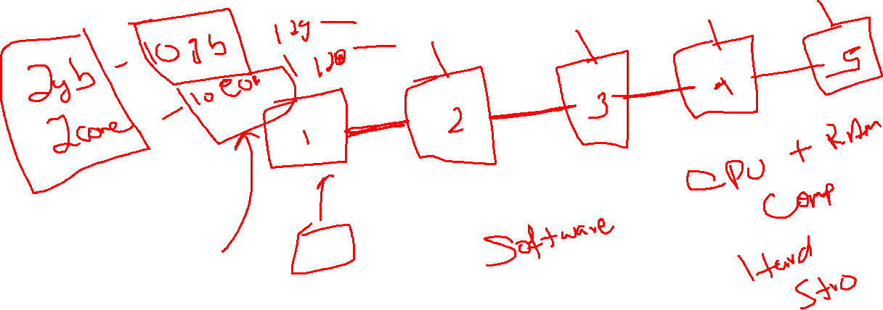
Data Warehouse
Data warehousing -> software that is capable of running on multiple systems at once to perform the single task

Slide 21
Cluster Computing
Distributed Storage
Distributed Computing

Slide 22
Bigdata
Supported Software’s
Hadoop
Spark

Slide 23
Hadoop
This technology will be created with the help of JAVA
In your Hadoop, because of intermediate result data transfer some disk I/O should need to happen between multiple stages, if the file size is too long(1tb), that 1 tb data should need to cross need to cross certain stages in map reduce process(it make some delay in execution because of delay in disk I/O)
is divided in to 2 major parts
Distributed Storage -> HDFS(Hadoop Distributed File System)
Distributed Computing -> MapReduce(Mapper and Reducer -> Computing unit to run the jobs on JVM)

Slide 24
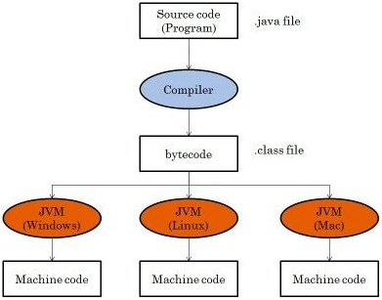

Slide 25
Java program
Byte code -> JVM -> Java Virtual Machine -> Platform
HDFS
MapReduce

Slide 26
Apache Spark
Spark will the alternative technology for the problem we are facing in MapReduce -> Disk utilization between intermediate stage
Data Transfer between intermediate stage will be done on RAM
By default, this Hadoop will not support for stream processing of data (data in Realtime), to overcome from this spark gave us the solution
Spark, by default they came up with multiple API support -> Scala, Java, Python
Spark will support for multiple technologies such as Machine Learning, R Programming, Batch Processing, Stream processing

Slide 27
Bigdata
Hadoop -> Architecture -> less
Spark

Slide 28
Hadoop
Industries are using Hadoop extensively to analyze their data sets. The reason is that Hadoop framework is based on a simple programming model (MapReduce) and it enables a computing solution that is scalable, flexible, fault-tolerant and cost effective. Here, the main concern is to maintain speed in processing large datasets in terms of waiting time between queries and waiting time to run the program.
Spark was introduced by Apache Software Foundation for speeding up the Hadoop computational computing software process.
As against a common belief, Spark is not a modified version of Hadoop and is not, really, dependent on Hadoop because it has its own cluster management. Hadoop is just one of the ways to implement Spark.
Spark uses Hadoop in two ways – one is storage and second is processing. Since Spark has its own cluster management computation, it uses Hadoop for storage purpose only.

Slide 29
Apache Spark
Apache Spark is a lightning-fast cluster computing technology, designed for fast computation.
It is based on Hadoop MapReduce and it extends the MapReduce model to efficiently use it for more types of computations, which includes interactive queries and stream processing.
The main feature of Spark is its in-memory cluster computing that increases the processing speed of an application.
Spark is designed to cover a wide range of workloads such as batch applications, iterative algorithms, interactive queries and streaming.
Apart from supporting all these workload in a respective system, it reduces the management burden of maintaining separate tools.

Slide 30
Evolution of Apache Spark
Spark is one of Hadoop’s sub project developed in 2009 in UC Berkeley’s AMPLab by Matei Zaharia.
It was Open Sourced in 2010 under a BSD license.
It was donated to Apache software foundation in 2013, and now Apache Spark has become a top level Apache project from Feb-2014.
Features of Apache Spark

Slide 31
Apache Spark Features
Speed − Spark helps to run an application in Hadoop cluster, up to 100 times faster in memory, and 10 times faster when running on disk. This is possible by reducing number of read/write operations to disk. It stores the intermediate processing data in memory.
Supports multiple languages − Spark provides built-in APIs in Java, Scala, or Python. Therefore, you can write applications in different languages. Spark comes up with 80 high-level operators for interactive querying.
Advanced Analytics − Spark not only supports ‘Map’ and ‘reduce’. It also supports SQL queries, Streaming data, Machine learning (ML), and Graph algorithms.

Slide 32
Spark Deployment Methods
Spark Independent
Spark on Hadoop Version 1 -> SIMR
Spark in YARN(Version 2)

Slide 33
Spark Components
Spark SQL
Spark Streaming
Spark MiLB
Spark Graphx
Spark Core

Slide 34
Spark Components
Spark Core
The Spark Core is the heart of Spark and performs the core functionality.
It holds the components for task scheduling, fault recovery, interacting with storage systems and memory management.
Spark SQL
The Spark SQL is built on the top of Spark Core. It provides support for structured data.
It allows to query the data via SQL (Structured Query Language) as well as the Apache Hive variant of SQL?called the HQL (Hive Query Language).
It supports JDBC and ODBC connections that establish a relation between Java objects and existing databases, data warehouses and business intelligence tools.
It also supports various sources of data like Hive tables, Parquet, and JSON.

Slide 35
Spark Components
Spark Streaming
Spark Streaming is a Spark component that supports scalable and fault-tolerant processing of streaming data.
It uses Spark Core's fast scheduling capability to perform streaming analytics.
It accepts data in mini-batches and performs RDD transformations on that data.
Its design ensures that the applications written for streaming data can be reused to analyze batches of historical data with little modification.
The log files generated by web servers can be considered as a real-time example of a data stream.
MLlib
The MLlib is a Machine Learning library that contains various machine learning algorithms.
These include correlations and hypothesis testing, classification and regression, clustering, and principal component analysis.
It is nine times faster than the disk-based implementation used by Apache Mahout.

Slide 36
Spark Components
GraphX
The GraphX is a library that is used to manipulate graphs and perform graph-parallel computations.
It facilitates to create a directed graph with arbitrary properties attached to each vertex and edge.
To manipulate graph, it supports various fundamental operators like subgraph, join Vertices, and aggregate Messages.

