Slide 1
DynamoDB
NoSQL Serverless Database

Slide 2
RDBMS
Database
DB Engine
Structured Query Language -> to communicate with your DBEngine
Normalization -> Achieve Minimum Latency
ACID -> ensure the Quality of Service
Different Databases
Microsoft SQL
MySQL
Oracle database
Postgres
MariaDB
Amazon Aurora

Slide 3
Database -> RDBMS
Database -> is the one of the fastest way to store and retrieve the data
Websites -> Database -> to store and retrieve the efficiently
Structured data
Semi–Structured data
Unstructured

Slide 4
Cloud Industry
Machine Learning
Artificial Intelligence
Social websites
Gaming Industry

Slide 5
Need of store and retrieving the data from and to the databases will get increased
Machines -> Semi-structed -> XML, JSON
Companies -> Structured -> Tables
JSON -> manually you cant able to store and retrieve the data from the JSON Files
Database -> encode and decode the JSON Files -> DB Engine
NoSQL Database

Slide 6
NoSQL Database
NoSQL databases (aka "not only SQL") are non-tabular databases and store data differently than relational tables. NoSQL databases come in a variety of types based on their data model. The main types are
Document Database -> MongoDB
key-value database -> DynamoDB
Column Oriented database -> HBASE
Graph Based database -> Neo4j

Slide 7
NoSQL
Minimum Latency -> by means of architecture, they came up with the solution for it
CAP Theorem -> ensure the quality of the product -> you need to satisfy the 3 out of 2 conditions as mandatory and one as skip/fine tune it
In terms of the CAP theorem, DynamoDB is an Available & Partition-tolerant (AP) database with eventual write consistency. ... Since such failures are common in multi-region/global apps running on public clouds such as AWS, DynamoDB tries to reduce such failures by limiting strongly consistent reads only to a single region

Slide 8
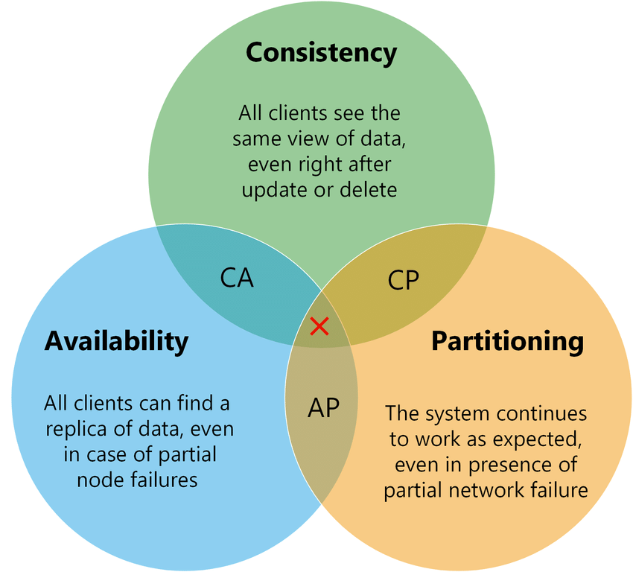
CAP Theorem

Slide 9
Solution
Strong Consistent Read
Eventually Consistent Read

Slide 10
Udemy - 1025
Types of Databases
Amazon RDS
Amazon DynamoDB

Slide 11
NoSQL Database
NoSQL databases are non-relational databases and are distributed
NoSQL databases include MongoDB, DynamoDB, Redis ..
NoSQL databases do not support query joins
All the data that is needed for a query is present in one row
NoSQL databases don’t perform aggregations such as SUM, AVG..
NoSQL databases scales horizontally

Slide 12
Amazon DynamoDB
Fully managed, highly available with replication across multiple availability zones
NoSQL database – not a relational database
Scales to massive workloads , distributed database
Millions of requests seconds, trillions of row, 100s of Tb of storage
Fast and consistent in performance(low level latency on retrieval(single digit milli seconds latency))
Integrated with IAM for security , authorization, administration
Enables event driven programming with DynamoDB streams
Low cost and auto-scaling capabilities
DynamoDB is a fully managed, key-value, and document database that delivers single-digit-millisecond performance at any scale.

Slide 13
Basic Terminologies
DynamoDB is made of Tables
Each tables has a primary key(must be decided at creation time)
Primary Key -> Partition key + Sort Key
Each table has infinite number of items(Row in the table -> Item)
Maximum size of the item is 400kb
Data Types it supported are:
Scalar Types: String, Number, Binary, Boolean, Null
Document Types -> List, Map
Set Types -> String set, Number set, Binary Set

Slide 14
DynamoDB -> Primary key
Option 1: Partition key(Hash Key)
Partition key must be unique for each item
Partition key must be diverse, so that data is distributed

Slide 15
DynamoDB -> Primary Keys
Option 2: Partition key + sort key(Hash + Range)
This combination is unique for each items
Data is grouped by partition key

Slide 16
Movie Database
Movie_id
Producer_name
Lead_actor_name
Movie_language
Option suggest the entry for partition key and sort key

Slide 17
CAP Theorem
DynamoDB, higher priority for Availability and Partition Tolerance and it took the options as consistency
If you do any update or delete, they cant give any assurity that all the clients an view the same data -> Consistency
They give you the options to select our consistency level
READ -> Strong Consistent, Eventually Consistent

Slide 18
DynamoDB -> Read/Write Capacity Modes
Provisioned Mode
You specify the number of read/writes per second
You need to plan the capacity beforehand
Pay for provisioned read and write capacity units
On-Demand Mode
Read/Write automatically scales up/down depends on your workload
No Capacity planning needed
Pay for what you use, more expensive

Slide 19
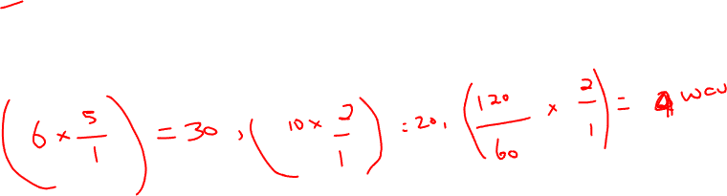
DynamoDB Write Capacity Unit(WCU)
One Write Capacity Unit(WCU) represents one write per second for an item up to 1 kb in size
If the Item is larger than 1 kb it will consider another WCU
Example 1: 10 items per second with 2 kb in size => 20 WCU
Example 2: 6 items per second with 4.5kb => 30 WCU
Example 3: 120 items per minute with 2 kb in size => 4 WCU

Slide 20
DynamoDB -> RCU
Eventually Consistent(default)
Strong Consistent

Slide 21
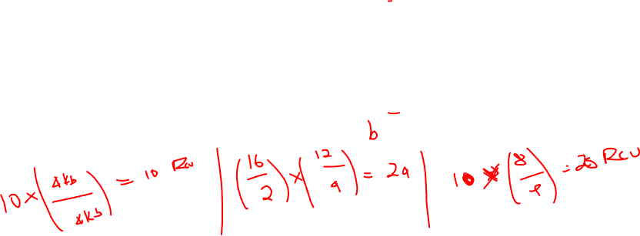
DynamoDB -> Read Capacity Unit(RCU)
One RCU -> 1 Strong Consistent per second/2 eventually consistent per second for an item up to 4 kb in size
If the item that is larger than 4 kb it will consider another RCU
Example -> 10 strong consistent read/sec with 4 kb in size -> 10RCU
Example: 16 eventually consistent read/sec 12kb in size > 24 RCU
Example: 10 Strong consistent read/sec 6kn in size -> 20 RCU

Slide 22
Data is stored as partitions
Partition key goes through a hashing algorithm to know to which partition it goes
If I exceed the provisioned WCU/RCU we get the error ProvisonedThroughputExceedException
Indexes ->
Global Index
Seconday index

Slide 23
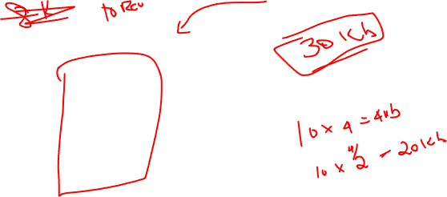

Slide 24
AWS Lambda
Lambda -> SAAS -> they will give you the console to deploy your aws related operations
Serverless -> is a new paradigm in which the developers doesn’t have to manage the servers anymore
They just deploy code. Functions!
Initially.. Serverless == FAAS (Function as a service)
Serverless was pioneered by AWS Lambda but now also includes anything that’s managed: “databases, Messaging, storage, etc..”
Serverless doesn’t mean there are no servers..
It means you don’t need to manage/ provision and maintain them

Slide 25
Serverless in AWS
AWS Lambda
DynamoDB
AWS Cognito
AWS API Gateway
Amazon s3
AWS SNS
AWS SQS
AWS Kinesis Data Firehose
Aurora Serverless
Step Function
Fargate

Slide 26
EC2 vs Lambda
Amazon EC2
Virtual Servers on the cloud
Limited by RAM and CPU
Continuously running
Scaling means intervention to add/remove the servers
Amazon Lambda
Virtual Functions – there is no need to manage the servers
Limited by time -> short executions
Runs on-demand
Scaling is automated

Slide 27
Benefits of Lambda
Easy Pricing
Pay per request and compute time
Free tier of 1,000,000 AWS Lambda Request and 400,000 GBs of compute time
Integrate with the whole AWS suite of services
Integrated with many programming languages
Easy Monitoring through AWS CloudWatch
Easy to get more resources per functions(up to 10GB of RAM)
Increasing RAM will also improve CPU and Network

Slide 28
AWS Lambda Language Support
Node.js
Python
Java(Java 8 Compatible)
C#(.NET Core)
Golang
C#/PowerShell
Ruby
Custom Runtime API(Community supported, example Rust)
Lambda Container image

Slide 29
AWS Lambda Integration
API Gateway
Kinesis
S3
DynamoDB
CloudFront
CloudWatch Logs
CloudWatch Events Events Bridge
SNS
SQS
Cognito

Slide 30
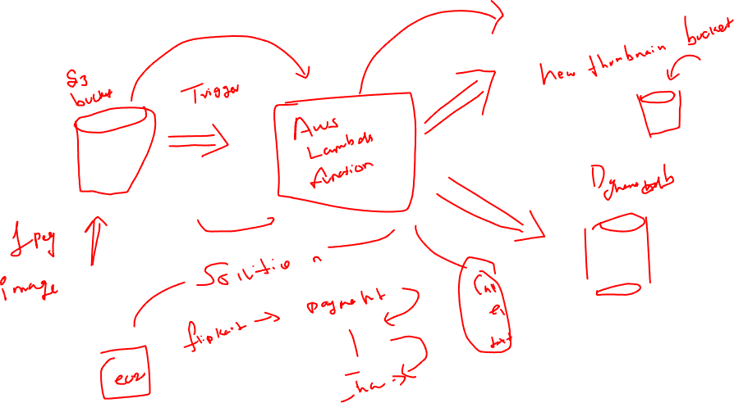

Slide 31
AWS Lambda Pricing: example
Pay per calls:
First 1,000,000 requests are free
$0.20 per 1 million requests thereafter($0.0000002 per request)
Pay per duration
4,00,000 GB-seconds of compute time per month for free
4,00,000 seconds if the functions is 1 GB Ram
3,200,000 Seconds if the function is 128MB Ram

Slide 32
Break -> 0500

