Slide 2
Data Analyst
Curriculum -> perform various method that will be alliable to perform the data analytics
Basics
Database -> structured
Data Ware House -> ETL + Structured
Expert
Big Data -> e-learning -> Structured+ Unstructured and Semi structures
Aws – Data engineering -> Structured+ Unstructured and Semi structures
Program
JAVA
Python
Unix -> OS

Slide 3
Hands-on
Project -> Mentor

Slide 4
DBMS & Data Modeling
If you want to store and retrieve the data from the computer what will be fastest way to do it?
What are the different methods will be available?

Slide 5
If we our data in the organized way – so that we can retrieve the data as fast as possible
Depends on data
Structured -> data will be organized in well defined format, it got more features to search as fast as possible
Primary key, Foreign key, Indexes, Views
Semi-Structured -> data will be in the format of organized manner and its application will take care of store and retrieve the data
Ex: excel, JSON, CSV, TSV
Un structured data -> data will be in various format and file type

Slide 6
Excel

Slide 7



What is database?
DB Engine
Storage

Slide 8
Centralized database
Sub Office 1
Head Office
Sub Office 3
Sub Office 2
Sub Office 4

Slide 9
Distributed database
Sub Office 1
Head Office
Sub Office 3
Sub Office 2
Sub Office 4

Slide 10
Relational database
NoSQL database

Slide 11

Relational Database
This database is based on the relational data model, which stores data in the form of rows(tuple) and columns(attributes), and together forms a table(relation).
A relational database uses SQL for storing, manipulating, as well as maintaining the data.
E.F. Codd invented the database in 1970. Each table in the database carries a key that makes the data unique from others.
SQL -> Structured Query language

Slide 12
RDBMS
SQL
DB Engine
Storage

Slide 13
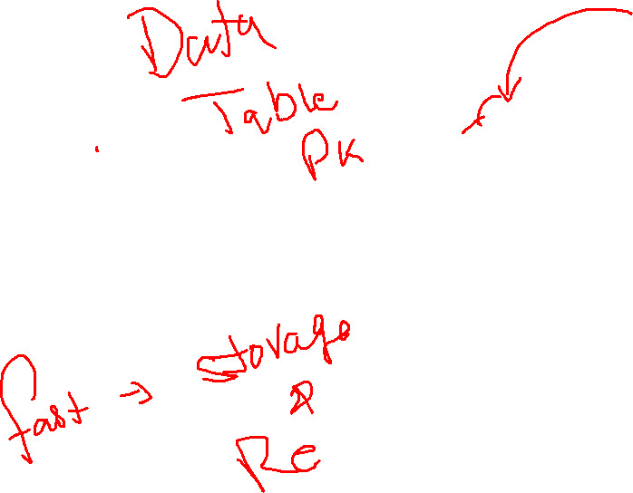
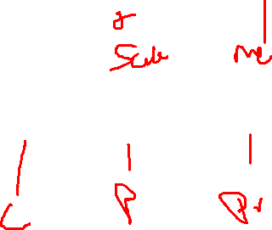
RDBMS
SQL
DB Engine
Storage

Slide 14
RDBMS
MYSQL
Microsoft SQL
Oracle SQL
MariaDB
Postgres
Amazon Aurora

Slide 15
RDBMS
to maintain the standard some kind of terms and conditions
ACID
Normalization

Slide 16
ACID
A means Atomicity: This ensures the data operation will complete either with success or with failure. It follows the 'all or nothing' strategy. For example, a transaction will either be committed or will abort.
C means Consistency: If we perform any operation over the data, its value before and after the operation should be preserved. For example, the account balance before and after the transaction should be correct, i.e., it should remain conserved.
I means Isolation: There can be concurrent users for accessing data at the same time from the database. Thus, isolation between the data should remain isolated. For example, when multiple transactions occur at the same time, one transaction effects should not be visible to the other transactions in the database.
D means Durability: It ensures that once it completes the operation and commits the data, data changes should remain permanent.

Slide 17
Example
ATM Machine
Atomicity
Consistency

Slide 18
Database -> IFSC CODE
Account No
1
2
3
4
5
6

