Slide 2
Syllabus
MYSQL
Data Warehousing
Java
Python
Unix
Soft Skills
AWS

Slide 3
MCQ/Hands-on based Assessment
Lab

Slide 4
Data Analytics
At the end of curriculum
MySQL
Ansi-SQL
Data warehousing
Big data
AWS -> Amazon Cloud
JAVA
Python

Slide 5
Introduction to Database Systems

Slide 6
Computer
3 types
Structured data -> they will use this method of data format in Databases
Un structured data -> txt, movies,zip
Semi-Structured data -> Csv, TSV, Json

Slide 7
Website
Gaming
Database was the fastest method to store and retrieve the information from the backend
To store and retrieve the information from the database, you need to follow some terms and conditions
Formatted data -> in the tabular format

Slide 8
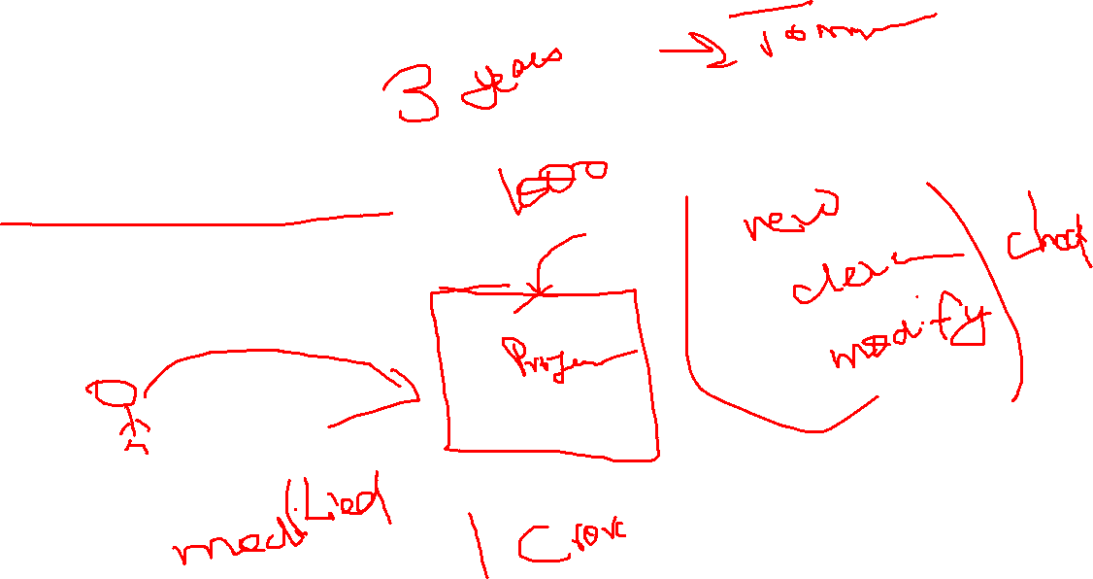
Versioning management

Slide 9
If you wat to search for something
Processor
Ram
How database management is differ from this approach

Slide 10



Software defines processor and storage unit
SQL – Structured query language
Database engine
Database Storage

Slide 11
Normalization
Acid Properties
Primark key
Foreign key
Indexing
Views

Slide 12
Customer end -> Client application
Server end -> MySQL application
Storage layer
If all the 3 layers will be evaluable on single machine -> 1 tier architecture
Client + server and storage -> 2 tier architecture
Client + Server + storage -> 3 tier architecture

