Slide 2
Cloud

Slide 3
2003
100 employees
Sharing – Restricted – Data Security
100 Employees workspace along with their system
Capital Expenses – System Hardware
30000 * 100 = 3000000
Life time – Real Projects – Software support + Features added
1 Years – 300000 – Hardware
CAPEX and OPEX

Slide 4
2003
30000 – Employees
Lifetime – 12 month
8 hours – Hardware Utilization – 100 %
16 Hours idle
4 Months

Slide 5
2010
Virtualization – concept, that will allow you to run the multiple OS same hardware with higher security
VMware – Application/ OS

Slide 6

Allow you to partition this hardware in to multiple slices – each and
every slices we will install the OS and we give it you Employees
100 Slices – 100 Employees OS
Through Network they will allow the users to access this particular OS
10-15 lakh – setup – 50% expenses

Slide 7
Software – 16 GB – details of ip, username and password
To access this OS remotely
20.84.120.19
Karthick1808
Welcome@12345
Windows - 4 GB
Upgrade
NEW
Rent hardware

Slide 8
2012
Giant Companies – Advantage of Virtualization - internet based rental providing model – Cloud Providers
Amazon, Azure, Oracle, Google Cloud
USA Based Companies – Customer Production Market
Increased – these kind of architecture
Hourly based billing
No commitment
No advance payment

Slide 9
IAAS
SAAS
PAAS

Slide 10
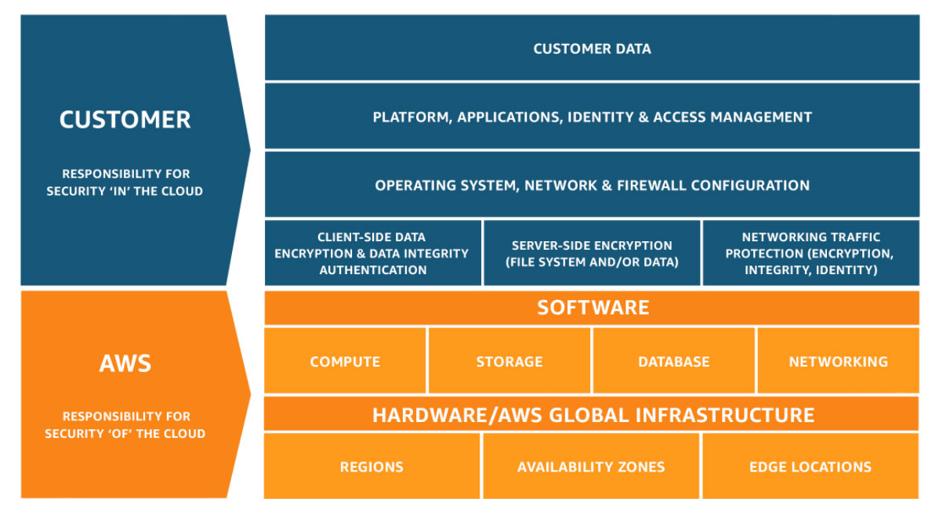

Slide 11
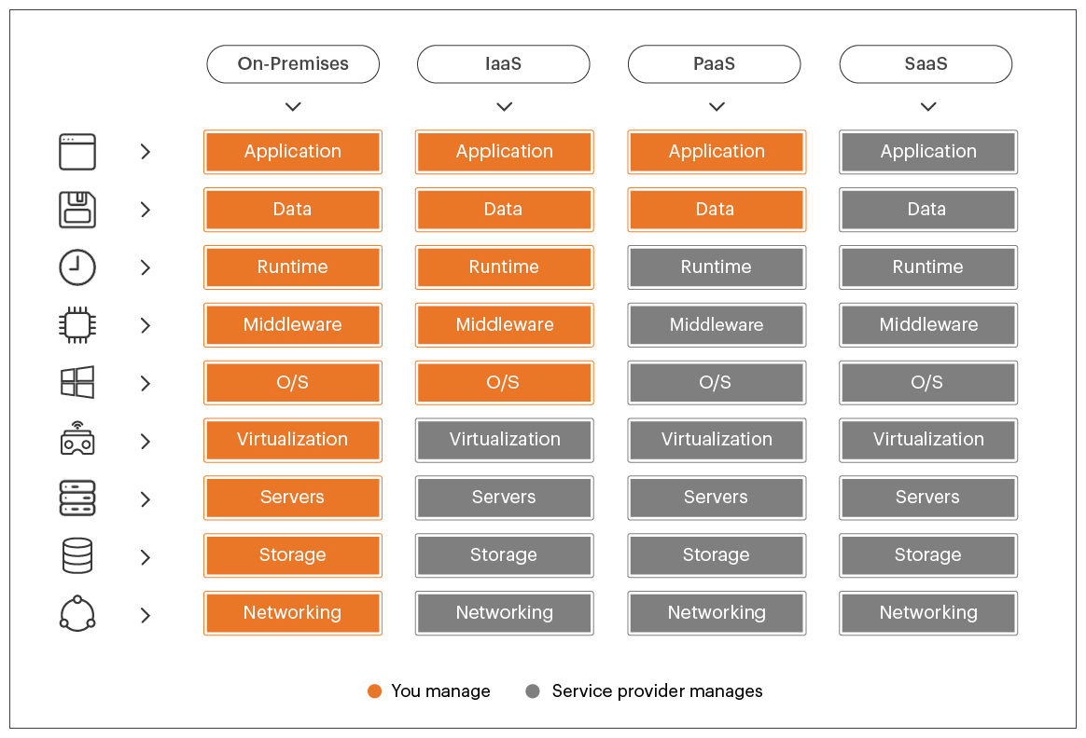

Slide 12
IAAS
IAAS – Underlying OS Access
PAAS – Developer we can develop out own thing
Software is available for local installation
SAAS – User interface – Application feature specific - GMAIL
Software is not available for local installation

Slide 13
Theory
Usage, core concepts such as elasticity, scalability, virtualization IaaS, PaaS, SaaS
Region, Availability Zone, Edge Locations
EMR(Managed Hadoop and Spark)(PAAS)
Glue(ETL) PAAS
Athena – Data Analytical

Slide 14
Handson
EC2 - IAAS
S3 – PAAS – Storage(Data Lake)
DynamoDB – PAAS(NoSQL Database)
Lambda – PAAS(Event based Triggers)
Redshift – PAAS(Data warehousing Platform)

Slide 15
Scaling
Technique that will help you dynamically allocate the resources for out medium
Vertical Scaling – Single Machine Dependent
Example – database – performance – shutdown – increase the hardware
Horizontal Scaling – Application Dependent
Application architecture – ability to run the single task by using the resources available in multiple machines
Application Architecture – Network
Increase – add more machines to the network

Slide 16
MySQL
Runtime and middle ware
OS Architecture, Processor Architecture
Middleware - Client Tool, query execution

