Slide 1
EC2-Elastic Compute cloud
Karthick Selvam
support@benchmarkinnovations.in

Slide 2
Topics to discuss in EC2
Purchasing Options
Instance Types
EC2 Classic VS EC2 VPC
EC2 Storage Options
Amazon Machine Images
EC2 Container Service

Slide 3
AWS global infrastructure
16 Regions
-Choose a region for Optimize Latency, Minimize Cost or address Regulatory Requirements
44 Availability Zones
-Insulated from failovers from other Availability Zones(separated from each other and provide you level of durability to your Architecture.)
-Plans for 14 more Availability Zones and five more Regions in China, France, Hong Kong, Sweden, and a second AWS GovCloud Region in the US-EAST.
56 Edge Locations
-CloudFront distributions at edge locations for higher performance delivery of Internet Content.
-Edge locations are used by CloudFront service which is content delivery Network service in AWS.
Services are Limited depends upon regions Check-out in this link.
https://aws.amazon.com/about-aws/global-infrastructure/regional-product-services/

Slide 4
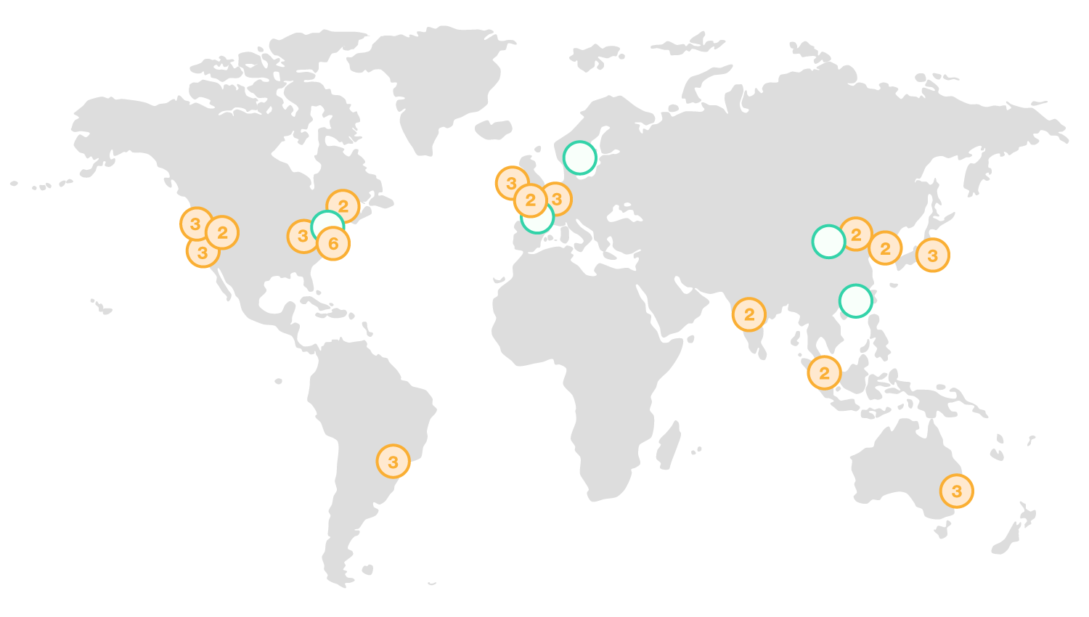
Edge Locations

Slide 5
EC2 Purchasing options
On-Demand-Services
-Pay for compute capacity by the hour with no long-term commitments or upfront payments.
Reserved Instances
-Provide you with a significant discount (up to 75%) compared to On-Demand Instance pricing
Spot Instances
-Purchase compute capacity with no upfront commitment and at hourly rates usually lower than to On-Demand rate

Slide 6
Ec2 instance types
General Purpose(M series)
-Small and mid-size databases, data processing tasks that require additional memory, caching fleets, and for running backend servers for SAP, Microsoft SharePoint, cluster computing, and other enterprise applications(T2,M3,M4)
Compute Optimized(C Series)
-High performance front-end fleets, web-servers, batch processing, distributed analysis, high performance science and engineering applications, and serving, MMO gaming, and video-encoding(C3,C4)
Memory Optimized(R Series)
-High performance databases, distributed memory caches, in-memory analytics, genome assembly and analytics larger deployment of SAP, Microsoft SharePoint, and other enterprise applications(R3)
GPU(G Series)
-3D application streaming, machine learning, video encoding and other server-side graphics or GPU compute workloads.(G2)
Storage Optimized(D/I Series)
-NoSQL databases like Cassandra and MangoDB, scale out transactional databases, data warehousing,
Hadoop, and cluster file systems(I2)
-Massively Parallel Processing(MPP) data warehousing, MapReduce and Hadoop distributed computing, distributed file systems, network file systems, log or data-processing applications(D2)
More Info
https://aws.amazon.com/ec2/instance-types/

Slide 7
Storage options for ec2 instances
Instance Family | Some use cases
General Purpose(t2,m4,m3) | Low traffic websites and web applications Small database and mid size databases
Compute Optimized(c4,c3) | Higher performance front end fleets Video encoding
Memory Optimized(r3) | High Performance databases Distributed memory caches
Storage Optimized(i2,d2) | Data Warehousing Log or data Processing applications
GPU Instances(g2) | 3D application streaming Machine learning

Slide 8
EC2 Storage options
Elastic Block Storage(EBS)
Replicated within Single AZ
EBS optimized instance provide dedicated throughput between EC2 and EBS volume.
EBS volumes attached at instance launch are deleted when instance terminated
EBS volumes attached to a running instance are not deleted, when instance is terminated but are detached with data intact.
16TB
Instance Store
Physically attached to host server
Data NOT LOST when OS is rebooted
Data LOST when:
Underlying drive fails
Instance is stopped
Instance is terminated
Do not rely on for valuable, long-term data.
You cannot detach and attach to another instances.
10 GB

Slide 9
EBS storage options
General Purpose (SSD)
default choice
Provisioned IOPS (SSD)
Consistent and low-latency performance
I/O intensive applications such as large relational or NoSQL databases
Magnetic
Lowest cost per gigabyte
EBS Snapshots
Point in time backup of EBS volume to Amazon S3.
Incremental Backup
Can be copied to other regions or accounts.
EBS Encryption
AWS Key Management Services(KMS) master keys or Customer Master key(CMK)
Data stored at rest encrypted (including snapshots created) as well as data in transit between EBS and EC2.

Slide 10
Amazon Machine Images
Provides the information required to launch an instance
A template for the root volumes for the instance(for example, an operating system, an application server and applications)
Launch Permissions that control which AWS accounts can use the AMI to launch instances
A block device mapping that specifies the volumes to attach to the instance when its launched

Slide 11
EC2 classic and EC2 VPC
EC2 service introduced in 2006. Instance run in a single, flat network(Classic Network) that you share with other customers.
VPC service introduced in 2009. Instances run in virtual private cloud(VPC) that's logically isolated to your AWS account
All new AWS accounts must have EC2 instances launched inside a VPC.
New accounts have a default VPC already setup
Old accounts still allow EC2 instances to be launched outside of a VPC but only in previously used regions

Slide 12
EC2 Classic | EC2 VPC
EIP is disassociated when instance stopped | EIP remains associates when instance stopped
Unlimited number of security groups | Up to 5 security groups
Can't change the SGs of a running instance | Can change the SGs of a running instances
SG rule for inbound traffic only | SG rules for inbound and outbound traffic
instance can access the Internet by default | Requires IGW and route to IGW
DNS hostnames are enabled by default | DNS hostnames are disabled in default VPC
Runs on shared hardware only | Shared hardware or single-tenant hardware

