Slide 1
Introduction
Karthick Selvam
trainingatbangalore@gmail.com

Slide 2
Definition
Cloud Computing is the delivery of computing services—servers, storage, databases, networking, software, analytics and more—over the Internet (“the cloud”). Companies offering these computing services are called cloud providers and typically charge for cloud computing services based on usage, similar to how you are billed for water or electricity at home.

Slide 3
Types of Clouds
Public Cloud: In public cloud, the third-party service providers make resources and services available to their customers via Internet. Customer’s data and related security is with the service providers’ owned infrastructure.
Private Cloud :A private cloud also provides almost similar features as public cloud, but the data and services are managed by the organization or by the third party only for the customer’s organization.
Hybrid Cloud: A hybrid cloud is the combination of both private and public cloud. The decision to run on private or public cloud usually depends on various parameters like sensitivity of data and applications, industry certifications and required standards, regulations, etc.

Slide 4
Types of cloud services
Infrastructure-as-a-service (IaaS)
The most basic category of cloud computing services. With IaaS, you rent IT infrastructure—servers and virtual machines (VMs), storage, networks, operating systems—from a cloud provider on a pay-as-you-go basis.
Platform as a service (PaaS)
Platform-as-a-service (PaaS) refers to cloud computing services that supply an on-demand environment for developing, testing, delivering and managing software applications. PaaS is designed to make it easier for developers to quickly create web or mobile apps, without worrying about setting up or managing the underlying infrastructure of servers, storage, network and databases needed for development.
Software as a service (SaaS)
Software-as-a-service (SaaS) is a method for delivering software applications over the Internet, on demand and typically on a subscription basis. With SaaS, cloud providers host and manage the software application and underlying infrastructure and handle any maintenance, like software upgrades and security patching. Users connect to the application over the Internet, usually with a web browser on their phone, tablet or PC

Slide 5
Example
IAAS (Infrastructure As A Service) :
The base layer
Deals with Virtual Machines, Storage (Hard Disks), Servers, Network, Load Balancers etc
PAAS (Platform As A Service) :
A layer on top of IAAS
Runtimes (like java runtimes), Databases (like mySql, Oracle), Web Servers (tomcat etc)
SAAS (Software As A Service) :
A layer on top on PAAS
Applications like email (Gmail, Yahoo mail etc), Social Networking sites (Facebook etc)
To quickly relate consider the below Google's offerings:
IAAS : Google Compute Engine (One can develop programs to be run on high performing google's computing infrastructure)
PAAS : Google App Engine (One can develop applications and let them execute on top of Google app engine which take care of the execution)
SAAS : Gmail, Google+ etc (One can use email services and extend email/google+ based applications to form newer applications)

Slide 6
Advantages of Cloud Computing
Cost-Efficient − Building our own servers and tools is time-consuming as well as expensive as we need to order, pay for, install, and configure expensive hardware, long before we need it. However, using cloud computing, we only pay for the amount we use and when we use the computing resources.
Reliability − A cloud computing platform provides much more managed, reliable and consistent service than an in-house IT infrastructure. It guarantees 24x7 and 365 days of service.
Unlimited Storage − Cloud computing provides almost unlimited storage capacity, i.e., we need not worry about running out of storage space or increasing our current storage space availability.
Backup & Recovery − Storing data in the cloud, backing it up and restoring the same is relatively easier than storing it on a physical device.
Easy Access to Information − Once you register yourself in cloud, you can access your account from anywhere in the world provided there is internet connection at that point.

Slide 7
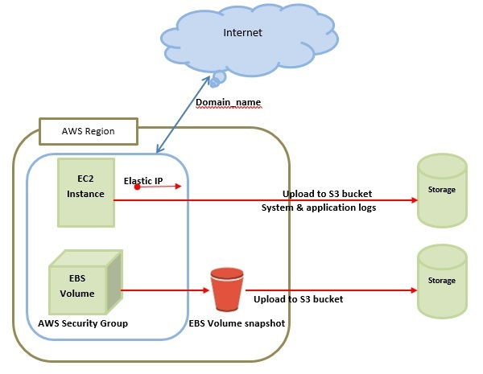
Amazon Web Services - Basic Architecture

Slide 8
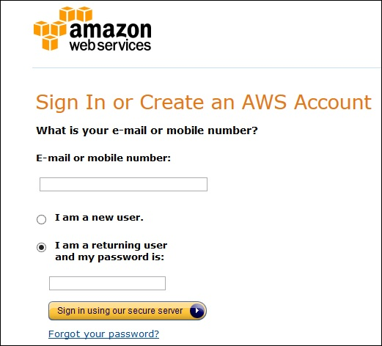
Amazon Web Services - Account
Step 1 − To create an AWS account, open this link https://aws.amazon.comand sign-up for new account and enter the required details.

Slide 9
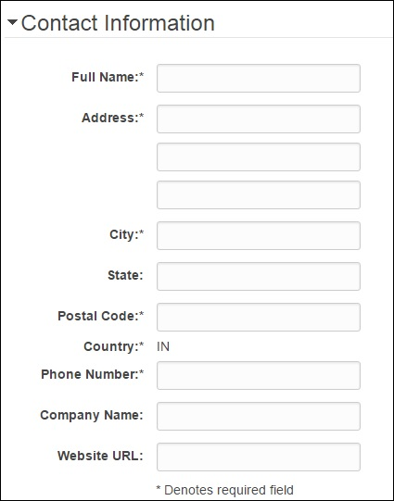
Step 2 − After providing an email-address, complete this form. Amazon uses this information for billing, invoicing and identifying the account. After creating the account, sign-up for the services needed.

Slide 10
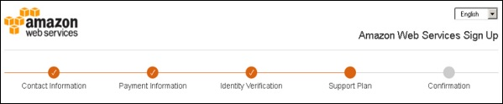
Step 3 − To sign-up for the services, enter the payment information. Amazon executes a minimal amount transaction against the card on the file to check that it is valid. This charge varies with the region.
Step 4 − Next, is the identity verification. Amazon does a call back to verify the provided contact number.
Step 5 − Choose a support plan. Subscribe to one of the plans like Basic, Developer, Business, or Enterprise. The basic plan costs nothing and has limited resources, which is good to get familiar with AWS.
Step 6 − The final step is confirmation. Click the link to login again and it redirects to AWS management console.

Slide 11
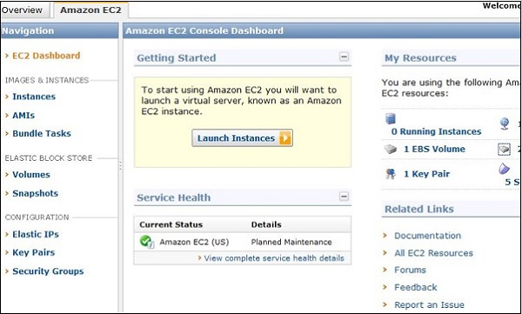
AWS - Elastic Compute Cloud
Amazon EC2 (Elastic Compute Cloud) is a web service interface that provides resizable compute capacity in the AWS cloud.
EC2 instances can be resized and the number of instances scaled up or down as per our requirement. These instances can be launched in one or more geographical locations or regions, and Availability Zones (AZs).

Slide 12
How to Use AWS EC2
Step 1 − Sign-in to AWS account and open IAM console by using the following link https://console.aws.amazon.com/iam/.
Step 2 − In the navigation Panel, create/view groups and follow the instructions.
Step 3 − Create IAM user. Choose users in the navigation pane. Then create new users and add users to the groups.
Step 4 − Create a Virtual Private Cloud using the following instructions.
Open the Amazon VPC console by using the following link − https://console.aws.amazon.com/vpc/
Select VPC from the navigation panel. Then select the same region in which we have created key-pair.

Slide 13
Select start VPC wizard on VPC dashboard.
Select VPC configuration page and make sure that VPC with single subnet is selected. The choose Select.
VPC with a single public subnet page will open. Enter the VPC name in the name field and leave other configurations as default.
Select create VPC, then select Ok.
Step 5 − Create WebServerSG security groups and add rules using the following instructions.
On the VPC console, select Security groups in the navigation panel.
Select create security group and fill the required details like group name, name tag, etc.
Select your VPC ID from the menu. Then select yes, create button.
Now a group is created. Select the edit option in the inbound rules tab to create rules.

Slide 14
Step 6 − Launch EC2 instance into VPC using the following instructions.
Open EC2 console by using the following link − https://console.aws.amazon.com/ec2/
Select launch instance option in the dashboard.
A new page will open. Choose Instance Type and provide the configuration. Then select Next: Configure Instance Details.
A new page will open. Select VPC from the network list. Select subnet from the subnet list and leave the other settings as default.
Click Next until the Tag Instances page appears.
Step 7 − On the Tag Instances page, provide a tag with a name to the instances. Select Next: Configure Security Group.
Step 8 − On the Configure Security Group page, choose the Select an existing security group option. Select the WebServerSG group that we created previously, and then choose Review and Launch.

Slide 15
Step 9 − Check Instance details on Review Instance Launch page then click the Launch button.
Step 10 − A pop up dialog box will open. Select an existing key pair or create a new key pair. Then select the acknowledgement check box and click the Launch Instances button.

