Slide 1
IAM
Karthick Selvam

Slide 2
IDENTITY ACCESS MANAGEMENT
Shared Responsibility Model
What is IAM?
Users
Groups
Roles
Identity Federation

Slide 3
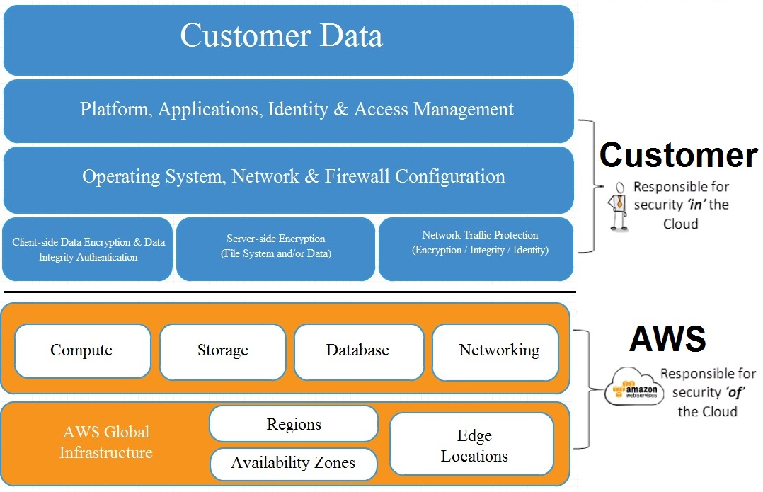
AWS Secured Shared Responsibility

Slide 4
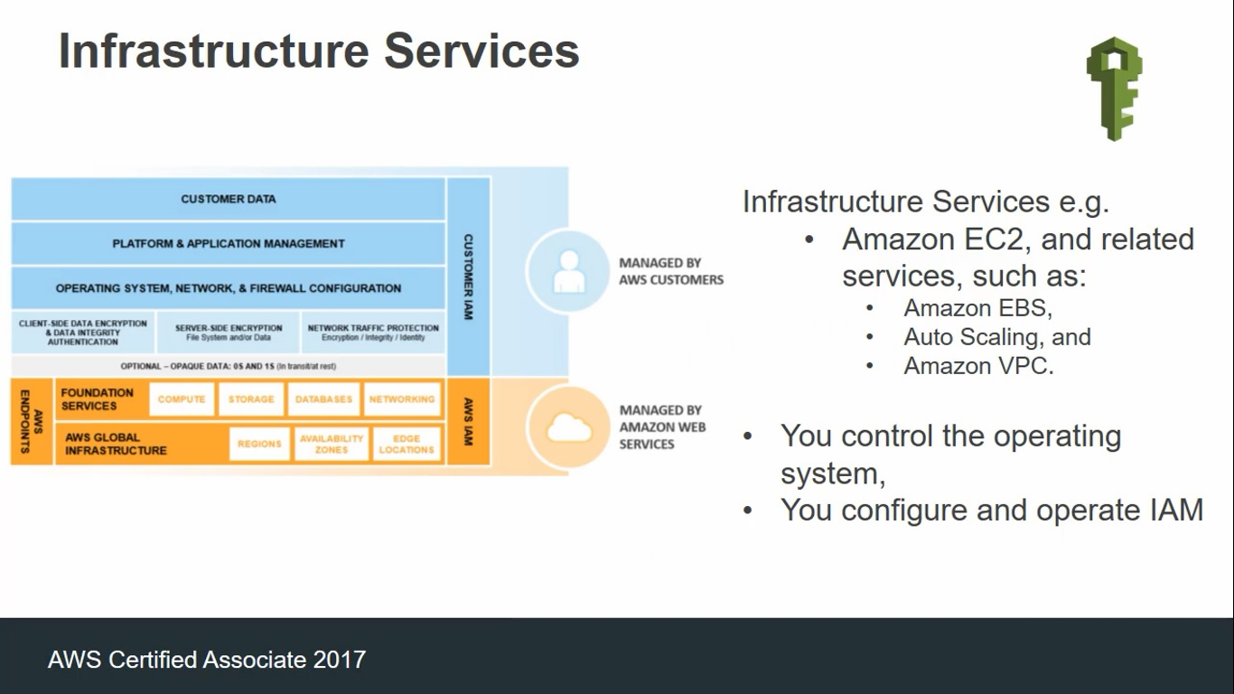

Slide 5
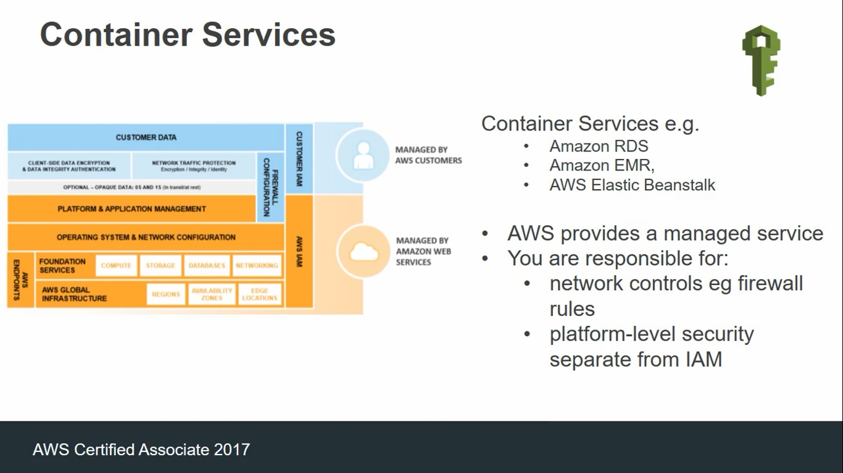

Slide 6
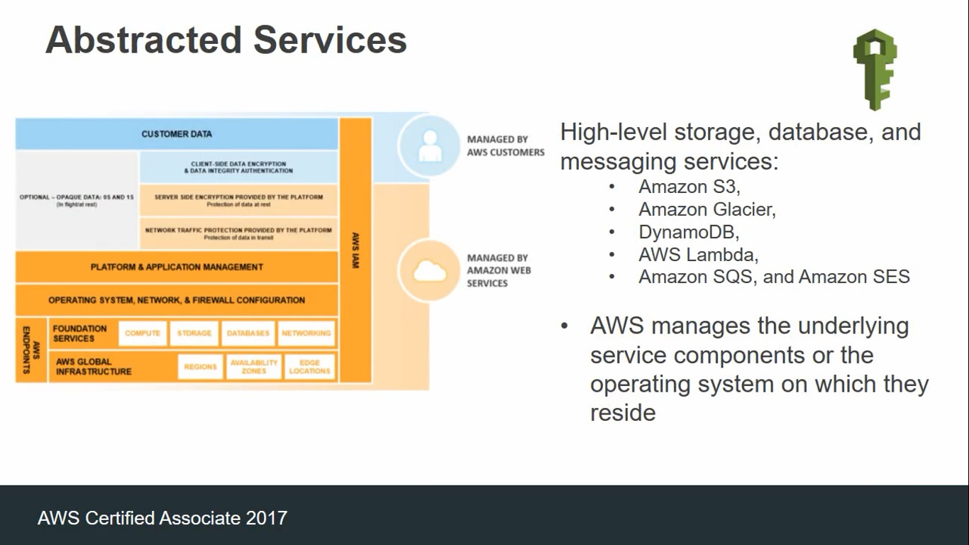

Slide 7
What is IAM?
A wed service that allows you to securely control individual and group access to your AWS resource
Create and manage user identities ("IAM users") and grant permissions
Features
shared access to your AWS Account
Granular permissions
Secure access to AWS resource for applications that run on Amazon EC2
Identity federation to grant permissions for users outside of AWS
Payment card Industry (PCI) Data Security Standard(DSS) Compliance
Access log auditing using CloudTrail
Eventually Consistent
Free to use

Slide 8
IAM Policies
By Default, users can't access anything in your account.
Grant permissions through policies that define the effect, actions, resources and optional conditions
{
"Version":"2012-1017".
"Statement":{
"Effect":"Allow",
"Action":"dynamodb:*",
"Resource":"arn:aws:dynamodb:us-west-2:123456789012:table/Books"
}
}

Slide 9
Users
Represent the person or service accesing your account
Consists of a name and credentials
Users are identified by:
A "friendly name" eg "Bill“
Amazon Resource Name(ARN)
- arn:aws:iam::account-ID-without-hyphens:user/Bill
Unique identifier which is returned only you use the API, SDKs, Tools for Windows PowerShell, or AWS CLI to create the user
Credentials that can be associated to a user:
Console password. Users will have a url link to login to the console.
Access keys(access key ID and a secret access key), max2.
SSH keys with AWS CodeCommit
Server certificates
Never use root user to access resourcec unless absolutely essentials. Create admin users with requires permissions. Always enable multi-factor authentication of the root user.

Slide 10
Roles
Defined permissions that can be assumed by users or resources
Allow EC@ instances to access other AWS resources
Grant users in one AWS account access to resource in another account
Scenarios
Can be used to allow users to temporarily assume a role with least privilege access to critical resources
Application running on an EC2 instance can access AWS resources

Slide 11
Identity Federation
An IAM role can be used to specify permissions for externally identified (federated)users.
Max 5000 users per account. Identity federation enables unlimited temporary
Identified by your organization or a thrid-party identity provider.
Methods of federating users:
Amazon cognito(developer authenticated identities. guest accecc ot public identity service provider).
Public Identity Service Providers or OprnID connect(Facebook, Google, Amazon etc).
Identity provider software packages that support SAML 2.0(Security Assertion Markup Language 2.0).
Creating a custom identity broker application that authenticates users (e.g. with the enterprise's LDAP or Active Directory Services). The application then assumes temporary credentials for the user.*
*Preferres option to use the AWS Directory Service for Active Directory and use this for enterprise and AWS access.

