Slide 1
Amazon Web Services - Amazon S3

Slide 2
Amazon S3 Terminology
Bucket
Uniquely named container for objects stored in S3
Total volume of data and number of objects are unlimited
100 buckets per account (can be increased by request to AWS).
Objects
Entities(data and metadata) stored in a bucket.
0 bytes to a maximum of 5 TB.
Largest object upload in 5 GB.
Multi-part upload for 100 MB to 5 TB.
Keys
Identifier of object in bucket. Object uniquely identified by bucket, key and version ID.

Slide 3
Web Store
S3 is web store no a file system
Eventually consistent- Index updated after data change synchronized across multi-az.
Read after write consistency with new objects synchronized across multi-az before indexed and success returned
Upload new object ->Synchronized ->S3 Index Updated-> Success Returned
Updates and deleted not read after write/delete consistent they are eventually consistent
Update or Delete existing object -> Success Returned -> Synchronized -> S3 Index Updated

Slide 4
Secure by Default
S3 is secure by default but can be modified through:
IAM roles, users and groups (fine grained control)
Bucket Policies applied at the bucket level (fine grained control).
Access Control Lists(ACL) applied at the bucket and/or object level.

Slide 5
Amazon S3 (Simple Storage Service) is a scalable, high-speed, low-cost web-based service designed for online backup and archiving of data and application programs.
It allows to upload, store, and download any type of files up to 5 GB in size.
This service allows the subscribers to access the same systems that Amazon uses to run its own web sites.
How to Configure S3?
Following are the steps to configure a S3 account.
Step 1 − Open the Amazon S3 console using this link − https://console.aws.amazon.com/s3/home

Slide 6
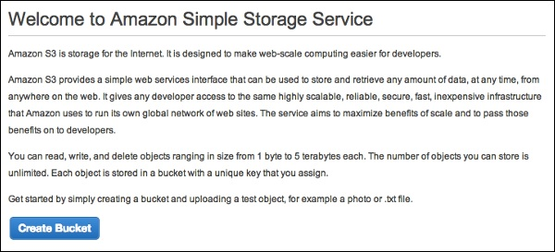
Step 2 − Create a Bucket using the following steps.
A prompt window will open. Click the Create Bucket button at the bottom of the page.

Slide 7
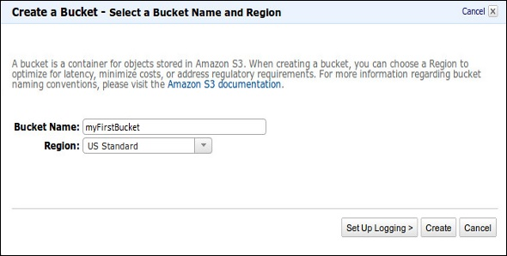
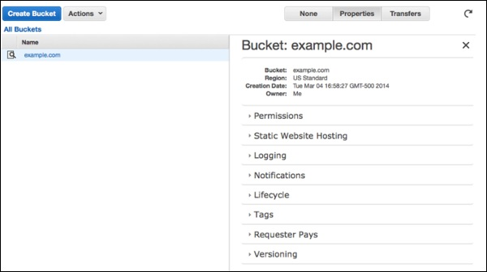
Create a Bucket dialog box will open. Fill the required details and click the Create button.
The bucket is created successfully in Amazon S3. The console displays the list of buckets and its properties.

Slide 8
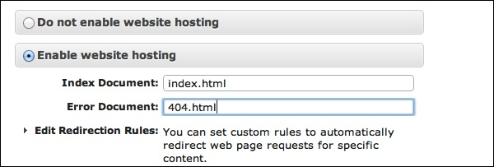
Select the Static Website Hosting option. Click the radio button Enable website hosting and fill the required details.
Step 3 − Add an Object to a bucket using the following steps.
Open the Amazon S3 console using the following link − https://console.aws.amazon.com/s3/home
Click the Upload button.

Slide 9
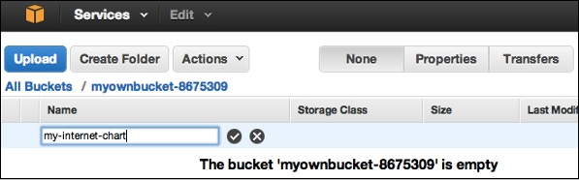
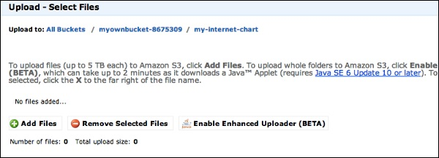
Click the Add files option. Select those files which are to be uploaded from the system and then click the Open button.

Slide 10
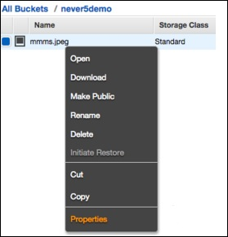
Click the start upload button. The files will get uploaded into the bucket.
To open/download an object − In the Amazon S3 console, in the Objects & Folders list, right-click on the object to be opened/downloaded. Then, select the required object.

Slide 11
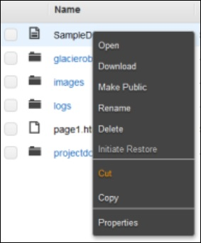
How to Move S3 Objects?
Following are the steps to move S3 objects.
step 1 − Open Amazon S3 console.
step 2 − Select the files & folders option in the panel. Right-click on the object that is to be moved and click the Cut option.
step 3 − Open the location where we want this object. Right-click on the folder/bucket where the object is to be moved and click the Paste into option.

Slide 12
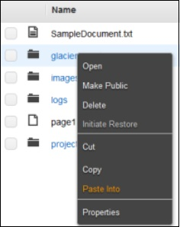
How to Delete an Object?
Step 1 − Open Amazon S3.
Step 2 − Select the files & folders option in the panel. Right-click on the object that is to be deleted. Select the delete option.
Step 3 − A pop-up window will open for confirmation. Click Ok.

Slide 13
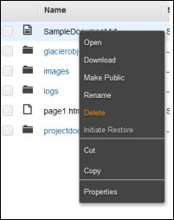
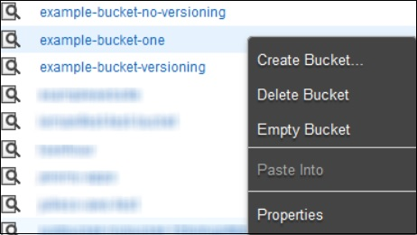
How to Empty a Bucket?
Step 1 − Open Amazon S3 console.
Step 2 − Right-click on the bucket that is to be emptied and click the empty bucket option.

Slide 14
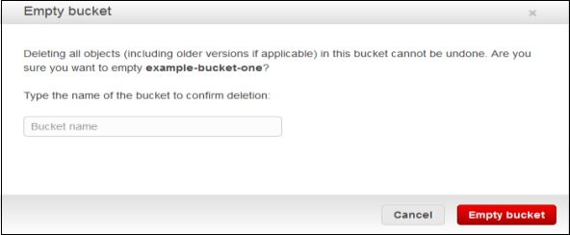
Step 3 − A confirmation message will appear on the pop-up window. Read it carefully and click the Empty bucket button to confirm.
Amazon S3 Features
Low cost and Easy to Use − Using Amazon S3, the user can store a large amount of data at very low charges.
Secure − Amazon S3 supports data transfer over SSL and the data gets encrypted automatically once it is uploaded. The user has complete control over their data by configuring bucket policies using AWS IAM.

Slide 15
Scalable − Using Amazon S3, there need not be any worry about storage concerns. We can store as much data as we have and access it anytime.
Higher performance − Amazon S3 is integrated with Amazon Cloud Front, that distributes content to the end users with low latency and provides high data transfer speeds without any minimum usage commitments.
Integrated with AWS services − Amazon S3 integrated with AWS services include Amazon Cloud Front, Amazon Cloud Watch, Amazon Kinesis, Amazon RDS, Amazon Route 53, Amazon VPC, AWS Lambda, Amazon EBS, Amazon Dynamo DB, etc

Slide 16
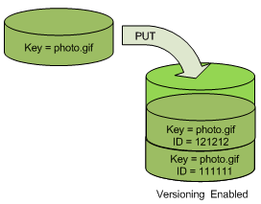
Object Versioning
Versioning enables you to keep multiple versions of an object in one bucket, for example, my-image.jpg (version 111111) and my-image.jpg (version 222222).
You might want to enable versioning to protect yourself from unintended overwrites and deletions or to archive objects so that you can retrieve previous versions of them.
The following figure shows that when a new version of photo.gif is PUT into a bucket that already contains an object with the same name, the original object (ID = 111111) remains in the bucket, Amazon S3 generates a new version ID (121212), and adds the newer version to the bucket.

Slide 17
THANK YOU

