Slide 2
EMR
3-4 to deploy the cluster(Hadoop cluster)
All the 4 systems should be linked with in same private network no public network.
If you want to install Hadoop cluster means in all those system we need to install java in all those system and we need to configure the environmental variable.
You need to select one system as master and one as secondary master and 2 as work nodes and configure the Hadoop settings
Sqoop, hive, hbase, pig, zookeeper manually configure and install that one

Slide 3
EMR
Elastic Map Reduce - > PAAS service to deploy your Hadoop ready made cluster
By default EMR will use EC2 to provision the machines and for configuration it uses the EMR
2 charges that will be applicable for us, EMR charges and EC2 charges

Slide 4
EMR
Provisioning – Deploying
Bootstrapping – Applying Configurations

Slide 5
In ec2 if you want to deploy machines is it possible to create without security group?

Slide 6
HDFS

Slide 7
MapReduce
Mapreduce, it works in java
There are no phases that will be available in Mapreduce, for each and every stage they save the partial result to hard drive and retrieve the result from the hard drive and it will generate an final output
Because of multiple disks I/O should need to process the Mapreduce jobs, to save the partial results and final results it will take high process time

Slide 8
SPARK
Spark, will be the memory resilient program to process the jobs that will be available in Hadoop architecture.
At first they think like, it will be replacement for MapReduce, but it didn’t vanish the Mapreduce market.
Is it possible to work without hdfs, because of hdfs, Mapreduce still survive in the market.
memory resilient- it will handle the entire job in ram, 10 tb data to process to process.(RDD)
Because of entire concept in spark resides on ram, it is faster but not cheaper if you compare with Mapreduce.
Is it possible to work in spark without HDFS, yes they been providing the options to work with internal storage , external storage and Data lake providers.
Readily com up with support for batch processing as well as stream processing also.

Slide 9
Batch Processing data – data will reside in storage all the time, whenever we want we need to pull the data manually or time based pull.
EX: Cricket broadcasting updated score for each and every ball. Because of some problems to upload the data manually my score will not be accurate
Stream processing
Ex: some algorithm ,they will update the score in automated manner

Slide 10
SPARK
Apache Spark is a lightning-fast cluster computing technology, designed for fast computation. It is based on Hadoop MapReduce and it extends the MapReduce model to efficiently use it for more types of computations, which includes interactive queries and stream processing. The main feature of Spark is its in-memory cluster computing that increases the processing speed of an application.
Spark is designed to cover a wide range of workloads such as batch applications, iterative algorithms, interactive queries and streaming. Apart from supporting all these workload in a respective system, it reduces the management burden of maintaining separate tools.

Slide 11
Evolution of Apache Spark
Spark is one of Hadoop’s sub project developed in 2009 in UC Berkeley’s AMPLab by Matei Zaharia. It was Open Sourced in 2010 under a BSD license. It was donated to Apache software foundation in 2013, and now Apache Spark has become a top level Apache project from Feb-2014.

Slide 12
Features of Apache Spark
Apache Spark has following features.
Speed − Spark helps to run an application in Hadoop cluster, up to 100 times faster in memory, and 10 times faster when running on disk. This is possible by reducing number of read/write operations to disk. It stores the intermediate processing data in memory.
Supports multiple languages − Spark provides built-in APIs in Java, Scala, or Python. Therefore, you can write applications in different languages. Spark comes up with 80 high-level operators for interactive querying.
Advanced Analytics − Spark not only supports ‘Map’ and ‘reduce’. It also supports SQL queries, Streaming data, Machine learning (ML), and Graph algorithms.

Slide 13
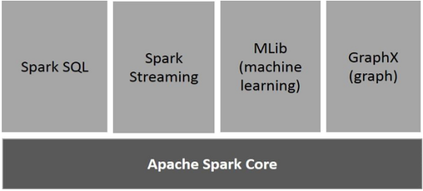
Spark Components

Slide 14
Spark Components
Apache Spark Core
Spark Core is the underlying general execution engine for spark platform that all other functionality is built upon. It provides In-Memory computing and referencing datasets in external storage systems.
Spark SQL
Spark SQL is a component on top of Spark Core that introduces a new data abstraction called SchemaRDD, which provides support for structured and semi-structured data.
Spark Streaming
Spark Streaming leverages Spark Core's fast scheduling capability to perform streaming analytics. It ingests data in mini-batches and performs RDD (Resilient Distributed Datasets) transformations on those mini-batches of data.

Slide 15
Spark Components
MLlib (Machine Learning Library)
MLlib is a distributed machine learning framework above Spark because of the distributed memory-based Spark architecture. It is, according to benchmarks, done by the MLlib developers against the Alternating Least Squares (ALS) implementations. Spark MLlib is nine times as fast as the Hadoop disk-based version of Apache Mahout (before Mahout gained a Spark interface).
GraphX
GraphX is a distributed graph-processing framework on top of Spark. It provides an API for expressing graph computation that can model the user-defined graphs by using Pregel abstraction API. It also provides an optimized runtime for this abstraction

