Slide 1
Bigdata Fundamentals

Slide 2
Agenda
Need of Bigdata Architecture?
History of Bigdata
Architecture of Bigdata
Bigdata Storage module
Bigdata Processing Module
Hands-On labs
Bigdata Storage Module
Bigdata Processing Module
Spark, Hive

Slide 3
Need of Bigdata Architecture?
Data is too large and Complex to Compute

Slide 4
3 V Approach in Bigdata
Volume
Variety
Velocity

Slide 5
Volume
Compare the ratio of the data consumption from 2009 to 2020?
According to International data corporation 44x times it got increased
From 0.8 Zettabytes to 35 Zettabytes
By 2022 60 Zettabytes
By 2022 there will be 5200 gb of data that every person will consume

Slide 6
Volume
12 + tb twitter
25+ tb Facebook
30 billion RFID tags
4.6 billion camera phone
100s of millions gps enabled
2+ billion active users available by end 2011

Slide 7
Variety
CSV
TSV
JSON – linkedin, facebokk
AVRO - bigdata
ORC
Parquet
XML – linkedin, facebook

Slide 8
Velocity
Because of data its been growing exponentially, our storage and processing medium that should need to support
Speed of data generation

Slide 9
Veracity
Break up to 11.20

Slide 10
Hadoop Components
Storage Module -> HDFS(Hadoop Distributed File System ) storage concept that will run on multiple computers
EX: 2 TB data(4 systems with 500 GB hard drive)(Logically it will combine all the storage and treat as single logical entity )
Data – logical binaries (File system – Method to store and retrieve the data efficiently)
File system approach to store and retrieve the large volume of data in the distributed file system
Processing Module -> Map Reduce

Slide 12
History
OCT, 2003 -> Google File System Published(Theory)
Dec, 2004 ->Jeffrey Dean & Sanjay Ghemawat from Google, published another paper MapReduce: Simplified Data Processing on Large Cluster(Theory)
Jan, 2006 -> Inspired by above papers that google published, Doug Cutting, a yahoo employee, developed an opensource implementation of MapReduce Framework
Apr, 2006 -> Hadoop 0.1.0 Released
May, 2006 -> Yahoo deploys 300 Machine Hadoop Cluster
Apr, 2007 -> Yahoo Deploys 2 Cluster of 1000 Machines
Jul, 2008 -> Hadoop wins Terabyte sort Benchmark

Slide 13
History
Jun, 2010, Yahoo 4000 Nodes/ 70 Petabytes
Dec, 2011 -> Apache Hadoop Release 1.0.0 available
Oct 2013 -> Apache Hadoop Release 2.2.0 (Yarn)
Dec 2015 Apache Hadoop 2.6.3 Released
Hadoop was named after Doug Cuttings son toy elephant

Slide 14
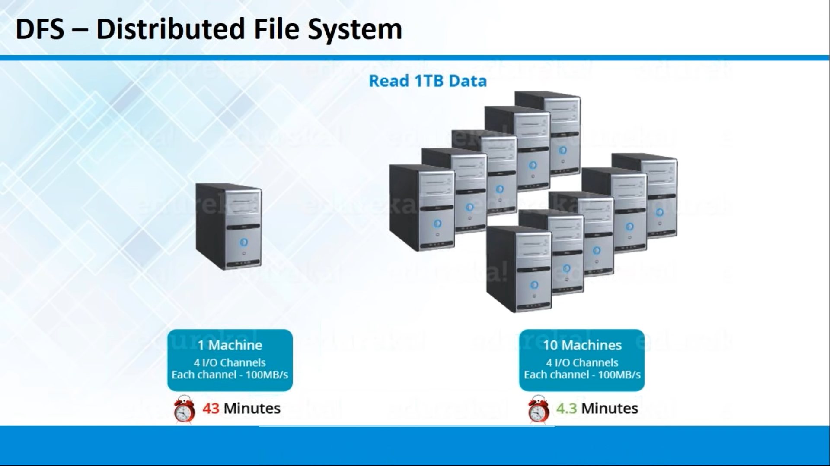

Slide 15
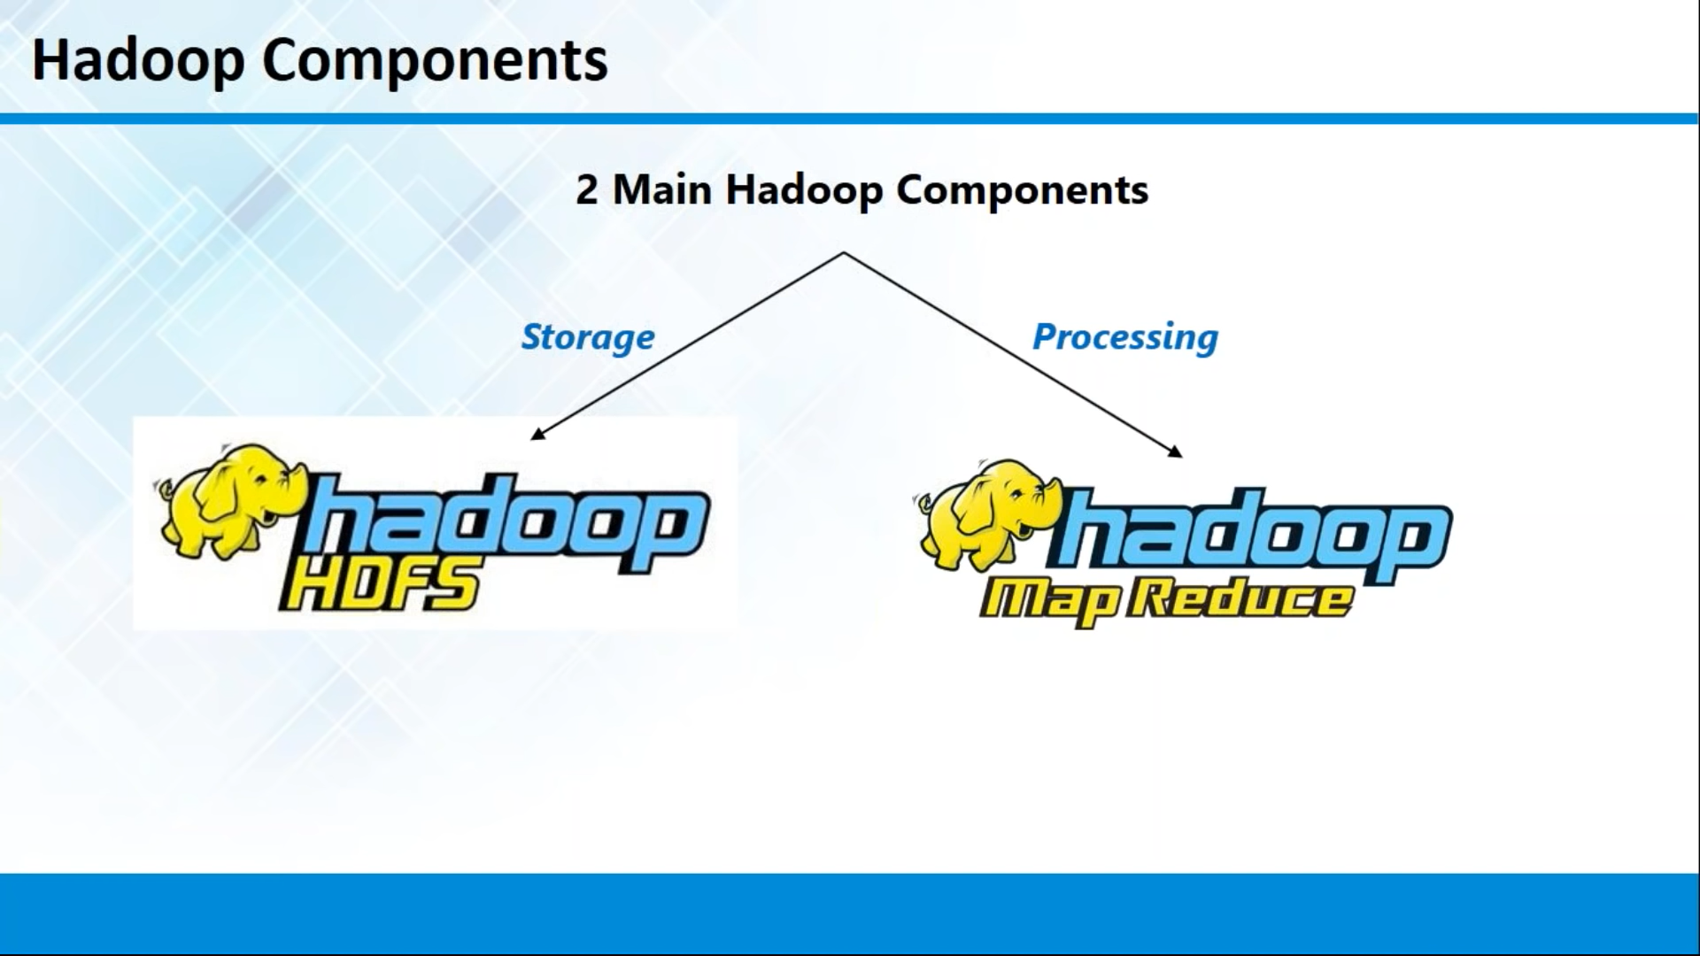

Slide 16
Hadoop Distributions
1.0 -> it is suitable only for Java Programmers
2.0 -> API -> user friendliness
3.0
Some Software is working on group of computers at the particular time to execute on particular task
Master
Slave

Slide 17
Hadoop 1.0
HDFS
Name Node(Master)
Data Node(Slave)
Secondary Name Node(Secondary Master)
MapReduce
Job Tracker(Master)
Task Tracker (Slave)

Slide 18
Hadoop 2.0
HDFS
Name Node(Master)
Data Node (Slave)
Secondary Name Node (Secondary Master)
MapReduce
Resource Manager (Master)
Node Manager (Slave)

