Slide 1
Hands on with Airlines Dataset in Apache Spark
Aim to cross learn Spark APIs with Python
Skill to handle Apache Spark Analytics

Slide 2
Project Description
Domain : Fleet Management - Airlines
Source : CSV
Stage : MySQL -> Hivee
Data Ingest : Sqoop/Spark SQL Context
Action : Data Cleansing /Data quality
ETL : Spark API : PySpark/Spark
Output : JSON

Slide 3










Project Architecture
Output in
JSON
and Parquet
Raw Data (CSV)
Sqoop
Load File Into
Hive or Hbase
Linking Hive
With Spark
Spark Analytics
using Pyspark

Slide 4
Data Extraction
Step 1 :
Dataset Source:
https://accenture-dataexpo-2009.s3.amazonaws.com/2007.csv.bz2
Dataset Description:
The data consists of flight arrival and departure details for all commercial flights within the USA.
This is a large dataset.
There are nearly 100 million records which takes up more than 500 mega-bytes of space when uncompressed.

Slide 5
Dataset Column-wise Description - 1
Name | Description
Year | 2007
Month | 1-12
DayofMonth | 1-31
DayOfWeek | 1 (Monday) - 7 (Sunday)
DepTime | actual departure time (local, hhmm)
CRSDepTime | scheduled departure time (local, hhmm)
ArrTime | actual arrival time (local, hhmm)
CRSArrTime | scheduled arrival time (local, hhmm)
UniqueCarrier | unique carrier code
FlightNum | flight number
TailNum | plane tail number
ActualElapsedTime | in minutes
CRSElapsedTime | in minutes
ArrDelay | arrival delay, in minutes
DepDelay | departure delay, in minutes
Origin | origin IATA airport code
Dest | destination IATA airport code
Distance | in miles
TaxiIn | taxi in time, in minutes
TaxiOut | taxi out time in minutes
Cancelled | was the flight cancelled?
CancellationCode | reason for cancellation (A = carrier, B = weather, C = NAS, D = security)
Diverted | 1 = yes, 0 = no
CarrierDelay | in minutes
WeatherDelay | in minutes
NASDelay | in minutes
SecurityDelay | in minutes
LateAircraftDelay | in minutes

Slide 6
Step 2 :
Loading the Data in MySQL Database.
Why To Load In MySQL Database?
As per the Project Architecture we need to Import Data Using Sqoop Tool which requires a relational
database as a source.
What is Sqoop ?
Sqoop is a command-line interface application for transferring data between relational databases and
Hadoop.

Slide 7
How to Load the Data in MySQL
Step 1:
Creating MySQL Table Using the Following Commands:
Create a Database using :
Create Database project;
Using Created Database:
Use project;
Create a Table using :
create table record_2007 (Year int, Month int, DayofMonth int ,DayOfWeek int, DepTime int, CRSDepTime int, ArrTime int, CRSArrTime int, UniqueCarrier char(40), FlightNum int, TailNum char(40), ActualElapsedTime int, CRSElapsedTime int, AirTime int, ArrDelay int, DepDelay int, Origin char(40), Dest char(40), Distance int, TaxiIn int, TaxiOut int, Cancelled int, CancellationCode char(40), Diverted char(40), CarrierDelay int, WeatherDelay int, NASDelay int, SecurityDelay int, LateAircraftDelay int ) ;

Slide 8
How to Load the Data in MySQL - 2
Step 2 :
How to Load Data in Created MySQL Table:
load data infile ‘/home/cloudera/Desktop/csv_Data/2007.csv’ into table record_2007 fields
terminated by ‘,’ lines terminated by ‘\n’

Slide 9
Data Loading in Hive using Sqoop
Why Directly Importing in Hive?
For Creating Less Overheads we Directly import data to hive using Sqoop, inspite of Importing in HDFS
and Loading in Hive External Table .
Command to directly Import In Hive table:
(Pre-requisite : Create a Database in Hive using : create database project)
Sqoop import –connect jdbc:mysql://127.0.0.1:3306/project
–username root –password cloudera
--split-by FlightNum
–table record_2007
–target-dir /user/cloudera/record_2007/
--hive-import
–hive-table project.record_2007

Slide 10
Linking Hive With Spark
Since we have loaded the data in Hive Internal Table we need to Link the Hive with Spark .
Command :
ln –s /usr/lib/hive/conf/hive-site.xml /usr/lib/spark/conf/hive-site.xml

Slide 11
Analytics Using PySpark
Why Pyspark?
It is majorly used for processing structured and semi-structured datasets. Spark offers high-speed computing, agility, and relative ease of use are perfect complements to MapReduce. Thus, with PySpark you can process the data by making use of SQL as well as HiveQL
Pyspark script to run any sql query on Hive internal table and Saving to a Data frame:
from pyspark.sql import HiveContext
from pyspark.context import SparkContext
sc = SparkContext.getOrCreate ("local", "MyApp")
com = HiveContext(sc)
df = com.sql(“ select * from project.record_2007 limit 10 ")

Slide 12
To save as JSON file format:
df.coalesce(1).write.save("QUERY-01_json",format = "JSON") To save as PARQUET file format:
df.coalesce(1).write.save("QUERY-01",format = “PARQUET")

Slide 13
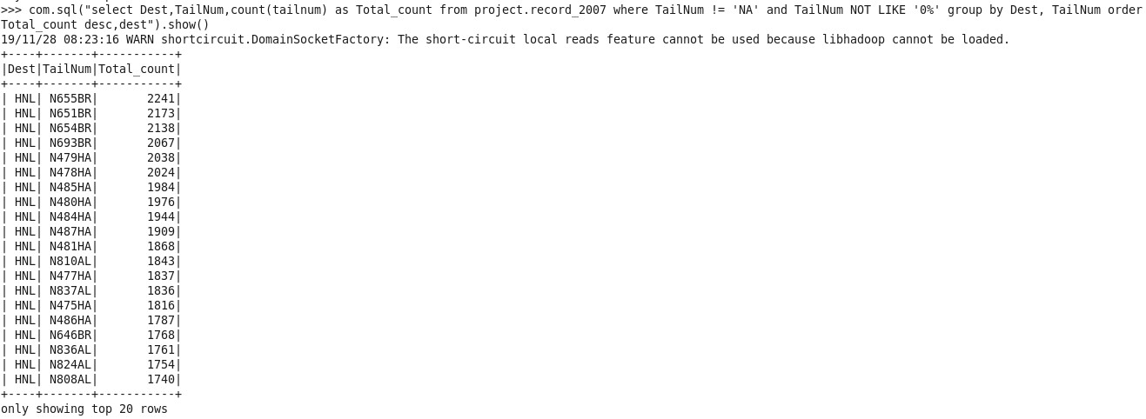
Query1
Find the most Frequent tailnumber which is getting in destination by maximum.
select Dest,TailNum,count(tailnum) as Total_count from project.record_2007 where TailNum != 'NA' and TailNum NOT LIKE '0%' group by Dest, TailNum order by Total_count desc,dest

Slide 14
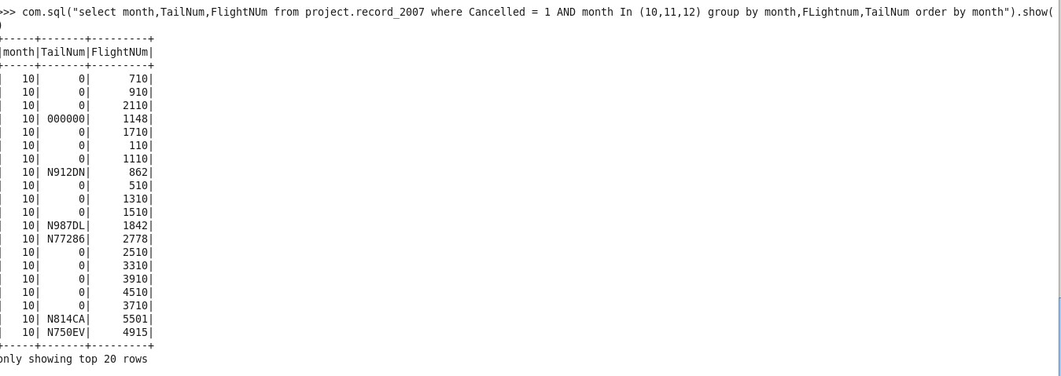
Query 2
Find out the cancelled flight details for the last quarter.
select month,TailNum,FlightNUm from project.record_2007 where Cancelled = 1 AND month In (10,11,12) group by month,FLightnum,TailNum order by month.

Slide 15
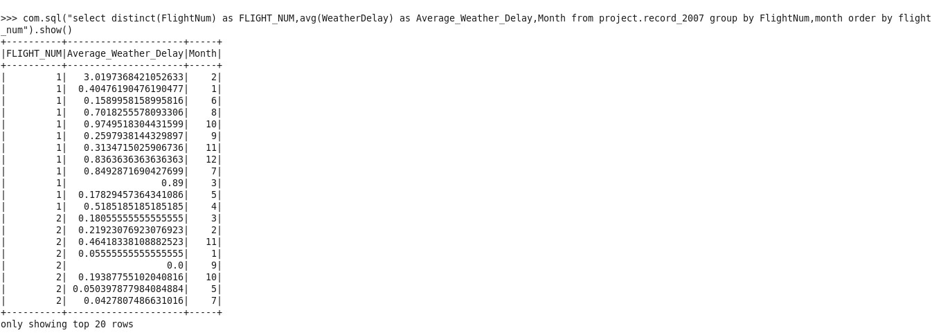
Query 3
Find out the average weather delays for a particular flight per month.
select distinct(FlightNum) as FLIGHT_NUM,month,avg(WeatherDelay) as Average_Weather_Delay from project.record_2007 group by FlightNum,Month order by flight_num,month

Slide 16
Query 4
Inspite of NASDelay, SecurityDelay, LateAircraftDelay, weatherDelay, CarrierDelay which flight reached on time.
select FlightNum from project.record_2007 where (CarrierDelay>0 OR WeatherDelay>0 OR NASDelay>0 OR
SecurityDelay>0 OR LateAircraftDelay> 0) ANd ArrDelay<=0

Slide 17
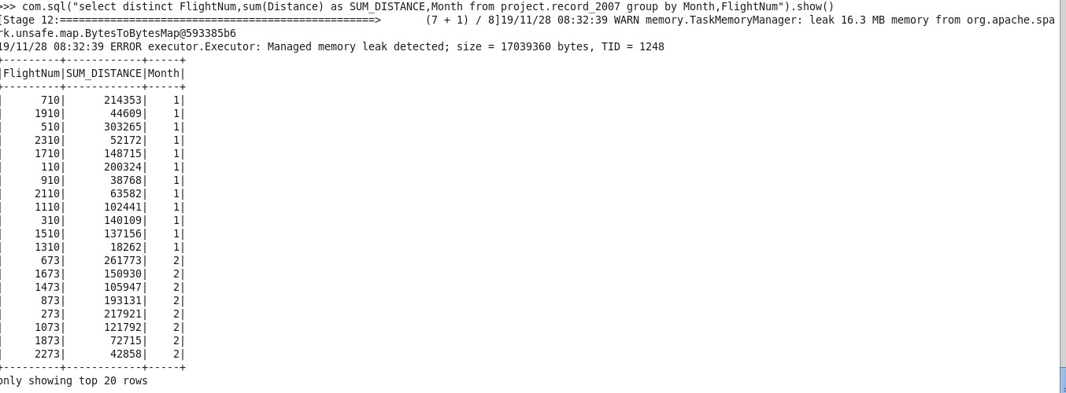
Query 5
Monthwise total distance travelled by each flight number
select distinct FlightNum,sum(Distance) as SUM_DISTANCE,Month from
project.record_2007 group by Month,FlightNum

Slide 18
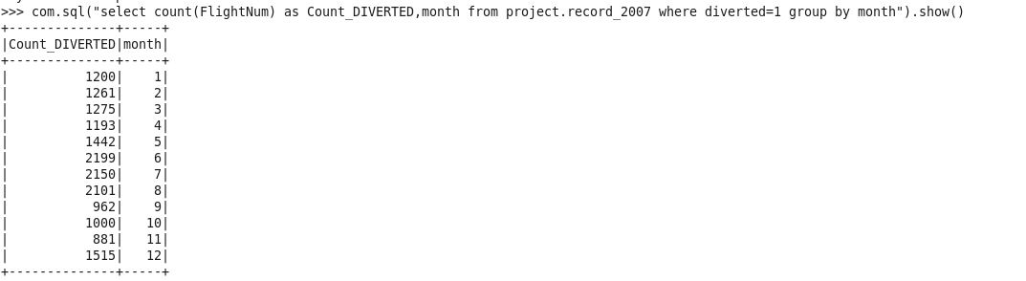
Query 6
Month wise how many get diverted (origin to destination)
select count(FlightNum) as Count_DIVERTED,month from project.record_2007 where diverted=1 group by month

Slide 19
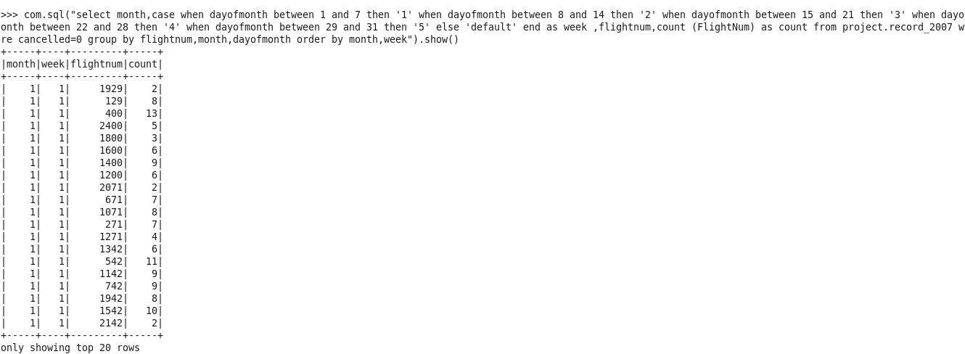
Query 7
Week and monthwise num of trips in all the flights.
select month,case when dayofmonth between 1 and 7 then '1' when dayofmonth between 8 and 14 then '2' when
dayofmonth between 15 and 21 then '3' when dayofmonth between 22 and 28 then '4' when dayofmonth between 29 and 31 then '5' else 'default' end as week ,flightnum,count (FlightNum) as count from project.record_2007 where cancelled=0 group by flightnum,month,dayofmonth order by month,week

Slide 20
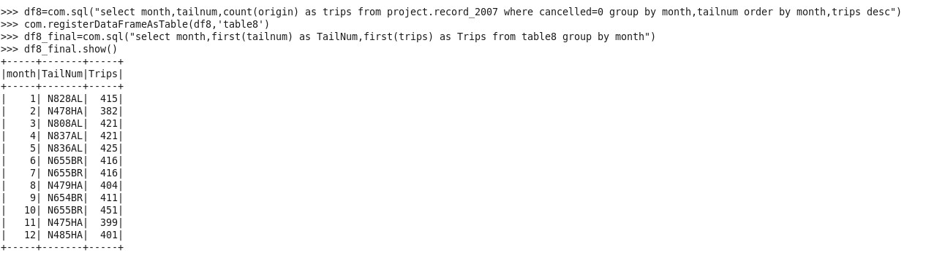
Query 8
Which flights covered maximum origin and destination by month wise
df8=com.sql("select month,tailnum,count(origin) as trips from project.record_2007 where cancelled=0 group by
month,tailnum order by month,trips desc")
com.registerDataFrameAsTable(df8,'table8’)
df8_final=com.sql("select month,first(tailnum) as TailNum,first(trips) as Trips from table8 group by month")

Slide 21
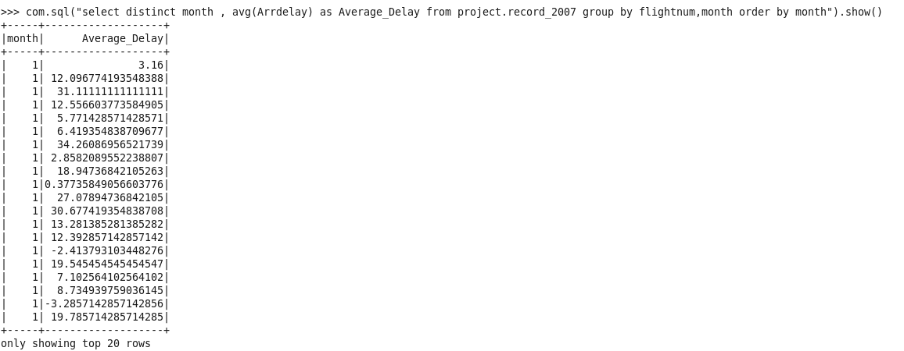
Query 9
Average monthwise arrival delay
select distinct month , avg(Arrdelay) as Average_Delay from project.record_2007 group by flightnum,month

Slide 22
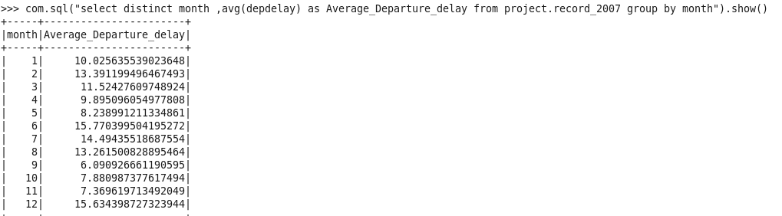
Query 10
Average month wise departure delays
select distinct month , avg(depdelay) as Average_Departure_delay from project.record_2007 group by month

Slide 23
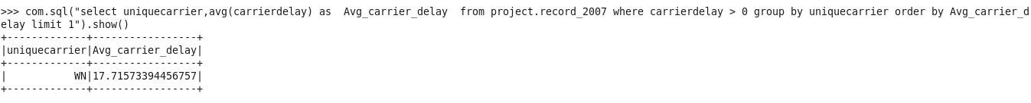
Query 11
Which carrier performs better?
select uniquecarrier,avg(carrierdelay) as Avg_carrier_delay from project.record_2007 where carrierdelay > 0 group by
uniquecarrier order by Avg_carrier_delay limit 1

Slide 24
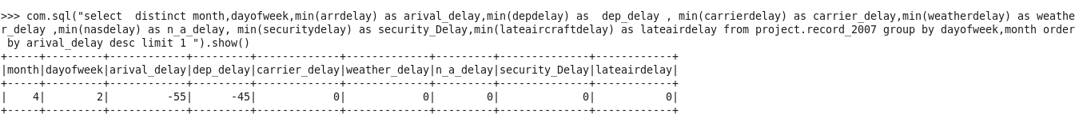
Query 12
When is the best day of week/time of year to fly to minimise delays ?
select distinct month,dayofweek,min(arrdelay)as arival_delay,min(depdelay) as dep_delay , min(carrierdelay) as carrier_delay,min(weatherdelay) as weather_delay ,min(nasdelay) as n_a_delay, min(securitydelay) as security_Delay,min(lateaircraftdelay) as lateairdelay from project.record_2007 group by dayofweek,month order by arival_delay desc limit 1

Slide 25
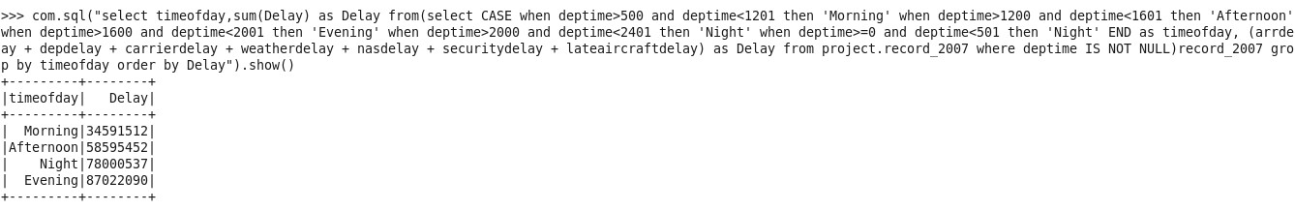
Query 12
When is the best time of day to fly to minimise delays ?
select timeofday,sum(Delay) as Delay from(select CASE when deptime>500 and deptime<1201 then 'Morning' when deptime>1200 and deptime<1601 then 'Afternoon' when deptime>1600 and deptime<2001 then 'Evening' when deptime>2000 and deptime<2401 then 'Night' when deptime>=0 and deptime<501 then 'Night' END as timeofday, (arrdelay + depdelay + carrierdelay + weatherdelay + nasdelay + securitydelay + lateaircraftdelay) as Delay from project.record_2007 where deptime IS NOT NULL)record_2007 group by timeofday order by Delay

Slide 26
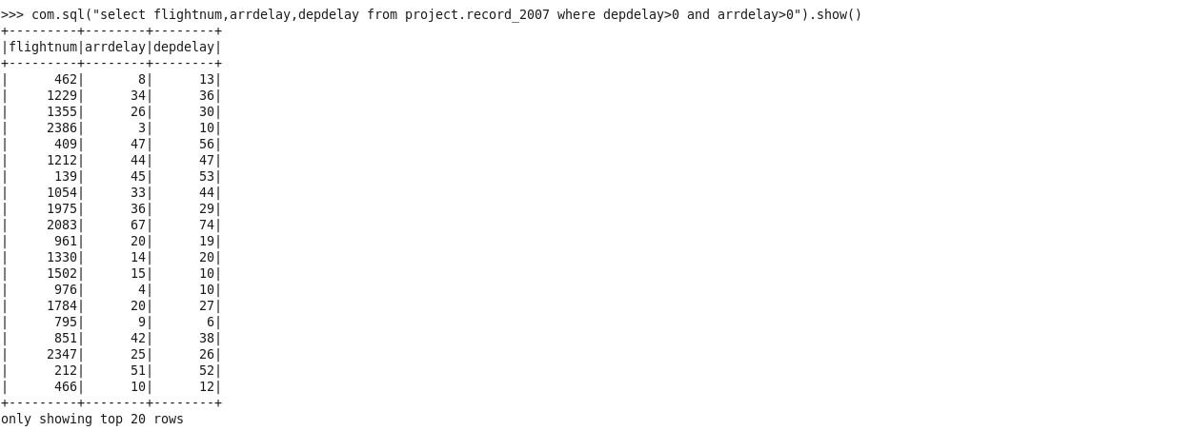
Query 13
Can you detect cascading failures as delays in one airport create delays in others? Are there critical links in the system?
select flightnum,arrdelay,depdelay from project.record_2007 where depdelay>0 and arrdelay>0

Slide 27
Query 14
Month-wise percentage of cancellation reason
dfm1 = com.sql("select month,sum(cancelled) sum_cancel from project.record_2007 group by month")
dfm1.registerTempTable("month1")
dfm2 = com.sql("select month,cancellationcode,sum(cancelled)*100 cancel_percent from project.record_2007 where
cancellationcode<>'' group by month,cancellationcode")
dfm2.registerTempTable("month2")df4 = com.sql("select mt1.month,mt2.cancellationcode,mt2.cancel_percent/mt1.sum_cancel final_percent from month1 mt1, month2 mt2 where mt1.month = mt2.month order by mt1.month")

Slide 28
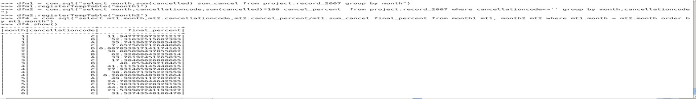

Slide 29
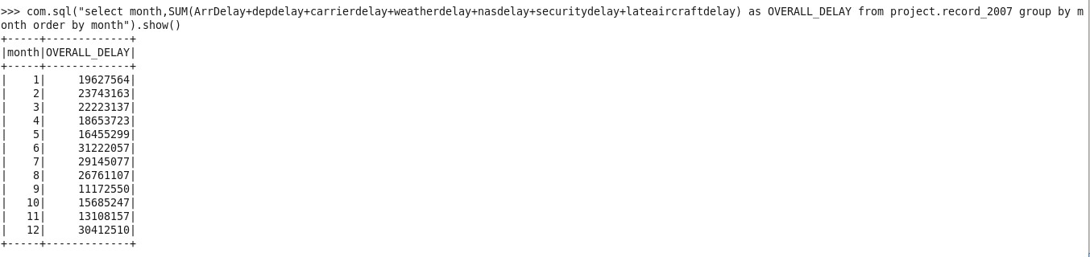
Query 15
Do older planes suffer more delays?
Select month,SUM(ArrDelay+depdelay+carrierdelay+weatherdelay+nasdelay+securitydelay+lateaircraftdelay) as OVERALL_DELAY from project.record_2007 group by month order by month

Slide 30
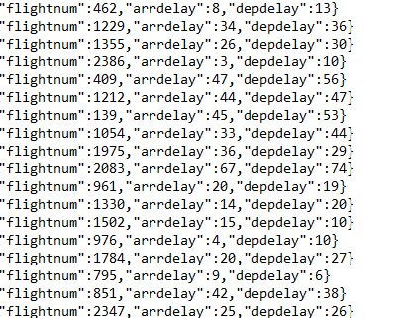
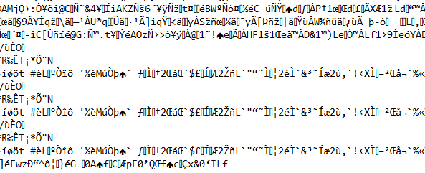
Output Files :
PARQUET FILE
JSON FILE

