Slide 2
Spark
To deal with bigdata architecture
Hadoop
Spark

Slide 3
Company -> if your company database reach the maximum level – to fix the performance issue as a data engineer what we do?
What if we reach the maximum level by means of capacity -> Storage/Computing or max connection
Because of the database poor performance -> none will fix the issue
If the same situation happen in business will you agree?
By what means the database reach the maximum capacity
Volume -> 65536 TB -> ?

Slide 4


Database Engine
Database Storage
They designed this database engine -> revert back to your query
How fast it was reverting back -> performance
Database engine -> Max performance default parameters -> optimal
Max parameters -> max volume ->65536 TB
Database engine -> wont accept / performance issue

Slide 5
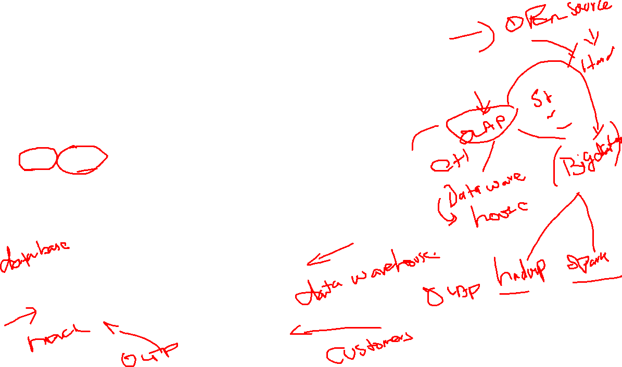
As a database engineer -> overcome from this problem?
Vertical and horizontal scaling
OLTP/OLAP ->how we are using the database
Banking -> text based -> updating / modifying -> RAID
Flipkart -> merchant based / customer based website

Slide 6
Bigdata
Open Source + Commodity hardware(normal hardware)
All the types of data
Architecture Administrator -> performance is based on hardware and how good you are maintaining the architecture / Cloud -> readymade bigdata architecture -> Cost -> setup + hardware
Architecture Developer
Hadoop -> Sqoop, Hive, HBase, Zookeeper, Kafka, Flume, Pig
Spark -> Scala + Java + python

Slide 7
How bigdata architecture will work?
Bigdata architecture -> distributed in nature

Slide 8

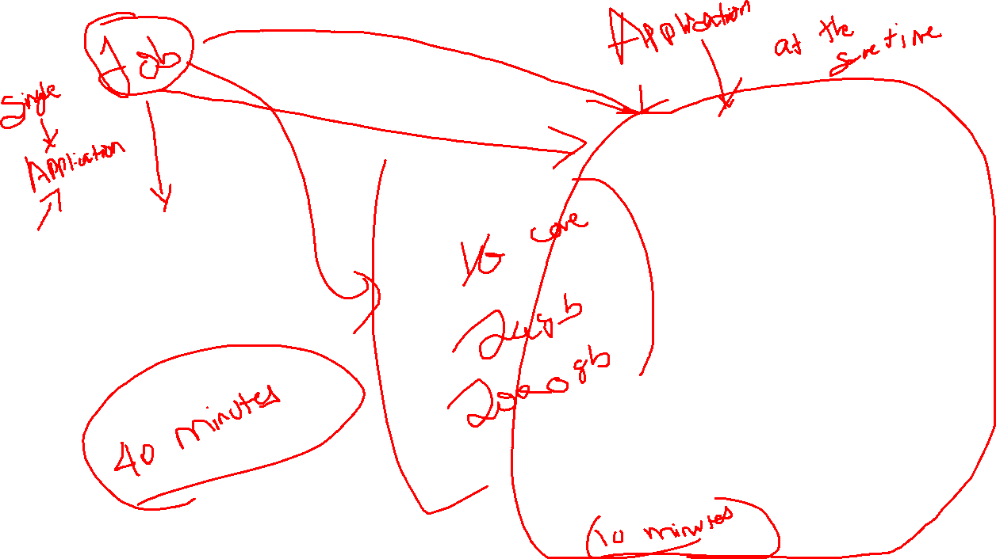
4 Core -> Processor
6 GB -> RAM
500 GB -> Storage
4 Core -> Processor
6 GB -> RAM
500 GB -> Storage
4 Core -> Processor
6 GB -> RAM
500 GB -> Storage
4 Core -> Processor
6 GB -> RAM
500 GB -> Storage
4 Core -> Processor
6 GB -> RAM
500 GB -> Storage

Slide 9
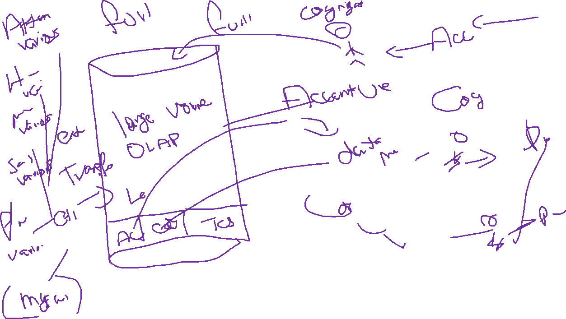

Slide 10
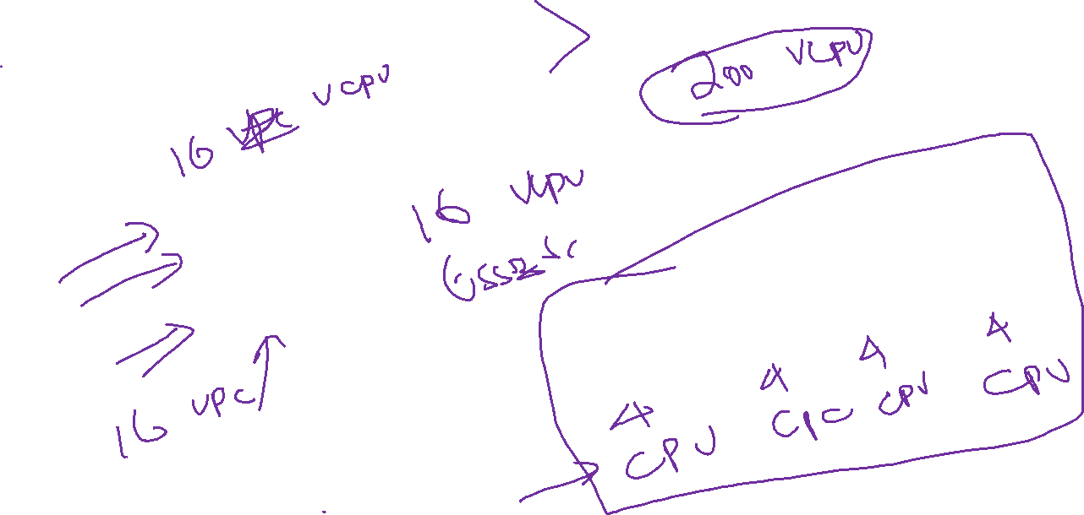
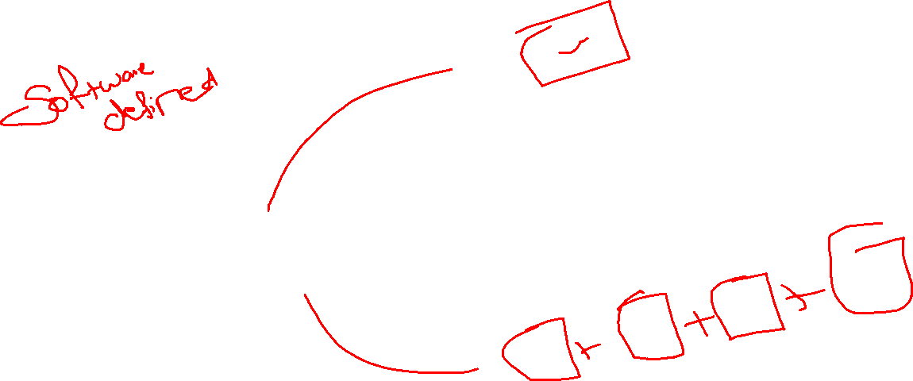
Database Engine

Slide 11
Terminologies
Cluster Computing -> group of computer that are design to execute a common task connected through common network(Public/Private)
Distributed Storage -> cluster -> storage -> helps you to fetch the storage from multiple machines -> treat it as one logical large volume of storage and it give you some extra features
Distributed Computing -> helps you to fetch the compute resource(CPU+RAM) from multiple machines -> treat it as one logical large computing capacity to perform the large task -> short duration
Auto scaling -> process of expanding the computing resources to meet up your demands -> Expanding/Reduce
Vertical Scaling -> single system -> power off -> expand the resources(CPU+ RAM + Hard drive )
Horizontal Scaling -> Cluster -> add the system -> remove

Slide 12
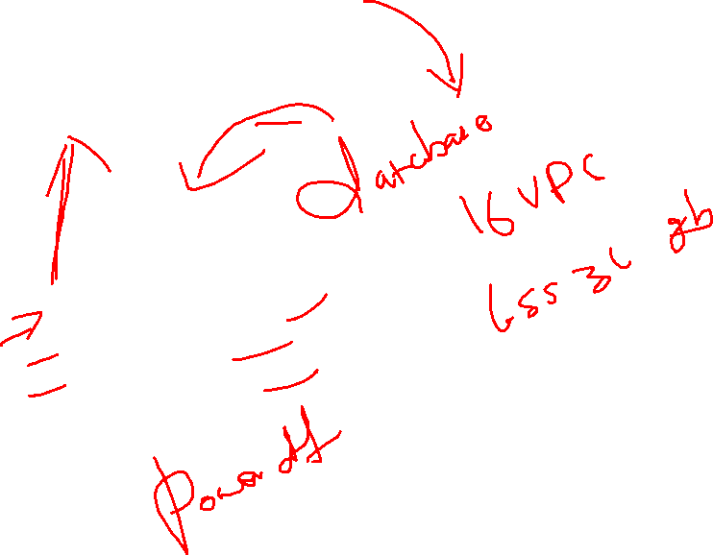
4 Core -> Processor
6 GB -> RAM
500 GB -> Storage

Slide 13
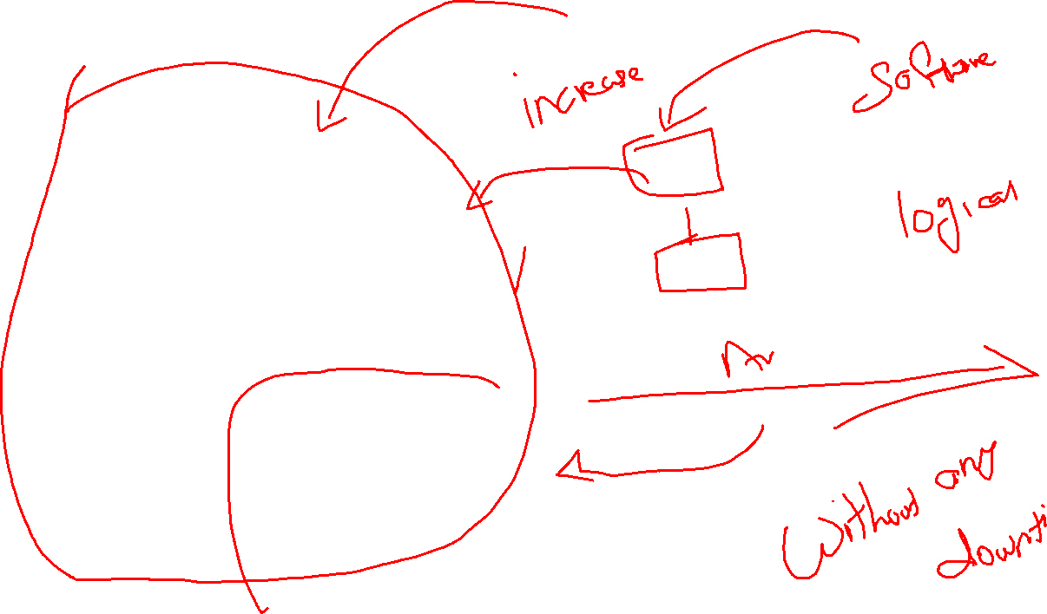
4 Core -> Processor
6 GB -> RAM
500 GB -> Storage
4 Core -> Processor
6 GB -> RAM
500 GB -> Storage
4 Core -> Processor
6 GB -> RAM
500 GB -> Storage
4 Core -> Processor
6 GB -> RAM
500 GB -> Storage

Slide 14
Bigdata
Hadoop -> Cluster Management Tool -> JAVA -> 2005
Distributed Storage – HDFS -> Hadoop Distributed File System
Distributed Computing -> Distributed -> JAVA -> MapReduce
Earlier -> JAVA -> 2.0 -> Other programmers
MapReduce -> Distributed Computing(Method) -> Consume Various Steps -> For each and every step it need to transfer the intermediate data from one step to another -> Disk I/O -> More time
Spark -> Cluster Management Tool -> SCALA -> 2009
Distributed Storage -> all the cloud integration
Distributed Computing -> (Disk I/O -> RAM),streaming, by default all the data analysis with all the types of data -> natively
RAM -> Costlier
Existing Hadoop Customer -> Spark -> MapReduce, YARN
HDFS -> yes they are supported
Standalone -> yes they are supported

Slide 15
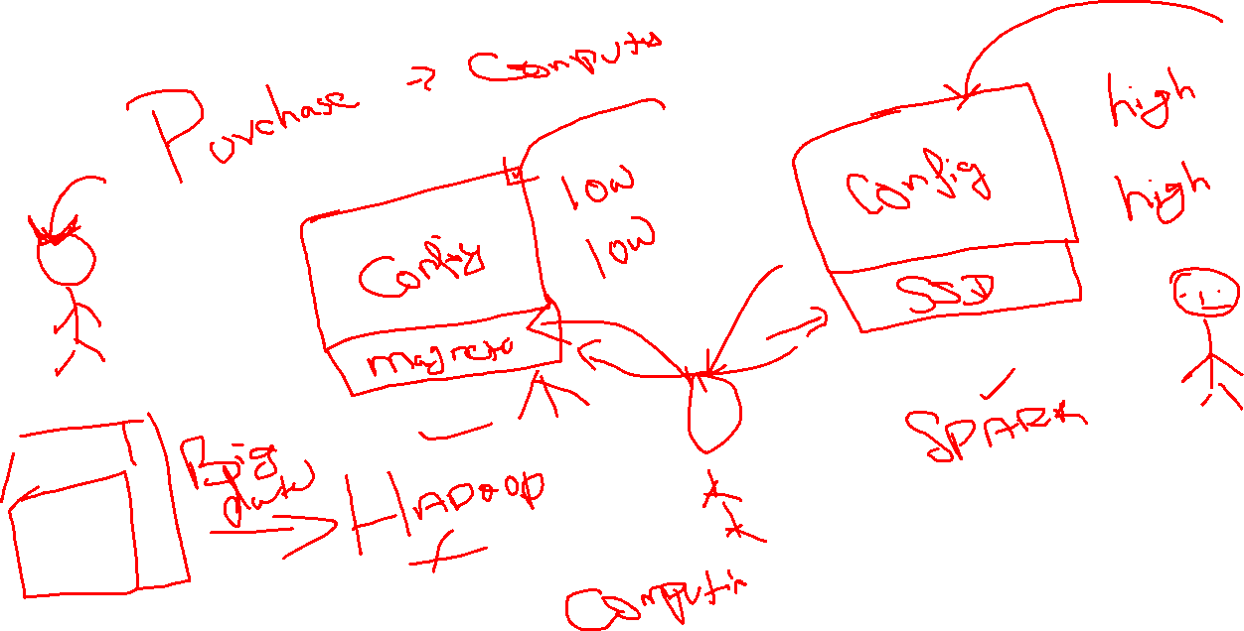

Slide 16
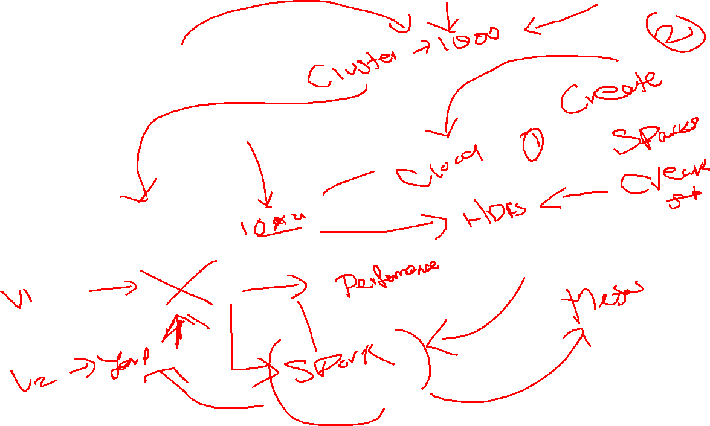
Company
HDFS
Mapreduce

Slide 17
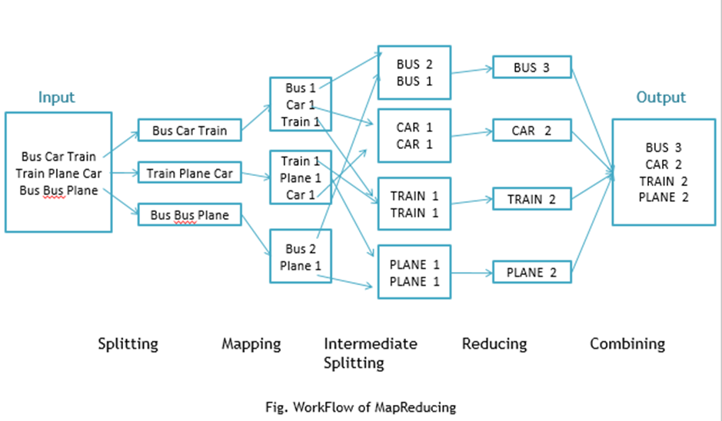
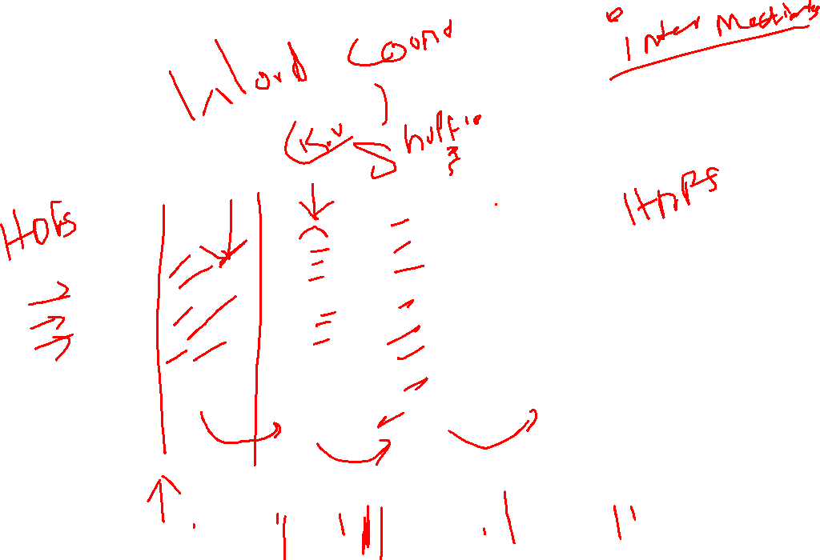

Slide 18
Spark
Scala
Python

Slide 19
Administrator
Databricks -> support -> Spark
Databricks -> Cloud cluster -> free of cost without any payment

Slide 20
Bigdata
Hadoop
Spark

Slide 21
Spark
Administrator -> Set up and maintain the architecture -> opensource tool to maintain the cluster manually
Developer -> Internal components of Hadoop

Slide 22
Lab Environment
Databricks Cloud -> Community Edition
Databricks -> Premium company to deal with the spark architecture in the higher end -> Administrator + support + track and secure your environment -> Premium
Databricks -> Advantage of maintain the hardware on the cloud platforms(AWS + Google + Azure)
Databricks -> not going with any kind of cloud vendors
Databricks -> Community edition version

Slide 23
Community
15.3 GB Memory -> RAM
2 Cores -> CPU
1 DBU
Storage -> DBFS is the Databricks File System. Simply, it provides a simple place to put data in Databricks.
As a Community Edition user, your cluster will automatically terminate after an idle period of two hours.

Slide 24
Spark Components
Spark Core -> basic underlying component of spark -> all the types of data -> libraries especially to deal with all the types of data
Spark SQL -> Structured data
Spark Streaming -> Streaming data
Spark MLiB -> Machine learning algorithms
Spark Graphx -> Graphical algorithms

Slide 25
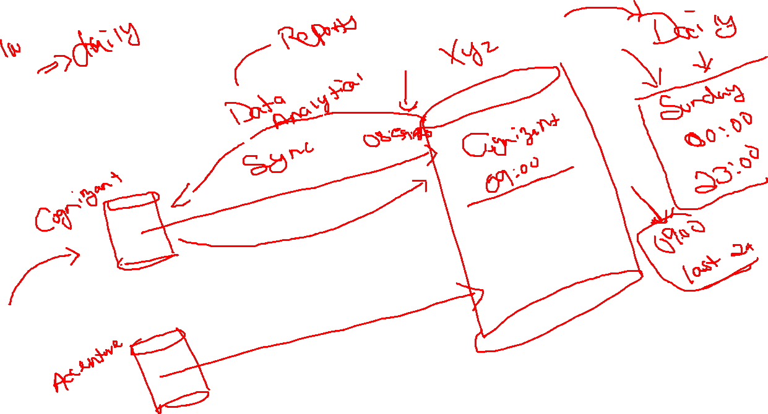
Data Origin

Slide 26
Batch Processing
How we are going to pull the data from customer end
Updated data -> send the sync and get the updated data
Schedular -> Corn job -> depends on timing -> send the sync request automatically -> pull the data

Slide 27
Stream Processing
Architecture -> monitor for data change in client side -> push the data automatically whenever the changes happen from client side
Receive and process -> batches, batch interval

Slide 28

Streaming
Consumer
Producer
Distributed architecture
Apache Kafka
24*7
Client
Bigdata

Slide 29
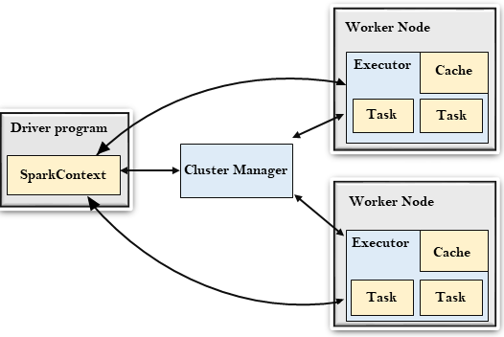
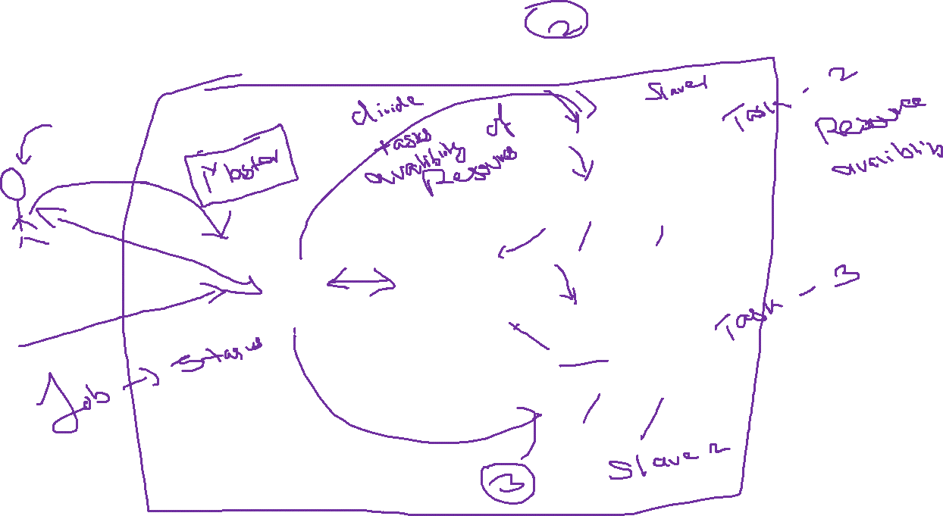
Spark Architecture

Slide 30
RDD ->
Resilient Distributed Data Set
Resilient -> it got recover it self automatically from failover
Distributed -> data will be available in multiple machines
Dataset
RDD -> dataset that is available multiple machines and it got the feature of automatic failover recovery
Basic storage component -> Spark -> RDD
Spark -> RAM -> RDD -> Immutable in nature(Replace/create new)
Directed Acyclic Graph(DAG) -> Working procedure of the Spark

Slide 31
Spark Program
Establish the driver link -> Spark Context
Data -> We need to convert it to RDD
To perform the Data Analytical
Transformations -> Spark Transformation is a function that produces new RDD from the existing RDDs. It takes RDD as input and produces one or more RDD as output. Each time it creates new RDD when we apply any transformation. Thus, the so input RDDs, cannot be changed since RDD are immutable in nature. By default spark transformations are lazy in nature
Spark will not start the job immediately, when you apply the transformations
Actions: if you want to start the transformation, you need to initialize the actions
x

Slide 32
Spark core
How to establish the driver link to our program
Spark Context
SparkConf
How to create the RDD
RDD -> Array of objects
2 methods
Parallelizing the existing object
Reference the external data set
x

Slide 33
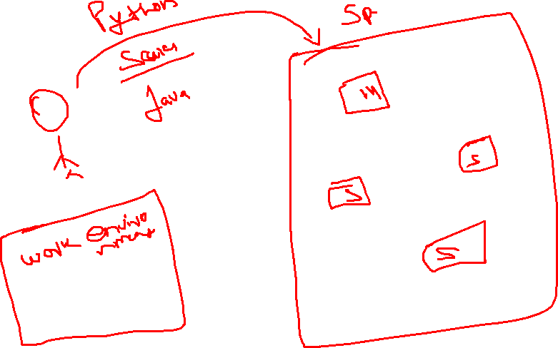
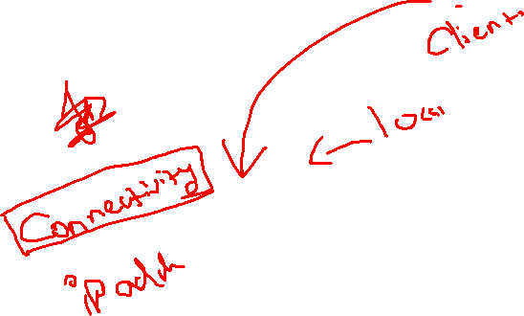
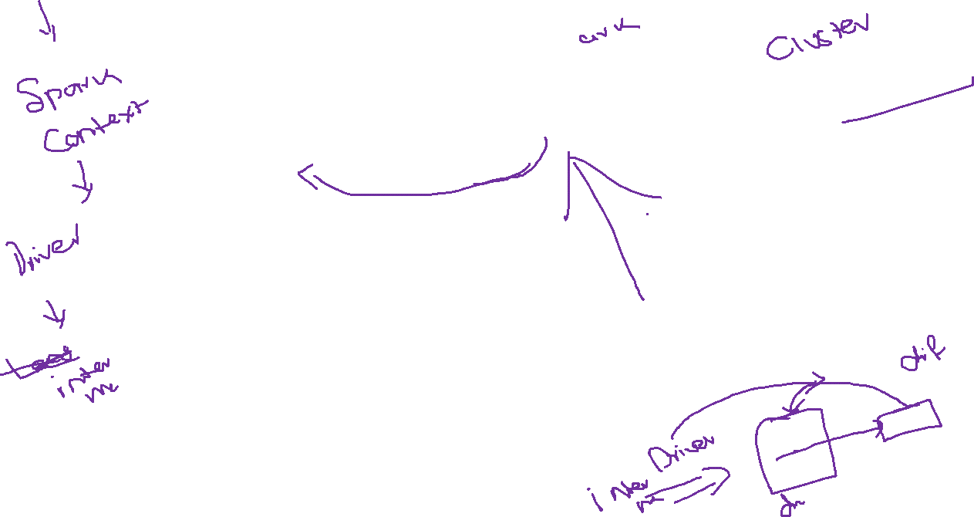

Slide 34
Spark properties control most application parameters and can be set by using a SparkConf object, or through Java system properties. Environment variables can be used to set per-machine settings, such as the IP address, through the conf/spark-env.sh script on each node.

Slide 35
External
Default format -> Strings -> collection of object
It will consider each line as object(content, empty)

Slide 36
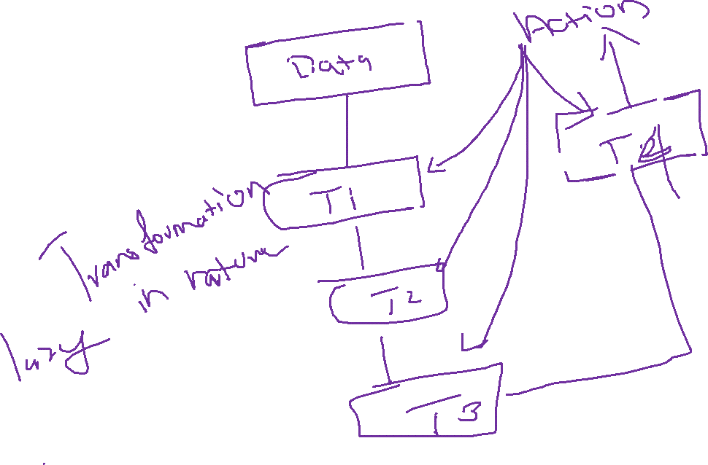

Slide 37
Transformation -> Functions -> you cannot go for any kind of transformations in spark -> custom transformation will not be allowed
Transformations -> Lazy in nature

Slide 38
Map -> no input = no out

Slide 39
Group by key and reduce by key
To apply this transformation -> in the format of key and value pair
(K,V)
(ant,1) (ant,1) -> (ant,2)

Slide 40
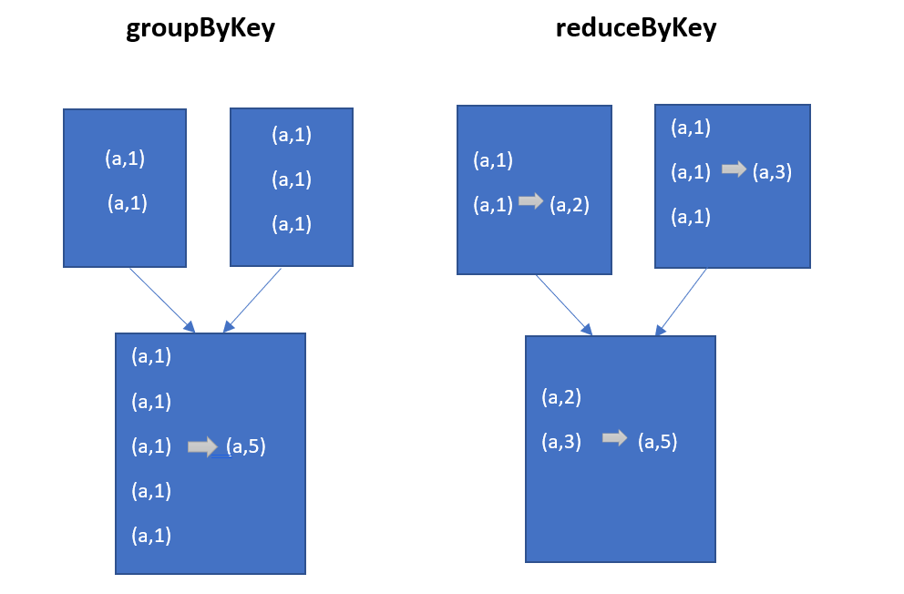

Slide 41
By default -> spark -> partiions

Slide 42
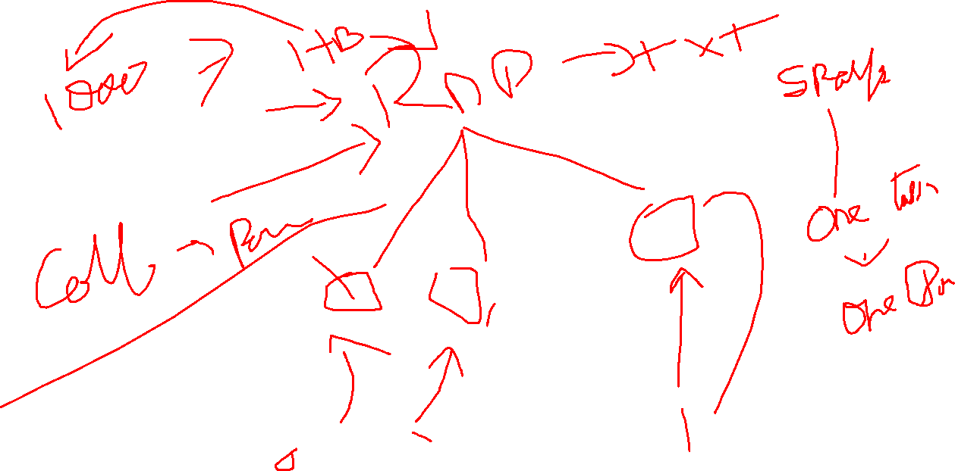

Slide 43
Repartition -> Algorithms -> both increase and decrease
Coalesce -> Algorithms -> decrease

Slide 44
Mini Project – 03.30
Show the number of students in the file.
Show the total marks achieved by Female and Male students
Show the total number of students that have passed and failed. 50+ marks are required to pass the course.
Show the total number of students enrolled per course
Show the total marks that students have achieved per course
Show the average marks that students have achieved per course
Show the minimum and maximum marks achieved per course
Show the average age of male and female students

Slide 45
Spark DataFrames
DataFrame is a wrapper on the RDD
A DataFrame is a dataset organized into names columns
It is conceptually equivalent to the table in the relational database or DataFrame on R/Python
DataFrames can be constructed from a wide array of source such as
Structured files
Unstructured
External databases
Existing RDDS

Slide 46
For creating the driver link -> Spark Context
Spark Session

