Slide 2
Synapse Analytics
Traditional Data Warehouse
Advanced Data Warehouse
ETL
ELT
Machine Learning
Pipelines

Slide 3
Traditional Data Warehousing
Oracle Exadata
IBM DB2
Teradata
Netezza
Expert in handling the OLAP data
Tabular data with Schema
ETL – Structured, Unstructured, Semi-Structured – to convert this data

Slide 4
Data Replication = 1+2
To support this – Medallion architecture
Bronze Data
Si

Slide 5
Application
Stateless Application
Stateful Application
We don’t have any proper medium to handle the data properly
2003(Data Ware Housing)
2007(Bigdata)
Data(less) - > Relational Databases(OTLP)

Slide 6
OLTP
CRUD
Create
Update
Delete
And Read Operations
Banking – CRUD Support – OLTP - Maximum Volume 256 TB – Database – text
Facebook – 6 months - HIVE

Slide 7
OLAP
Amazon – Customer
How huge Customer Count, How huge Products count – to handle both in proper way – OLTP – because of some limitations
Customer - > Update, Delete, Create – Read(how huge it will be)
OLAP = Online Analytical Processing – Expert in analytical Processing

Slide 8
Database(OLTP)
Whatever CRUD(USER) is Doing it will impact the direct data that is available in the table
Application Tier
- Brain of your system(Processing Layer)
Presentation Tier
User Facing
CRUD
Data Tier
Data Storage and management Layer
ANSI SQL
CRUD

Slide 9
Data Warehousing (OLAP) – Large Amount of data
Whatever CRUD(USER) is Doing it will impact the direct data that is available in the table
Data Tier
Data Storage and management Layer
Application Tier
- Brain of your system(Processing Layer)
Presentation Tier
User Facing
CRUD
ANSI SQL
Metadata Layer
Smallest Version of your actual data
Reading

Slide 10
Amazon
Merchants
Customers
Merchants -> Products(Pictures + Price + Quantity)
Customers -> (Products) OLAP + Reviews(OLTP)
Mixed of architectures

Slide 11
ELT Process
Extract, Transform and Loading
Data Warehouse = Structured + Schema
Load the Converted data in to
Data Warehousing
Data ingestion
Extraction
Structured
Un Structured
Semi Structured
Transformation
Computing Layer
Conditions
Unstructured -> Structured
Semi Structured -> Structured

Slide 12
Medallion Architecture
Bronze Layer
Data as it is in Raw Format
Direct Client(Raw Format)
Silver Layer
As per our analytical purpose – Keep only required data
Cleansed
Gold Layer
Converted data – Business intelligence Purpose

Slide 13
Cloud
Object Storage -> that doesn’t have any limitations on volume and variety
Because of storage cost is cheap
ELT

Slide 14
ELT
1 PB
From Customer
2GB – take only 2gb of data from source – Transform it and USE
Extract and Loading

Slide 15
Azure Synapse Analytics
Azure Synapse is an enterprise analytics service that accelerates time to insight across data warehouses and big data systems.
Azure Synapse brings together the best of SQL technologies used in enterprise data warehousing, Spark technologies used for big data, Data Explorer for log and time series analytics, Pipelines for data integration and ETL/ELT, and deep integration with other Azure services such as Power BI, Cosmos DB, and AZURE ML.

Slide 16
Synapse Workspace is the top level container in Azure Synapse Analytics
It’s the central environment where all synapse resources live and are managed together
Analytical environment that connects storage, compute, security and tools under one name space.

Slide 17
To handle the SQL – Dedicated SQL Pool and Serverless SQL Pool
To handle the Bigdata workloads – Apache Spark Runtime
Data Explorer pools can be used to run near real-time analytics on large volumes of logs and time series data streaming from applications, websites, IoT devices, and more.

Slide 18
Batch Processing
  Example: Project – 2PB –
  before running the if your data volume is huge(pre planned data) how long its going to run
  Suggested – Dedicated Pool
  Example – Daily report(00.00 to 23:59) I need to submit to manager meeting around 9am
Stream Processing
  React immediately for events happen in source system – Credit card fraudulent analysis system – Axis -> Accenture
  Accenture need to react for whatever the terms and conditions to define the transaction as fraudulent – send the notification to the customer notification

Slide 19
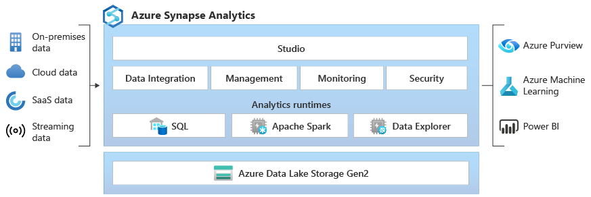

Slide 20
Event Hub
Synapse
Predefined Terms and Conditions
(Pipeline)
Event Notification

Slide 21
Data Engineer
Data Scientist
Data Analytical Engineer
ETL Engineer

Slide 22
CDC

Slide 23
2 PB
Serverless = per TB - Transactions logs from Axis – we don’t know when customer will do the transactions and transactions are light weighted
Scenario = Some kind of pool that is not charging depends on time
Dedicated = Est. cost per hour
Dedicated Pool = Per Hour
Security issues – analyse the entire company logs – where it goes wrong = 1 PB = Serverless = 2 hours = 33 USD and $1000

Slide 24
Streaming logs – Bigdata
Dedicated Apache Pool – Batch Processing, Stream Processing
Data Explorer - Dedicated

Slide 25
Storage Account Gen2
1 PB
Synapse Analytics
To handle the workloads
Run the for analytical – your are chargeable for it
Dedicated Pool – billing with start whenever you are starting the run time

