Slide 1
Python Iterables, Iterators & Generators
Explained with Udupi Garden Menu
With Real-World Udupi Garden Restaurant Examples

Slide 2
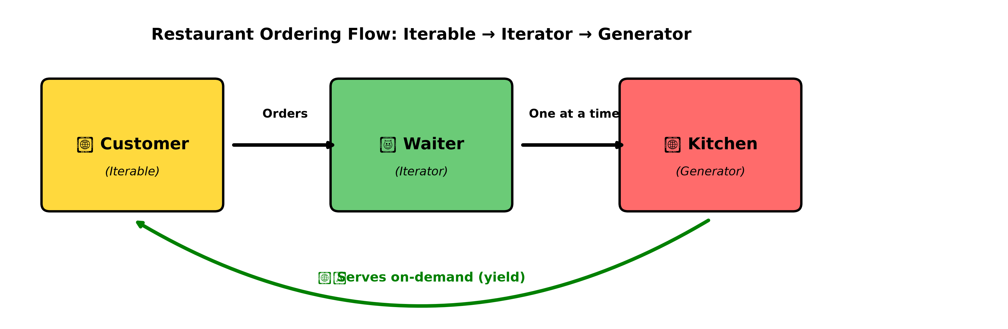
The Restaurant Analogy
🏪 Imagine you're at Udupi Garden Restaurant...
Question: How does the restaurant serve 100 customers efficiently?
❌ BAD: Make all 100 meals at once → Cold food, wasted memory
✅ GOOD: Make meals when ordered → Fresh food, efficient!
This is exactly how Python generators work!
Let's understand the three concepts:
• Iterable (Menu Card) - See all options
• Iterator (Waiter) - Order one by one
• Generator (Kitchen) - Cook on-demand

Slide 3
What is an Iterable?
📋 ITERABLE = The Menu Card
Definition:
• Any object that can return an iterator
• Has __iter__() method
Examples:
• Lists: ['Masala Dosa', 'Idli', 'Vada']
• Tuples: ('Dosa', 'Coffee')
• Strings: 'UDUPI'
• Dictionaries: {'breakfast': 'Idli', 'lunch': 'Thali'}
Key Features:
✓ Can iterate multiple times
✓ All items stored in memory
✓ Supports len() and indexing

Slide 4
Iterable: Code Example
# Udupi Garden Menu (Iterable)
menu = ["Masala Dosa", "Plain Dosa", "Idli", "Vada", "Pongal"]
# You can iterate multiple times
for item in menu:
print(item)
# Supports indexing
print(menu[0]) # "Masala Dosa"
# Has length
print(len(menu)) # 5
# Check if iterable
print(hasattr(menu, '__iter__')) # True
💡 Like a menu card - you can read it again and again, see all items at once!

Slide 5
What is an Iterator?
🙋 ITERATOR = The Waiter
Definition:
• Object that remembers its position
• Has __iter__() AND __next__() methods
How it works:
1. Create iterator: menu_iter = iter(menu)
2. Get next item: next(menu_iter)
3. Raises StopIteration when exhausted
Key Features:
✓ One-way traversal (can't go back)
✓ Can iterate only once
✗ No indexing or len()
✓ More memory efficient than storing all data
Think: Waiter taking orders one at a time, can't go backwards!

Slide 6
Iterator: Code Example
# Creating iterator from menu
menu = ["Masala Dosa", "Idli", "Vada"]
menu_iterator = iter(menu)
# Getting items one by one
print(next(menu_iterator)) # "Masala Dosa"
print(next(menu_iterator)) # "Idli"
print(next(menu_iterator)) # "Vada"
# What happens next?
print(next(menu_iterator)) # Raises StopIteration!
# Can iterate only once
for item in menu_iterator: # Nothing happens (exhausted)
print(item)
💡 Like a waiter - remembers position, serves one order at a time, can't repeat!

Slide 7
Custom Iterator Class
class UdupiMenuIterator:
def __init__(self, items):
self.items = items
self.index = 0
def __iter__(self):
return self
def __next__(self):
if self.index >= len(self.items):
raise StopIteration
item = self.items[self.index]
self.index += 1
return item
# Usage
menu = UdupiMenuIterator(["Dosa", "Idli", "Vada"])
print(next(menu)) # "Dosa"
print(next(menu)) # "Idli"
💡 Custom iterator with __iter__() and __next__() methods

Slide 8
What is a Generator?
🍳 GENERATOR = The Kitchen
Definition:
• Special iterator created with 'yield' keyword
• Generates values on-demand (lazy evaluation)
How it works:
• Function pauses at 'yield'
• Resumes when next() is called
• State is maintained between calls
Key Benefits:
⭐ EXTREMELY memory efficient
⭐ Perfect for large or infinite sequences
⭐ Values computed only when needed
✓ Lazy evaluation
Think: Kitchen making food ONLY when customer orders!

Slide 9
Generator: Code Example
def serve_menu_items():
print("Making Dosa...")
yield "Masala Dosa"
print("Making Idli...")
yield "Idli"
print("Making Coffee...")
yield "Filter Coffee"
# Create generator
kitchen = serve_menu_items()
# Get items on-demand
print(next(kitchen)) # Prints "Making Dosa..." then "Masala Dosa"
print(next(kitchen)) # Prints "Making Idli..." then "Idli"
print(next(kitchen)) # Prints "Making Coffee..." then "Filter Coffee"
💡 Function pauses at yield, resumes when next() called - items made on-demand!

Slide 10
Generator Expression
# List comprehension (creates full list)
menu = ["DOSA", "IDLI", "VADA"]
lowercase_list = [item.lower() for item in menu]
print(lowercase_list) # ['dosa', 'idli', 'vada']
# Generator expression (parentheses instead of brackets)
lowercase_gen = (item.lower() for item in menu)
print(lowercase_gen) # <generator object>
# Get items on-demand
print(next(lowercase_gen)) # 'dosa'
print(next(lowercase_gen)) # 'idli'
# Memory comparison
import sys
print(sys.getsizeof(lowercase_list)) # ~120 bytes
print(sys.getsizeof(lowercase_gen)) # ~104 bytes
💡 Generator expression: () instead of [] - creates generator, not list!

Slide 11
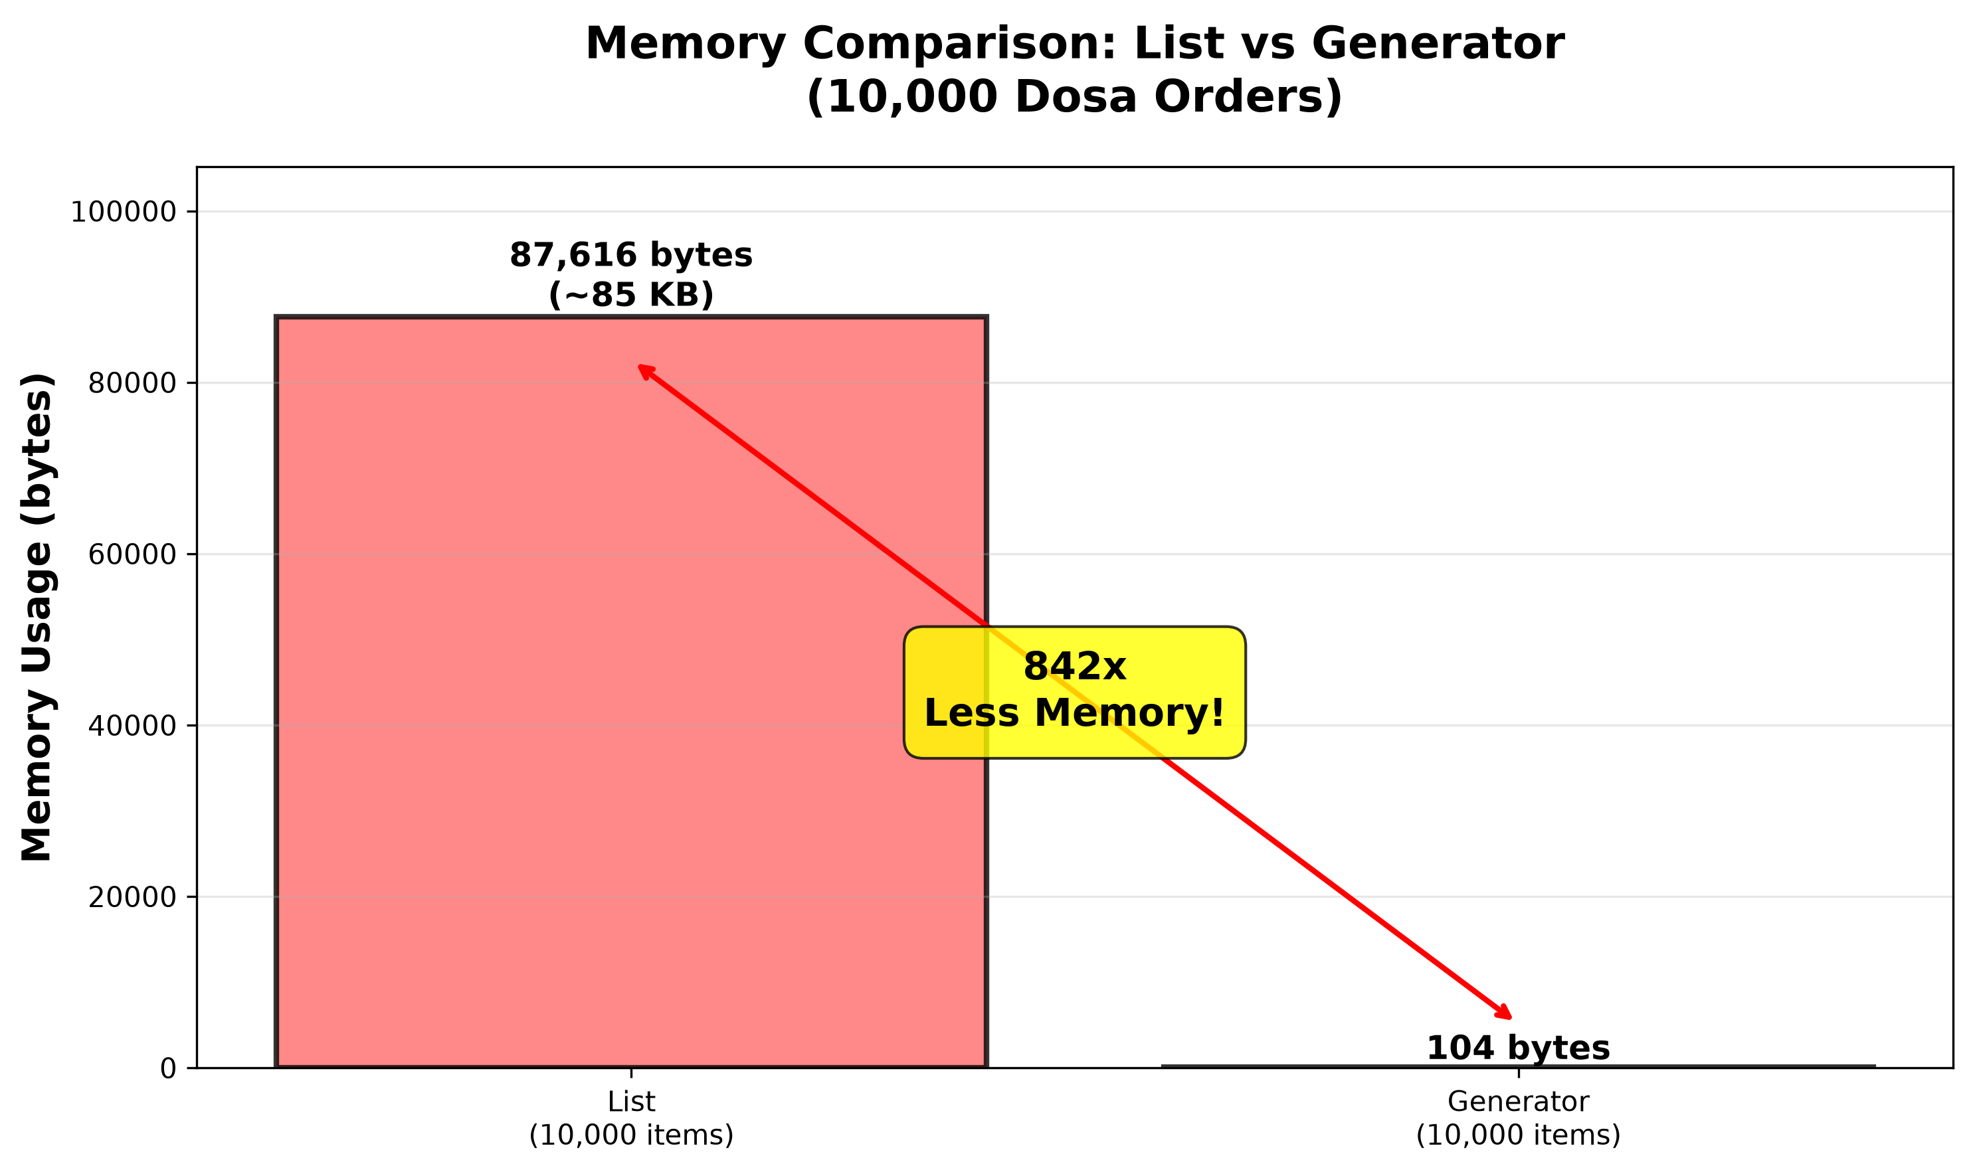
Memory Comparison: THE KEY DIFFERENCE!

Slide 12
Advanced: Combos & Infinite Sequences
def generate_combos():
dosas = ["Masala Dosa", "Plain Dosa", "Rava Dosa"]
drinks = ["Filter Coffee", "Tea"]
for dosa in dosas:
for drink in drinks:
yield f"{dosa} + {drink}"
# Generate meal combinations
combos = generate_combos()
print(next(combos)) # "Masala Dosa + Filter Coffee"
print(next(combos)) # "Masala Dosa + Tea"
print(next(combos)) # "Plain Dosa + Filter Coffee"
# ... and so on
# Infinite generator
def infinite_orders():
num = 1
while True:
yield f"Order #{num}: Masala Dosa"
num += 1
💡 Generators can create combinations and infinite sequences efficiently!

Slide 13
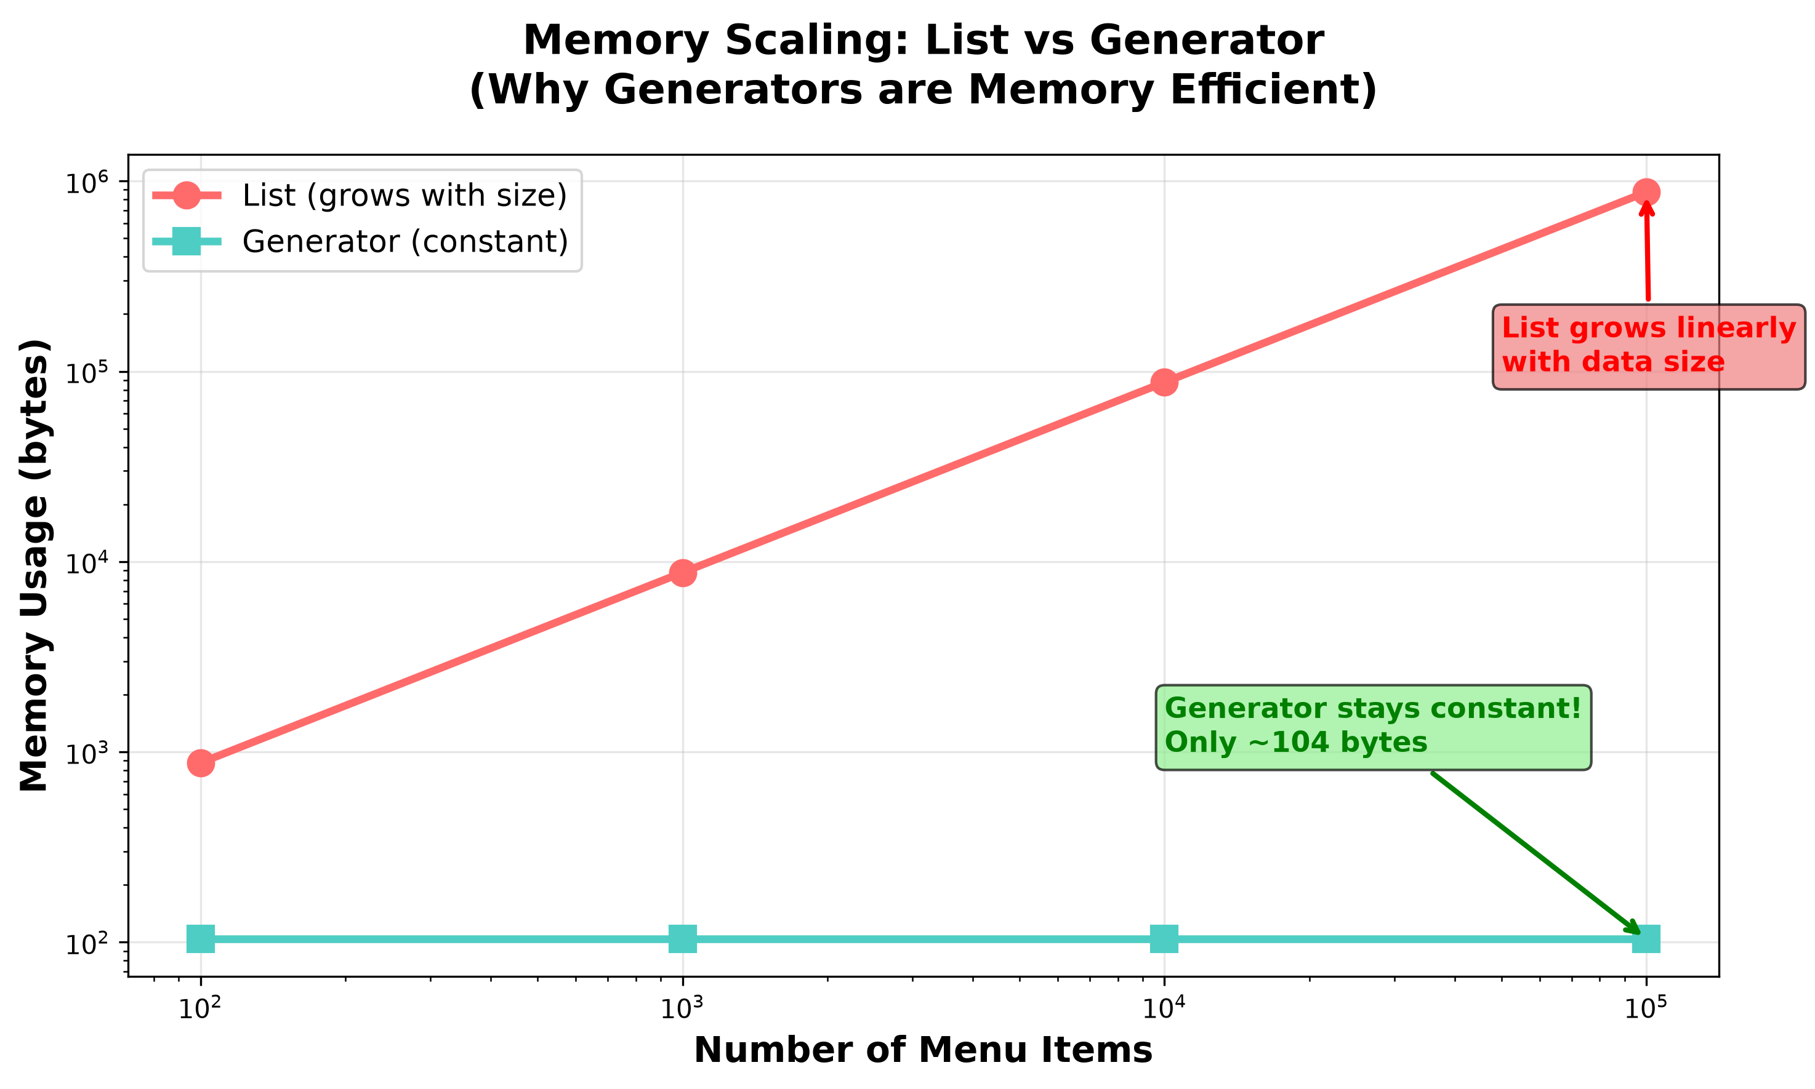
Memory Scaling: Why Generators Win

Slide 14
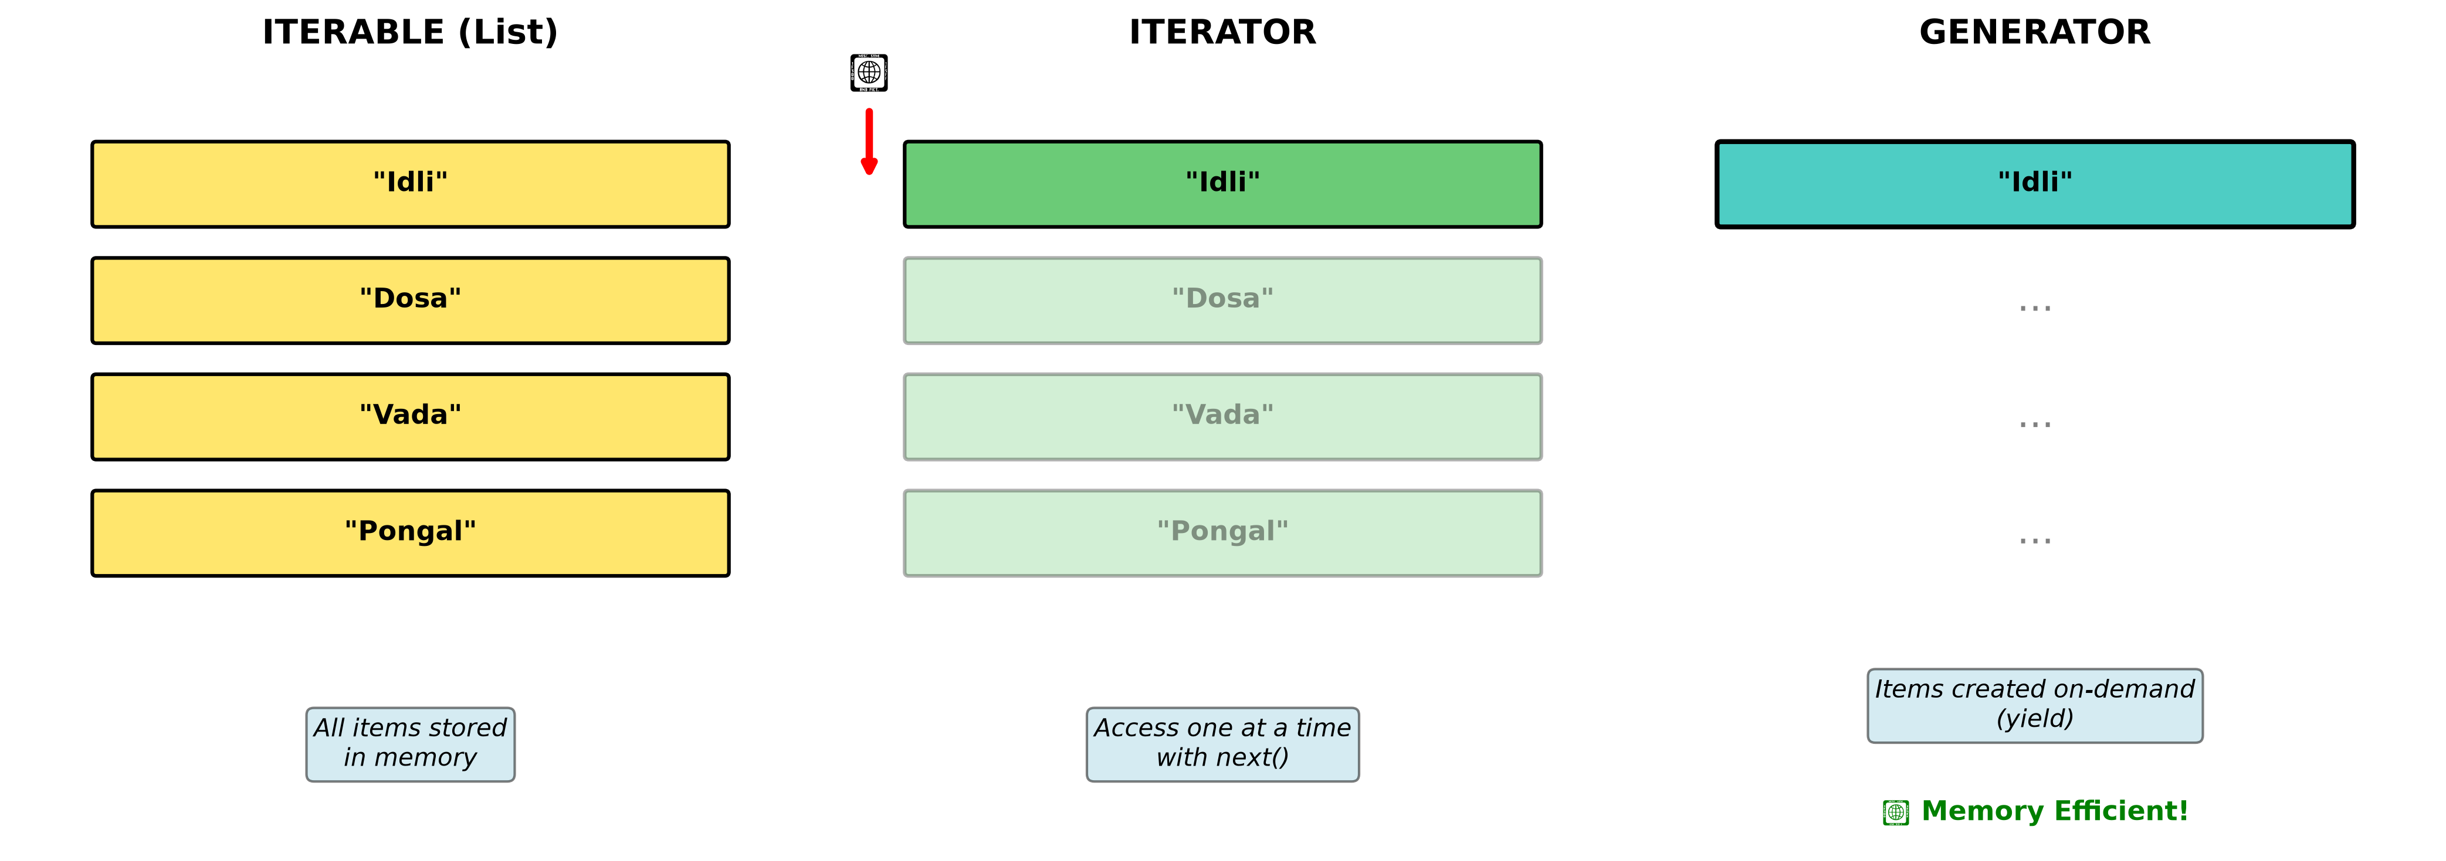
When to Use Each?
Decision Guide:
✅ Use ITERABLE (List/Tuple) when:
• Small dataset that fits in memory
• Need multiple passes through data
• Need random access with indexing
• Example: Display menu categories
✅ Use ITERATOR when:
• Process items once sequentially
• Large dataset, don't need all in memory
• Example: Processing log files
✅ Use GENERATOR when:
• Very large or infinite sequences
• Memory efficiency is critical
• Items computed on-demand
• Example: Streaming data, huge files

Slide 15
Practical Use Cases
Real-World Applications:
🏪 Restaurant Scenarios:
• Menu categories → Iterable (display all)
• Order queue → Iterator (process once)
• Daily specials → Generator (create on-demand)
💻 Python Applications:
• Reading huge files → Generator
• Streaming data → Generator
• Processing logs → Iterator
• Database cursors → Iterator
• Infinite sequences → Generator
Example: Reading 1GB file
❌ list: Loads all 1GB into memory
✅ generator: Reads one line at a time

Slide 16
Summary & Key Takeaways
🎯 Key Takeaways:
📋 ITERABLE (Menu Card)
• All items visible, can read multiple times
• Uses more memory, but supports indexing
🙋 ITERATOR (Waiter)
• Access items one at a time, remembers position
• One-way traversal, more memory efficient
🍳 GENERATOR (Kitchen)
• Creates items on-demand with 'yield'
• MOST memory efficient (100-800x less!)
• Perfect for large data and infinite sequences
Remember: List = 87KB, Generator = 104 bytes for 10,000 items!
Practice with the demo files: examples/*.py

