Slide 2
Efficiency in Data Management:
Data structures allow you to store data in an organized way, making it easier and faster to access, modify, or update data. For instance, searching for an element in a well-structured array or list can be much quicker than searching in an unstructured format.
Optimized Resource Use:
By using appropriate data structures, you can optimize memory and processing resources. Some data structures are designed to minimize the amount of memory used or to make operations like insertion or deletion faster.

Slide 3
Solving Complex Problems:
Many complex algorithms rely on specific data structures to function efficiently. For example, graphs and trees are used in algorithms related to network routing, artificial intelligence, and database indexing.
Data Relationships Representation:
Data structures allow you to represent and manage relationships between data points. For instance, graphs can represent networks, trees can represent hierarchical data, and hash tables can represent associative arrays.
Database Efficiency:
In the context of databases, data structures like B-trees and hash tables are critical for indexing and ensuring that data retrieval operations are fast and efficient. They help in organizing the database in a way that minimizes the time required for operations like searching, inserting, and deleting records.
Scalability:
As data grows, the choice of data structure becomes even more critical. Efficient data structures ensure that operations remain performant even as the volume of data increases.

Slide 4
Linear Data Structures
Linear data structures arrange data in a sequential manner where each element has a unique predecessor and successor, except for the first and last elements. They are simpler to implement and traverse.
Non-Linear Data Structures
Non-linear data structures arrange data in a hierarchical manner, where each element can connect to multiple elements, making traversal more complex.

Slide 5
Linear Data Structures
Arrays
Linked Lists
Stacks
Queues

Slide 6
Non-Linear Data Structures
Trees
Graphs
Heaps

Slide 7
Array
Definition:
An array is a collection of elements, each identified by an index or key. The elements are stored in contiguous memory locations, making it possible to access elements quickly using their indices.
Characteristics:
Fixed Size: Arrays have a fixed size, meaning the number of elements (length) is determined when the array is created.
Homogeneous Elements: All elements in an array must be of the same data type (e.g., all integers, all floats, etc.).
Indexing: The array index starts at 0, meaning the first element is accessed using index 0, the second element using index 1, and so on.

Slide 8
'b': signed char (1 byte) — values range from -128 to 127.
'B': unsigned char (1 byte) — values range from 0 to 255.
'u': Unicode character (2 or 4 bytes) — Python 2 only, for storing Unicode characters.
'h': signed short (2 bytes) — values range from -32,768 to 32,767.
'H': unsigned short (2 bytes) — values range from 0 to 65,535.
'i': signed int (4 bytes) — values range from -2,147,483,648 to 2,147,483,647.
'I': unsigned int (4 bytes) — values range from 0 to 4,294,967,295.
'l': signed long (4 bytes) — same range as 'i' on most platforms.
'L': unsigned long (4 bytes) — same range as 'I' on most platforms.
'q': signed long long (8 bytes) — values range from -9,223,372,036,854,775,808 to 9,223,372,036,854,775,807.
'Q': unsigned long long (8 bytes) — values range from 0 to 18,446,744,073,709,551,615.
'f': float (4 bytes) — single-precision floating-point.
'd': double (8 bytes) — double-precision floating-point

Slide 9
A stack is a linear data structure that follows the Last In, First Out (LIFO) principle. In simpler terms, it means that the last element added to the stack will be the first one to be removed. Imagine a stack of plates: you add plates to the top, and you also take them off from the top.

Slide 10
Stack (LIFO/FILO):
Elements are added (pushed) and removed (popped) from the same end of the stack.
Only the last element added (the "top" of the stack) is accessible directly.
There is no direct access to any other element unless it is popped off the stack first.
Array:
Elements can be accessed directly using their index.
Any element can be accessed, modified, or removed based on its position in the array.
No constraints on how you access or modify the elements.

Slide 11
Key Concepts and Methods of a Stack
Push: Add an element to the top of the stack.
Pop: Remove and return the element from the top of the stack.
Peek/Top: Return the element at the top of the stack without removing it.
isEmpty: Check if the stack is empty.
isFull: Check if the stack is full (used in cases of stacks with a fixed size).
Size: Return the number of elements in the stack.

Slide 12
A queue is a linear data structure that follows the First In, First Out (FIFO) principle. This means that the first element added to the queue will be the first one to be removed, much like a line of people waiting at a checkout counter: the first person in line is the first one to be served.
Fixed Type
Homogeneous
FIFIO

Slide 13
Key Concepts in Queue
Enqueue: Add an element to the end of the queue.
Dequeue: Remove and return the element from the front of the queue.
Front (or Peek): Return the element at the front of the queue without removing it.
isEmpty: Check if the queue is empty.
isFull: Check if the queue is full (used in cases of queues with a fixed size).
Size: Return the number of elements in the queue.

Slide 14
30 Mins
Linked List
Types
Key concepts
Various way to implement linked list in python

Slide 15
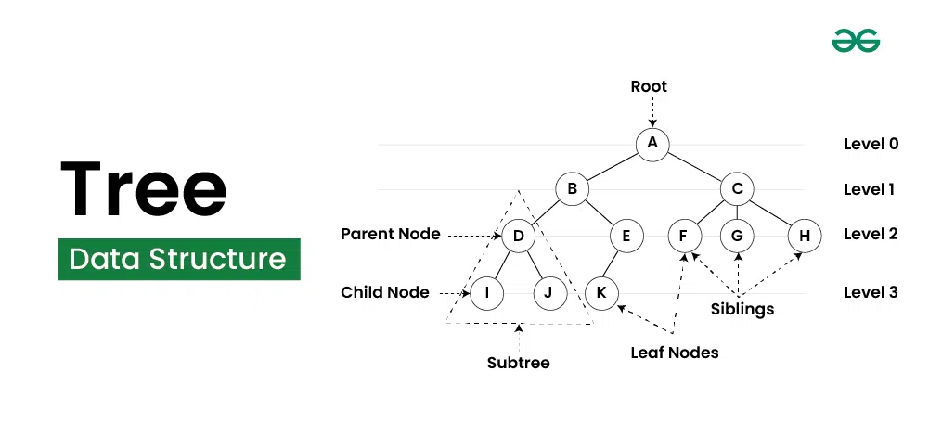

Slide 16
4 typees of Traversal method in Tree
Pre Order
Post Order
In Order
Level Order

Slide 17
Node: The basic unit of a tree. Each node contains a value (or data) and may have references (or pointers) to its child nodes.
Root: The topmost node in a tree. The root node is the only node that has no parent, and every other node is a descendant of the root.
Parent: A node that has one or more child nodes.
Child: A node that is a descendant of another node (the parent).
Leaf: A node that does not have any children. Leaf nodes are at the bottom of the tree.
Subtree: A tree formed by a node and all of its descendants.
Edge: The connection between two nodes. Each edge connects a parent node to a child node.
Height: The length of the longest path from the root to a leaf. The height of a tree is the height of the root node.
Depth: The length of the path from the root to a particular node. The depth of the root node is 0.
Binary Tree: A type of tree in which each node has at most two children. These children are often referred to as the left child and the right child.

Slide 18
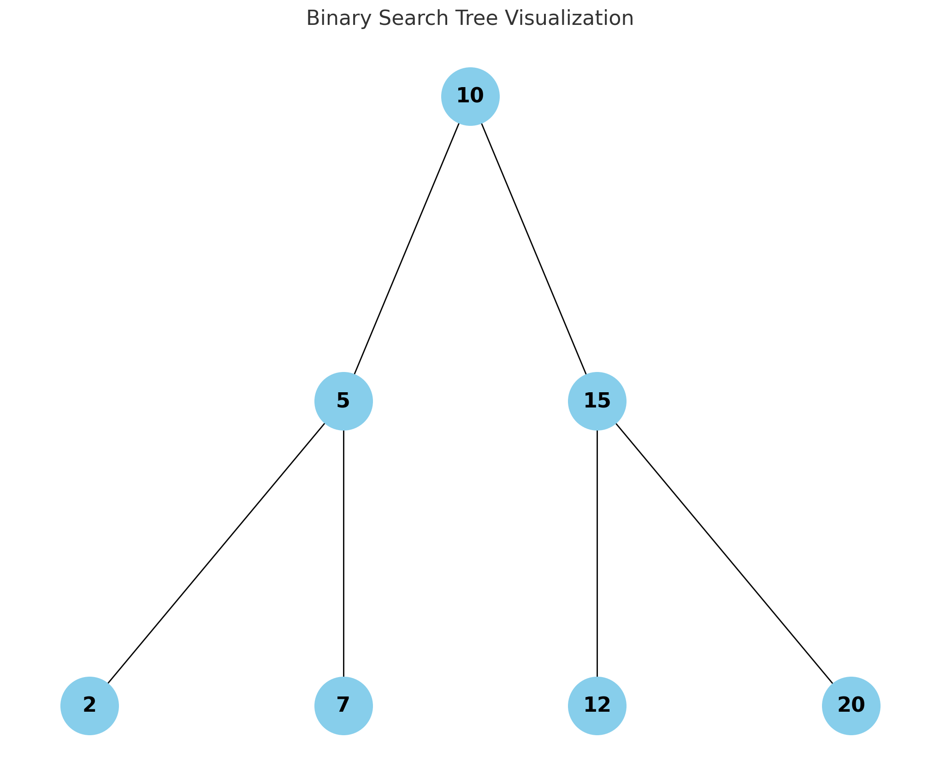

Slide 19
