Slide 1
Data Representation in Flink

Slide 2


Data Representation
DataStream
DataSet
Immutable collections of data

Slide 3
Data Representation
DataStream
DataSet
Contains duplicates

Slide 4
DataStream
Unbounded collection of data
Represents streaming entities
- Tweets
Log messages Stock prices
-
-

Slide 5
DataSet
Bounded collection of data
Represents static, unchanging records
Log files
Database records

Slide 6
Data Representation
DataStream
DataSet
Can be transformed but not mutated

Slide 7
Data Representation
DataStream
Transformations on streams produce new streams of data

Slide 8





Flink Programming Model
Data Source
Transformations
Data Sink

Slide 9



Transformations
A directed-acyclic graph
Data Source
Data Sink

Slide 10
Flink Programming Model
Transformations
Data Source
Data Sink

Slide 11
Transformations
Each stream is lazily evaluated
filter()
map()
reduce()
map()
Data Source
Data Sink
flatMap()
sum()
keyBy()

Slide 12
Lazy Evaluation
filter()
map()
reduce()
map()
None of these operations are executed when first encountered…
each operation is added to a plan

Slide 13
Lazy Evaluation
filter()
map()
reduce()
map()
Operations are run when execute() is called

Slide 14
Anatomy of a Flink Program

Slide 15
Anatomy of a Flink Program
Execution environment
Local or remote
Transformations
Slice and dice data in different ways
Execute
Trigger execution
Initial data
Load or create
Save results
File or screen

Slide 16
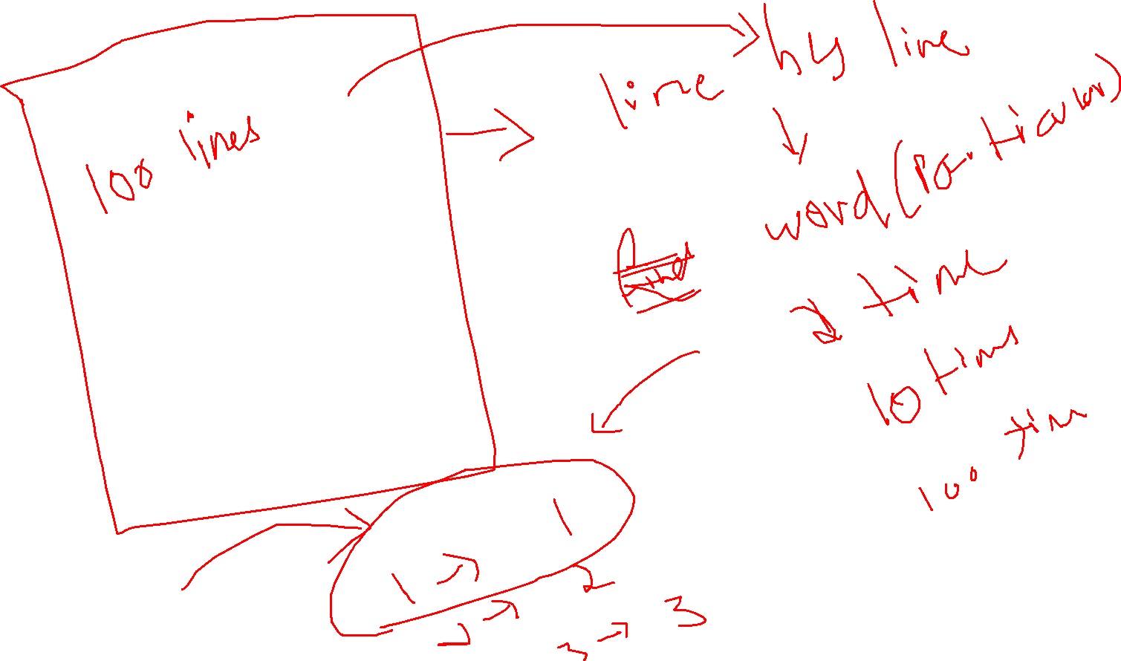

Slide 17
Stateless Transformation
A Stateless Transformation process each and every record independently without needing to remember the past data
Each out depends only on the current input element, not on previous or future elements

Slide 18
Stateless Transformation
Filter
Map
Flat Map
On
Datasream
Dataset
Table – sql queries
Data Stream – File based
Source(incremental append)
Sink (Incremental append)

Slide 20
Demo
Set up and run a Flink program on your local machine
Filter numbers from a stream of text using the filter() transformation

Slide 21
Anatomy of a Flink Program
Execution environment
Local or remote

Slide 22
Anatomy of a Flink Program
Execution environment
Local or remote
Initial data
Load or create

Slide 23
Anatomy of a Flink Program
Execution environment
Local or remote
Transformations
Slice and dice data in different ways
Initial data
Load or create

Slide 24
Anatomy of a Flink Program
Execution environment
Local or remote
Transformations
Slice and dice data in different ways
Initial data
Load or create
Save results
File or screen

Slide 25
Anatomy of a Flink Program
Execution environment
Local or remote
Transformations
Slice and dice data in different ways
Execute
Trigger execution
Initial data
Load or create
Save results
File or screen

Slide 26







Filter Transformations
filter()

Slide 27
Demo
Round up decimals to the next integer using the map() transformation
Chain multiple transformations

Slide 28


Map Transformations
map()

Slide 29

Demo
Split sentences into words using flatMap()
Accept arguments from the command line
Read a file as a stream

Slide 30



Map Transformations
flatMap()

Slide 31
Stateless and Stateful Transformations

Slide 32


Stream Transformations
Stateless
Transformations which are applied on a single stream entity
Stateful
Transformations which accumulate across multiple stream entities

Slide 33
Stateless Transformations
Processing a single entity at a time map(), flatMap(), filter()
All transformations used so far have been stateless

Slide 34
Stateful Transformations
Include data from more than one streaming entity
Accumulate data across a longer time interval
entire stream
window
per key, per operator

Slide 35
Stateful Transformations
Accumulate information across entities in a stream

Slide 36
Keyed Streams

Slide 37
94 79 32 83 95 22 19 65 43 30
Keyed Streams
Students’ marks out of 100 in various finals

Slide 38
Keyed Streams
Jane
Bob Emily
Bill
Bob Jane
Sally
Lina
Bob Jane
94 79 32 83 95 22 19 65 43 30
Make much more sense when associated with a name

Slide 39
Keyed Streams
Jane
Bob Emily
Bill
Bob Jane
Sally
Lina
Bob Jane
94 79 32 83 95 22 19 65 43 30
What is the highest score for Jane across all her classes?

Slide 40
Keyed Streams
Jane
94 22 30
94

Slide 41

Keyed Streams
KeyedStream
Keys in Flink are not physical keys, they are virtual

Slide 42
Keyed Streams
Logical grouping of the underlying stream
Virtual keys, not physical
Specified using a grouping operator
i.e. keyBy()

Slide 43
Demo
Calculate the frequency of words occurring in a data stream
Use keyBy() to create a KeyedStream and sum() as an aggregation operator

Slide 44
Demo
Use the reduce() operation on a KeyedStream to calculate average view time on a web page on a site

Slide 45

Summary
Understood the building blocks of a Flink program
Used operations on DataStreams and KeyedStreams
Practiced writing programs in Java using the Flink API

