Slide 2
Data
Structured
Unstructured
Semi-Structured

Slide 3
Database
Storage
Db Engine

Slide 4
Ecommerce
By means of my website I want to store and data
Here I got 2 options
Through my site I can store and retrieve the data through hard drive
Through my site I can store and retrieve the data through data base

Slide 5
Database is the fastest medium to store and retrieve the data as quick as possible
Normalized = Structured

Slide 6
Structured data – Database(Relational Database)
Microsoft SQL
Oracle
MySQL
MariaDB
Postgres

Slide 7
Semi – Structured = Database
Key-value
Document
Column family oriented
Graph
Ex: Mongo
Redis
Cassandra, DynamoDB, Hbase

Slide 8
Apache Webserver in public Cloud
How logs are generation in an automated manner

Slide 9
Splunk – 2003 – 2006
SIEM – Security Information and Event Management
It’s a system that collects aggregates analyze and report on security events and log across your IT environment to detect threats , monitor anomalies and help with compliance

Slide 10
Splunk forwarders are lightweight components of the Splunk platform , is responsible for collection and sending data from various sources to a Splunk indexer for processing and storage.
They are crucial for efficient log management, scalability and centralizes data collection.

Slide 11
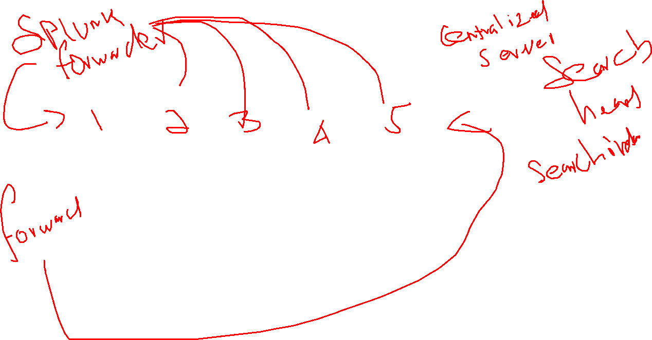

Slide 12
11.25 Break

Slide 13
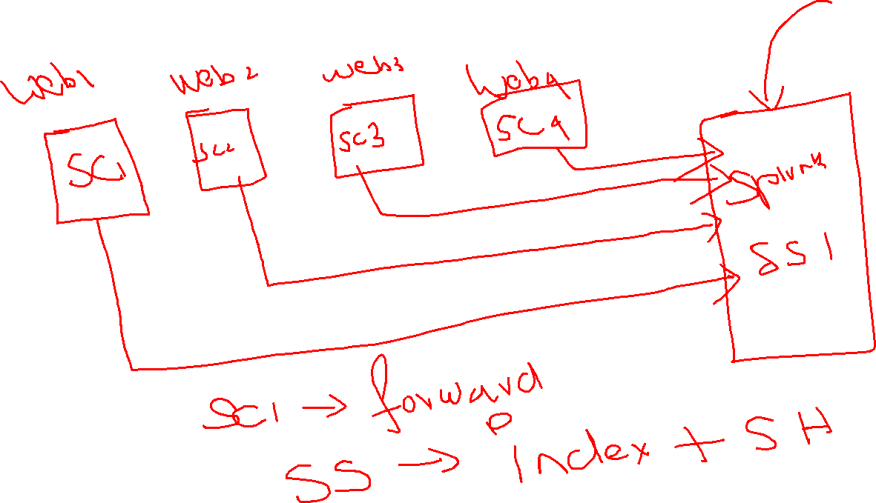
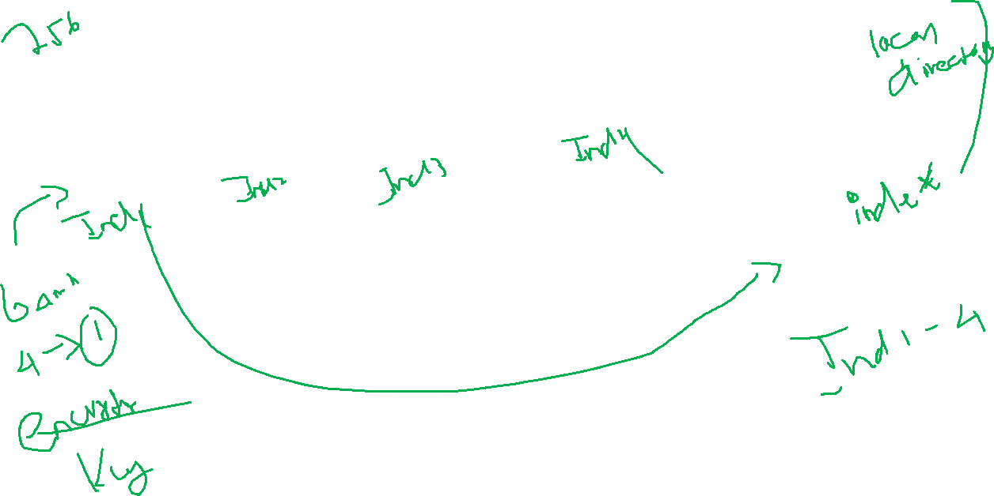

Slide 14
Splunk Index = which will help you to store the information in Splunk from different forwarders and from local machine
In the backend Splunk index will save the corresponding data in the format of buckets in local storage machine or remote storage machine

Slide 15

Apache Webserver 1
223.178.84.251 - - [28/Apr/2025:04:53:45 +0000] "GET / HTTP/1.1" 200 312 "-" "Mozilla/5.0 (Windows NT 10.0; Win64; x64) AppleWebKit/537.36 (KHTML, like Gecko) Chrome/135.0.0.0 Safari/537.36 Edg/135.0.0.0“
223.178.84.251 - - [28/Apr/2025:04:53:45 +0000] "GET / HTTP/1.1" 200 312 "-" "Mozilla/5.0 (Windows NT 10.0; Win64; x64) AppleWebKit/537.36 (KHTML, like Gecko) Chrome/135.0.0.0 Safari/537.36 Edg/135.0.0.0"
223.178.84.251 - - [28/Apr/2025:04:53:45 +0000] "GET / HTTP/1.1" 200 312 "-" "Mozilla/5.0 (Windows NT 10.0; Win64; x64) AppleWebKit/537.36 (KHTML, like Gecko) Chrome/135.0.0.0 Safari/537.36 Edg/135.0.0.0"

Slide 16
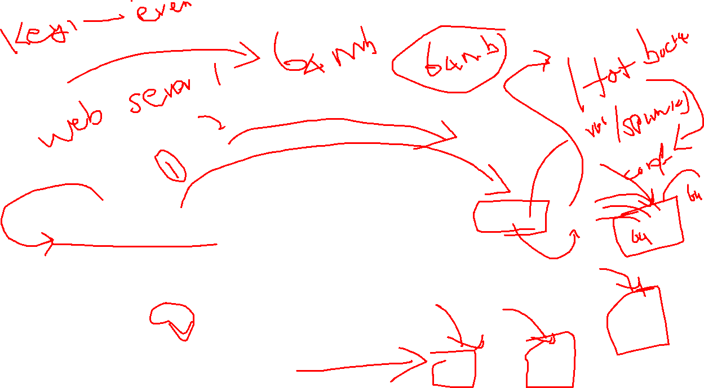
Splunk Forwarder
Splunk Webserver 1
/val/log/apache2/access.log
Splunk SH + Index

Slide 18
State= newyork = 100 - separate index
Index – buckets – hot
Whenever you are search index=newyork
hot, warm, cold, and frozen

Slide 19
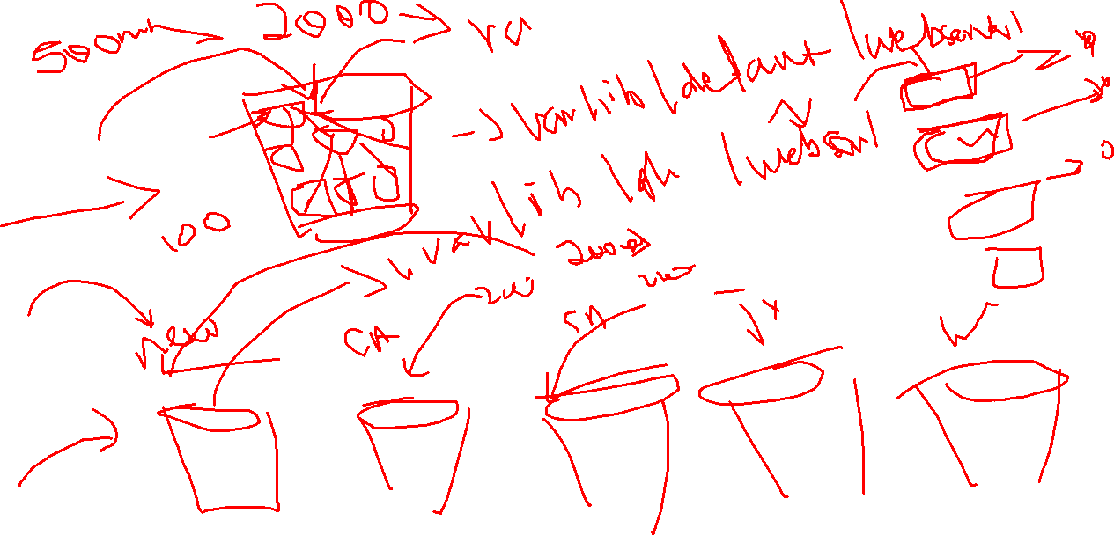

Slide 20
Development
Forwarders
Index cluster
Search Head Cluster – search operation
All the three components we can configure it as stans alone components
Why should I need to go for stand alone installation?

Slide 21
1gb
1pb

Slide 22
Training
Forwarder
SH
Index
Enterprise – 500 MB/day

Slide 23
Development
Forwarder
Index
Search Head

Slide 24
Development
Forwarder 100
Index
Search Head

Slide 25
AWS Cloud
Web Server
Public Access
Splunk forwarder
Search Head
Index
We will query Forwarded

Slide 26
Splunk Components
Processing
Forwarder
Universal Forwarder
Heavy Forwarder
Indexer, Search Head – installed in you machine – how to link your forwarder --> indexer -> Search Head
Management
Deployment Server
License Server/Master
Cluster Manager
Deployer

Slide 27
Same Network
Deepan
Splunk forwarder
192.168.51.161
Lokesh
Splunk
192.168.51.160

Slide 28
Deployment Server
Centralized configuration manager
Manages deployment apps for clients
Configured through the forwarder management interface

Slide 29
License Manager
Centralized License Manager
Clients are called as license slave
100 License -it will distribute data limitation – over machines
Manage the license pools and stack

Slide 30
Indexer Cluster Master
Manages indexer Clusters
Coordinates the activities within the cluster
Manages the data replication
Manages buckets(Storage) for the cluster
Handles update for the index cluster

Slide 31
Input.conf
[monitor:///path/to/logs]
disabled = 0
index = your_index_name
sourcetype = your_sourcetype

Slide 32
/opt/splunk/etc/system/local/outputs.conf
[tcpout]
defaultGroup = primary_indexers,secondary_indexers
[tcpout:primary_indexers]
server = indexer1:9997,indexer2:9997,indexer3:9997
# Load balancing method (roundRobin or autoLB)
loadBalance = autoLB
[tcpout:secondary_indexers]
server = indexer4:9997,indexer5:9997
loadBalance = autoLB

Slide 33
Search Head Cluster Deployer
Search Head
8 GB
4 Core
Search Head
8 GB
4 Core
Indexer
1 PB
Search Head
8 GB
4 Core
Search Head
8 GB
4 Core

Slide 34
Search Head Deployer – 3 Machine Cluster
Deployment
User Management

Slide 35
Splunk Deployment Server
Deployment Server
Linux Heavy Forwarder

Slide 36
Search Head Index Forwarder
Forwarder
Cluster – 3 Machines

